Slide 1
Food Fight!
Menu Planning with the New Regulations and Relief from the Growing Pains over Grains

Slide 2
What are CACFP regulations and why do they matter?

Slide 3
Sample Meal Pattern Plan
Breakfast
Cereal (Grain)
Banana (Fruit)
Low fat milk (Milk)
Or
Yogurt (Meat)
Strawberries (Fruit)
Low fat milk (Milk)

Slide 4
Sample Meal Pattern Plan
Lunch/Supper
Spaghetti
Ground beef (Meat)
Pasta (Grain)
Marinara Sauce (Vegetable)
Salad (1/2 cup counts as ¼ cup Veg)
Apple (Fruit)
Low fat milk

Slide 5
Sample Meal Pattern Plan
Snacks: Choose Two Food Groups/Components
String Cheese (Meat)
Juice (Fruit)
Or
Crackers (Grain)
Strawberries (Fruit)

Slide 6
Important Requirements to Note
Juice
Allowed only once per day
Yogurt
Must contain less than 23 grams of sugar per 6 oz of yogurt

Slide 7
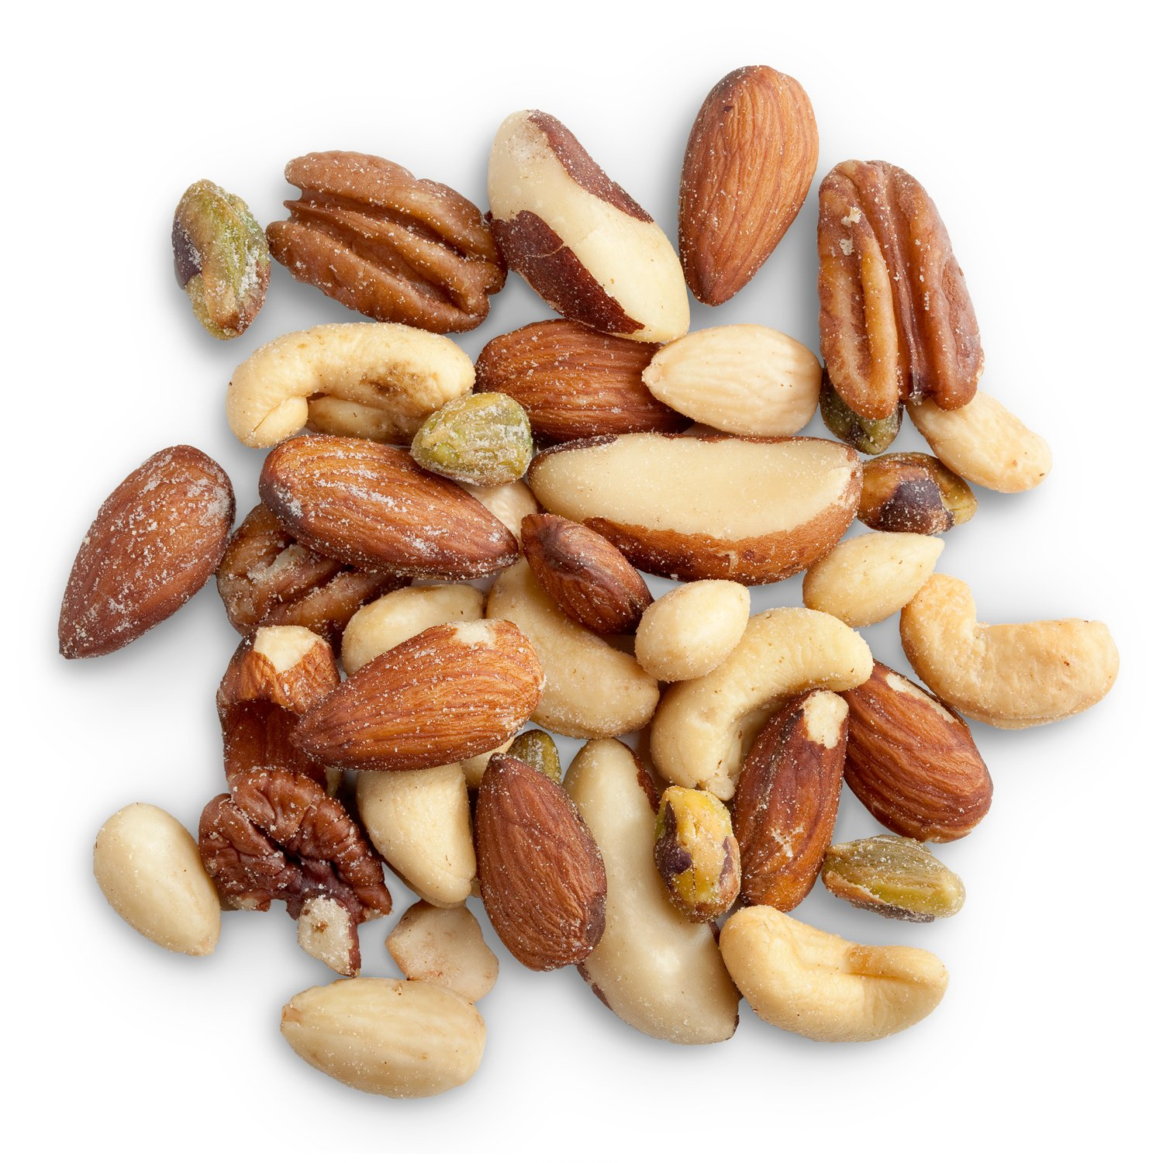
Important Requirements to Note
Nuts
No more than 50% of daily requirement for meat can come from nuts.
Milk
Age 1: Unflavored whole milk
Age 2-5: Unflavored low-fat milk or unflavored fat-free (skim) milk
Age 6+: Unflavored low-fat milk, unflavored fat-free (skim) milk, or flavored fat-free (skim) milk

Slide 8
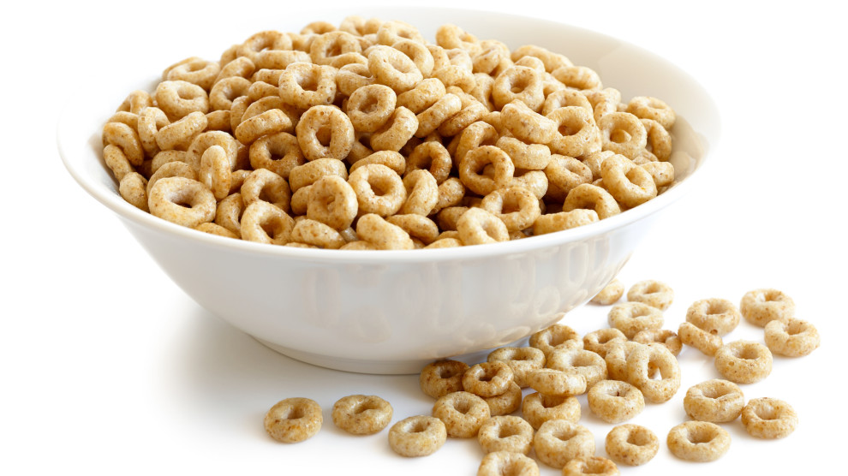
Important Requirements to Note
Grains: See back page for details
Whole grains must be served once per day
Cold cereal: Must contain less than 6 grams sugar per oz of cereal

Slide 9
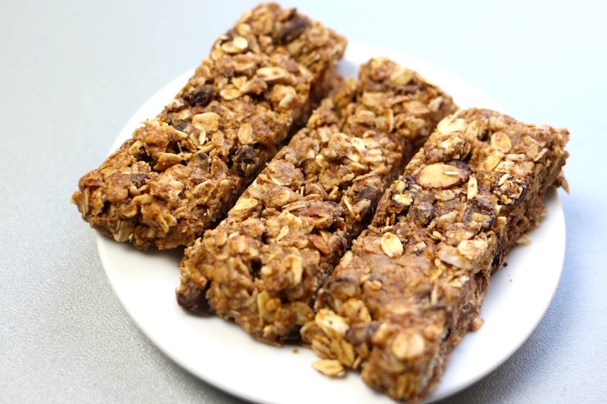
Grain Based Desserts
Grain based desserts are NOT a creditable grain component for meals or snacks.

Slide 10
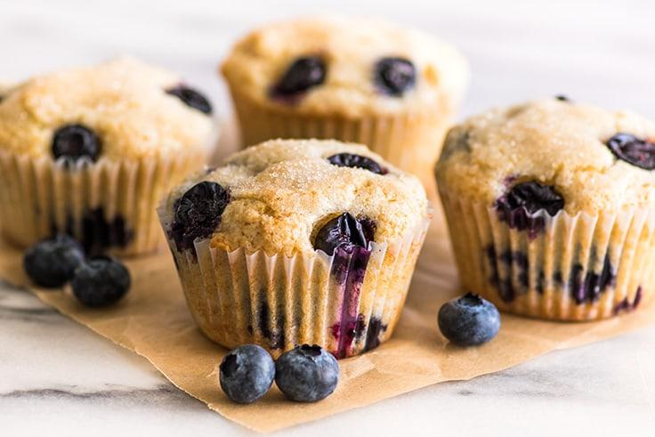
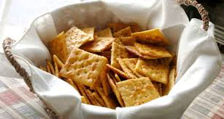
Sweet grains, but okay to serve

Slide 11
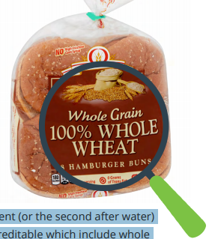
What is Whole Grain Rich?
Foods that contain “100% whole grains” or at least 50% whole grains and the remaining grains are enriched
This is whole grain rich!

Slide 12
The 4 Criteria of Whole Grains
Must meet at least 1 of the 4 following criteria
Label states “100% Whole Grain” or “100% Whole Wheat”
Whole grain health claim is stated on the package
A product formulation statement or CN label is available to credit the grains
Use the Rule of Three to check for Whole grains in the Ingredients List
Cereal: Look for “WIC Approved”
on the grocery store tag
Look for Non-Creditable Grains
Disregard grain ingredients that are in small amounts

Slide 13
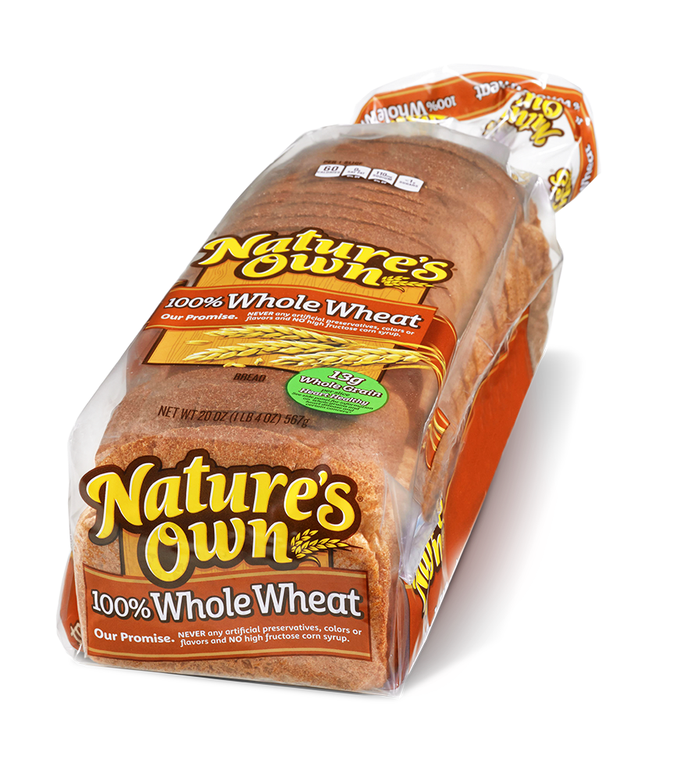
The 4 Criteria of Whole Grains:
CHECKBOX 1
100% Whole Grain or 100% Whole Wheat
is stated on the label
This is whole grain rich!

Slide 14
The 4 Criteria of Whole Grains:
CHECKBOX 2
Whole grain health claim is stated on the package

Slide 15
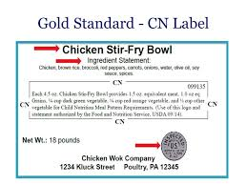
The 4 Criteria of Whole Grains:
CHECKBOX 3
Commercially prepared mixed dishes must have a Product Formulation Statement (PFS) or CN label to credit the grains as fitting the meal pattern

Slide 16
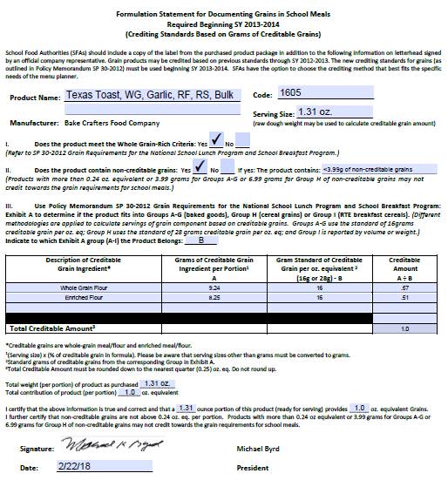
Sample Product Formulation Statement (PFS)

Slide 17
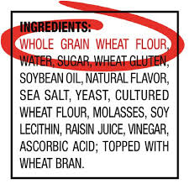
The 4 Criteria of Whole Grains:
CHECKBOX 4
Using the Ingredients List
The Rule of Three
A whole grain is listed as the first ingredient (or the second after water) and
The next two grain ingredients are creditable which include whole grains, enriched grains, bran, and germ.

Slide 18
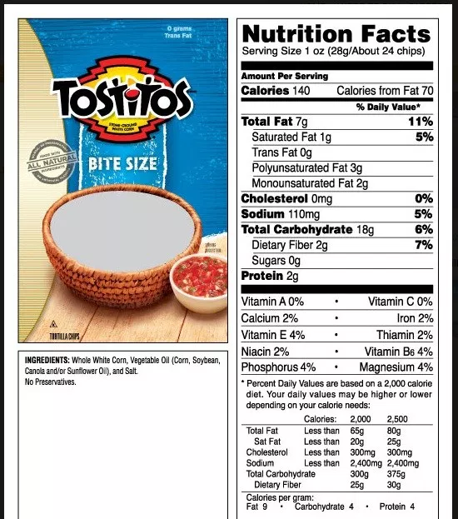
Is this Whole Grain?

Slide 19
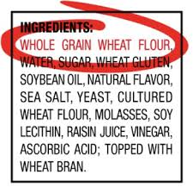
Is this Whole Grain?

Slide 20
Is this Whole Grain?
Is this enriched?
Is this creditable for grains in CACFP?

Slide 21
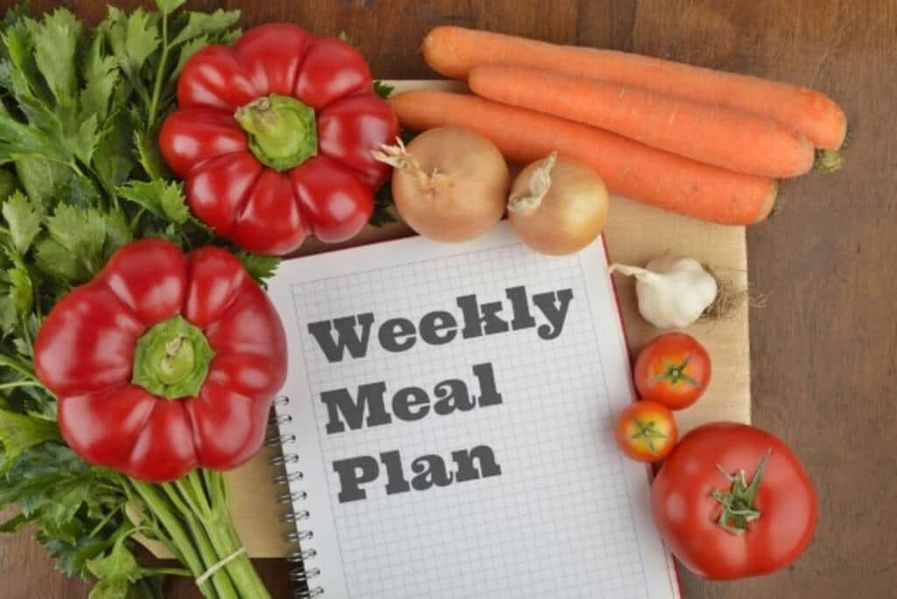
How to Incorporate these Guidelines
into your Life
Juice: Smaller serving size, 100% juice
Whole Grains
Incorporating more vegetables into meals
Snacks: two or more food groups
Recognize “dessert” grains
Incorporate all 5 food groups into lunch and dinner
Recognizing serving size
Hidden sugars

Slide 22
How to Incorporate these Guidelines
into your Life
Snacks: Contain two or more food groups/components
Lunch and Dinner: Incorporate all 5 food groups into meal
Choose whole grains
Recognize “dessert” grains
Reduce serving sizes
Juice: Smaller serving size, 100% juice only

Slide 23
Brought To You By

