Slide 2
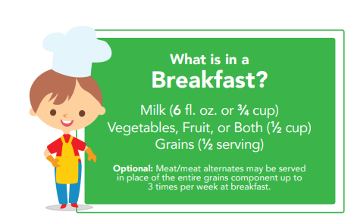
What’s in a CACFP Breakfast of Champions?

Slide 3
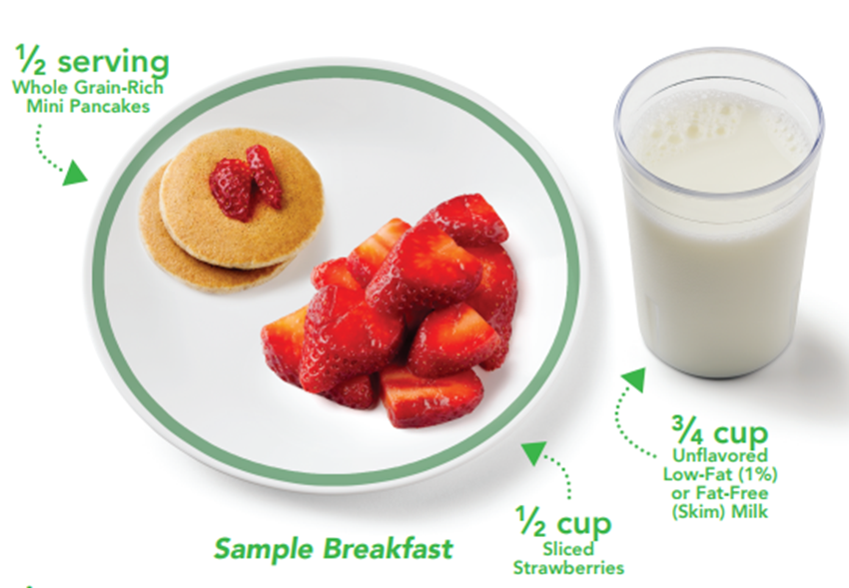
Note: Serving Sizes are minimums.
Sample Meals for Children Ages 3-5
New Meal Patterns Implementation October 1,2017

Slide 4
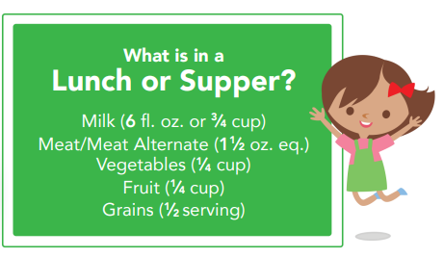
What’s in a CACFP Lunch/Supper of Champions?

Slide 5
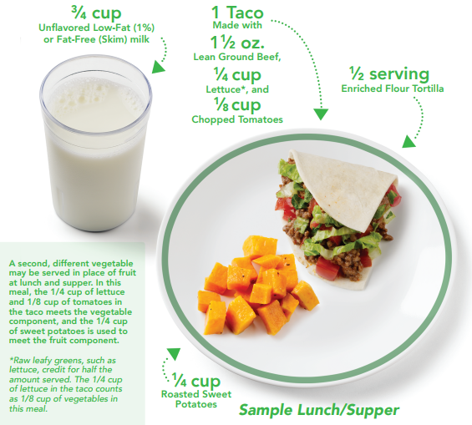
A second, different vegetable may be served in place of fruit at lunch and supper. In this meal, the 1/4 cup of lettuce and 1/8 cup of tomatoes in the taco meets the vegetable component, and the 1/4 cup of sweet potatoes is used to meet the fruit component. *Raw leafy greens, such as lettuce, credit for half the amount served. The 1/4 cup of lettuce in the taco counts as 1/8 cup of vegetables in this meal.
Note: Serving Sizes are minimums.
Sample Meal for Children Ages 3-5
New Meal Patterns Implementation October 1,2017

Slide 6
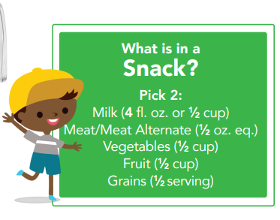
What’s in a CACFP Snack
of Champions?

Slide 7
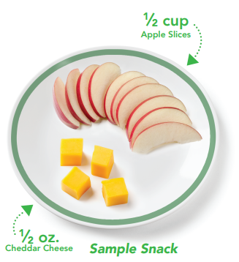
Note: Serving Sizes are minimums.
Sample Meal for Children Ages 3-5
New Meal Patterns Implementation October 1,2017

Slide 8
What about Grains, Water, Minimums?
Note: Serving Sizes are minimums.
For more information on ounce equivalents and serving sizes @ https://teamnutrition.usda.gov
New CACFP Meal Patterns Implementation
10 - 1 - 17
All grains served must be whole grain-rich or enriched.
Breakfast cereals may also be fortified.
At least one grain served each day must be whole grain-rich.
Source: Team Nutrition

