Slide 1

CCFP Roundtable Discussion
Universal City, California — October 2015
Rachel Powell, PhD, MPH
Centers for Disease Control and Prevention
Disclaimer: The findings of this presentation are the conclusions of the presenter and do not necessarily represent the official policies of the CDC nor does the mention of any names or organizations imply endorsement by the Federal government.
www.HealthyKidsHealthyFuture.org
Notes:
Welcome and Introductions

Slide 2
Childhood Obesity
More than 1 in 5 children ages 2 – 5 years old are overweight or obese.
Children who are overweight or obese as preschoolers are 5 times as likely as normal-weight children to be overweight or obese as adults.
Obesity increases the likelihood of certain diseases and health problems during both childhood and later in adulthood.

Slide 3
Why obesity prevention in child care and early education programs?
Habits and preferences form early and become increasingly difficult to change.
Prevention must start early – small window of opportunity for many children.
Young children are strongly influenced by role-modeling.
11 million children spend 30 hours/week in care.
You are in a unique position to educate and influence providers.

Slide 4
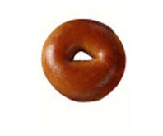

Bagel
20 Years Ago
Today
140 Calories
3 inch diameter
How many calories are in this bagel?

Slide 5
Bagel
20 Years Ago
Today
350 Calories
6 inch diameter
140 Calories
3 inch diameter
Calorie Difference: 210 Calories

Slide 6
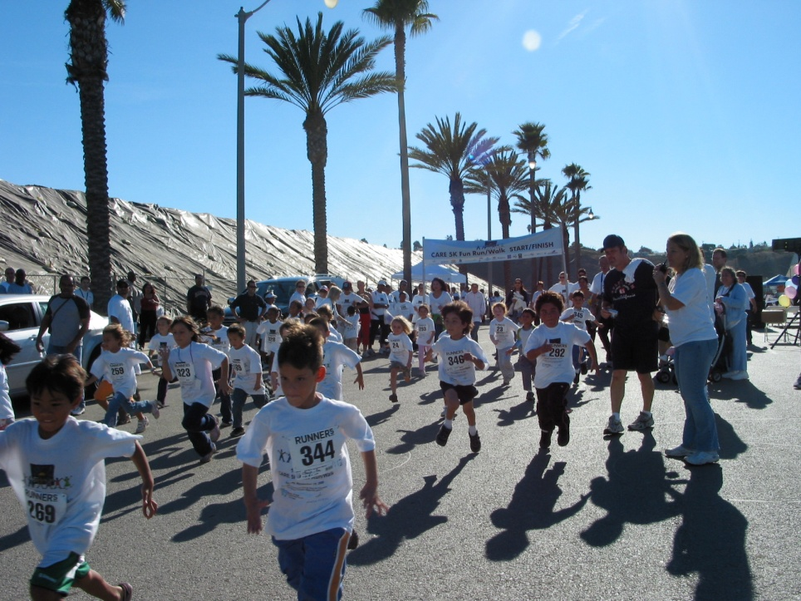
200 Calories
55 minutes of walking
30 minutes of cycling
23 minutes of jogging
17 minutes of swimming

Slide 7

Moving Forward, Reversing the Trend
“ … we know the cure for this. This isn't like putting a man on the moon or inventing the Internet - it doesn't take some stroke of genius or feat of technology. ... Rarely in the history of this country have we encountered a problem of such magnitude and consequence that is so eminently solvable.”
Michelle Obama
February 9, 2010

Slide 8

Let’s Move! Child Care Overview
One component of the First Lady’s Let’s Move! initiative to solve the obesity problem
Supports ECE providers to adopt best practices in 5 goal areas through free resources and interactive, online tools
Core self-assessment tool (LMCC Checklist Quiz) and interactive action planning tool
Recognizes providers who meet best practices
www.healthykidshealthyfuture.org
Notes:
Talking Point:
LMCC is a voluntary initiative

Slide 9
Simple Steps
Become a Recognized Let’s Move! Child Care Provider & celebrate your success!
Yes
Sign up
Take Checklist Quiz
Meet all best practices?
No
Build action plan
Make program improvements
Use free online resources & tips
Notes:
Suggested talking points:
As a review, here is the process for participating in LMCC.
You can take the quiz as many times as you want!
Remember, once you take the quiz, build an action plan, and make changes, be sure to go back to the LMCC website and re-take the Checklist Quiz to show you’re meeting best practices.
You have to record that you’re meeting all of the best practices to become a Recognized Let’s Move! Child Care Provider!

Slide 10
As of September 30, 2015
Become a Recognized Let’s Move! Child Care Provider & celebrate your success!
17,850 providers
12,139 providers
Yes
1,344 of quizzes show meeting 100% best practices
Sign up
Take Checklist Quiz
Meet all best practices?
1,027,295 children served by registered providers
No
2,846 of quizzes show meeting > 75% best practices
Notes:
Suggested talking points:
As a review, here is the process for participating in LMCC.
You can take the quiz as many times as you want!
Remember, once you take the quiz, build an action plan, and make changes, be sure to go back to the LMCC website and re-take the Checklist Quiz to show you’re meeting best practices.
You have to record that you’re meeting all of the best practices to become a Recognized Let’s Move! Child Care Provider!

Slide 11
Sign Up & Let’s Move! Child Care Quiz

Slide 12
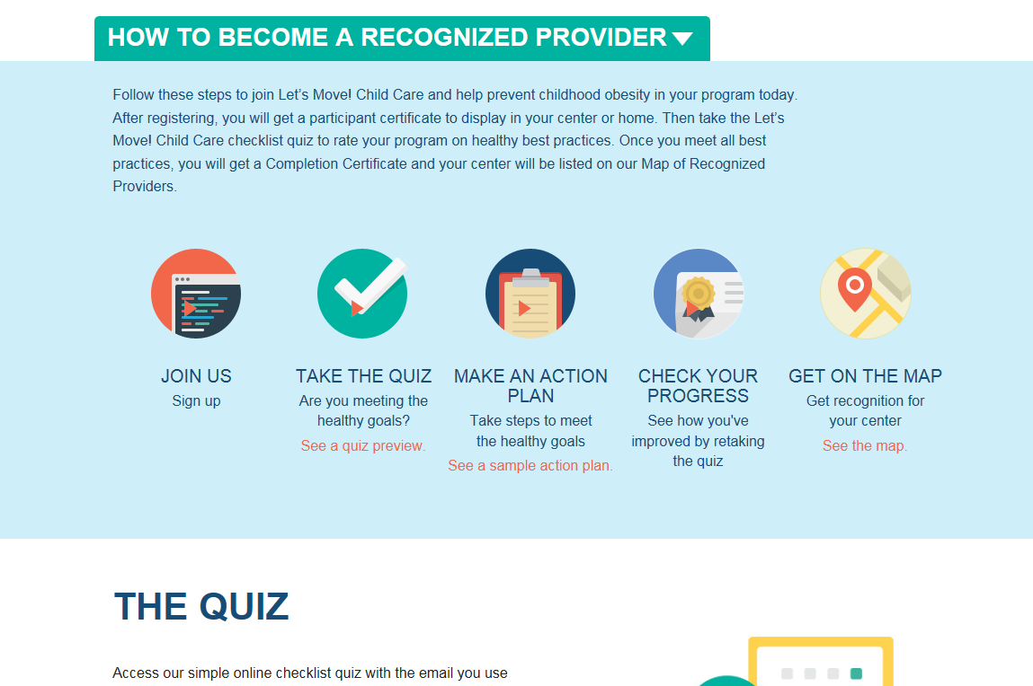
Sign Up!

Slide 13
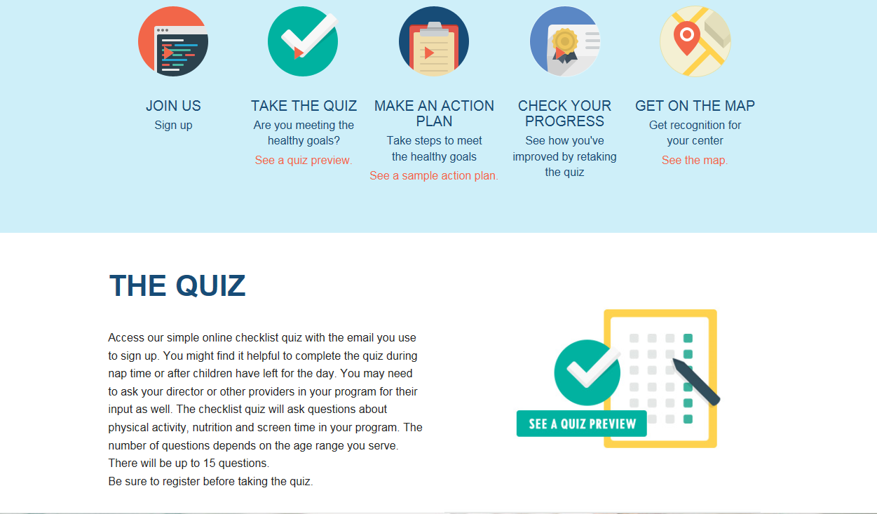
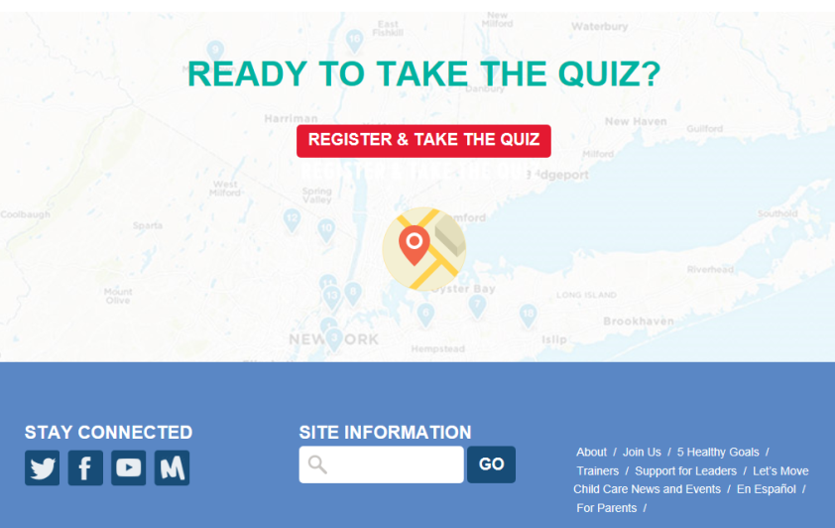
Take the Checklist Quiz
Don’t forget! You must register before taking the quiz
See where you are and make a manageable action plan to achieve the LMCC goals
Notes:
Suggested talking points:
To take the Checklist Quiz, go to the ‘Join Us’ page on the LMCC website and click ‘Take Quiz’.
Remember, the first step is to sign up! You have to sign up to be able to take the Checklist Quiz.

Slide 14
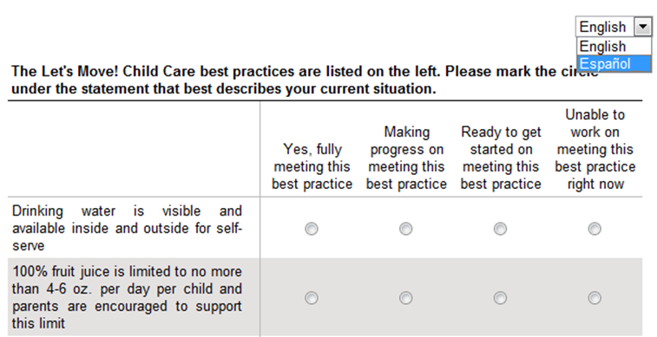
Checklist Quiz
Answer questions to see which best practices you are meeting and which goals you need to work on
Available in Spanish too!
Notes:
Suggested talking points:
The Quiz is available in English & Spanish. To take the Quiz in Spanish, click on the drop down menu and select ‘Español’.
The Quiz is tailored to your program! You will only get questions that are relevant to the age groups you serve. For example, if you do not care for infants, you will not get questions about supporting breastfeeding.
This part of the Quiz generally takes 5-10 minutes to complete if you care for infants, toddlers and preschoolers. It takes less time if you do not care for all age groups.

Slide 15
Action Plan using the Checklist Quiz
Action Planning is an important step in making changes
Providers choose their priorities
Start where they are; where the program is most likely to be successful
Be ready to create concrete action steps with specific individuals responsible
Samples are available
Notes:
Action Planning is an important part of making changes

Slide 16
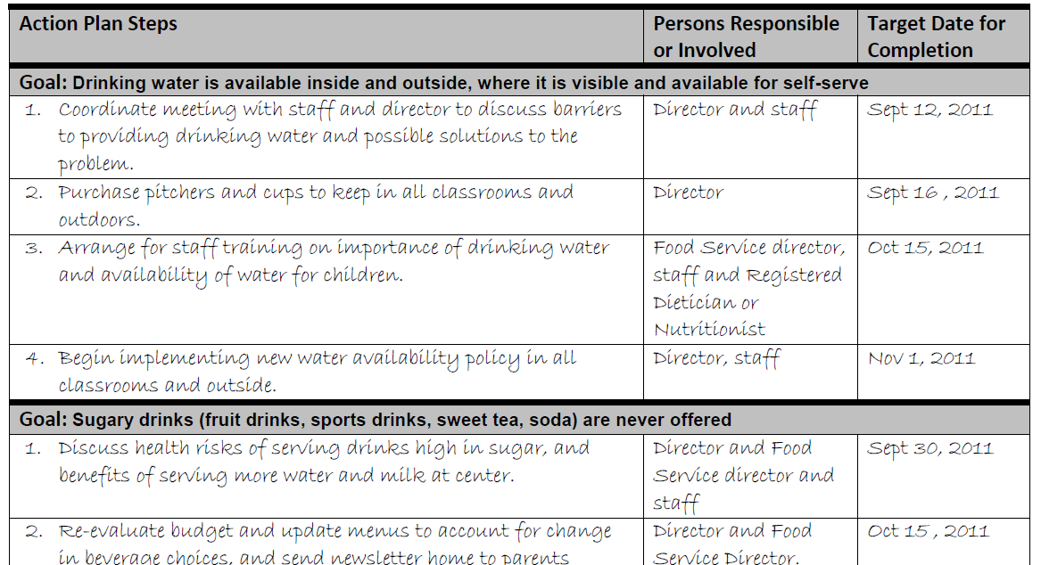
Sample Action Plan
Notes:
Sample Action Plans are available for centers and family child care homes. Here’s what the center sample plan looks like.

Slide 17

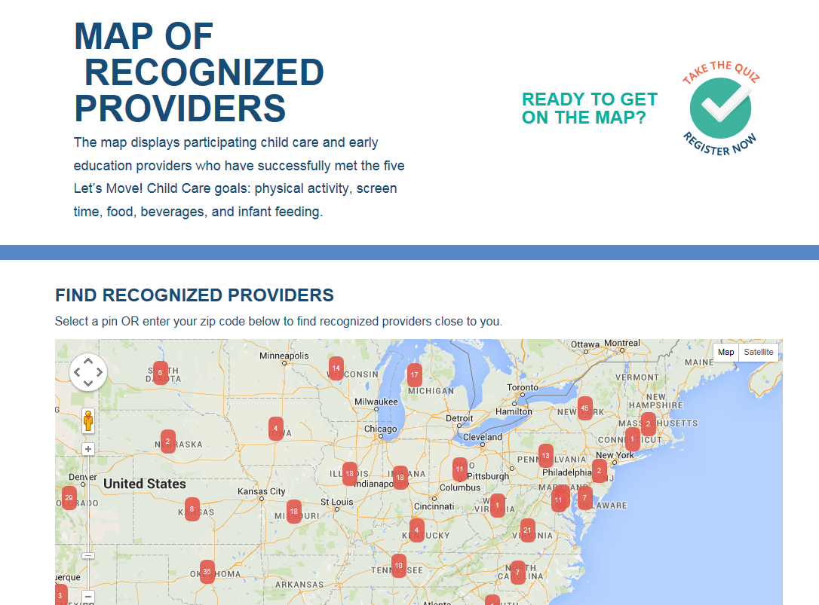
Be a Recognized LMCC Provider!
Get Your
Recognition Award
Be Featured on the LMCC Map
Notes:
Suggested talking points:
Recognized Providers earn a Provider Recognition Award (as shown here on the left). You can display the award in your program or share it with families to let them know what you’re doing to help kids grow up healthy.
Also, Recognized Providers are showcased on the interactive LMCC map on the LMCC website. You can use the map to search for Recognized Programs in your area. This is a useful tool for families who are looking for programs that are promoting children'

Slide 18
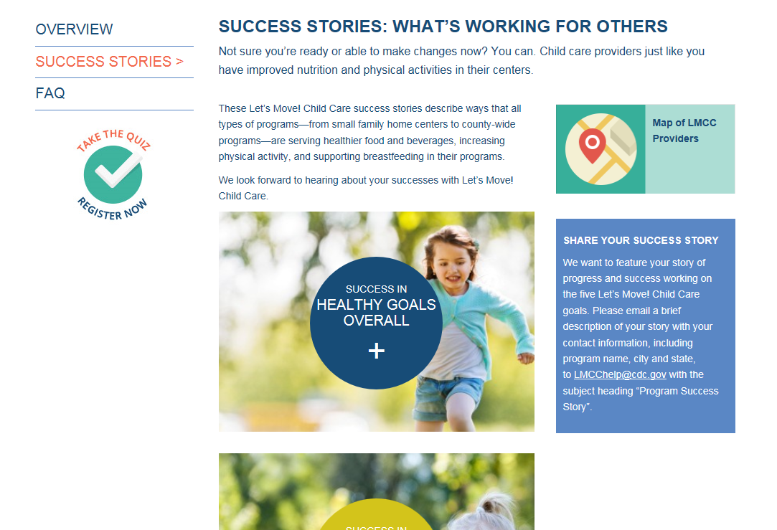
Success Stories
Learn from others and overcome challenges
Submit Success Stories
  May be highlighted in e-mail blasts, articles or on the LMCC website
Inspire others to achieve the LMCC goals
Be recognized for outstanding efforts

Slide 19
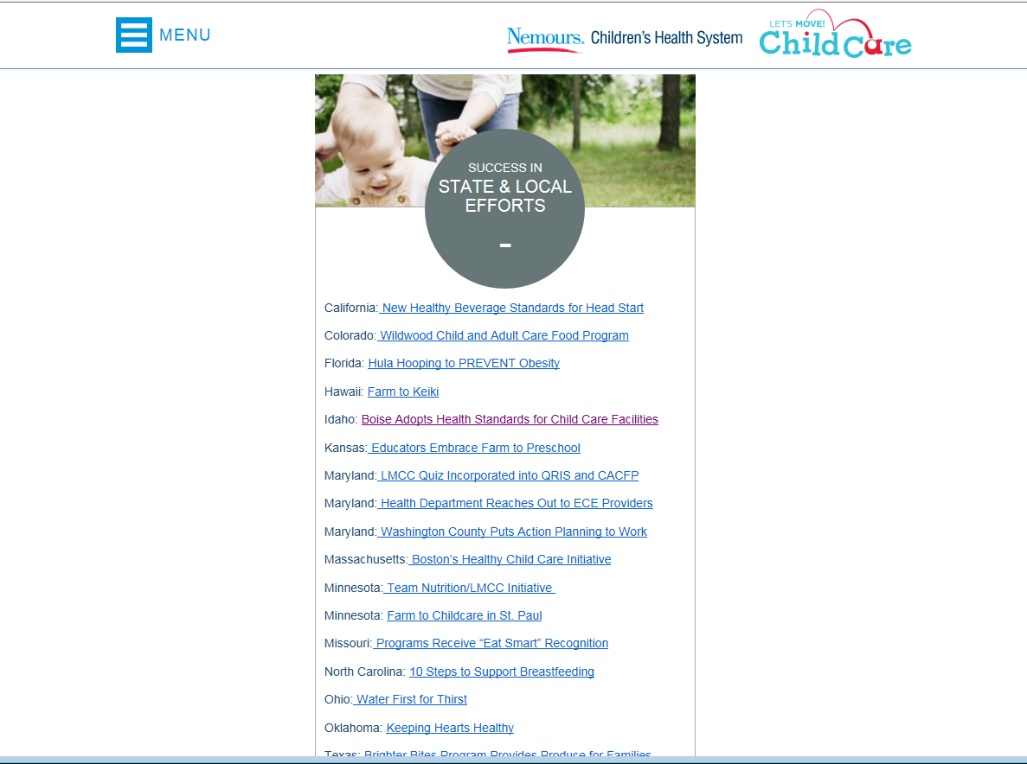
Success Stories
State & Local Level
Provider level

Slide 20

Physical Activity Best Practices
% Providers meeting practices
Infants: Short supervised periods of tummy time several times each day (3-5 min, longer as tolerated)
Toddlers & Preschoolers: Active play time every day, both indoor and outdoor
  Toddlers: 60 – 90 minutes or more
  (for half-day programs, 30 minutes or more)
  Preschoolers: 120 minutes or more
  (for half-day programs, 60 minutes or more)
33%
62%
53%

Slide 21

Screen Time Best Practices
% Providers meeting Practices
Infants: No screen time
Toddlers: No more than 3 – 4 times per year, or never
Preschoolers:
  Only for educational or physical activity purposes
  No more than 30 minutes per week or never, while in your care
  Work with families to ensure no more than 1 - 2 hours per day
Provide screen time reduction and/or media literacy education to parents at least twice a year,
  e.g. special programs, newsletters, or information sheets
40%
60%
57%

Slide 22

Food Best Practices
% Providers meeting Practices
Toddlers and preschoolers
  Serve a fruit and/or a vegetable at every meal
    Juice doesn’t count as fruit
    French fries, tater tots, and hash browns don’t count as vegetables!
  Limit fried and pre-fried foods: no more than 1/month
  French fries, tater tots, hash browns, potato chips, frozen and breaded meats or fish
Preschoolers: Serve all meals family style when possible so that children are encouraged to serve themselves with limited help.
77%
61% fried potatoes
49% fried meat or fish
46%
Notes:
Suggested talking points:
Offering healthy food is important, particularly because many children eat most of their daily meals and snacks while in care, especially children in full-time care.

Slide 23
Beverages Best Practices
% Providers meeting Practices
68%
Water: Visible and available inside and outside for self-serve
Fruit juice: Only100%; limited to no more than 4 – 6 oz. per day per child and encourage parents to support this limit
Sugary Drinks: Never
(includes fruit drinks, sports drinks, sweet tea, and soda)
Milk: Serve only 1% or non-fat (skim) milk to children 2 years and older
(unless otherwise directed by the child’s health provider)
65%
87%
73%

Slide 24


Infant Feeding Best Practice
% Providers meeting Practices
Have a private space for moms to breastfeed or pump
other than a bathroom
appropriate seating and privacy
39%
Have the space available for mothers who want privacy; but allow breastfeeding openly too.
Notes:
Suggested talking points:
There are many ways that programs can support breastfeeding moms and babies. The LMCC infant feeding best practice focuses on one of the ways.
Breast milk is like any other food and should not be present in a bathroom.
It’s ideal to welcome moms who wish to breastfeed in the classroom and to provide a private space for those who wish to use it.

Slide 25
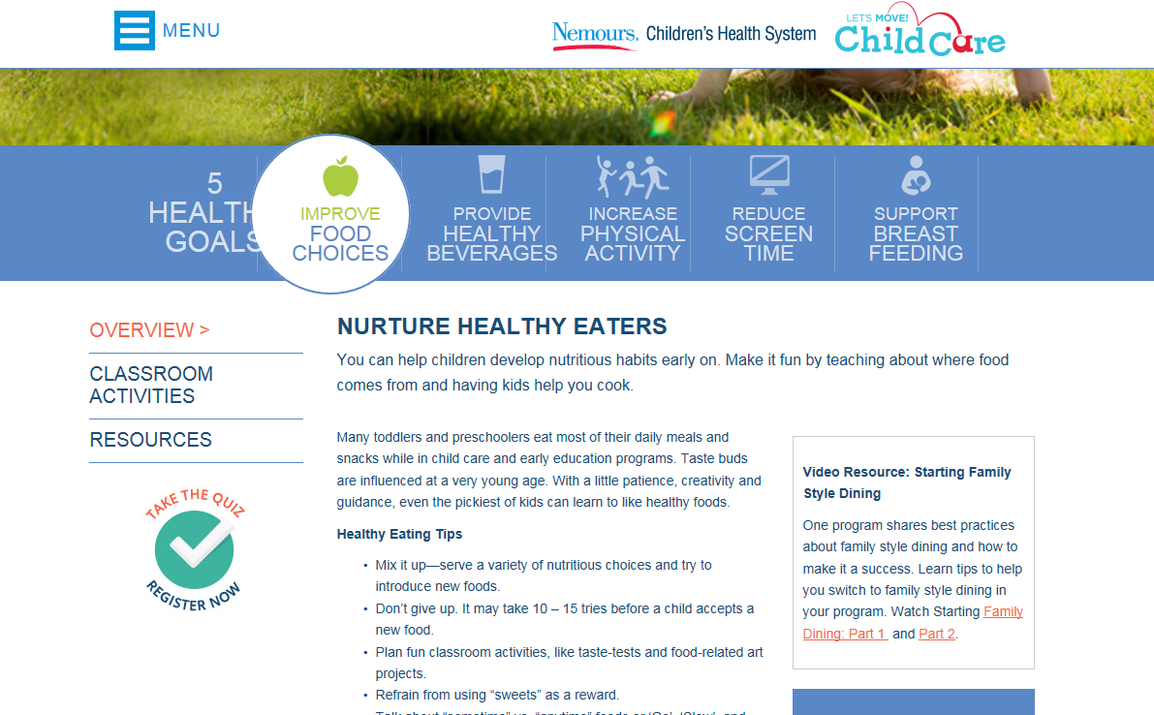
Resources for 5 goal areas
Healthy Eating and Physical Activity tabs offer:
  Tips, resources, online tools and activities
  Educational information:
    Videos
    Articles
    Parent resources
  Suggestions for programs to meet components of LMCC goals:
    Policies
    Practices
Notes:
As seen here, resources and tips are provided in a few different formats for ease of use
Providers are encouraged to share LMCC information and the HKHF.org website with families
At home, families can supplement the healthy practices that are taking place in their child’s program

Slide 26
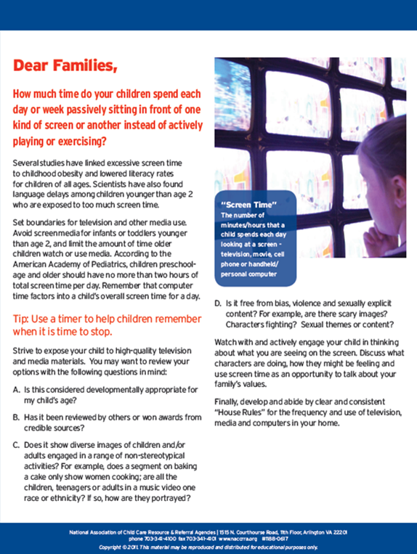
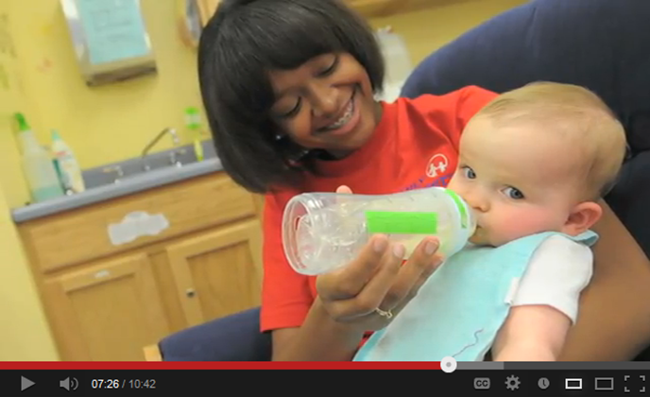


What Kind of Resources Can You Find?
Curricula
Training videos
Menu Planning & Recipes
Activity Sheets
Tips ECE providers can use to eat healthier and be active
Parent Resources
And more!
Notes:
Mention newsletter goes out to the people on listserve

Slide 27
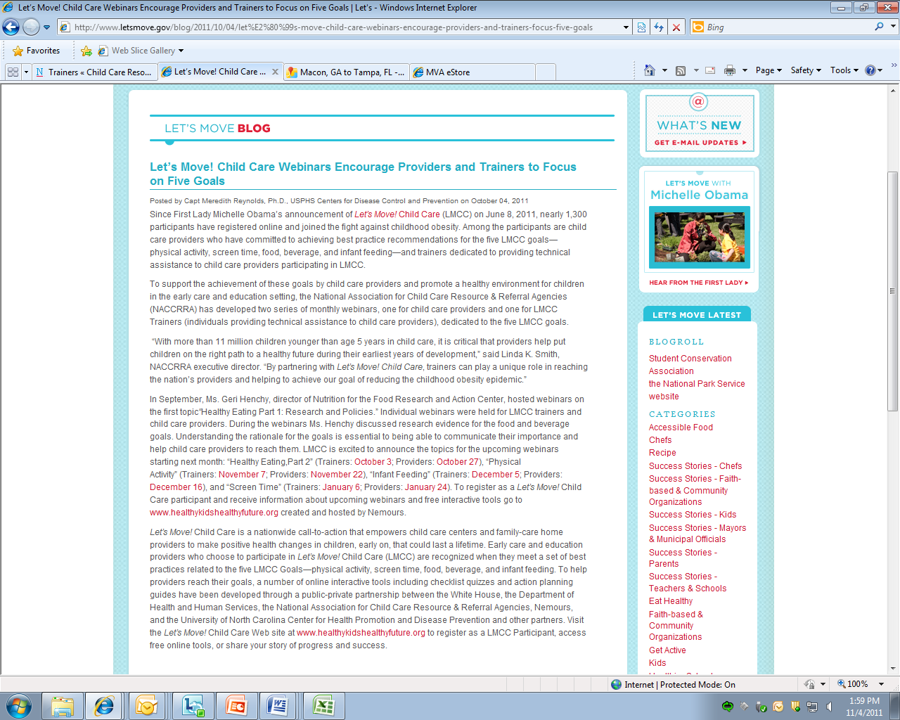


Blogs and E-mails
Visit: www.letsmove.gov
Notes:
As part of signing up, you will be automatically enrolled to receive emails with tips and resources. Some past topics include:
Physical Activity in the Winter Months
Identifying and working with consultants
Enhancing your play space
Creating breastfeeding friendly environments
You can also sign up to receive blog posts on www.letsmove.gov. Some of the recent Blog Topics include:
Webinars (October)
“Take it Outside! Week” (November)
Healthy Holiday Celebrations (December)
Success Stories
Tips for Healthy Eating and Physical Activity

Slide 28
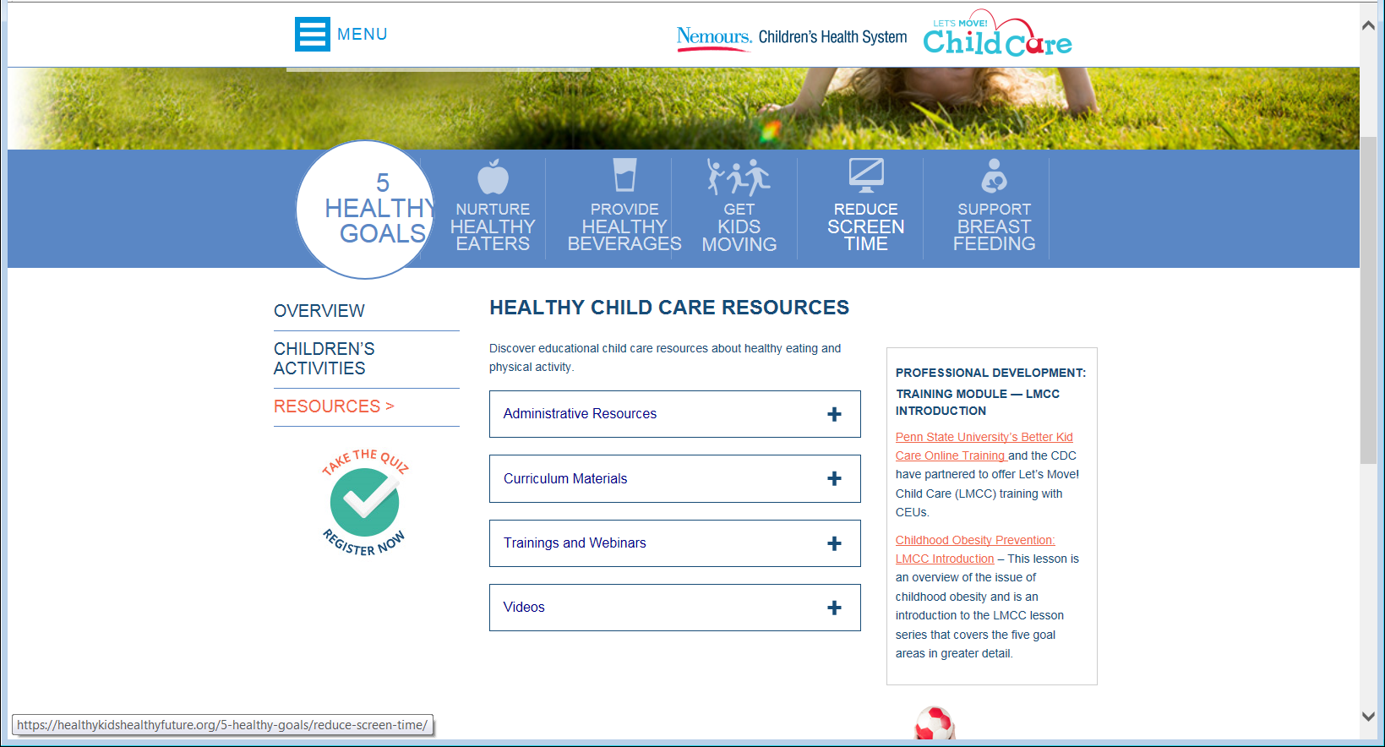
Free Online Trainings for Providers
Notes:
Talking points:
Webinars/online trainings are archived on the LMCC website ‘Free Online Trainings’ page.

Slide 29
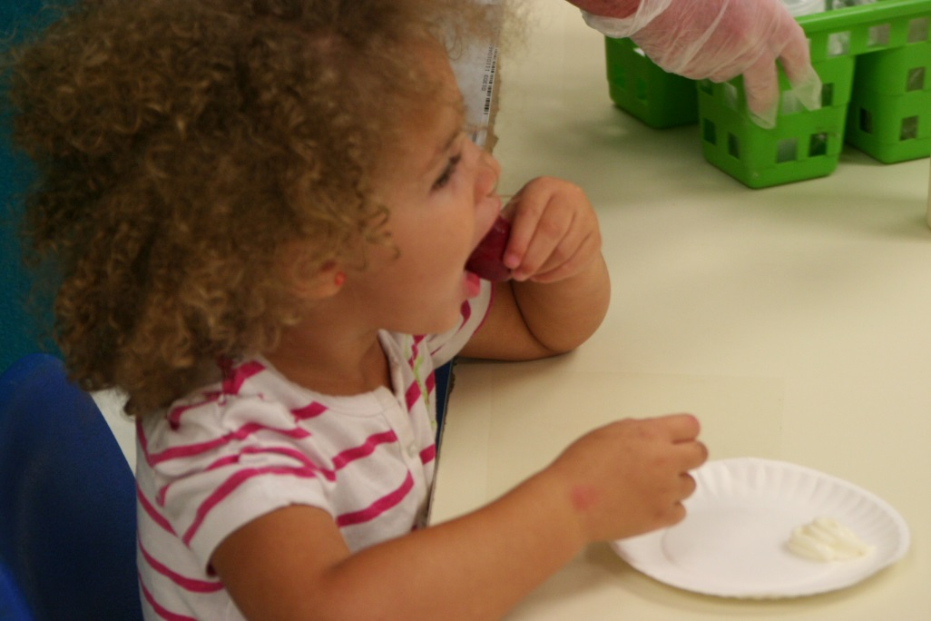
Penn State Better Kid Care
To provide evidence-informed professional development for early care and education and out of school time professionals to improve the quality of their care and educational practices.

Slide 30
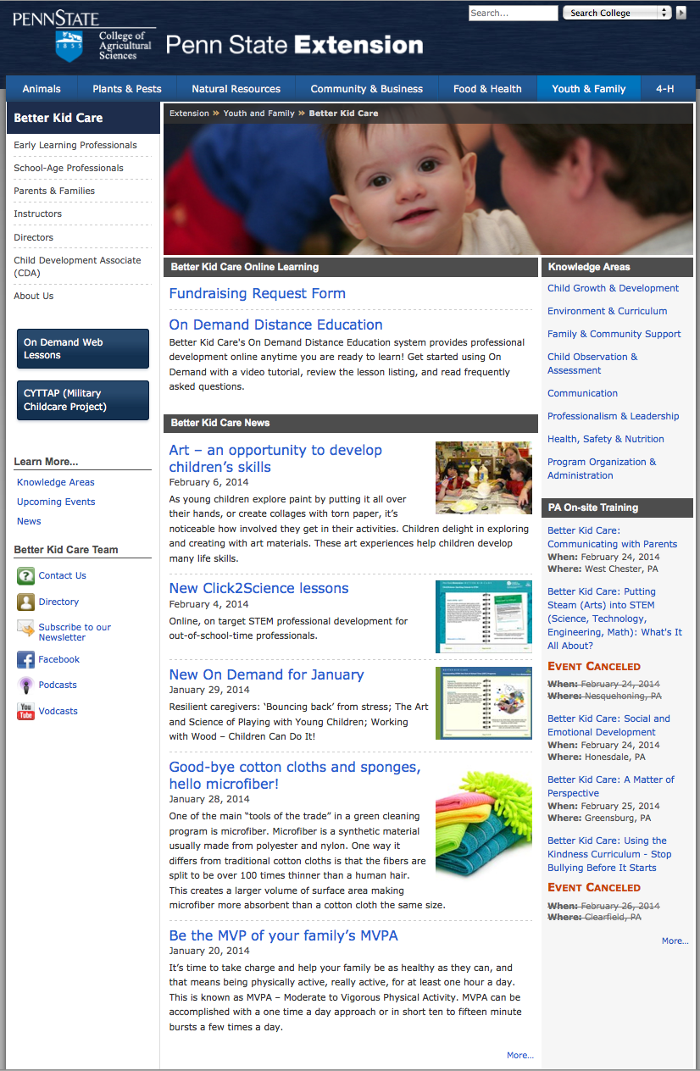
Better Kid Care Website
http://extension.psu.edu/youth/betterkidcare
On Demand Web Lessons
Health, Safety and
Nutrition

Slide 31
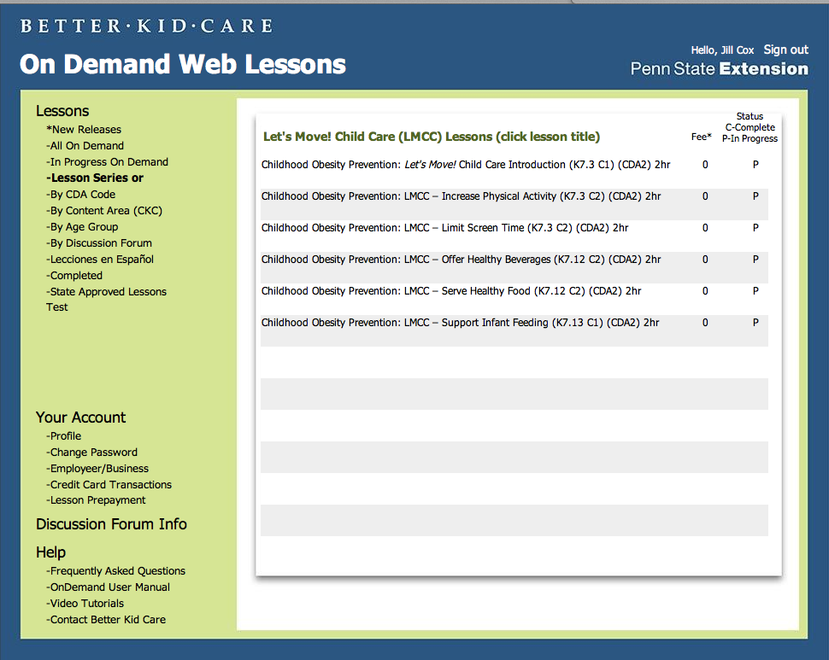
Let’s Move! Child Care Lessons
LMCC Introduction
Increase Physical Activity
Limit Screen Time
Offer Healthy Beverages
Serve Healthy Food
Support Infant Feeding

Slide 32
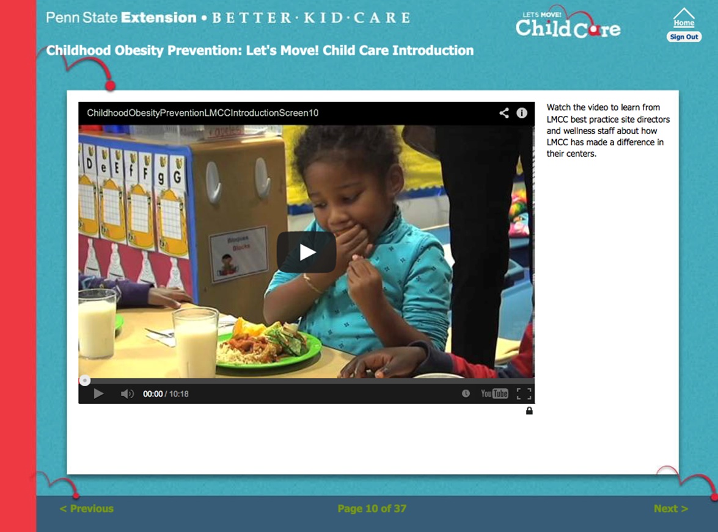
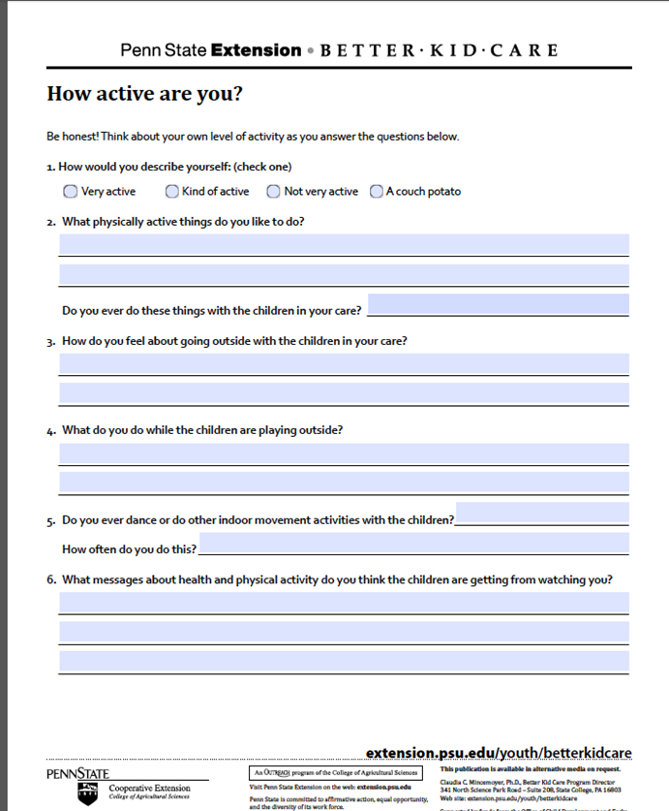
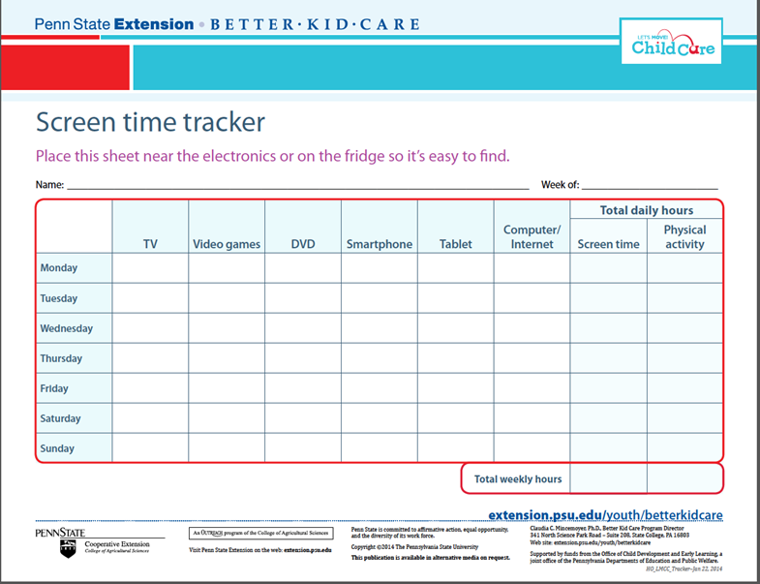
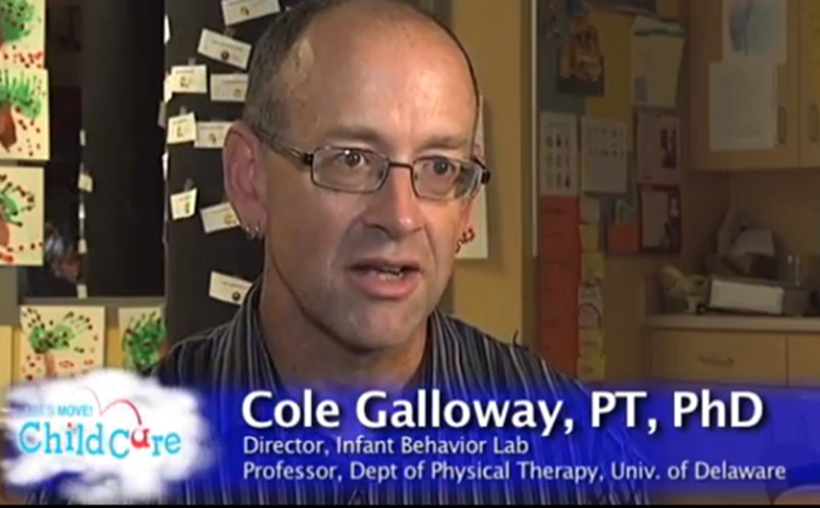
Content of LMCC Lessons
Overview and objectives
Video learning
Reflection Activities
Interviews with Experts
LMCC Resources
Additional Resources
Assessment

Slide 33
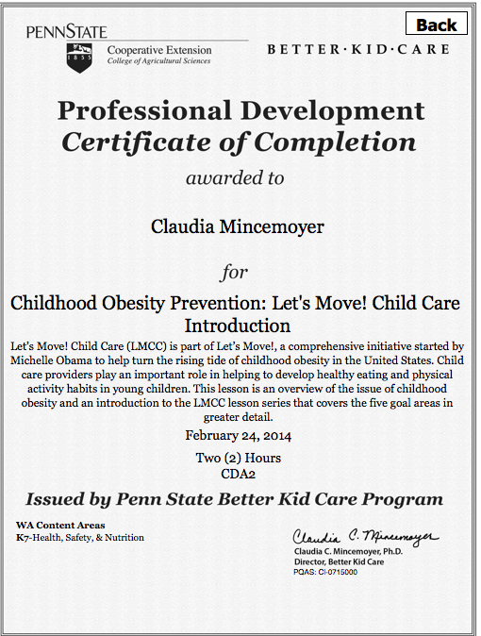
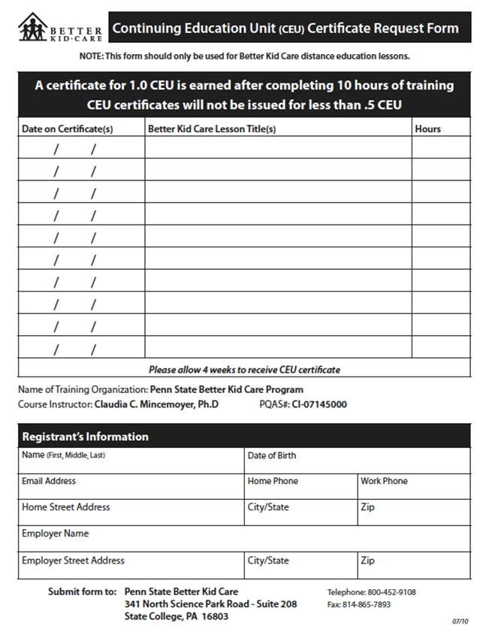

Certificate of Completion & CEU Form
Complete and submit CEU form to Penn State

Slide 34
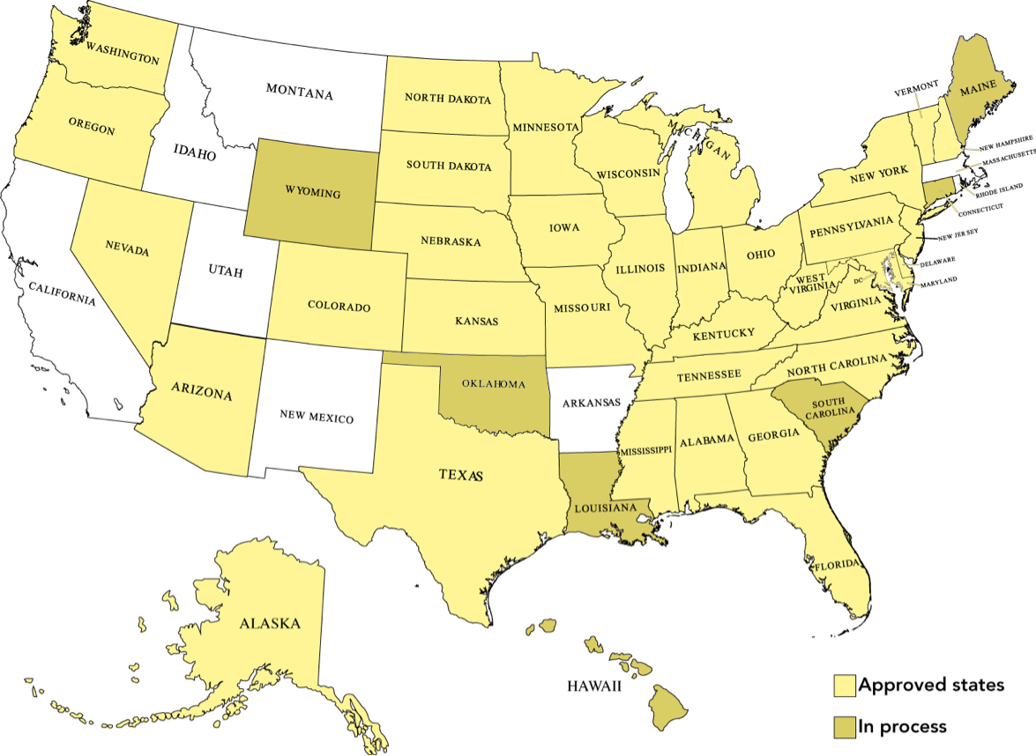
What states accept BKC modules for professional development credit?

Slide 35
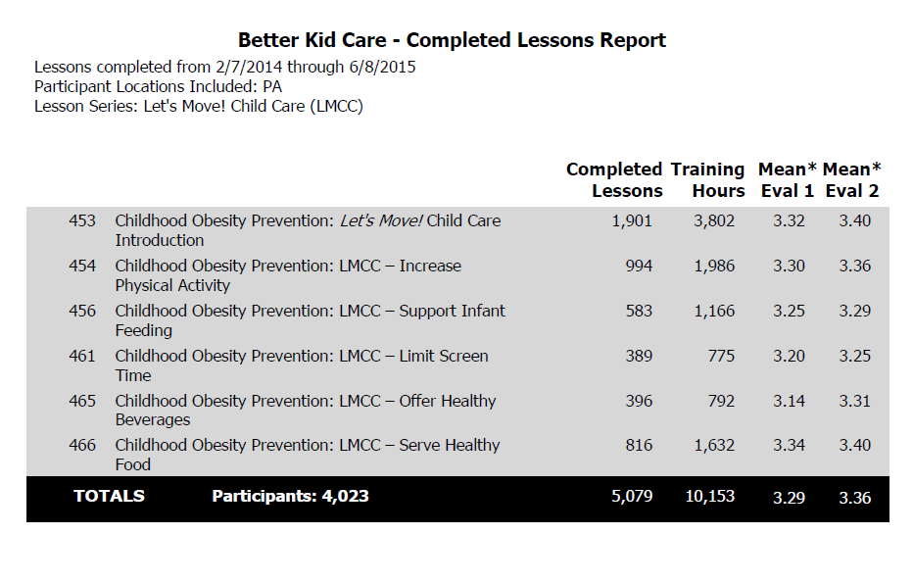
Pennsylvania BKC participation
Evaluation 1: How much did you learn in this professional development lesson?
Evaluation 2: How much of what you learned will you be able to use with the children or families in your care?
Scale:
4 – a great deal
3 – a lot
2 – a little
1 – nothing at all
Notes:
If a state contracts with BKC to purchase a bulk quantity of lessons, then they could provide additional data such as a break out by county. BKC would be able to provide them with other aggregate outcome data under those circumstances as well.

Slide 36
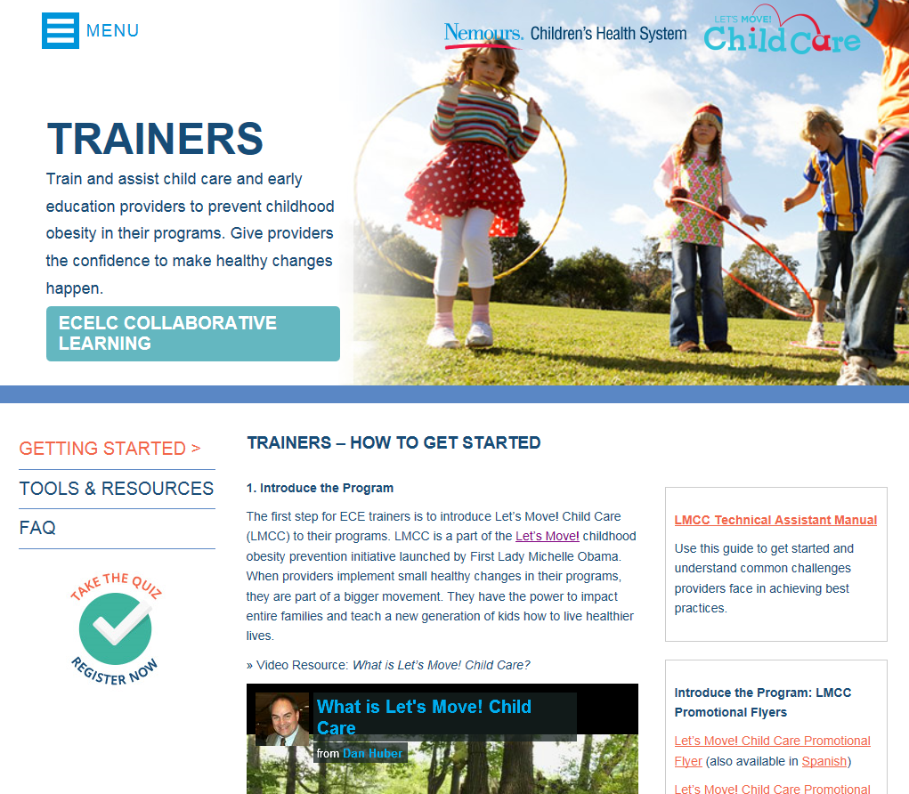
Slide sets for Trainers
Overview of LMCC and 5 in-depth slide sets for each of the 5 LMCC goal areas
  Best practices & rationale
  Tips & Resources
  Activity ideas
  Videos & ideas for handouts

Slide 37

Put your thinking caps on!
Form groups of 3 and discuss:
3 ways CACFP Sponsors can promote LMCC and support providers to meet the best practices.

Slide 38
For more information
Visit www.HealthyKidsHealthyFuture.org
Contact the Let’s Move! Child Care Help Desk
LMCChelp@cdc.gov
Share your success stories!
LMCChelp@cdc.gov

