Slide 1
CCFP Roundtable Conference
Nutrition at its Peak:
Welcome to the New Meal Pattern
Notes:
Nutrition at its Peak:
Making a Great Program Even Better!

Slide 2
Overview
New Meal Pattern
Washington Political Update

Slide 3
The New Meal Pattern
Making a Great Program Even Better!

Slide 4
Supporting a Successful Implementation
What you can do
Notes:
Dialogue and communications

Slide 5
Child & Adult Care Food Program
New Healthier Meal Pattern Timeline
October 2017
Preparation, Feedback & Dialogue
Implementation
April
2016

Slide 6
Child & Adult Care Food Program
New Healthier Meal Pattern Timeline
October 2017
Graham Crackers Back
Transition Year Policy Issued
Preparation, Feedback & Dialogue
Implementation
April
2016
Notes:
Great training from USDA & States

Slide 7
CACFP Dialogue
Roundtable Conference
Offer feedback on your implementation experience
Ask questions
Share successful strategies
Notes:
Today, Tomorrow & the Next Day
Offer feedback on your experience with implementation
Ask questions
Share successful strategies
Learn

Slide 8
Continue the Dialogue in Your State
Implementation – Transition Year
Partners for CACFP Success
State Agency
Sponsors
Centers, Head Start, & Afterschool Programs
Family Child Care Providers
Reflect
Clarify
Share
Notes:
There are 22 states here – implementation will happen in the states to the local level – where the change will happen.
And --
Many of you are state leaders and others represent organizations with network/members on the state and local level.

Slide 9
Supporting Success
Communicate the new improvements to parents, teachers & children

Slide 10
Messaging
We are making a good program even better!
Now CACFP will be the gold standard in good nutrition!
CACFP helps children grow healthy & strong
Nutrition habits start early.
Notes:
Many of you already have these partnerships. CACFP provides reimbursements for healthy meals served to children in child care & afterschool programs.
More children need to be in CACFP. New friends comments period

Slide 12
Congress
Budget Battles
Fiscal Year 2018
Notes:
This Congress started in January.

Slide 13
Congress
What is happening now
What you can do about it

Slide 14
Congress
Budget Battles FY2018
Protecting Programs – Protecting Families
Notes:
This Congress started in January.

Slide 15
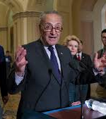
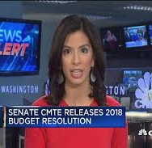
What big budget bill passed last week?
Notes:
Budget Battles in the News

Slide 16
Senate Passed a Budget Last Week
The Senate budget resolution assumes a reduction of trillions of dollars for critical programs over the next 10 years, including the SNAP (Food Stamp Program) & Medicaid
Threatens many programs that support families
(No specific cuts listed for CACFP)
Notes:
The Senate passes a budget resolution, a key step on the way to tax reform.
It still needs to reconcile its budget proposal with a different one passed by the House.
Once Congress approves a budget, it will start writing a tax bill that Republicans hope to pass this year.

Slide 17
House Budget Resolution is Worse
The House budget resolution assumes a reduction of trillions of dollars for critical programs over the next 10 years, including SNAP, Medicaid & many other programs that support families
Jeopardizes funding for many programs that support families
(No specific cuts listed for CACFP)
Notes:
The Senate passes a budget resolution, a key step on the way to tax reform.
It still needs to reconcile its budget proposal with a different one passed by the House.
Once Congress approves a budget, it will start writing a tax bill that Republicans hope to pass this year.

Slide 18
House Budget Resolution
The House passed budget resolution sets the stage for Congress to make billions of dollars in cuts to federal retirement benefits -- civil service pensions
Notes:
USDA included – Head Start in HHS and Child care folks – national, regional and others.

Slide 19
Next Step
The House & Senate will try to reconcile these bad budget proposals
Notes:
The current extension expires December 8th
The Senate passes a budget resolution, a key step on the way to tax reform.
It still needs to reconcile its budget proposal with a different one passed by the House.
Once Congress approves a budget, it will start writing a tax bill that Republicans hope to pass this year.

Slide 20
Congress – Bad Budgets
What You Can Do
Notes:
Many have objected to these bad budgets – you may be one of them. We have to keep objecting.

Slide 21
Advocacy Action Plan
Let Congress know your views:
Call or e-mail your member of Congress
Sign-on to letters of opposition
Communicate through your associations

Slide 23
Educate & Advocate
Visit Your congressional representatives; educate them about CACFP, establish relationships with political partnerships
Notes:
If still going then add here. If not then add further up to discuss what we all did working together to get the senate bill.

Slide 25
Welcome to the New Meal Pattern
ROUNDTABLE
Working together we can make a great program even better!

Slide 26
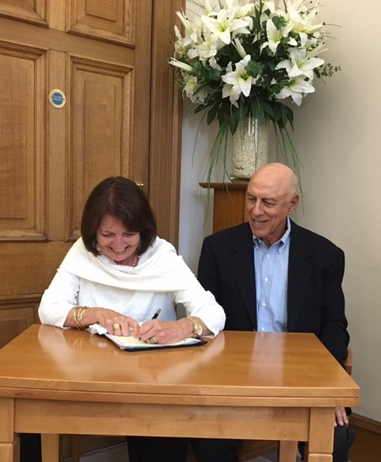
Congratulations to Paula & Bob
Married in Scotland this Summer

Slide 27
FRAC.org
Geraldine Henchy | 202.986.2200 | ghenchy@frac.org
Connect With FRAC
@fractweets
@fracgram
Facebook.com/foodresearchandactioncenter
Linkedin.com/company/food-research-and-action-center

