Slide 1
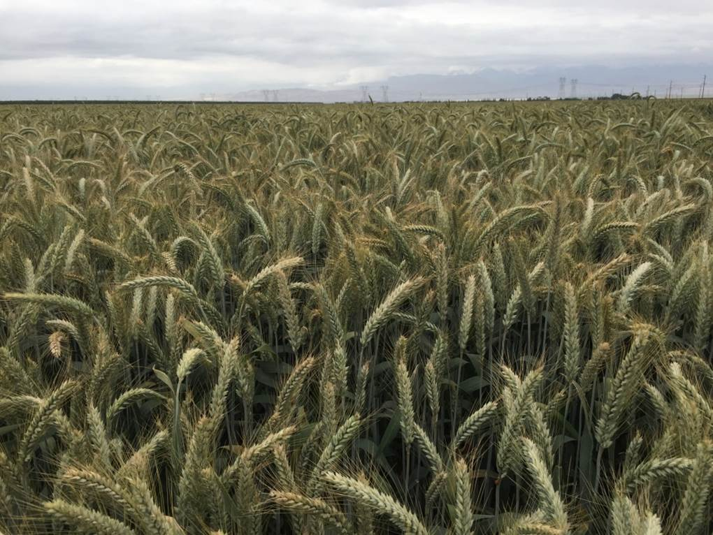
Talking Grains, Growing Grains, Eating Grains
–Let’s See the Menu! –
Presented by Bryan Brown and Brooke ten Bosch
Community Action Partnership of San Luis Obispo County

Slide 2
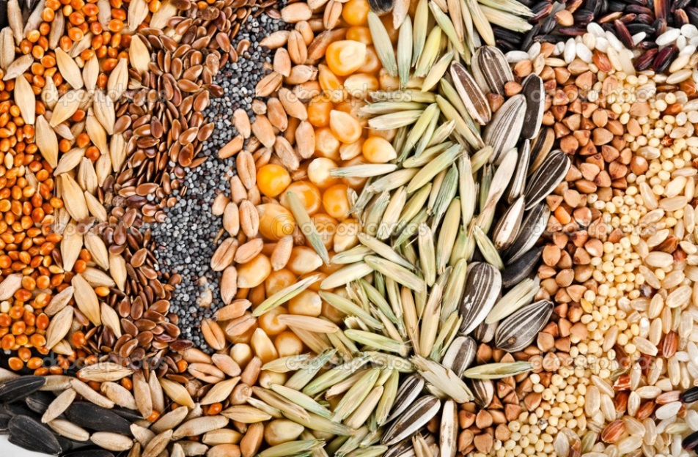
Nutritional Variation
Grains vs. Seeds
Both are packed with nutrients and we should be eating more of them either in their whole form or sprouted.
Grains have a higher carbohydrate to protein ratio, whereas for seeds it is the other way around.

Slide 3
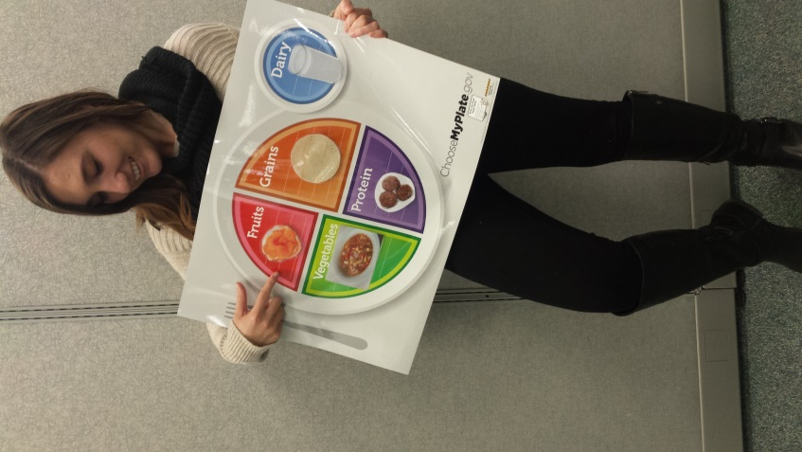
USDA Best Practices for whole grains in the CACFP
Current Best Practice:
Make half your grains whole grain
Future Best Practice:
Provide at least two servings of whole grain-rich grains per day

Slide 4
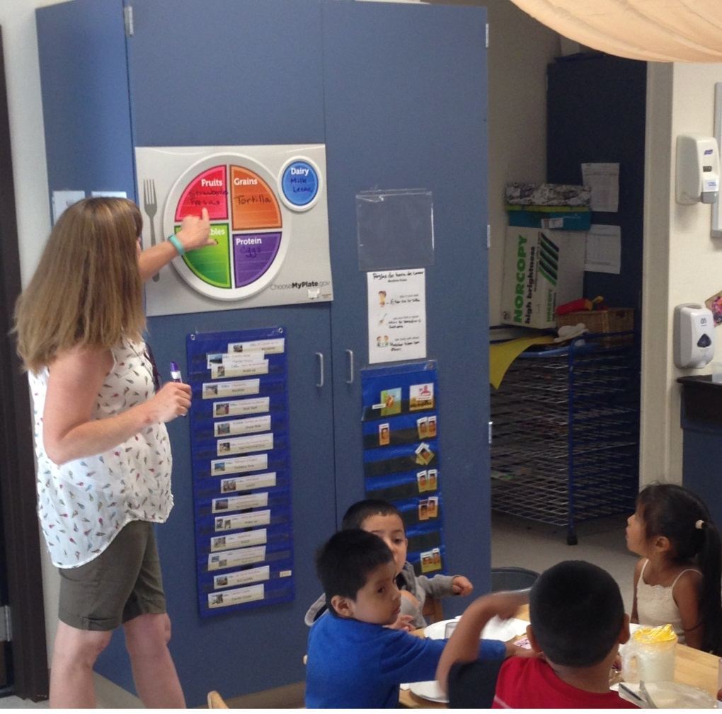
Biggest Factors to Consider
Classroom staff support
Kitchen staff experience with whole grains
Cost
Product availability
The challenge of creativity

Slide 5
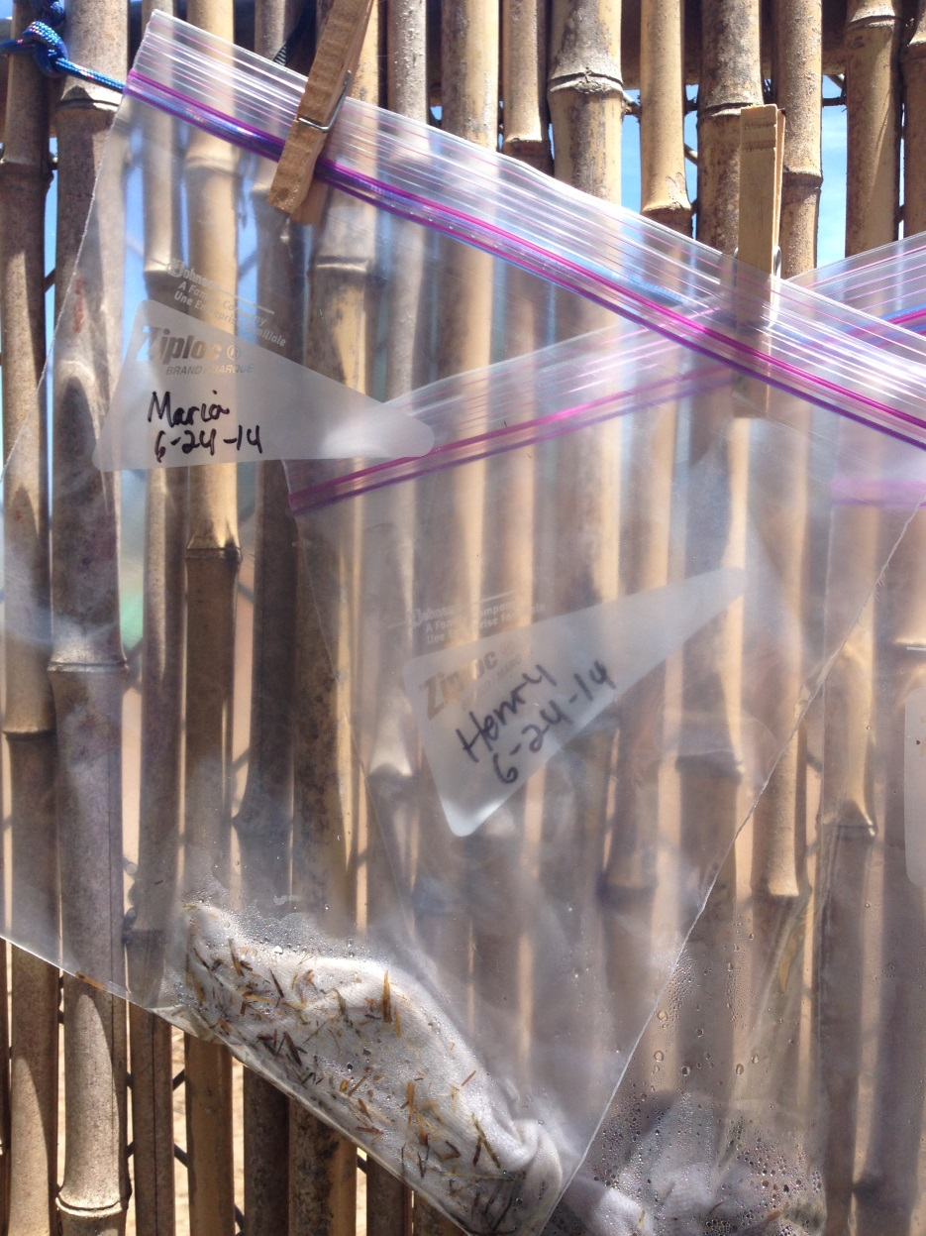
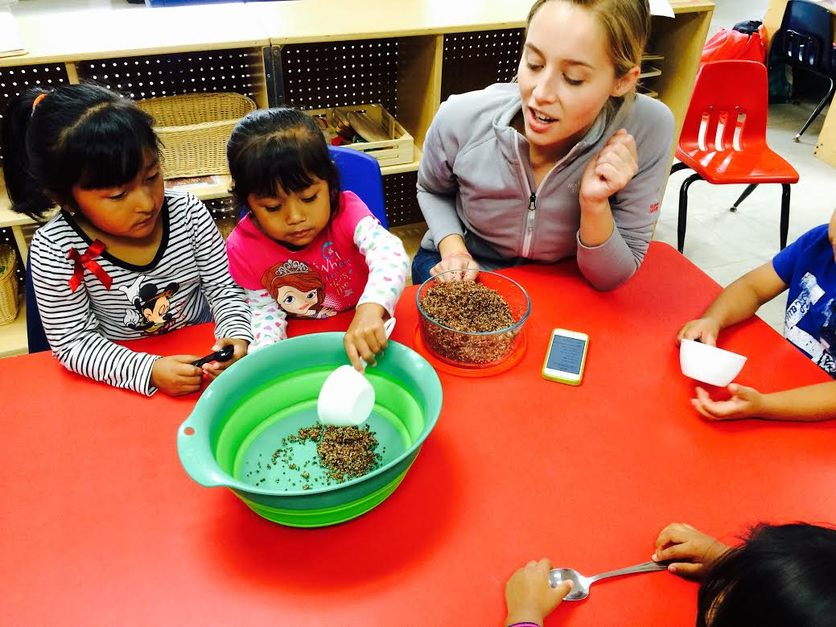
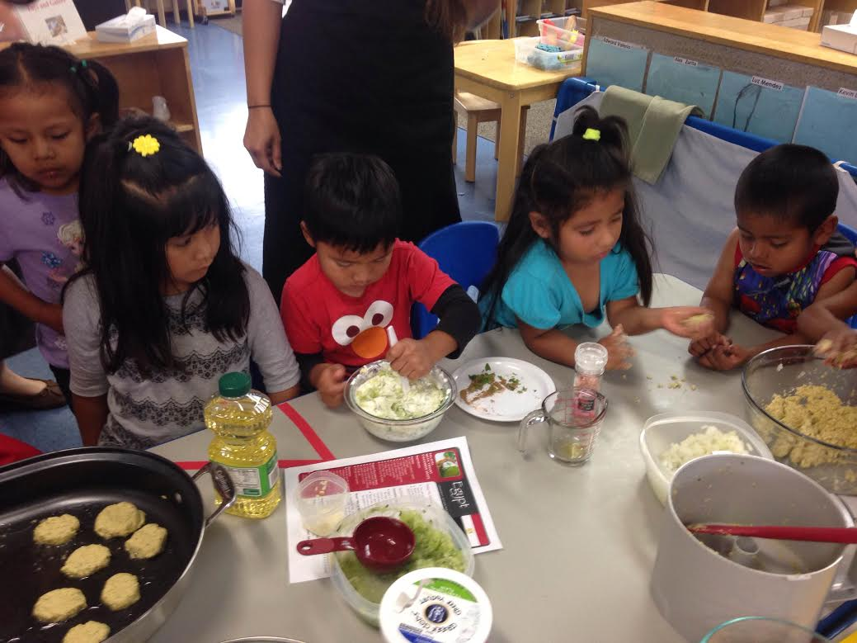
Classroom Experience

Slide 6
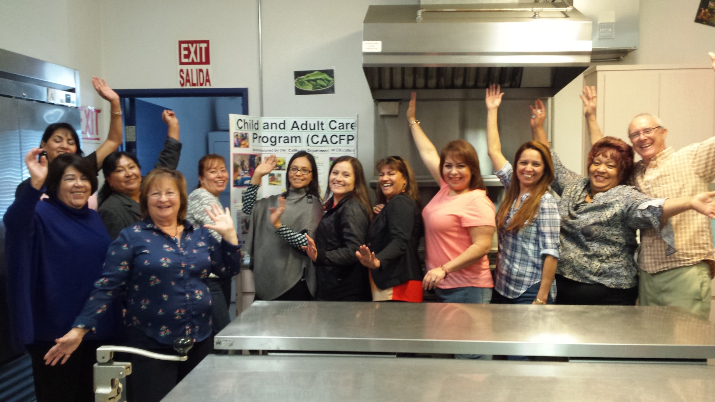
Cook Experience

Slide 7
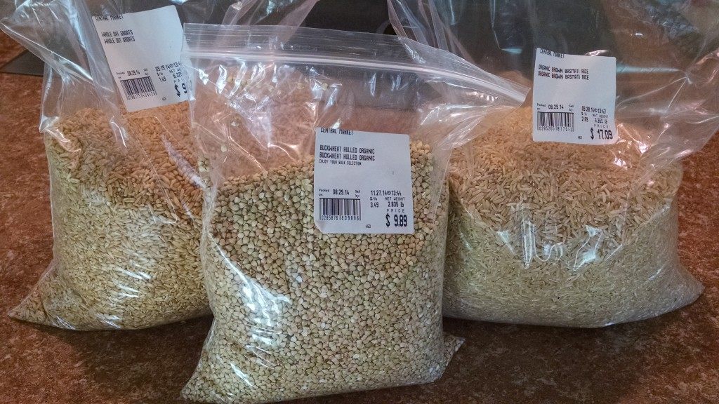
Cost
Blending lower cost familiar whole grains with novelty grains & seeds
Asking for bulk quantity discounts
Centralized purchasing and distributing out to centers

Slide 8

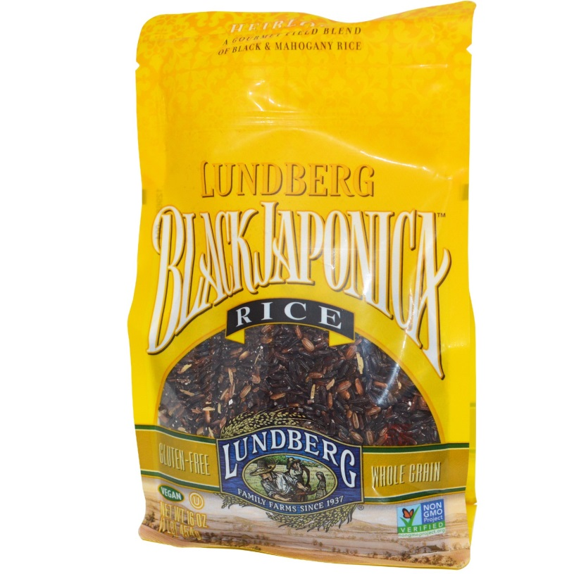
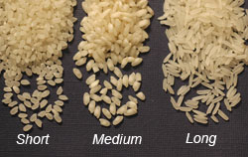
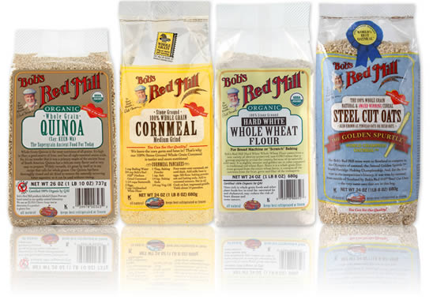

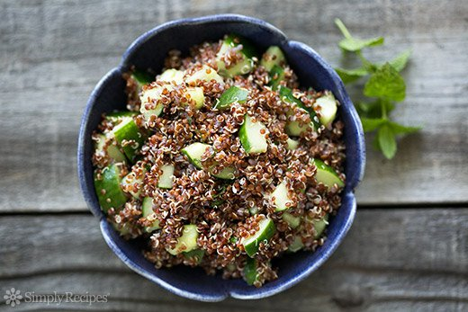
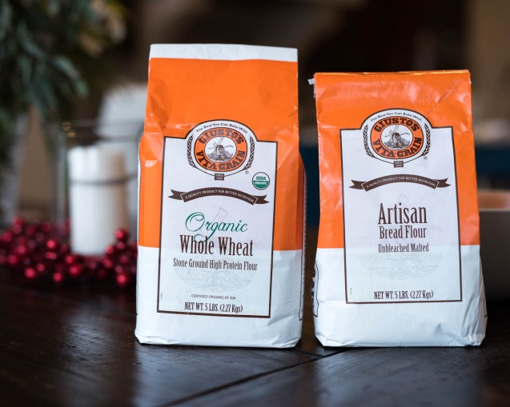
* Photos:
1. image of quinoa on salad
2. image of red rice mixed in with short grain rice.
3. Guisti’s 9-grain mix being held up by Terry
4. Lundberg website
5. Bob’s Red Mill website
6. Pamela’s website
7. Sysco product numbers for whole wheat spaghetti and breadsticks
8. Ak Mak website

Slide 9
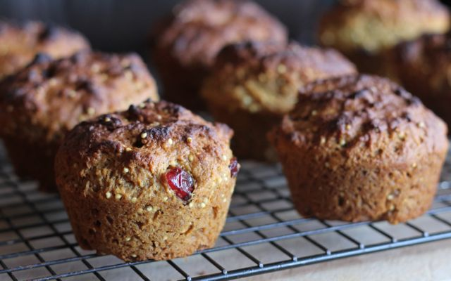
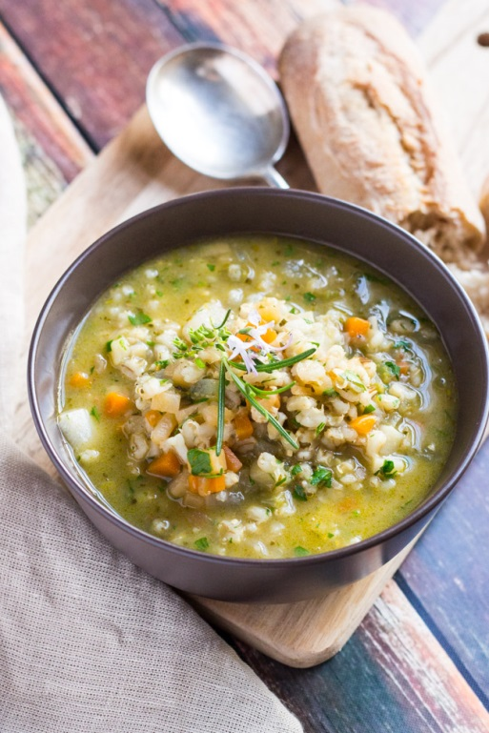

The Challenge of Menu Creativity
Winter soups love grains
Muffins are a good place for seeds and small grains.
Grains as a side dish but served with moisture
Dinner rolls and bread sticks that are whole grain-rich
Whole wheat spaghetti is always loved
**Keep it simple, offer choices, let the children investigate and choose.

Slide 10


