Slide 1
What do we know– what do we want to know?
Recent, current, and future research leading to policy in childcare nutrition
Ken Hecht & Wendi Gosliner
CACFP Roundtable Conference - October 2014

Slide 2
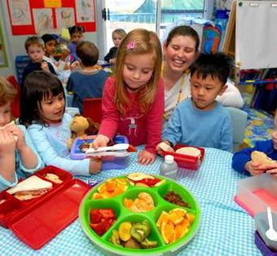
Session overview
What we know
    Game
    Research highlights
    Case Study
What we want to know
    Small discussions
    Large group sharing

Slide 3
“Fact or Fiction”
The rules are simple:
When I say, “Fact or Fiction?”
If it is a Fact stand up
If it is Fiction sit down
University of California, Berkeley
Notes:
Disclaimer: Much of the information is about 2-5 year old children, as this is what’s tracked in NHANES

Slide 4
Early childhood dietary intake is important for long term health.
Fact or Fiction?
Fact: Stand up
Fiction: Sit down
University of California, Berkeley

Slide 5

FACT– STAND UP!

Slide 6
According to the most recent National Health and Nutrition Examination Survey (NHANES) data (2009-2010), less than 30% of 2-5 year olds ate fruit on a given day.
Fact or Fiction?
Fact: Stand up
Fiction: Sit down
University of California, Berkeley

Slide 7
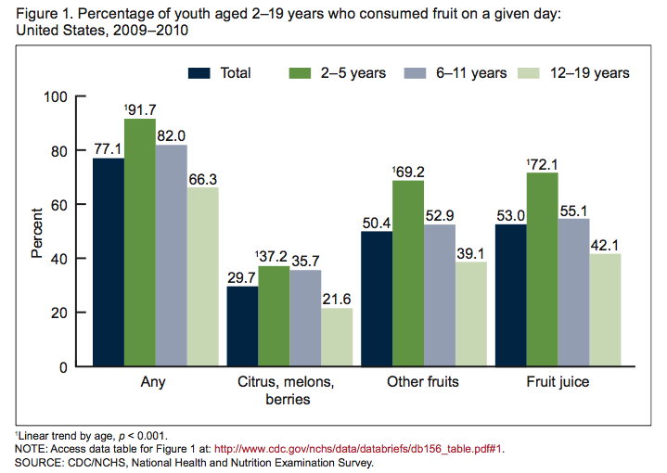
FICTION– SIT DOWN!

Slide 8
According to the most recent NHANES data (2009-2010), on a given day, more 2-5 year old children consumed red and orange vegetables than consumed starchy or dark green or other vegetables
Fact or Fiction?
Fact: Stand up
Fiction: Sit down
University of California, Berkeley

Slide 9
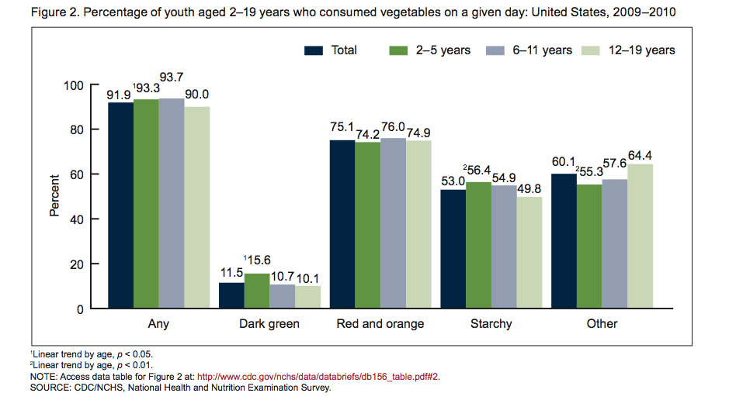
FACT– STAND UP!

Slide 10
The most current national estimates show obesity rates declining among 2-5 year old children
Fact or Fiction?
Fact: Stand up
Fiction: Sit down
University of California, Berkeley

Slide 11
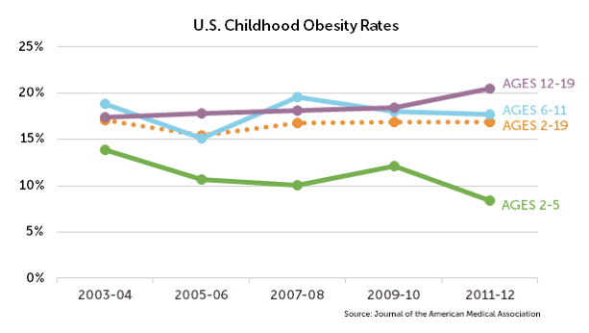
FACT– STAND UP!
Notes:
http://www.rwjf.org/en/research-publications/find-rwjf-research/2013/09/signs-of-progress.html
Rate declined from 14% in ‘03-’04 to 8.4% in 2011-2012

Slide 12
Between 1999-2010, NHANES data show significant decreases in calorie intake among 2-5 year olds
Fact or Fiction?
Fact: Stand up
Fiction: Sit down
University of California, Berkeley

Slide 13
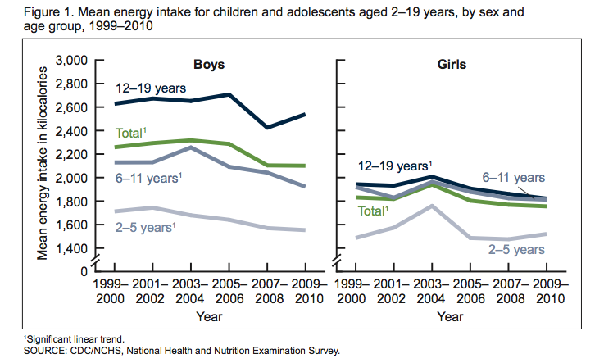
FACT AND FICTION– STAND & SIT!
Notes:
For boys, trend is significant for 2-5 year olds. But not for girls…

Slide 14
Research shows that children participating in CACFP drink more milk and fewer sweetened beverages than those not participating
Fact or Fiction?
Fact: Stand up
Fiction: Sit down
University of California, Berkeley

Slide 15
FACT– STAND UP!
CACFP better than no CACFP:
▪ More milk
▪ Less juice
▪ Less sugary drinks
Room for all to improve:
▪ 1/5 usually whole milk
▪ 1/4 without water at table
Source: Ritchie et al. Childhood Obesity 2012

Slide 16

Grains
WHERE WE WANT TO BE
Total grains: 3-5 oz/day Whole grains: half or more
6.3 oz
< 1 oz
Sources: Kranz et al., AJPH, 2004 & JADA, 2006 (based on CSFII 1994-96, 98).
Notes:
Sources: Kranz et al., AJPH, 2004 & JADA, 2006 (based on CSFII 1994-96, 98).

Slide 17
Fruits and Vegetables
<50% of 2-3 year olds
WHERE WE WANT TO BE
Fruit: 1 to 1.5 cups/day (depending on age) Vegetables: 1 to 1.5 cups/day
<10% of 4-8 year olds
Sources: Kranz et al., AJPH, 2004 & JADA, 2006
(CSFII 1994-96, 98) ; Guenther, JADA, 2006 (NHANES 1999-2000);
Lorson, JADA, 2009 (NHANES 1999-2002)

Slide 18
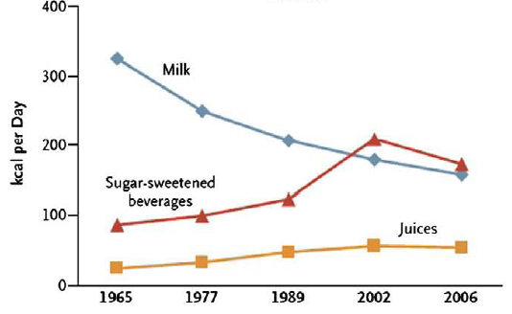
Beverage Intakes in Flux
(Source: Hu & Malik, 2010)
Notes:
Milk: recommend 2 cups/day for young children– ave intake is 1.5 cups; 17% drink no milk.
Figure shown is all children, not just young children
17% of 2-5 yr olds drink no milk on any given day and <10% drink skim or 1% and nearly half consume whole
Per capita intake for children 2-18 yrs from U.S. national surveys
SSBs leading single source of sugar and calories in diets of children (~10% kcals)
Daniels, S.R. Pediatrics, July 2008; vol 122: pp 198-208.
AAP changed its recommendation that weaned babies be fed whole milk until they're 2 years old.
Instead, after weaning, kids at risk of being overweight -- or whose families have a history of obesity, heart disease, or high cholesterol -- should get reduced-fat 2% milk between 12 months and 2 years of age.
Account for at least 1/5 of increase in kcals that has been observed during time period of rapid weight gain in last several decades

Slide 19

Added Sugar
WHERE WE WANT TO BE
< 10% of calories
16%

Slide 20
Healthy Eating in Early Child Education
PROMISING PRACTICES
Educational | Environmental
Comprehensive health education in conjunction with supporting environmental changes
Promotion to increase children’s acceptance of healthy foods Hands-on nutrition activities Simultaneous home and on-site activities | Repeated exposure to healthy foods Increase nutritional quality of foods provided Engage parents in providing healthy foods at home
Notes:
Now that we know the importance of utilizing ECE settings to promote health, we have found that the most effective strategy is to simply combine health education with supporting environmental changes!
For instance, combining social marketing with repeated exposure to healthy foods actually increases the child’s acceptance of those foods.
Some other educational strategies include hands-on nutrition activities like tasting new fruits and vegetables or integrating nutrition messages through simultaneous home and on-site activities. Notice that all of these strategies are a type of active learning.
On the environmental side, interventions such as increasing nutritional quality of food served on site or engaging parents in active participation with child’s healthcare at school can maximize outcomes.

Slide 21
Worksite wellness also shows promise

Slide 22

Physical Education in Child Care
PROMISING PRACTICES
Incorporate physical activity into existing curriculum Provide at least 2 hr/day of physical activity; half in structured activities and half in unstructured free play
PROMISING PRACTICES
Distribute information to parents reflecting child physical activity lessons Educate children to reduce TV/screen time and other sedentary behaviors

Slide 23

TAKE AWAYS
Integrate education with supportive environment
Include both nutrition education and physical education
Build in parent engagement

Slide 24
CACFP Guidelines
Update expected based upon 2010 IOM report, which recommended:
  More fruits, vegetables, and whole grains
  Less fat, sugar, salt
  Increased reimbursement
Child nutrition programs reauthorized 2015
Dietary guidelines update expected 2015

Slide 25
What we’ve learned from changes in school nutrition standards
Most schools meet the new standards
Change is difficult; some schools/districts struggling
Harvard study found that students are eating more fruits and vegetables; no increased waste

Slide 26


Water

Slide 27

Childcare Beverage Policy in California:
Research and the Policy Process

Slide 28
Why Childcare & Why Beverages?
Childcare
Beverages
Nearly 11 million children under age 5
Early habits established
No beverage standards in most childcare
Understudied
Nearly 1 in 4 children start school overweight or obese
On any day, 84% of preschoolers drink sugary drinks
11% total energy intake
Key contributor to excess weight gain

Slide 29
Model to Bridge
Policy to Research Continuum
Quantitative Research
Policy Recommendations
Policy Convening
Stakeholder Interviews
Notes:
Now a proven collaborative model we have used on several policy-relevant research projects. We developed a multi-method approach involving quantitative research to test hypotheses and generate policy-relevant data, qualitative research to be able to provide context to the quantitative findings and tell a compelling story that is grounded in practice, and a policy convening of decision makers in the state and federally to reflect on study findings and propose policy solutions, a sort of ground-up process which we have found generates substantial buy-in by contributing decision makers and their organizations.

Slide 30
2008 Statewide Survey
State licensed childcare databases
>10,000 Centers
>42,000 Daycare homes
Random sample selected
~1400
Surveys administered
~400
Notes:
2008 429 sites 76% centers 71%CACFP
2012 435 sites 69% centers 61%CACFP
Represents data on ~32,000 center and home

Slide 31
Framed Findings to Inform Policy
CACFP better than no CACFP:
▪ More milk
▪ Less juice
▪ Less sugary drinks
Room for all to improve:
▪ 1/5 usually whole milk
▪ 1/4 without water at table
Source: Ritchie et al. Childhood Obesity 2012

Slide 32
2010 California Legislation
Healthy Beverages in Childcare Law (AB 2084)
Milk
Juice
Water
Only 1% or non-fat (2 yrs +)
≤1svg/day
Available at all times
None!
Sugary Drinks
Notes:
STATE LAW IS BROADER THAN any other state law and federal HHFKA for CACFP
First childcare legislation of its kind and is now a model for federal guidance around CACFP
AB 2084 was enacted 9/10 and went into effect 1/1/12
HHFKA, signed December 2010, is similar for water and milk, except applies only to CACFP participants and went into effect no later than October 2011.

Slide 33
Assessed Policy Impact
Beverage changes from 2008 to 2012?
Providers awareness & compliance with law?
Facilitators of beverage change?
1
2
3
Notes:
Did the law result in changes in beverages served in childcare
To what extend were providers aware of and compliant with the new beverage regulation
What were facilitator to any observed beverage changes?

Slide 34
Water Access Improves
*P<0.05
Notes:
All axes show % of sites
Grey is 2008 before law
Orange is 2012 after law
Asterisk indicates that changes were significant (by logistic regression adjusting for site type)

Slide 35
Milk Type Improves
*P<0.05
Notes:
Type of milk usually served

Slide 36
Improvement in Other Beverages

Slide 37

Knowledge of Law
23%
Compliance
Source: Ritchie et al. J Acad Nutr Diet 2014
Notes:
Knowledge of law:
CACFP = 67%
Non-CACFP = 42% (p<.05)
Compliance with law:
CACFP = 30%
Non-CACFP = 12% (p<.05)

Slide 38
Policy Recommendations from Research
Beverage policy in all
childcare guidance
Beverage policy in mandated
provider training
Advocacy for
policy in other states &
federal CACFP revisions
Notes:
From policy convening
Childcare guidance – staff and parent handbooks, parent newsletters and education, menus posted and sent home
At this time, no required training for licensed childcare providers on child nutrition

Slide 39

Second Outcome: 2013 Foundations For Healthy Nutrition in Childcare Act (AB 290)
Previously NO nutrition training required for child care licensure in California
Increases the required health training for new providers to include 1 hour on child nutrition
Notes:
*California’s licensing laws do not require providers to undergo any nutrition training.
*Research shows child care provider training has the greatest impact on the quality of child care programs.
*Amend childcare licensing to increase the required hours of preventive health practices training for newly licensed providers to include one hour on childhood nutrition
* Goes into effect 2016

Slide 40
Value of Partnership:
Researcher Perspective
Ask correct research questions
Cross fertilization of ideas across research and advocacy disciplines
Interpret findings in practice- and policy-oriented ways
Input on development and dissemination of policy brief
Identify stakeholders to get buy-in on policy recommendations at convening so research is best used by the right people
Disseminate to different audiences
Quick translation of research into policy

Slide 41
What do we want to know?

Slide 42
Thank you for your time and attention!
Wendi Gosliner
Center for Weight & Health
UC Berkeley
wgosline@berkeley.edu
Ken Hecht
Nutrition Policy Institute
University of California
kenhecht34@gmail.com

