Slide 1
CACFP Roundtable Conference
October 19, 2016

Slide 2
Early Childhood Obesity Prevention Initiative (ECOPI) – General Overview
Project duration: July 2012 – June 2017
Funding: $41.2 million from First 5 Los Angeles
Target groups: children ages 0-5 and their families
Collaborations: County departments, community-based organizations, child care agencies, research and evaluation, and many others
Strategies: education, skills-building, policy, systems and environmental change efforts to promote improved nutrition, increase physical activity, and reduced obesity
Notes:
*CHLACC program implementation was from July 2012-June 2016; remainder of time dedicated to data analysis and program evaluation

Slide 3
ECOPI Overview - Programs
Early Childhood Obesity Prevention Initiative
(ECOPI)
Choose Health LA Kids
Choose Health LA Child Care
Choose Health LA Moms

Slide 4
Why Focus on Child Care Settings?
40% of 0-5 children in LAC (350,000) spend most of their day in child care.
Among the PHFE WIC population, 19% of 3 and 4 year olds in LA County are overweight.
Observational study by PHFE-WIC and CFPA (2008)¹ demonstrated significant need for improvement in nutrition policies and practices in licensed child care in LA County.
1: WIC report available at: http://cfpa.net/ChildNutrition/ChildCare/CFPAPublications/Gilbert-LA-ChildCareLunchAssessment-2008.pdf
Notes:
Children are taking in a significant portion of their daily calories in child care – therefore child care settings present an opportune environment to establish health eating habits and attitudes early in life as a way to prevent obesity.
The WIC Report noted that there is unanimous consent that child care providers need support, encouragement, resources and incentives to facilitate improving food, beverage and physical activity practices in all child care settings.
Due to the de‐centralized system of child care in Los Angeles County, thousands of independent and unconnected caregivers, centers and programs, and the busy lives providers lead, multiple, overlapping strategies are critical to improve nutrition and activity policies and practices in child care.
Over the past several years significant efforts have been made to improve nutrition and PA in child care environments that I’ll briefly share with you.

Slide 5
Child Care Nutrition - California Legislation
AB 2084 – Healthy beverages in child care (Chaptered 2010)
Standards for beverages in CCC. Maximum of 4 – 6 ounces of 100% fruit juice served. Only low fat milk served. No natural or artificially sweetened beverages. Water accessibility at all times.
AB 290 – Nutrition Training for Providers (Chaptered 2013)
Requires child care providers to complete one hour of nutrition training as a component of licensing.
Notes:
The new CACFP food program will also assist us.
AB 627
In 2009, AB 627 would have established basic nutrition and PA requirements as a condition of licensure. It was vetoed by Governor Schwarzenegger due to concerns about cost and feasibility of implementation by child care providers.
Would have required water to be available throughout the day, allowed only low-fat or non-fat milk to be served to children two years or older, and provided at least one serving of a vegetable at lunch or dinner, unless exempted in writing by a physician.

Slide 6
Choose Health LA Child Care
Program Framework:
Partnership with the county network of Resource and Referral (R&R) agencies
R&Rs provide training, tools and technical assistance to:
Child care centers
Licensed child care homes
License-exempt providers

Slide 7
Choose Health LA Child Care - Key Strategies
Conduct nutrition and physical activity workshops for child care providers that includes a policy component.
Incentivize training participation, offer swag and Cert. of Completion through Gateways to EducationTM program.
Offer on site coaching to reinforce provider learning and evaluate use of training information.
Evaluate trainings, and coaching through surveys and observational assessments
Conduct events for families to promote and encourage healthy nutrition and physical activity habits.

Slide 8
What We Hoped to Accomplish
Improved nutrition and PA practices in child care.
Creation and adoption of nutrition and PA policies in child care.
Providers communicate nutrition and PA policies with parents via newsletters or other venues.
Identified barriers and concerns that child care providers face in efforts to promote good nutrition and active play.
Promotion of, and the benefits of participation in, CACFP.
Reduced prevalence of overweight & obesity among children in child care.
Notes:
Above all we hope to reduce prevalence of overweight and obesity among children in child care
However, through implementation of the LA ROCCS Project SOW we anticipate accomplishing the outcomes described in the slide.
Other Considerations
Project may inform future advocacy efforts such as:
Enhanced licensing regulations with improved Nutrition and Physical Activity standards at the State level
Ways to improve participation in the Child and Adult Care Food Program (CACFP)
While it is not in the current project budget we hope the outcome of this project will influence the development of state standards for nutrition and PA in child care.

Slide 9
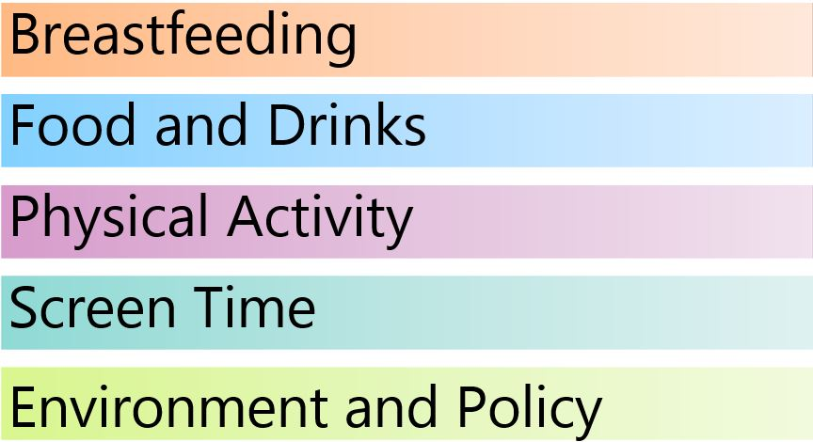
Curriculum for Child Care Providers
Notes:
Talk about the curriculum development

Slide 10
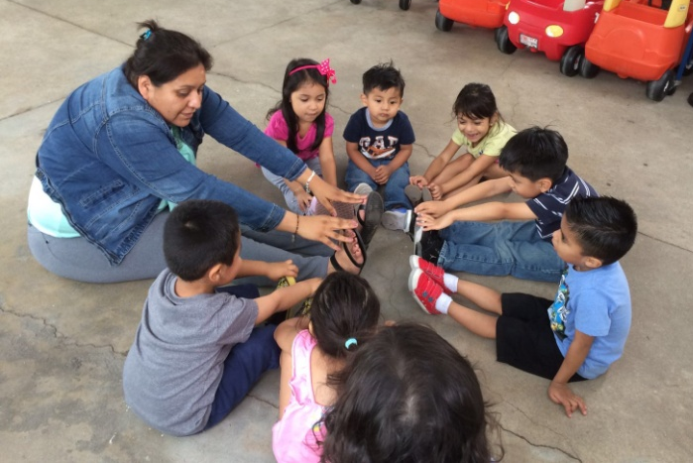
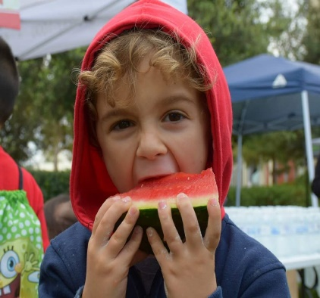
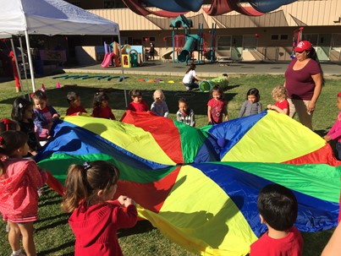
Program Accomplishments

Slide 11
Program Accomplishments
Trained over 5,800 ECE providers
Coached over 2,300 ECE providers
Goal: 5,500 by June 30, 2016
Types of providers trained:
Centers: 68%
Licensed Homes (FCC): 22%
License-Exempt: 10%
Goal: 2,200 by June 30, 2016
Additional 753 second visits given
Notes:
Coaching
This includes follow up 1 visits; there were an additional 753 follow up 2 visits
Goal is to coach 2,300 child care providers by June 30, 2016 which is approximately, 40% of providers trained
A large portion of providers continue to ask for help with ideas for structured physical activity or gardening. Many are also interested in serving meals family style. Coaches provide a variety of physical activity ideas culled from sources like Head Start Body Start, PE Central, and ideas from Jennifer Romack's "On the mmMove" program at Cal State University Northridge.

Slide 12
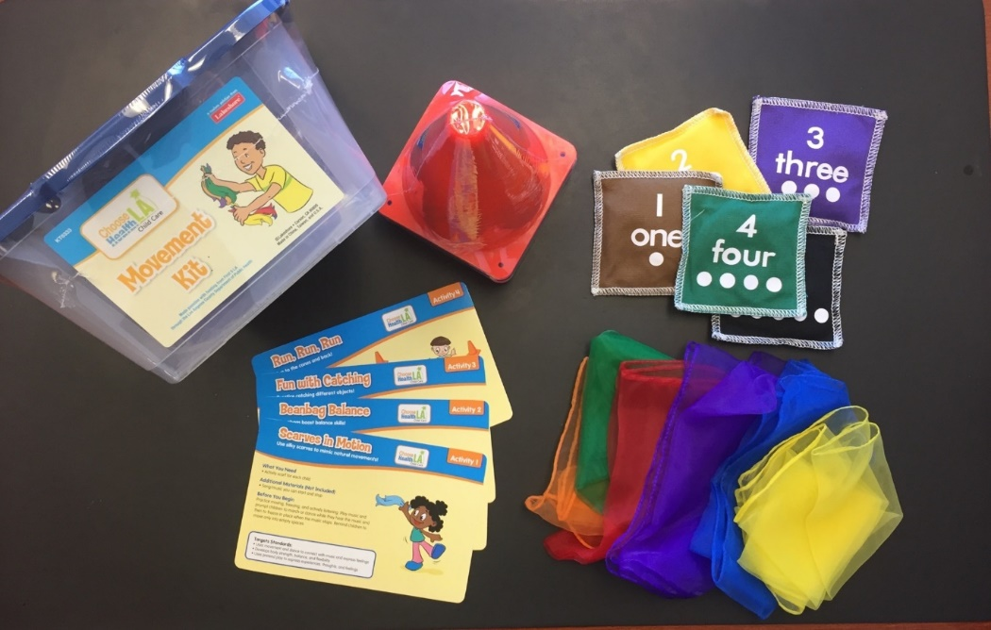
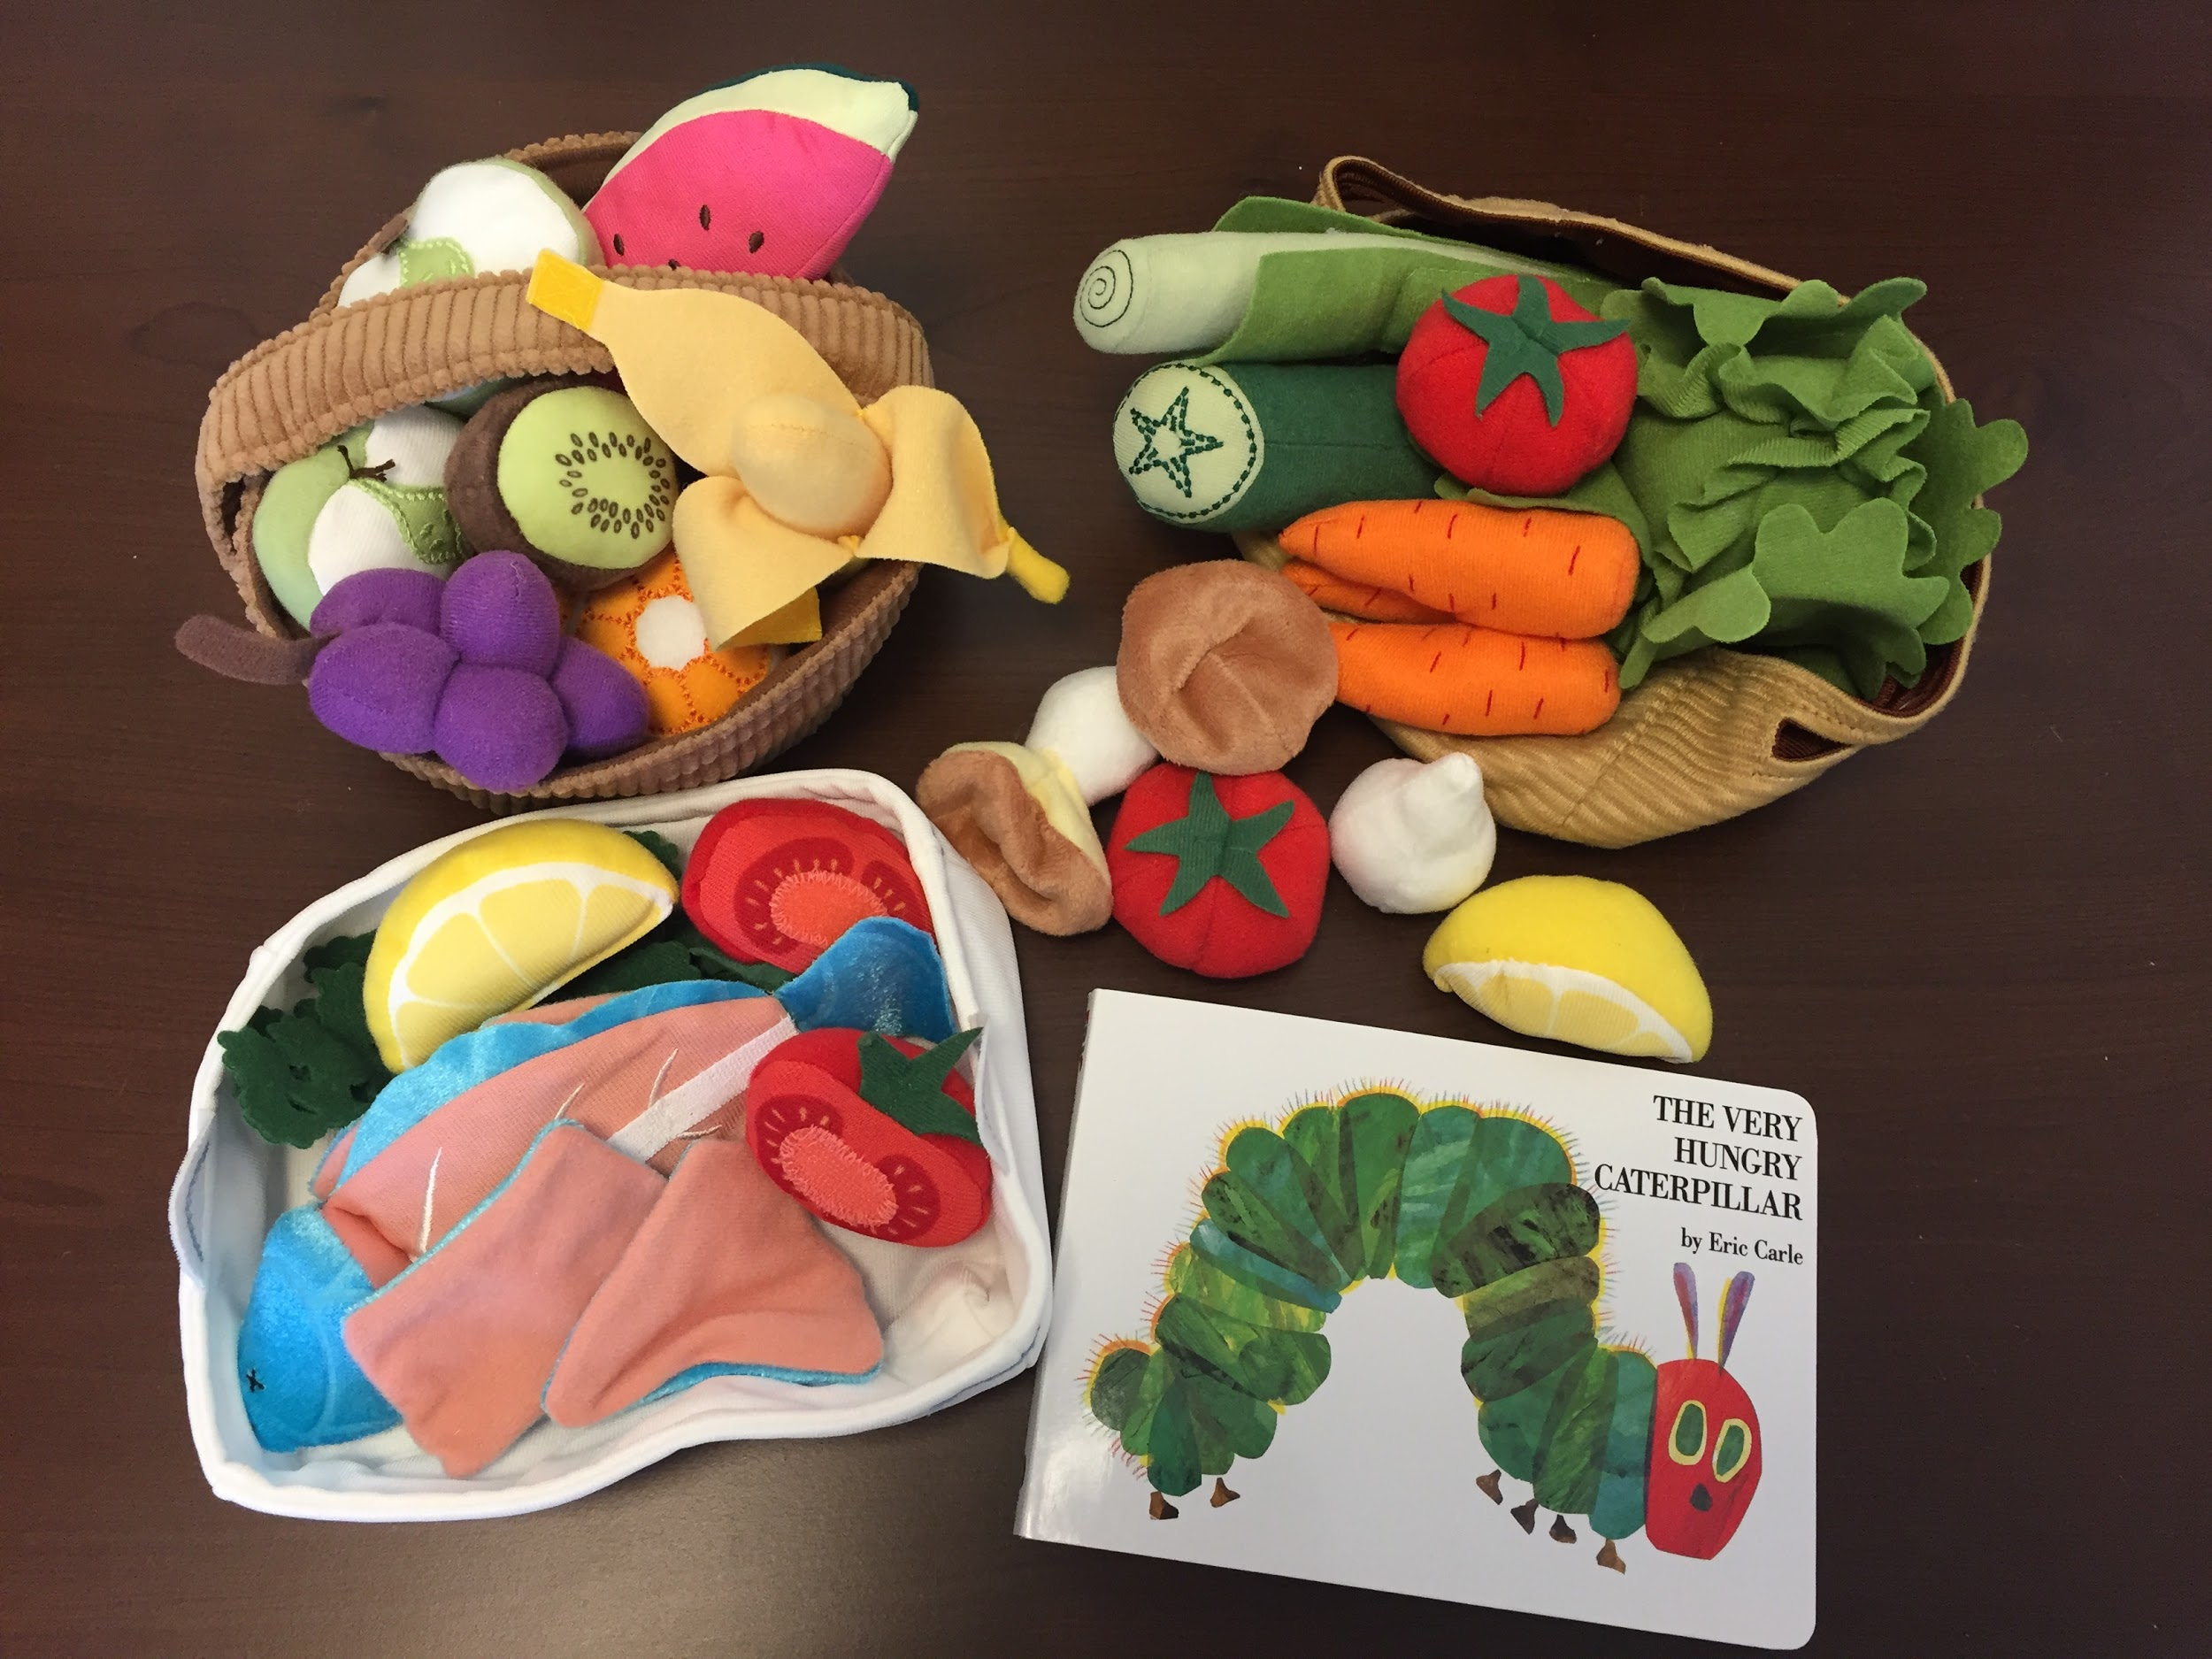
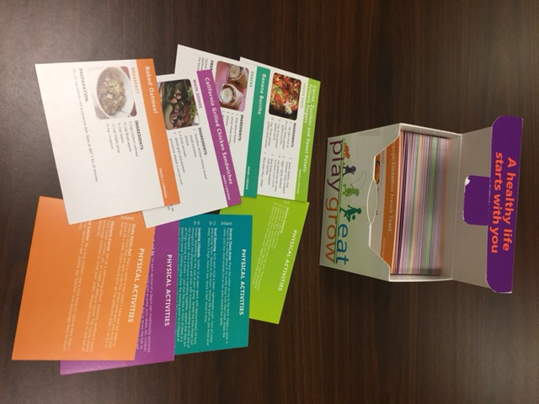
Training & Coaching Incentives
Notes:
Training:
Newsletter
Calendar
Handouts
Posters
Re-usable grocery bags
Portioned dining sets
Coaching:
PA kit
Yoga cards
Recipe cards
Healthy eating kit
Apron
Seeds
Books

Slide 13
Most Common Coaching Requests
Improve Food/Beverages
Menu plan improvements/recipe ideas
Developing new menus for new providers
Assistance with joining the Child and Adult Care Food Program (CACFP)
Healthy cooking activity ideas
Increase Physical Activity
Expanding physical activity ideas
Incorporating more structured play into curriculum
Reduce Screen Time
Doing physical activity instead of screen time
Others
Creating “Healthy Policies”
Starting a garden at child care sites
Developing ideas for classroom container gardening
Family engagement and support

Slide 14
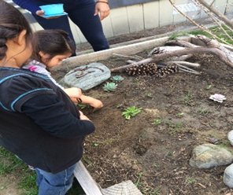
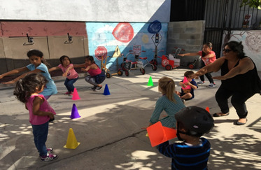
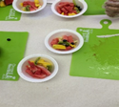
Making Healthy Changes
Gardening
Small steps to big changes
Structured physical activity
VS
Notes:
Using gardening as a way to learn about science and nutrition
Choosing healthier food options; introducing kids AND providers to new foods
Using PA kits

Slide 15
Program Accomplishments
Reached over 16,500 parents through events
Over 34,500 parents given print information
Goal: 7,400 by June 30, 2016
Families participated in activities and given print information
Goal: 20,211 by June 30, 2016
Materials disseminated:
Nutrition and PA handouts
CHLA CC Newsletters

Slide 16
Programmatic Changes Along the Way
Created a 1-hour version of the workshop for centers, tailored for Head Start and School District sites.
Scheduled center trainings during staff development time.
Marketed the workshops specifically for license-exempt providers who may want to become licensed.
Continued to create new and exciting giveaways.
Outreach strategies constantly evolved.

Slide 17
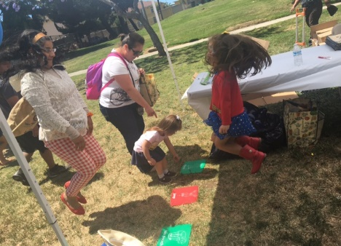
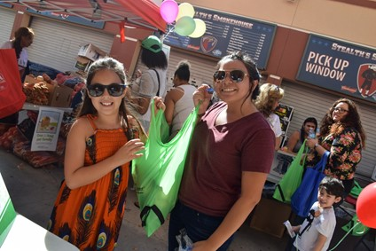
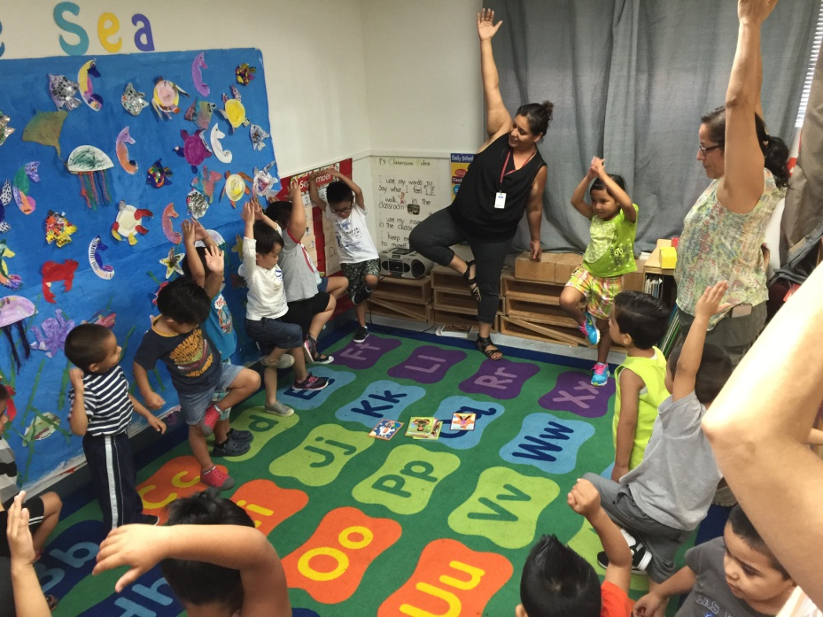
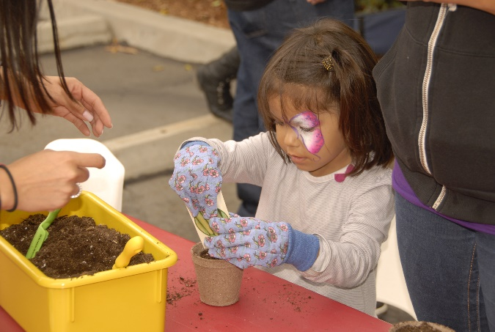
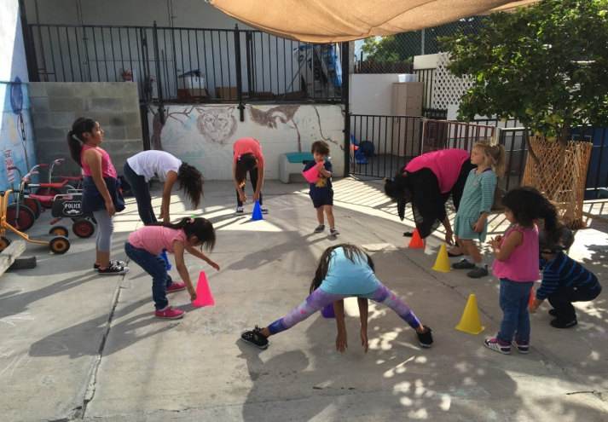
Program Evaluation

Slide 18
Evaluation Methods
Training and Coaching Satisfaction Surveys
Focus Groups
Observational Assessments
Policies and Practices Self-Assessment Questionnaire
Notes:
Mixed methods evaluation employing different data collection methods (quantitative and qualitative and self-reported and observational)
Training and Coaching Satisfaction surveys
Focus groups
Observational assessments
Baseline and 6 month assessments conducted in a sample of child care facilities to measure objectively how nutrition and/or physical activity policies, practices, and environments are impacted as a result of the program.
Policies and Practices Self-Assessment Questionnaire
preliminary results from the baseline and follow up measure the impact of training and coaching.
Policies and Practices Survey
They key purpose of this evaluation tool is to determine if policies and practices at child care sites are changed as a result of CHLA CC. Both groups of providers who received only training and those who received both training and coaching are included. The questionnaire does not ask for names, as to encourage honest responses, though the paper is coded with the Gateways ID number so that we may analyze the results based on various differences. This questionnaire is mailed to providers at their work address after attendance at a CHLA CC workshop using a reflective baseline method. A $10 gift card to Target is offered as incentive for completing the questionnaire. If completed, a second “post” questionnaire is mailed 4-6 months later. Preliminary results will be available in the next month or so.
On-Site Observations
To complement the policies and practices survey with a more objective measure we are conducting on-site observations of child care sites (centers and FCCs) to determine the effectiveness of the project. As funds are limited, on-site observations will only be conducted for sites receiving both training and coaching to limit the number of variables in the evaluation. Sites were recruited for full participation before attending a CHLA CC training to allow for a true baseline observation. The goal for year 3 was 45 sites with another 30 sites in year 4. Recruitment is being handled by the Child Care Alliance office and DPH.

Slide 19
Training and Coaching Satisfaction Surveys
Training Satisfaction survey given to every participant at the end of each workshop
Coaching Satisfaction survey given at the end of last coaching session
Data from every 4th survey was entered and analyzed at the end of each fiscal year
Notes:
Training:
2013-2014 (n=415)
2014-2015 (n= 553)
2015-2016 (n=367)
TOTAL: n= 1,335, out of 5,800 trained (23%)
Coaching:
N for 2013-2014=101
N for 2014-2015=149
N for 2015-2016=174
Total N: 424 out of 2,323 coached (18%)

Slide 20
Training Satisfaction Survey Results
Types of Providers Reached, by Program Year
Notes:
Child Care Center
Family Child Care Center
License-Exempt (inc. Family, Friend, Neighbor)
Other (students, serving in support role, no response)

Slide 21
Training Satisfaction Survey Results
Ages of Children Served, by Program Year
Notes:
Participants were also asked about the ages of children they care for, and are asked to select all that apply. Many family child care providers care for children that are a variety of ages; therefore, it was very common to see providers select multiple categories, and sometimes all three. The higher percentage of children served who are under 3 years and over 6 years of age in Year 4 (2015-2016) is most likely due to a greater number of FCC’s reached compared to the number of centers reached during that year (see Figure 1).

Slide 22
Training Satisfaction Survey Results
Providers who Agree or Strongly Agree with Following Statements, by Program Year:
Notes:
Providers who Agree or Strongly Agree with Following Statements:
Because of training, I plan to do new things with the children I serve
The training has increased my knowledge about the topic presented
The training was informative
The training presented helpful ideas I’ll be able to use

Slide 23
Coaching Satisfaction Survey Results
Main Goal Area for Coaching, by Program Year
Notes:
Main goal area consistently PA.
Across all 3 years is the breakdown of all participants receiving coaching, not only the ones who completed a survey.
In 2013-2014, Participants were allowed to select multiple goals, hence the % adding up to over 100. Years 14-15 and 15-16, participants selected a main goal to work on. the large number of “unknown” in year 3 represents participants who selected multiple goals (usually PA and food/beverage).

Slide 24
Coaching Satisfaction Survey Summary
Participants reporting a need for more resources to make changes in their programs
Program Year | Need Additional Resources? (Yes) | More Printed Materials | More Coaching Sessions | More Equipment | Other
2013-2014 | 52.5% | 56.7% | 22.6% | 62.3% | 17.0%
2014-2015 | 66.2% | 44.1% | 35.5% | 56.9% | 11.8%
2015-2016 | 49.4% | 52.9% | 28.7% | 64.4% | 12.6%
All 3 Years | 56.0% | 50.1% | 30.2% | 60.8% | 13.2%
Notes:
56% of participants across all 3 years of the program indicated they needed additional resources to make changes in their programs. Consistently, the most requested resource were equipment and more printed materials.

Slide 25
Training Satisfaction Survey – Comments
The best thing about this training was…
“New activities to do in the classroom – and for my own family.”
“The encouragement to develop a successful child care.”
“The DANCING! I’ve never danced.”

Slide 26
Coaching Satisfaction Survey – Comments
The best thing about this program was…
“I have done so many things with my daycare. We planted a big garden, we do art, we cook together, we play all kinds of physical activities. We sit down all together and talk about the things they like and don’t like. It’s so much more fun now.”
“The music and movement box she gave us helps our children with our mini Olympics in June and also with our DRDPs.”

Slide 27
Focus Groups Background
Purpose
Impact
Successes and challenges
Resources
Engaging parents and providers
Methods & Participants:
Eligibility (English/Spanish, Choose Health LA Child Care training and coaching, serve children 0-5)
7 focus groups (6-10 each)
4 English; 3 Spanish
54 participants (Female, Latino, 5+ years in business)
$40 gift card & light meal

Slide 28
Focus Groups Results
Prominent themes | Example comments
Participating increased knowledge and changed own health behavior | I’m more aware. I read the labels when I get something.
Modeling helped change children’s health | Our children have become more physical because the staff has now started doing more movement with them and engaging with them in the yard.
Children’s health improved | [Child name] is a child who didn’t like fruit. Now he eats bananas, and he eats peaches…that’s a success.
Hard to change some families eating habits | We’ve got a healthy breakfast ready and waiting. Dad will come in and go, “He just had all of this doughnuts. All he needs is a little swig of milk.”
Inclement weather as barriers to physical activity | Sometimes I hear teachers saying, “Oh, it’s too cold” when we have the rain during the winter season. Or, “it’s too windy or too hot.”

Slide 29
Focus Groups Results
Prominent themes | Example comments
Resources helped open dialogue with families | We have a parent newsletter [incorporated training information] where they get to read. I focus in on a particular food and how parents can help at home in having kids eat certain foods.
Written policies reinforced health message/s | As part of our policy that if, say for instance, we have celebration and the parents want to do a birthday party or something, as long as it’s healthy foods.
Multiple strategies to incorporate nutritious foods in meals/snacks | Our curriculum introduces new food all the time. They are experimenting, they are doing actual projects involving food and that really helps them.
Provide complimentary training and coaching for parents | I would like to have a workshop where the parents get involved so they can see what it is we’re doing and why we do policies around certain things.
More and regular coaching and networking opportunities desired | Provide different options for folks depending on their time commitment.

Slide 30
Observational Assessments Background
Purpose
Changes in nutrition and/or physical activity
Barriers and facilitators to promoting healthful changes
Assessment Focus
Foods served
Staff behavior
Physical activity opportunities
Methods & Participants
Purposive sampling & Pretest-Posttest design
Eligible providers (not Head Start, serves lunch, serves 3-5 year old)
65 matched pairs (31 centers; 34 homes) – owners or administrators
$100 gift card

Slide 31
Observational Assessments Results
Food environment:
No change – water access
No change – nutrition materials
*Significant increase – produce growing area
Staff behavior during lunch:
No change – most sat with children
*Significant increase – times encouraged new/healthy foods
No change – modelled eating same food
*p<0.05

Slide 32
Observational Assessments Results
Children’s behavior during lunch:
No change – lunch time
No change – clean plate
*Significant increase – family style + children serve
Foods offered:
No change – most served unsweetened fruit and non-fried vegetables
*Significant increase – dark colored vegetables
*Significant increase – grains
No change – except 1 at follow-up, no pre-packaged foods or sweets
*p<0.05

Slide 33
Observational Assessments Results
Physical activity environment:
No change – most physical activity outdoors
*Significant increase – physical activity materials
No change – except 1 at follow-up, no screen use during physical activity
Staff behavior during physical activity:
*Significant increase – participate in structured physical activity
*Significant decrease – participate in unstructured physical activity
*Significant increase – prompts to increase physical activity
*p<0.05

Slide 34
Observational Assessments Results
Children’s behavior during physical activity:
*Significant increase – structured physical activity
*Significant decrease – optional structured physical activity
*Significant decrease – unstructured physical activity minutes
Challenges:
Parent motivation – need training/resources for parents
Limited resources for staff (money, time, information, equipment, space)
Keeping children engaged in structured activity
*p<0.05

Slide 35
Observational Assessments Results
Recommendations:
Increase capacity of providers to engage staff and parents
More and regular coaching and networking opportunities desired
More interactive and skill-based learning opportunities

Slide 36
Policies and Practices Survey Background
Self-assessment based on the C.H.O.I.C.E. Toolkit, Self-Assessment Questionnaire, and NAP SACC
Participants were mailed a baseline and follow-up survey
Received 602 matched pairs
Notes:
CHOICE – developed by the Contra Costa Child Care Council and NAP SACC, created by the University of North Carolina t Chapel Hill.
Baseline survey was sent about 40 days after the training and follow-up after then. The follow-up survey had to have been received between 4-6 months after the participant attended a training to be included in the analyses.
Because the license-exempt group was so small, it was not included in the analyses.

Slide 37
Policies and Practices Survey Background
Surveys analyzed:
Type of Providers
Center - 77.9%
Family Child Care - 22.1%
Primary Language
English - 73.4%
Spanish - 26.6%
Coaching
Yes - 55.0%
No – 45%

Slide 38
Policies and Practices Results
Broad impact vs. deep impact
Ceiling effect
85% of participants indicated coaching was helpful
73% reported parents have responded generally positively to rules or guidelines about healthy practices
35% of providers saw increase in demand for their business
Notes:
Broad – goal to reach the greatest amount of people, deep- provide greater depth, more intensive services to smaller group; Goal of public health is to make greatest impact possible reaching many providers and impacting many children and families.
Ceiling effect – many providers may have started in the program with a high level of knowledge; therefore, when testing for changes between pre- and post- detecting differences more difficult if knowledge or practices were already high.
73% is of those who indicated they have shared rules or guidelines about healthy practices with parents.

Slide 39
Policies and Practices Results
Breastfeeding:
Spanish-speaking participants more prepared to make changes than English-speaking participants
Screen time:
English-speakers more prepared than Spanish speakers to make changes around screen time; note that quality of screen time is not assessed
Parent engagement:
67% of providers reported more materials for parents would be helpful for creating healthy practices and guidelines
Notes:
How to engage parents, how to involve them, provide them with resources for activities to do at home was a theme that came across all components of the evaluation (training survey, coaching satisfaction survey, focus groups, policies and practices survey)

Slide 40
Policies and Practices Results
Physical Activity (PA):
Significant increases in:
Parents receive written physical activity policy upon enrollment
Children have at least 60 minutes structured or teacher-led physical activity time
Information is provided to parents about their child’s physical activity while in child care
Staff participate in physical activities with children
Parents are provided information that encourages physical activity at home
Notes:
There were differences between centers and fccs at baseline on 6 items:
However, at follow-up there no differences in 4 of those areas. 2 areas still showed fccs doing less of: ensuring children with special needs have their needs met, meals and snacks are served at routine times.

Slide 41
Policies and Practices Results
Nutrition:
Significant increases in:
Parents receive written nutrition policies upon enrollment
Parents are given information about what their children are eating
Parents are given information about what their children are offered (menus)
Children decide which foods they will eat from the foods offered
Children serve themselves from serving dishes at meal time
Foods are served that reflect the ethnicity and cultures of the children in the centers/home
Special occasions and holidays are celebrated with healthy foods or with non-food treats
Parents are provided information on child nutrition and healthy eating
Notes:
FCCs more likely to serve snacks and dinner than CCCs
Serving flavored milk showed the greatest positive change:
This question asked participants to report how often they serve flavored or sweetened milk- 1 time a day or more, 2-3 times per week, 1 time per week or less, Never. Of those who had room for growth, that is, those who were serving flavored or sweetened milk with any frequency (except never), 62% made a positive change. 62% served less flavored or sweetened milk at follow-up than they did at baseline. This was a significant change.

Slide 42
Policies and Practices Results
CACFP participation:
Over 70% of providers surveyed participate
Self-efficacy (preparedness):
90% of providers feel prepared to make changes in food and beverage practices
94.4% of providers feel prepared in doing teacher-led physical activity
Providers feel least prepared to address breastfeeding
Notes:
Self-efficacy – 53.8% feel prepared to make changes in Breast feeding practices

Slide 43
Policies and Practices Results
Challenges:
Most frequently cited:
Lack of support from parents
Not enough resources to make changes
Providers who received coaching reported more challenges at baseline and follow-up than those who did not
Center-based providers reported more challenges at follow-up than family child care providers
Notes:
Challenges: 34.7% reported lack of support from parents; 33.4% not enough resources to make changes
Coached experienced more challenges – Those who were experiencing more challenges in taking steps towards creating healthy practices or routines and in creating written rules or guidelines may self-select into the coaching group. It’s possible that those who were facing more challenges felt they needed more support and were more likely to want to receive coaching than those who experienced less challenges.
Center-based more challenges: selected from factors that may be less of a challenge for fccs: e.g. lack of support from management/leadership staff, lack of support from other child care staff. There may not have been a difference at baseline because they didn’t start experiencing these challenges until they started trying to make changes at follow-up.

Slide 44
Lessons Learned from Program Implementation and Evaluation
Providers need more resources
for their sites
for parents
Providers need & want more training, especially around family engagement, as well as training for parents
FCC’s are fertile ground for making healthy changes
Further intervention regarding
breastfeeding practices needed
Need LE-specific trainings
Notes:
Across all evaluation methods, providers reported needing more resources and wanted to learn ways to engage parents. Evaluation also found that FCC’s are fertile ground for making healthy changes as they are typically more autonomous in decision-making, and many serve more meals and snacks than centers. [continue…]
Our target was that out of all providers trained, 10% would be license-exempt providers. They don't really consider themselves providers (more like neighbors or grandmas or friends) and could benefit from having training that is tailored specifically for them. When LEs did attend our training, we then sent them the CHLA Kids flyer for 6-week healthy parenting workshop – as of last month, 400 LEs had attended (identified themselves as “caring for one or more children in addition to their own at least 3 days a week.”

Slide 45
What We DID Accomplish
Improved nutrition and PA practices in child care.
Creation and adoption of nutrition and PA policies in child care.
Providers communicate nutrition and PA policies with parents via newsletters or other venues.
Identified barriers and concerns that child care providers face in efforts to promote good nutrition and active play.
Promotion of, and the benefits of participation in, CACFP.
Reduced prevalence of overweight & obesity among children in child care.
?
Notes:
In addition, we have created partnerships locally, statewide and nationally, and have set a precedent for Public Health to work with child care professionals.
We are also working with our partner, Child Care Resource Center, to put our entire curriculum online as videos that LAC providers can watch for credit. Look for this in 2017. We will also have provider highlight videos coming out at the end of this year.
Finally, we built momentum. Our work is not done but at least agencies are talking about these issues and perhaps more parents are demanding certain standards.

Slide 46
Narrative from the Field
This program has changed my life. Through the program I learned about portions, family-style eating, and physical activity – lessons I took home to my family too. My son has struggled with his weight for a long time and was unhappy and never wanted to go out. But since making changes at home, he lost 15 pounds, seems much happier, and displays greater self-confidence. Thank you. – CHLA CC participant*
“[CHLA CC] helped me attain my dream job, and I don't think anyone enjoyed this program as much as I did. It gave me the opportunity to inspire, motivate, create, and learn to become an efficient public speaker…I feel it was very positive for the children and families it reached, and that it provided more awareness about what we can all do to raise healthier children. I also feel it was a wonderful way of reaching out to providers, by giving them support and motivation, as they give so much of themselves for the children and families they serve.” – CHLA CC coach
*Edited for length and clarity

Slide 47
Special Thanks!
Choose Health LA Child Care Coaches:
Mariah Johnson – CCRC
Sharlout Golbari – Connections
Adriana Sanchez – Crystal Stairs
Sophia Gonzalez – MAOF
Armida Rosario – Options
Maria Ponce – Pathways
Dell Harris & Martha Arreguin – Pomona
Notes:
Holiday photo!

Slide 48
Contact Information
Helen O’Connor, MPH
Health Program Analyst
Los Angeles County Department of Public Health
(213) 639-6442 hoconnor@ph.lacounty.gov
Jeremiah Garza, PhD, MPH, MA
Associate
Sarah Samuels Center for Public Health Research & Evaluation
(510) 271-6799
jeremiah@samuelscenter.com

