Slide 1

Policy Opportunities to Elevate Nutrition Standards for Family Child Care Home Providers (FCCH’s) in CA
CCFP 24th Annual Roundtable Conference
October 26, 2015
Hector Gutierrez
Nutrition Policy Advocate, California Food Policy Advocates (CFPA)
Janet Scully
Program Manager, Los Angeles County Department of Public Health
Maternal, Child and Adolescent Health Programs

Slide 2
Goal of Today’s Presentation
Discuss challenges and opportunities for FCCHs to serve nutritious food for children in care
Identify policy opportunities to elevate and align nutrition standards for FCCHs providers that do not participate in the Child and Adult Care Food Program.
Articulate advocacy opportunities to improve the nutrition environment for licensed FCCHs

Slide 3
Presentation Outline
Part I:
  Give Context and Frame FCCH’s Landscape
  Present CFPA Work on Child Care
    David and Lucile Packard Foundation Nutrition Standard Pilot
    Kaiser Southern California Child Care Survey
Part II:
  Kaiser South Preliminary Data Results
  Next steps
Part III:
  Choose Health LA Childcare
  Data Findings
Part IV:
  Discuss Policy Opportunities to Improve Child Care Food Environments

Slide 4

We are a statewide policy and advocacy organization dedicated to improving the health and well being of low income Californians by increasing their access to nutritious, affordable food.
Notes:
Elyse Homel Vitale – Nutrition Policy Advocate at CFPA
CFPA is a statewide policy and advocacy organization dedicated to improving the health and well being of low income Californians by increasing their access to nutritious, affordable food.
CFPA has been around for 20+ years and since that time, we've employed a variety of strategies to develop and implement policies that move the needle on anti-hunger and nutrition issues.
We primarily focus on the federal nutrition programs, which we recognize have the potential to address the scope and scale of challenges associated with poor nutrition across our state. We work to optimize the reach and benefits of the federal nutrition programs.
I lead the CC Nutrition Advocacy and we focus on the child and adult care food program and then more broadly the child care nutrition environment.

Slide 5

The Opportunity with FCCH’s
Approximately 33,000 licensed FCCH’s in CA
The Child and Adult Care Food Program (CACFP) provides meals and snacks to nearly a half million children in child care centers, after-school settings, and family child care homes (FCCHs) in California each day.
In total, the CACFP meal pattern shapes the types of foods served to approximately 833,000 kids in California each day

Slide 6

CFPA Child Care Work
AB 2084: The Healthy Beverages in Child Care Act
AB 290: Require one hour of Childhood Nutrition Training
Advocacy & Policy
  Elevate Nutrition Standards in Child Adult Care Food Program (CACFP) & Other Federal Nutrition Programs
Current Work
  Packard Pilot to test Nutrition Standards for Family Child Care Homes
  Kaiser Southern California Child Care Survey & Convening
Notes:
AB 2084, the Healthy Beverages in Child Care Act, took effect January 1, 2012 and applies to all licensed child care homes and centers in California. The new healthy beverages standards require:
Clean and safe drinking water must be readily available throughout the day, including at all meal, snack, and play times.
Only fat-free or low-fat (1%) unsweetened, plain milk for children two years of age or older.
No more than one serving per day of 100 percent juice.
Beverages with added sweeteners, either natural or artificial, are prohibited (not including infant formula or complete balanced nutritional products designed for children)

Slide 7

Family Child Care Nutrition Standards
18-month Packard Project
Pilot based on science-based nutrition standards
Rigorous, small-scale testing of the proposed nutrition standards
Evaluation and interpretation of the findings
Policy development, refinement, and promotion.

Slide 8

Packard Advisory Group
Develop policy recommendations that improve the lives of kids and elevate the quality of care, without negatively impacting the viability of the FCCH workforce
Advisory Group
  Researchers, CACFP sponsors, provider representatives, health advocates, and other relevant stakeholders
  Advise on the necessary elements of a nutrition standard to be pilot tested

Slide 9
Scientific Advisory committee
Advisory Members
Facilitators
Susie Nanney, PhD, MPH, RD (U Minn)
Sara Neelon, PhD (John Hopkins)
Kathryn Henderson, PhD (formerly Yale)
Karen Cullen, DrPH (Baylor)
Elsie Taveras, MD (Harvard)
Jane Heinig, PhD (UC Davis)
Mary Story, PhD, RD (Duke)
Donna Johnson, PhD (UW)
Shannon Whaley, PhD (PHFE-WIC)
Angela Odoms-Young, PhD (UIC)
Dianne Stanton Ward, PhD (UNC)
Lorrene Ritchie, PhD, RD (NPI)
Lauren Au, PhD, RD (NPI)
Ken Hecht, JD (NPI)
Elyse Homel Vitale, MPH (CFPA)
Tracey Patterson, MPH (CFPA)
Tia Shimada, MPH (CFPA)
Funder:
Linda Shak (The David and Lucile Packard Foundation)

Slide 10

Family Child Care Nutrition Standards
Kaiser Southern California
Conduct web and phone-based surveys with FCCH providers to assess their capacity to provide healthful, nutritious meals and snacks
Find and disseminate case studies that highlight successful models of serving healthful food in Southern California Family Child Care settings serving low-income children.
Hold a policy convening to examine early childhood nutrition needs and strategies for improving nutrition in family care settings

Slide 11
Kaiser Southern California Child Care Survey
Geography:
  Kern | Los Angeles | San Diego | San Bernardino | Riverside
Survey Design
  Available in Spanish & English
  Survey could have been take over the phone, online, or mailed in
Dissemination
  R&R Agencies disseminated via email systems and word of mouth
Responses from FCCH’s
  Started the Survey N=302 | Completed Entire Survey N=268

Slide 12

Part II: CFPA Kaiser and Packard Findings

Slide 13

Packard
Scientific Advisory
Nutritionally Ideal Infant Practices for Family Child Care Homes:
Recommendations for 0-up to 12 months old

Slide 14

Packard
Scientific Advisory
Nutritionally Ideal Infant Practices for Family Child Care Homes:
Recommendations for 1-to-18-year-olds

Slide 15

Packard
Scientific Advisory Cont.

Slide 16

FCCH taking our Kaiser Survey
Total Reponses: N=302 | Completed Surveys: N=268
  Small Licensed Family Child Care Home: 57%
  Large Licensed Family Child Care Home: 43%
How Long have FCCH’s proving Care?
  Less than 1 year: 6%
  1-3 years: 17%
  4-6 years: 8%
  7-9 years: 14%
  More than 10 years: 55%

Slide 17
Notes:
Total Reponses: N= 302 (English: 260 | Spanish: 42)
Yes N= 182 | Percent= 60%
No N=120 | Percent= 40%

Slide 18
Notes:
Total Reponses: N=302 (English: 260 | Spanish: 42)
Never: N= 44 | Percent= 15%
Less than 1 time per year: N= 53 | Percent=18%
1 time per year: N=128 | Percent= 42%
2 or more times per year: 77 | Percent= 25%

Slide 19
Notes:
Total Responses: 302 (English: 260 | Spanish: 42)
Never: N= 40 | Percent= 13%
Less than 1 time per year: N= 18 | Percent= 6%
1 time per year: N=40 | Percent= 13%
2 or more times per year: N=204 | Percent= 67%

Slide 21
Notes:
Total Responses: 268 (English: 230 | Spanish: 38)
Yes: N= 240 | Percent= 90%
No: N= 28 | Percent 10%

Slide 22
Notes:
Total Responses: N=342 (English: 290 | Spanish: 52) (Check all that apply)
CACFP: N= 180| Percent= 53%
NAP SACC Best Practices: N= 7 | Percent= 2%
Caring for our Children: N= 33 | Percent= 10%
MyPlate: N= 110 | Percent= 32%
Nemours: N= 12 | Percent= 4%

Slide 23
Notes:
Total Responses: N=268 (English: 230 | Spanish: 38)
Wholesale Stores N= 126 | Percent= 47%
National Retail Grocery Stores N= 110 | Percent= 41%
Independent Grocery Store N= 13 | Percent= 5%
Convenience Stores N= 6 | Percent= 2%
Farmers Markets: N= 13 | Percent= 5%

Slide 24
Notes:
Total Responses: N=268 (English: 230 | Spanish: 38)
$0 to $50.00 N= 6 | Percent= 3%
51 to $100: N= 12 | Percent= 4%
$101 to $150.00 N= 14 | Percent= 5%
$151 to $250 N= 40 | Percent= 15%
$251 to $300: N= 39 | Percent= 15%
Over $350.00 N= 157 | Percent= 58%

Slide 25
Notes:
A. Breakfast
Total Responses N= 256
Yes: N=248 | Percent= 97% No: N=8 | Percent=3%
B. Morning Snack
Total Responses N= 242
Yes: N=214 | Percent= 88% No: N=28 | Percent=12%
C. Lunch
Total Responses N= 263
Yes: N=257 | Percent= 98% No: N=6 | Percent=2%
D. Afternoon Snack
Total Responses N= 259
Yes: N=255 | Percent= 98% No: N=4 | Percent=2%
E. Dinner/Supper
Total Responses N= 193
Yes: N=147 | Percent=76% No: N=46 | Percent=24%
F. Evening Snack
Total Responses N= 150
Yes: N=85 | Percent=57% No: N=65 | Percent=43%
G. Breast milk or formula
Total Responses N= 180
Yes: N=148 | Percent=82% No: N=32 | Percent=17%

Slide 26
Notes:
A. Whole Grains
Total Responses N= 266
Never: N= 0 | Percent= 0 %
Less than 1 time per week: N= 4 | Percent = 2%
1 time per week: N=18 | Percent = 7%
Once a day: N= 74 | Percent= 28%
2 or more times per day: N=170 | Percent 64%
B. Fresh or Frozen Fruits
Total Responses N= 266
Never: N= 1 | Percent= < 1%
Less than 1 time per week: N= 0 | Percent = 0%
1 time per week: N=0| Percent = 0%
Once a day: N= 9 | Percent= 9%
2 or more times per day: N=94 | Percent 90%
C. Fresh or Frozen Vegetables
Total Responses N= 264
Never: N= 3 | Percent= 1%
Less than 1 time per week: N= 2 | Percent = < 1%
1 time per week: N=5| Percent = 2%
Once a day: N= 58| Percent= 22%
2 or more times per day: N=196 | Percent 74%
D. Fried Foods
Total Responses N= 266
Never: N= 67 | Percent= 25%
Less than 1 time per week: N= 93 | Percent = 35%
1 time per week: N=73| Percent =27%
Once a day: N= 13| Percent= 5%
2 or more times per day: N=20 | Percent 8%

Slide 27
Notes:
A. Only Water
Total Responses N= 265
Never: N= 2 | Percent= <1 %
Less than 1 time per week: N= 0 | Percent = 0%
1 time per week: N=1 | Percent = <1%
Once a day: N= 12 | Percent= 5%
2 or more times per day: N=250 | Percent 94%
B. Non-fat or 1% milk
Total Responses N= 263
Never: N= 11 | Percent= 4%
Less than 1 time per week: N= 2 | Percent = 1%
1 time per week: N=1| Percent = <1%
Once a day: N= 31 | Percent= 12%
2 or more times per day: N=218 | Percent 83%
C. No More than 1 appropriate serving size of 100% juice
Total Responses N= 254
Never: N= 53 | Percent= 21%
Less than 1 time per week: N= 36 | Percent = 14%
1 time per week: N=51| Percent =20%
Once a day: N= 75| Percent= 30%
2 or more times per day: N=39 | Percent 15%

Slide 28
Capacity of FCCH’s
I am able to serve healthy meals and snacks to the children in my care
  Agree: 16%
  Strongly Agree: 80%
I read nutrition labels when buying food to serve to the children in my care
  Agree: 21%
  Strongly Agree: 66%
Notes:
I am able to serve healthy meals and snacks to the children in my care
Agree N= 38 | Percent= 16%
Strongly Agree: N=191 | Percent 80%
I read nutrition labels when buying food to serve to the children in my care
Agree N= 49 | Percent= 21%
Strongly Agree: N=157 | Percent 66%

Slide 29

Preparing meals and snacks that meet nutritional guidelines (for example, the CACFP meal pattern or other best practices) for the children in my care is not difficult to do.
  Total Responses N= 239
    Strongly Disagree: 1%
    Disagree: 3%
    Neutral: 5%
    Agree: 24%
    Strongly Agree: 67%
Notes:
D. I am able to incorporate nutrition education into the child care curriculum.
Total Responses N= 238
Strongly Disagree N=6 | Percent= 3%
Disagree: N= 8 | Percent = 3%
Neutral: N=29 | Percent = 12%
Agree N= 73 | Percent= 31%
Strongly Agree: N=122 | Percent 51%
E. Preparing meals and snacks that meet nutritional guidelines (for example, the CACFP meal pattern or other best practices) for the children in my care is not difficult to do.
Total Responses N= 239
Strongly Disagree N= 3 | Percent= 1%
Disagree: N= 6 | Percent = 3%
Neutral: N=12 | Percent = 5%
Agree N= 58 | Percent= 24%
Strongly Agree: N=160 | Percent 67%
F. I have cost-effective strategies for serving nutritious options to the children in my care.
Total Responses N= 238
Strongly Disagree N= 0 | Percent= 2%
Disagree: N= 3 | Percent = 3%
Neutral: N=16 | Percent = 19%
Agree N= 28 | Percent= 26%
Strongly Agree: N=56 | Percent 50%

Slide 30


Part III: Choose Health LA Child Care

Slide 31



Early Childhood Obesity Prevention Initiative (ECOPI) – General Overview
Project duration: July 2012 – June 2017
Funding: $41.2 million from First 5 Los Angeles
Target groups: children ages 0-5 and their families
Collaborations: County departments, community-based organizations, child care agencies, research and evaluation, and many others
Strategies: education, skills-building, policy, systems and environmental change efforts to promote improved nutrition, increase physical activity, and reduced obesity

Slide 32
ECOPI Overview - Programs
Early Childhood Obesity Prevention Initiative
(ECOPI)
Choose Health LA Moms
Choose Health LA Kids
Choose Health LA Child Care

Slide 33
Why Focus on Child Care Settings?
  40% of 0-5 children in LAC (350,000) spend most of their day in child care.
  Observational study by PHFE-WIC and CFPA (2008)¹ demonstrated significant need for improvement in nutrition policies and practices in licensed child care in LAC.
  Pilot project in South LA Child Care Centers showed potential success for new policies and licensing standards.
1: WIC report available at: http://cfpa.net/ChildNutrition/ChildCare/CFPAPublications/Gilbert-LA-ChildCareLunchAssessment-2008.pdf
Notes:
Children are taking in a significant portion of their daily calories in child care – therefore child care settings present an opportune environment to establish health eating habits and attitudes early in life as a way to prevent obesity.
The WIC Report noted that there is unanimous consent that child care providers need support, encouragement, resources and incentives to facilitate improving food, beverage and physical activity practices in all child care settings.
Due to the de‐centralized system of child care in Los Angeles County, thousands of independent and unconnected caregivers, centers and programs, and the busy lives providers lead, multiple, overlapping strategies are critical to improve nutrition and activity policies and practices in child care.
Over the past several years significant efforts have been made to improve nutrition and PA in child care environments that I’ll briefly share with you.

Slide 34
Child Care Nutrition - California Legislation
AB 2084 – Healthy beverages in child care (Chaptered 2010)
Standards for beverages in CCC. Maximum of 4 – 6 ounces of 100% fruit juice served. Only low fat milk served. No natural or artificially sweetened beverages. Water accessibility at all times.
AB 290 – Nutrition Training for Providers (Chaptered 2013)
Requires child care providers to complete one hour of nutrition training as a component of licensing.
Notes:
AB 627
In 2009, AB 627 would have established basic nutrition and PA requirements as a condition of licensure. It was vetoed by Governor Schwarzenegger due to concerns about cost and feasibility of implementation by child care providers.
Would have required water to be available throughout the day, allowed only low-fat or non-fat milk to be served to children two years or older, and provided at least one serving of a vegetable at lunch or dinner, unless exempted in writing by a physician.

Slide 35

Choose Health LA Child Care
Program Framework:
Partnership with the county network of Resource and Referral (R&R) agencies
R&Rs provide training, tools and technical assistance to:
  child care centers
  licensed child care homes
  license-exempt providers

Slide 36



Choose Health LA Child Care - Key Strategies
Conduct nutrition and physical activity workshops for child care providers that includes a policy component.
Offer on site coaching to reinforce provider learning and evaluate use of training information.
Conduct events for families to promote and encourage healthy nutrition and physical activity habits.
Evaluate trainings for satisfaction, increase in knowledge and readiness to change.
To incentivize training participation, offer Certificates of Completion through the R&R Gateways to Education program.
Notes:
Curriculum will be tailored specifically for each type of provider in both English and Spanish
Incorporation of parents via provider-parent meetings and workshops on healthy movement, food prep, etc.

Slide 37
What We Hope to Accomplish
Reduced prevalence of overweight and obesity among children in child care.
Improved nutrition and PA practices in child care.
Creation and adoption of nutrition and PA policies in child care.
Providers communicate nutrition and PA policies with parents via newsletters or other venues.
Identified barriers and concerns that child care providers face in efforts to promote good nutrition and active play.
Promotion and the benefits of participation in CACFP.
Notes:
Above all we hope to reduce prevalence of overweight and obesity among children in child care
However, through implementation of the LA ROCCS Project SOW we anticipate accomplishing the outcomes described in the slide.
Other Considerations
Project may inform future advocacy efforts such as:
Enhanced licensing regulations with improved Nutrition and Physical Activity standards at the State level
Ways to improve participation in the Child and Adult Care Food Program (CACFP)
While it is not in the current project budget we hope the outcome of this project will influence the development of state standards for nutrition and PA in child care.

Slide 38

Curriculum for Child Care Providers
Notes:
Talk about the curriculum development
Nikki will walk through components of the curriculum
And there will be a verbal quiz about nutrition and PA

Slide 39

Breastfeeding Food and Drinks Physical Activity Screen Time
Environment and Policy

Slide 40
In this workshop you will learn more about
How you can help children have healthy lives and how you can make changes within your practice and communicate those changes with staff and parents
Breastfeeding Physical Activity
What are the recommendations for
breastfeeding?
What are the benefits to both baby and mom of breastfeeding?
How can you support moms who choose to
breastfeed?
What is physical activity and why is it important
What are the different types of physical activity
How much do children need
Ideas for what to do and how to incorporate it into your day
Screen Time
Food and Drinks
What are the negative effects of screen time?
What are the recommendations for screen time?
What else can you do instead?
What are healthy foods and why are they
important?
How to read labels and choose healthy foods
What are healthy drinks for children?
Ways to save money on healthy foods
9

Slide 41
Breastfeeding
  How long do experts recommend that moms feed their babies only breast milk (with no other foods or beverages)?
    A. About 2 months
    B. About 6 months
    C. About 9 months
    D. About 1 year

Slide 42
Breastfeeding
  How long do experts recommend that moms feed their babies only breast milk (with no other foods or beverages)?
    A. About 2 months
    B. About 6 months
    C. About 9 months
    D. About 1 year

Slide 43

Food and Drinks
  Which of these foods is 100% whole grain?
    A. Oatmeal
    B. All breakfast cereals
    C. Multi-grain crackers
    D. White bread

Slide 44
Food and Drinks
  Which of these foods is 100% whole grain?
    A. Oatmeal
    B. All breakfast cereals
    C. Multi-grain crackers
    D. White bread

Slide 45

Physical Activity
  How much time per day should children do “structured” or teacher-led, physical activity?
    A. At least 15 minutes
    B. At least 30 minutes
    C. At least 60 minutes
    D. At least 120 minutes (2 hours)

Slide 46
Physical Activity
  How much time per day should children do “structured” or teacher-led, physical activity?
    A. At least 15 minutes
    B. At least 30 minutes
    C. At least 60 minutes
    D. At least 120 minutes (2 hours)

Slide 47

Screen Time
  What is the maximum recommended amount of screen time per day for children over 2 years old?
    A. 1 hour
    B. 2 hours
    C. 3 hours
    D. 4 hours

Slide 48
Screen Time
  What is the maximum recommended amount of screen time per day for children over 2 years old?
    A. 1 hour
    B. 2 hours
    C. 3 hours
    D. 4 hours

Slide 49

Physical Activity Break
Catch and Do

Slide 50




What have we accomplished so far…..
Notes:
We have trained 1732 providers as of August 15, 2014. The numbers in the update document are as of June 30, 2014.
Of the providers trained, approximately 50% are child care centers, 40% are licensed homes and 10% are license-exempt caregivers.

Slide 51
Agencies have trained over
4,200
Child Care Providers
Goal is to train 5,500 child care providers by June 30, 2016
Of the providers trained, 61% are centers, 24% are licensed
homes and 9% are license exempt caregivers

Slide 52



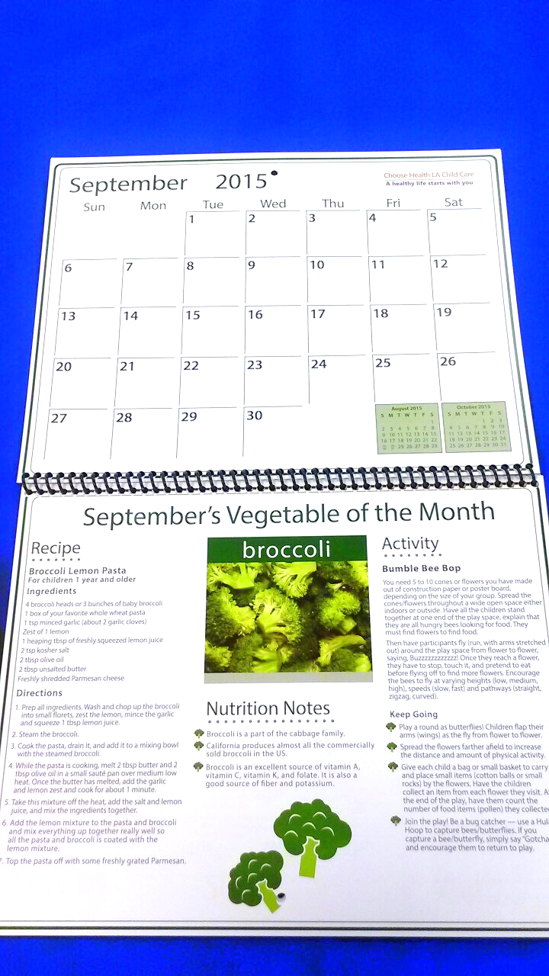

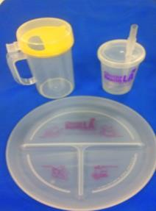
Training Incentives
Newsletter
Reusable bag
Calendar with Healthy Recipes and Activities
portion size tableware
Nutrition Posters

Slide 53
Agencies have conducted follow-up coaching visits to over
1,500
providers
Goal is to coach 2,200 child care providers by June 30, 2016
Notes:
Provider Most Common Coaching Requests
Menu plan improvements / recipe ideas
Developing new menus for new providers
Assistance with joininig the Child Care and Adult Food Program (CCAFP)
Healthy cooking activity ideas
Expanding physical activity ideas
Incorporating more stuctured play to curriculum
Starting a garden at child care sites
Developing ideas for classroom container gardening

Slide 54
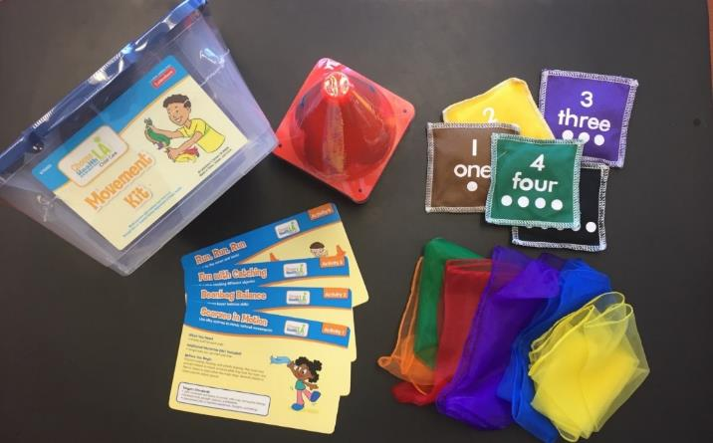





Coaching Incentives
Movement Kits
Yoga Cards
Recipe Cards

Slide 55



Family Child Care (FCC)
Over 1,000 FCCs have completed the CHLA Child Care Training
Approximately, 475 FCCs participated in coaching following training
Each FCC serves approximately 6 families
56% are Spanish Speakers, 36% are English Speakers
69% are Hispanic/Latino,
15% are Black/AA
Notes:
1033 FCCs trained
476 FCCs coached
Majority of those coached selected food/beverages or increase PA over reducing screen time or support breastfeeding
8% speak other languages such as Cantonese

Slide 56
Ethnicity Breakdown of FCC Providers Trained
Notes:
69% are Hispanic/Latino
15% are Black/AA
36% are English Speakers
56% are Spanish Speakers
8% speak other languages such as Cantonese

Slide 57
Agencies have reached 7,500
parents directly through events
Exceeded the goal of reaching 7,400 parents by June 30, 2016.

Slide 58

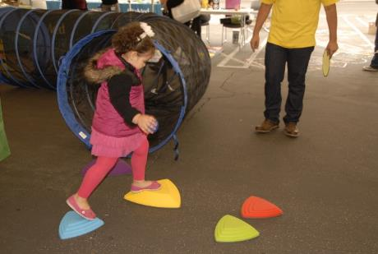
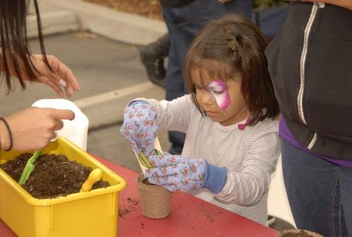
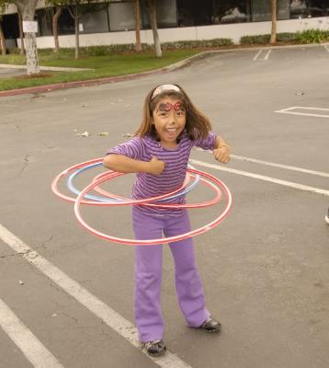
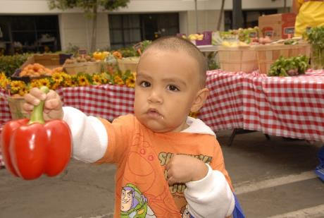
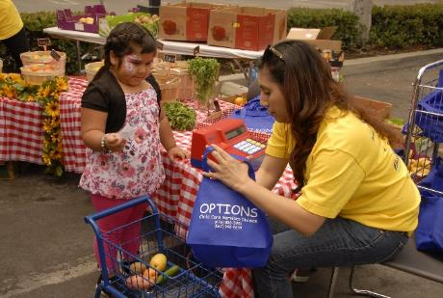



Play Your Way to Health Fair
Notes:
These pictures are from this year’s ‘Play Your Way to Health’ fair we had in May. There was a gardening booth, mini farmer’s market booth, and an obstacle course!

Slide 59
Evaluation
A Policies and Practices self-assessment questionnaire mailed to an initial sample of child care providers.
Baseline and 6 month follow-up questionnaires are compared to measure the impact of training and coaching.
Observational assessments conducted in a sample of child care facilities to measure more objectively how nutrition and/or physical activity policies, practices, and environments have been impacted as a result of the program.
Observational assessments are also be conducted at baseline and after 6 months.

Slide 60
Successes with FCC Providers
Usually have the authority to make changes
Recognize that small changes can have a large impact
Very responsive to the yoga cards and movement kits
More prepared to support breastfeeding
Notes:
78% stated that they are the owner/operator on the P and P Survey.
High baseline on many of the questions. Which is good news that providers are already offering nutritious food and physical activity
57% are already doing or making progress in parents receiving written nutrition policies or rules upon enrollment
74% are already reporting to parents what the children are served at the site

Slide 61



Challenges with FCC Providers
1. Getting them engaged
2. Getting provider to prioritize her own health and wellness
3. Structured play
4. Screen time
5. Need more resources
6. Concerned with the cost of making healthier meals
Notes:
Parent engagement – 42% state lack of support from parents
Question #38d
27% said they didn’t have enough money to make changes
41% said “no challenges”
#39 Challenges with creating written rules:
22% said lack of support from Parents
16% not enough training to make changes
18% not enough time to write out policies or rules
43% said “no challenges”
#40 Resources that would be helpful to create rules or guidelines
54% said more printed information – sample guidelines or template
69% said more materials for parents
40% more time with a coach
39% meet with other providers

Slide 62
Plans Moving Forward
Complete Intervention (training and coaching)
Evaluate Program
Recruit more FCCs to have a more representative sample for evaluation
Write final report for the program
Create a sustainability plan
Notes:
identify additional funding
Incorporate health and wellness into the QRIS (rating system)
LA 2050 Application

Slide 63
LA 2050 Grant Application – Please Vote!
Log in through Facebook or create a very quick account via GOOD maker
Funds would allow us to offer nutrition and physical activity trainings to Family, Friend and Neighbor child caregivers throughout LA County
http://myla2050live2015.maker.good.is/projects/caregiverandme.
Notes:
In collaboration with DPH Maternal, Child & Adolescent Health Programs, the Child Care Alliance of LA and others, Samantha Marshall of the T&L Foundation for Child Care Information has submitted a grant application to LA2050. These funds would allow us to offer nutrition and physical activity trainings to Family, Friend and Neighbor child caregivers in the areas of Los Angeles County with the highest childhood obesity rates, all in a fun “Caregiver & Me” setting. And today is the first day to VOTE!!
To find out more and to vote, see: http://myla2050live2015.maker.good.is/projects/caregiverandme. You can log in through Facebook or create a very quick account via GOOD maker. Click on the big blue “Vote” button before November 3rd and ask your colleagues, friends and family to do the same!
Help us maintain the momentum CHLA CC has created across the county to improve health in child care settings!

Slide 64


NEW Countywide Beverage Campaign

Slide 65
Contact Information
Janet Scully, MPH
Program Manager
Los Angeles County Department of Public Health
(213)639-6414
jscully@ph.lacounty.gov

Slide 66

Part IV: Policy Opportunities to improve Child Care Food Environments

Slide 67
What’s Happening ?
Institute of Medicine:
  Include specific requirements related to physical activity, sedentary activity, and child feeding in child care regulations
The National Resource Center for Health and Safety in Child Care and Early Education, American Academy of Pediatrics, and American Public Health Association:
  Preventing Childhood Obesity in Early Care and Education Programs:
  Selected standards from Caring for Our Children: National Health and Safety Performance Standards

Slide 68
Policy Recommendations (continued)
California Department of Education:
  Keeping Children Healthy in California’s Child Care Environments: Recommendations to Improve Nutrition and Increase Physical Activity
American Heart Association:
  Child care providers should meet minimum, uniform standards in nutrition, physical activity, screen time limitations, breastfeeding, and professional development

Slide 69
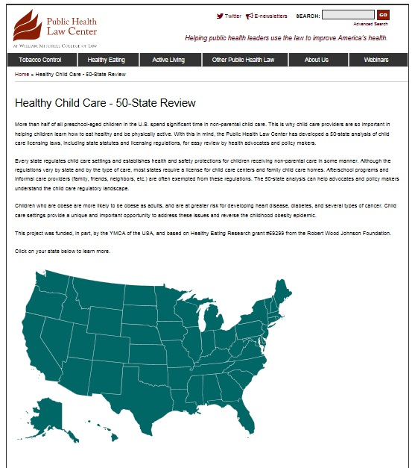
Policy Scan
Review of state statute & regulations related to family child care nutrition
  31 states require CACFP meal pattern

Slide 70

Case Study
“Nutrition and feeding practices for children strongly affect the development and long-term health of the child. Proper nutritional care during the early years is essential for intellectual, social, emotional, and physical growth.”

Slide 71

Mississippi: CACFP
“Guidelines from [CACFP] are used as the standard for menu planning and guidelines. However … the stricter guidelines [MSDH] shall be enforced.”
“Emphasis shall be placed on serving more whole grains and fewer foods high in fat, sugar, and sodium.”

Slide 72
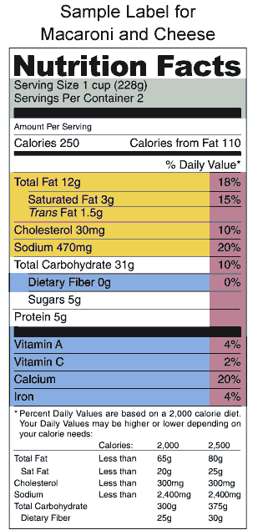
MS State Dept. of Health Nutrition Standard Guidelines
Requires cultural sensitivity
Food prep for health
  No added salt, no fried foods, limited pre-fried
Positive feeding practices
  Caregiver role modeling
  Family style encouraged
  Infant feeding cues
  Solid food introduction
  Use meal time for nutrition education
Breast feeding promotion
  Recommend, encourage, support

Slide 73
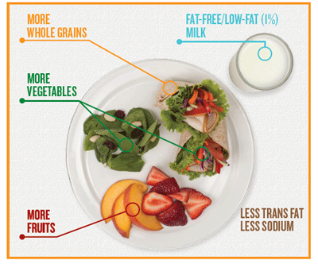
MSDH Nutrition Standard Guidelines (continued)
Offer variety of fruits & veggies
  Limit starchy vegetables to once per meal
  Vitamin C sources must be served daily
  Vitamin A sources must be served every other day
  Local produce and gardens promoted
Limited fat, sugar, sodium
Healthy Beverages
  Only 100% juice
  No SSBs
  Water freely available and offered regularly
Enriched or Whole Grains only
Healthy Proteins
  No processed or high fat meats allowed
  No processed cheese

Slide 74

CACFP Meal Pattern
CFPA advocate for nutrition-focused and feasible standards that safeguard and support the health of all CACFP participants
Continue to Advocate
Inform the CACFP roll out
Continue to work with USDA, FNS, CDE, and other interested stakeholders interested in child care settings

Slide 75

Next Steps
Develop nutrition standards to be pilot tested in FCCH’s
Document the process & Develop Case Studies Highlighting
  Kaiser South Survey Findings
  Packard Work
  Pilot Findings
Policy Convening October 2016
Continue to engage child care stakeholders
Take all that we learn and advocate for healthy nutrition standards for childcare settings

