Slide 1
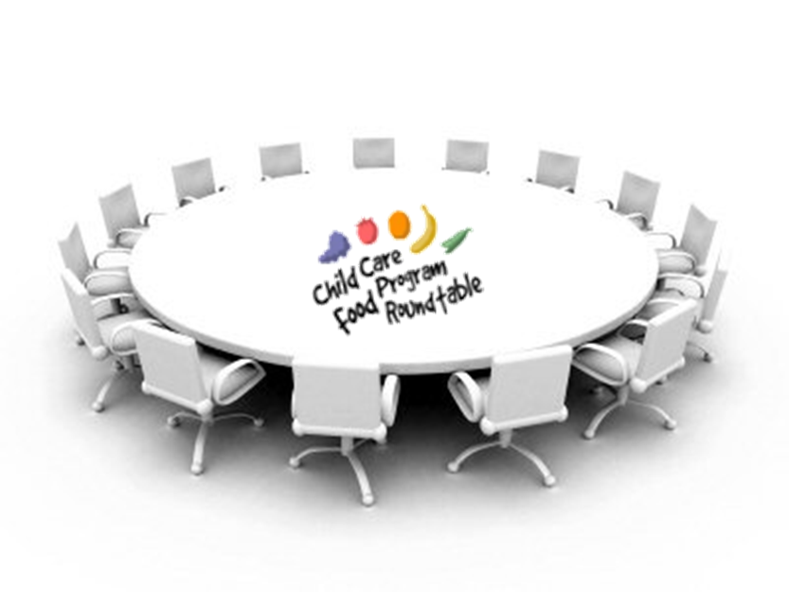
Get Involved

Slide 2
What’s It All About?
We will be “De-Mystifying” the CCFP Roundtable…
Just what IS this organization?
Meet the Advisory Council
Updates and Looking Ahead
How YOU Can Get More Involved

Slide 3
What is CCFP Roundtable?
Since 1977, a membership organization focused on preventing hunger and improving nutrition for our youngest children.
How? Protect and improve the Child and Adult Care Food Program.
Organized network: ~ 1000 program sponsors, providers and allies.
Prime focus:
Advocacy and Education

Slide 4
What is CCFP Roundtable?
Our Non-Profit Fiscal Sponsor is California Food Policy Advocates (CFPA).
Internal Governance is a Volunteer Advisory Council
staffed by Part-Time Coordinator.
Our Modest Operating Budget comes from:
Dues + Conference Revenue + Small Grants.

Slide 5
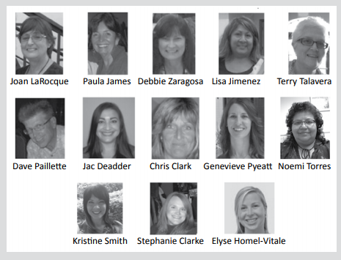
Meet Your Advisory Council!
Ensuring Fairness and Equity in Program Rules and Administration
Decades of CACFP Expertise and Experience
Dedicated to Healthy Kids;
Integrity;
a High-Quality Food Program
… Working and Advocating for YOU!

Slide 6
Roundtable’s Approach:
Communicate
Educate
Advocate

Slide 7
Advocate for a Better CACFP
Troubleshoot emerging admin problems – dialogue with state staff.
Elevate issues that need attention – usually to USDA or Congress.
Advocate on state and federal legislation and regulations, especially Child Nutrition.
Support
anti-hunger and
poverty prevention campaigns

Slide 8
Roundtable Advocacy Makes a Difference!
1970’s: Helped Grow the Program.
1980’s: Testified in Congress about importance of CACFP.
1990’s: Fought Block Grants – and won!
2000’s: Served on Paperwork Reduction Task Force
2010’s: Informed New Meal Pattern Decision making.

Slide 9
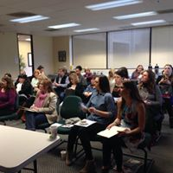
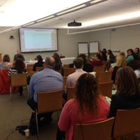
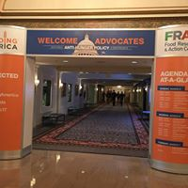
Training and Leadership Opportunities
At Roundtable Regional Meetings: Short In-service Trainings.
Annual Meeting: National Speakers and Substantive Workshops
Leaders involved in allied groups: CFPA, FRAC, National CACFP Forum and NAFCC, WIC, NHSA, CDPH.
Important Capitol Hill Visits during the National CACFP Forum Leadership Conference in Washington, DC.

Slide 10
2017: Behind the Scenes Advocacy
USDA Meal Pattern Rollout -- Grace Period
Meal Documentation in Family Child Care
Graham Crackers are Back
Partnering in Research:
Leveraging CACFP
to improve
early childhood nutrition

Slide 11
Improve Communication and Collaboration
Open Bi-Monthly Member Meetings – timely dialogue with CDE NSD partners.
E-Newsletters and Social Media Updates – keeping members in the know
Frequent Informal Contacts with CDE and USDA officials to problem-solve issues.

Slide 12
2018: Building Our Future Capacity
New Staff! Carolyn Brown
Grant Funding from Sunlight Giving: A Bottom Line Boost!
Grant Funding: Organizational Assessment and Succession Planning
Continued Advocacy and Education

Slide 13
Up Your Game with Roundtable!
What’s Your Level of Engagement?
Bronze Level: Pay Dues, Read E-news, Attend Annual Conference.
Silver Level: Attend and Speak Up at Regional Meetings, Advocate on Hot Issues.
Gold Level: Join Advisory Council, Help Plan Conference, go to DC meetings.
Platinum Level: Become a Roundtable Leader!

Slide 14
FEEDBACK
We Need and Welcome Your Feedback!
Online Conference Evaluation:
www.surveymonkey.com/r/H38FJV3
Coming Soon: Online Membership Survey.
Talk to Advisory Council Members
Send us an email! roundtable@cfpa.net

Slide 15
What Are Your Questions?
Find us on the Web: www.ccfproundtable.org
Twitter: @CCFPRoundtable
Facebook: ChildCareFoodProgramRoundtable

