Slide 1
Promote, Protect and Perfect CACFP
Supporting Centers

Slide 2
Learning Care Group, Inc.
For Profit Child Care Sponsor of affiliated centers in 33 states
450 centers currently contracted serving approx. 54,000 children daily
CACFP Coordinators geographically located near centers they oversee
Standardized systems and training programs developed to support CACFP compliance
Central office and state specific communication plan established

Slide 3
Training Plan to Support CACFP Compliance
Provide standardized training
  Coordinators to train center management
  Center management to train staff
  Training designed to allow for state specific variances to be inserted
  Expectation forms signed annually for center management, classroom staff, and cooks
  Mentor Program for Cooks and Managers
Documentation of training
  Standardized training sign in sheets and agenda provided
  Center management binder system to hold training documentation or
  Training documentation submitted with monthly claim to coordinator

Slide 4
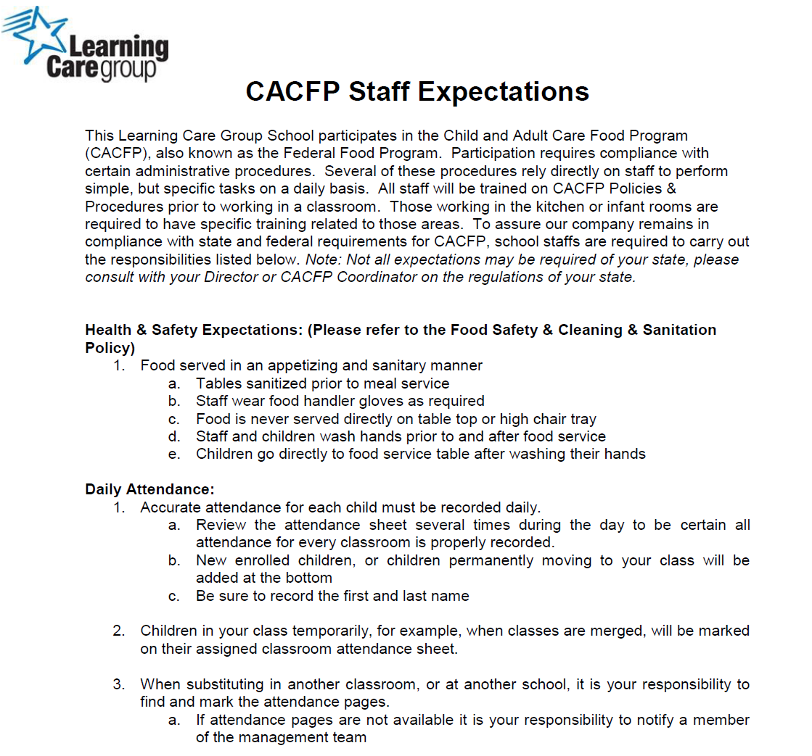
Learning Care Group Expectations

Slide 5
Monthly Training Plan

Slide 6
Communication Support
Keeping staff engaged to comply with CACFP regulations and processes
Monthly communication of claim results, missing IEF forms, disallowed meals including notes for compliance improvement
Corrective action plan process
Cook quarterly newsletter and nutrition education
District Manager/Director Weekly Newsletter
  Policy Updates
  Menu/New Product Updates
Monthly compliance recognition for high levels of compliance including monitor visits

Slide 7

Contact Info.
dpomerson@learningcaregroup.com
Office: 248-697-9106

Slide 8


Slide 9


