Slide 1
Farm to Preschool Making Connections and Developing Infrastructure
Bryan Brown, BS Food Science, Food Program Manager
Wendy Minarik, MPP, RDN - Nutrition Coordinator
Mariah Marten-Ray, Cal Poly SLO candidate BS- Nutrition Science
Notes:
FTP is a good thing: Hitting your metrics for school readiness (science, mathematics, visual arts, and
performing arts) plus it’s fun
SAY: In the study 2 of 12 schools had specific standards based garden curriculum.
• Example: Farm to Preschool is a great free resource for preschool and toddler aged children
(see handout) www.farmtopreschool.org

Slide 2
Learning Objectives
Background on Farm to Preschool movement
Identify key ingredients for Farm to Preschool infrastructure
Networking with community partners and supporting volunteers
Share our story: A case study

Slide 3
FTP Background
Notes:
Bryan’s notes

Slide 4
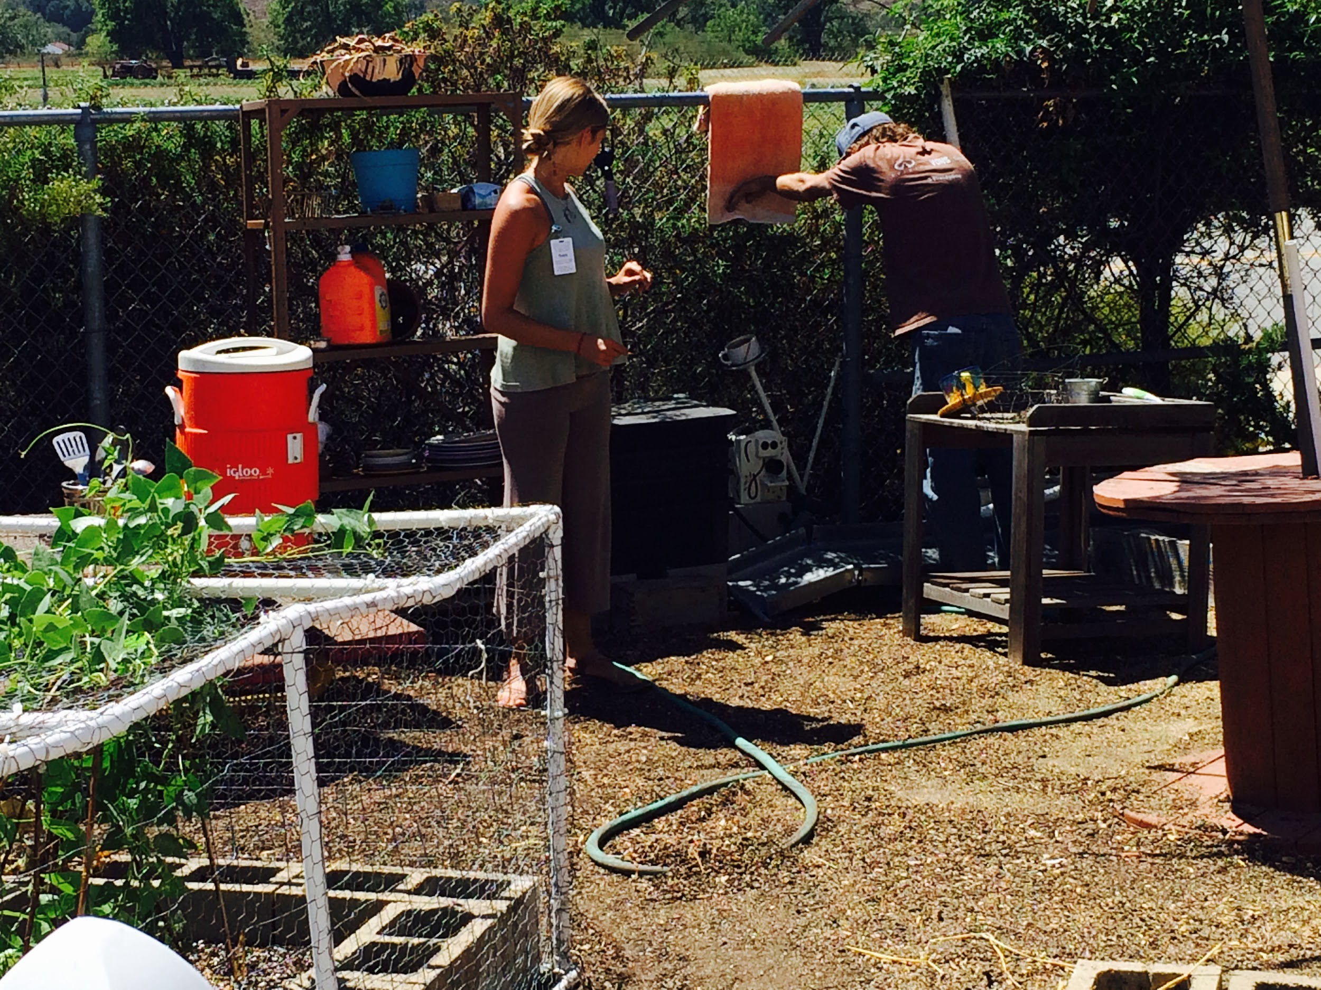
Outdoor Classrooms at CAPSLO
Notes:
Bryan’s notes:

Slide 5
What does it look like?
Environmental: meeting the needs of today without compromising the needs of future generations
But in Program Design: developing strategies to maintain the program
Notes:
Downfall right now of school garden programs is how do deal with burnout when there is very little funding to support programs? Because FTP can be so effective in both direct and indirect learning outcomes and is an experience every child should have, we need to be thinking of succession from the beginning,

Slide 6
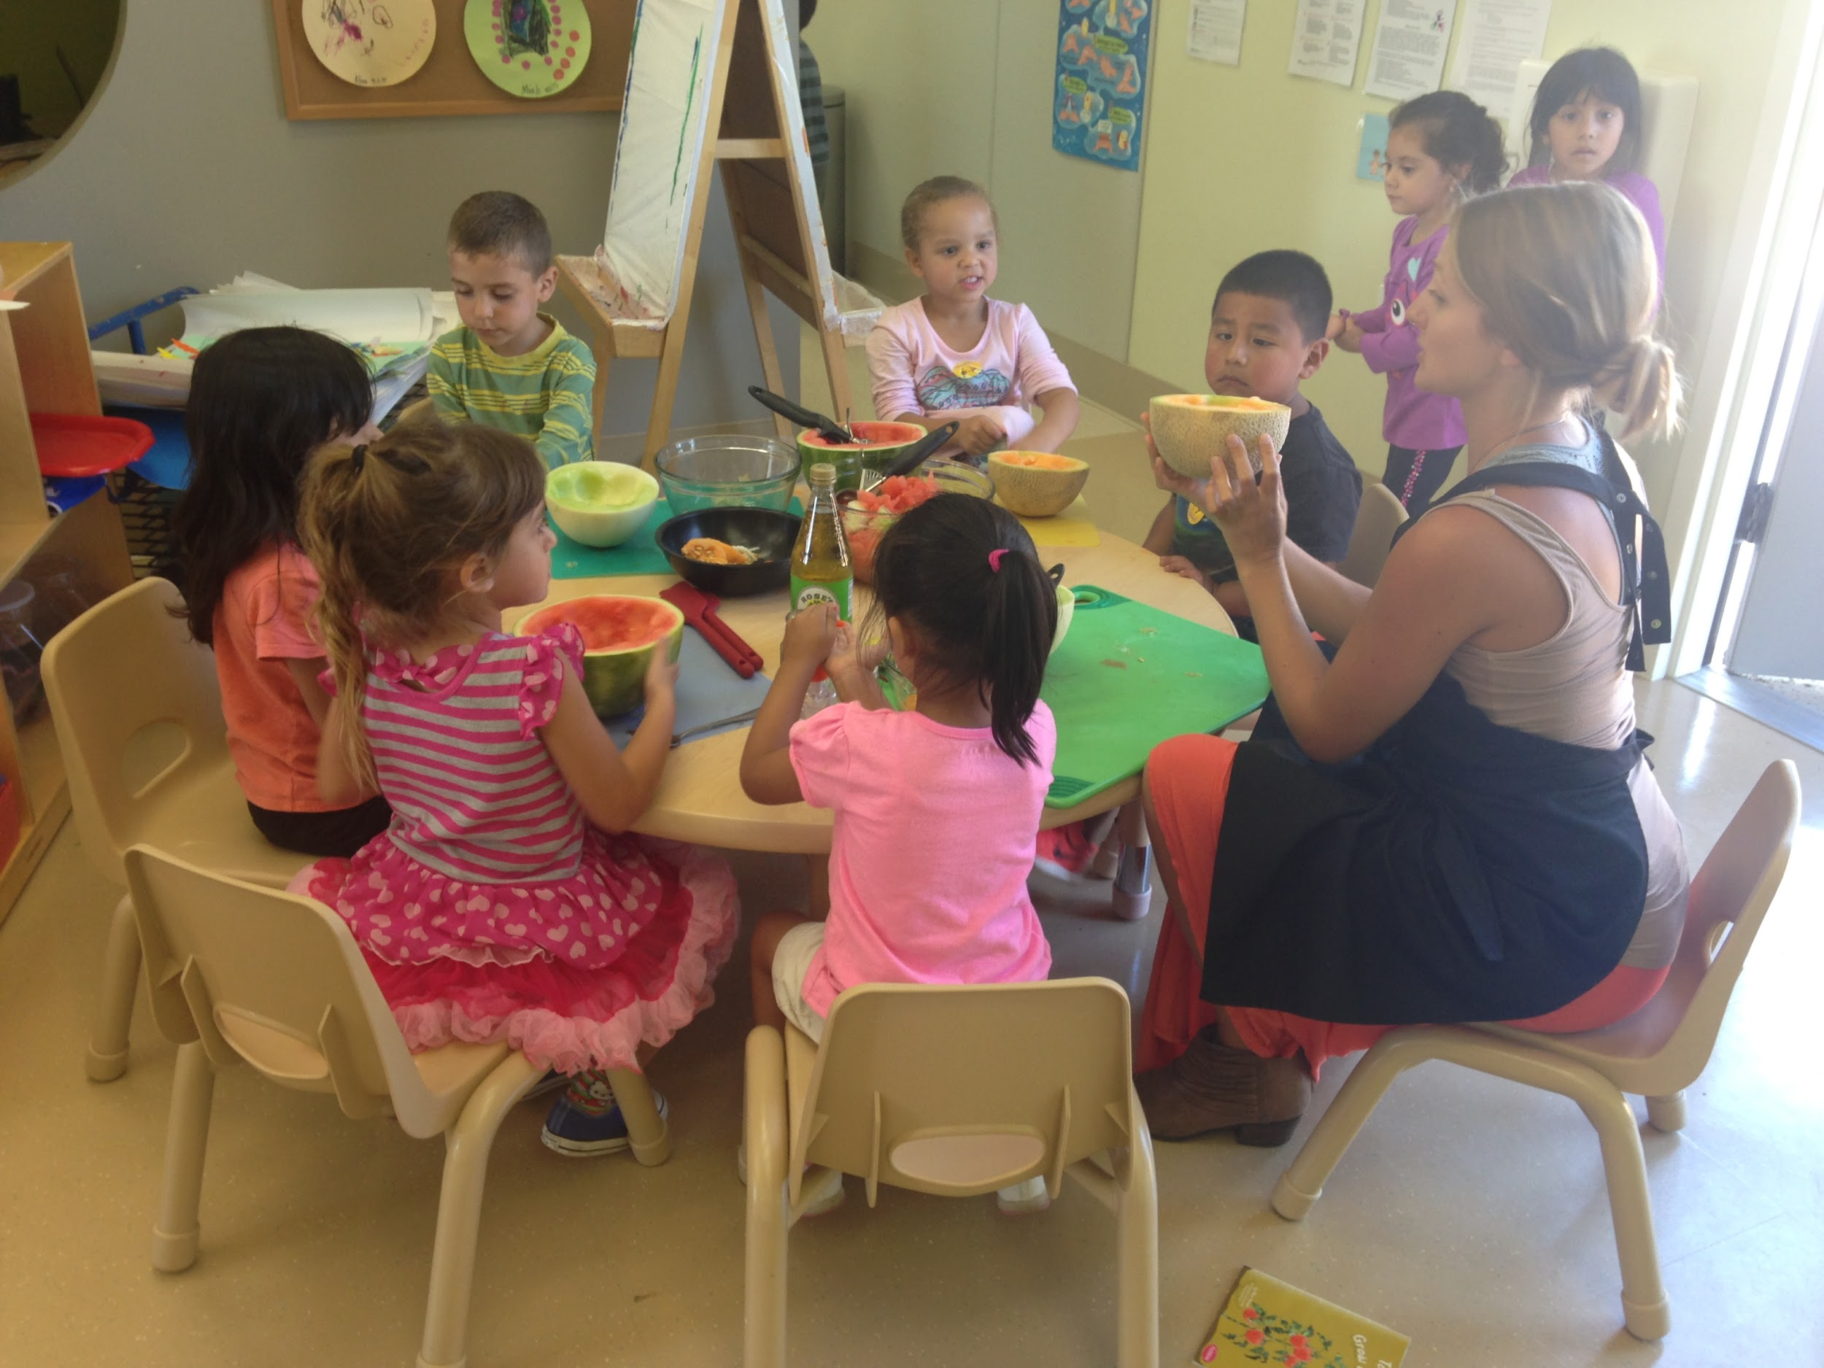
Consider:
Lessons
need to be scaleable
tool to meeting
academic standards
Vision
Is it realistic?
Achievable timeline :
1 month, 3 month, 6 months
Do you have the know how, spaces, community partners
Leadership, support, and labor

Slide 7
Key Leadership:
“Champion”:
works with leadership to advocate for garden success
supports garden-coordinator in all aspects of implementation and maintenance
“Garden-Coordinator” (Volunteer/Paid):
co-creates vision of program
develops and maintains the infrastructure and community connections

Slide 8
Two Program Models:
Motivated teacher or leader (“champion”) at a single preschool initiates FTP program
FTP is rolled out by a “champion” as a community based program serving multiple preschools
Both models require community support for long term sustainability!
Notes:
Multiple venues within an organization such as HS, a county, a network of montessori schools, etc
no single person should accept sole responsibility of program = burden

Slide 9
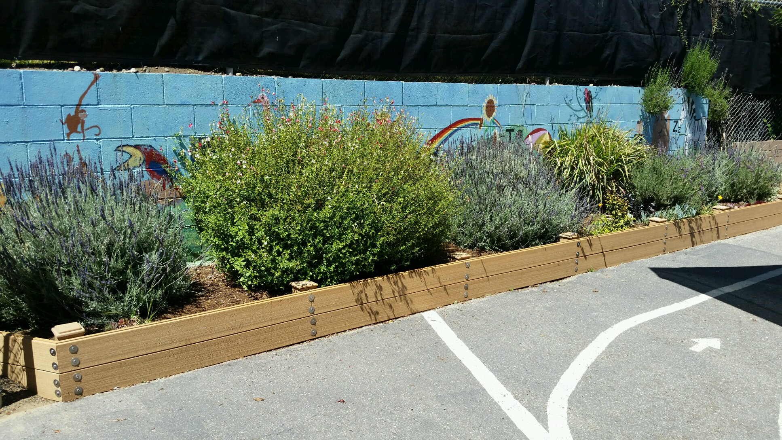
Building Infrastructure
Providing the stuff:
Garden Bed, soil, irrigation, kids gardening tools, seeds, plants, etc.
Children's routines and community helpers

Slide 10
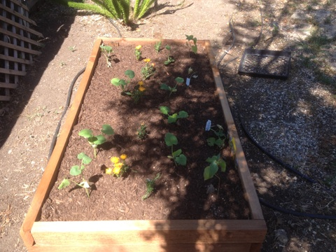
Building Infrastructure
Establish Community
Partners
Gardening Clubs and
Volunteer Organizations
Examples of grants
to apply for:
http://grants.kidsgardening.org/ and farmtopreschool.org
Notes:
*Remember to be creative in what you apply for (math, science, language arts grants are all fair game as experiential learning in this age group is encouraged).
potential long-term volunteers, county volunteer days, business who have employee volunteer days (whole foods, home depot) to help build the infrastructure

Slide 11
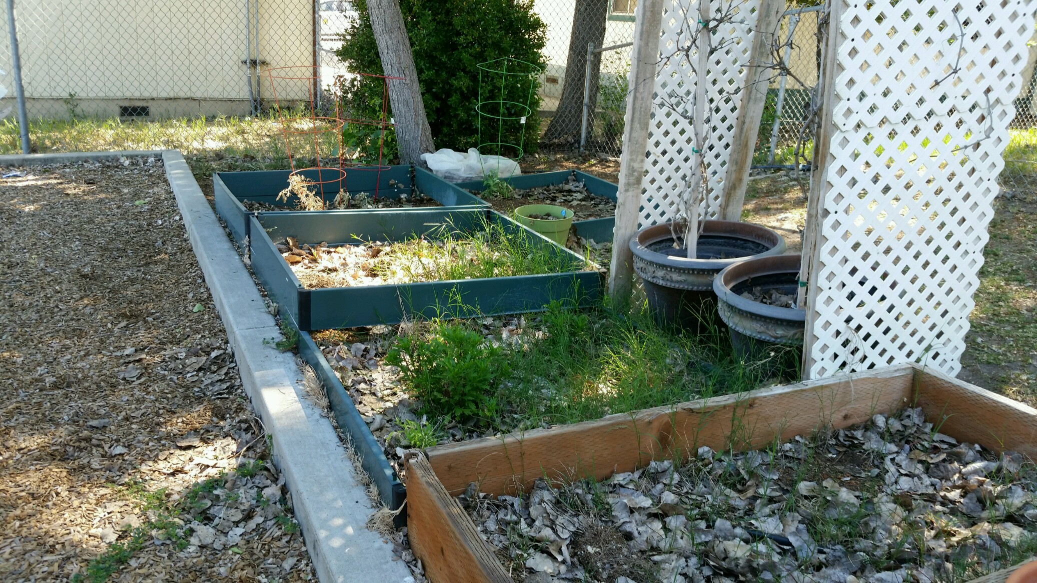
Site Visits-assessment
Space: Sun exposure, water availability, existing planters
Staff: Enthusiasm, skills and needs
Resources:
What can I re-use,
or need to make?
Notes:
Assess the space. Where? What can grow? How big? Why does the staff want it?
Also how involved will the staff realistically be? Should you install irrigation?
Assess existing infrastructure. What can we reuse? What do the need?
Staff vision. Is it realistic, collaborate and provide anecdotal evidence of what works.
Prioritize needs eg. is there already 1 bed, is there a community garden nearby, etc.
You may want to develop a garden assessment tool
(Share our garden assessment tool)

Slide 12
Garden Assessment Tool
Climate
Sun
Water
Soil
Contact information
Constrain
Safety
Interest
Notes:
This is the one we made, feel free to modify for your gardens needs
Great for future garden coordinators to know what to assess

Slide 13
Making Connections
Recruit the Right Type of Support
Establish a weekly one-hour time block (or other timeframe) for volunteers to run lessons
Volunteers who find meaning and value in the experience
The right volunteer for the right position!
anticipate the replacement of volunteers
Notes:
Site visits of preschools to communicate with staff
barriers, successes, vision (realistic), support needed
establish a weekly one-hour time block (or other timeframe) they would like for volunteers to run lessons
Recruit from sources who find meaning and value in the experience
The right volunteer for the right position! Opportunity should fulfill the volunteer’s interests; the volunteer should also have a level of experience. Difference in the duties and skills needed between a caretaker of the garden, a garden educator, and a garden coordinator
anticipate the replacement of volunteers by recruiting from sources who have a revolving pool of interested individuals

Slide 14
Volunteers
Recruitment
Communication
Support

Slide 15
HR Procedures
Garden coordinator vs. others
Basics: application, interview/meeting
Comprehensive: +Livescan, +TB skin test
Track hours & resources contributed.

Slide 16
Examples of Sustainable Support:
College Students
Snowball networking
Community volunteers organizations
Farm based education
Ex: Farmbasededucation.org
Notes:
College students: Good for garden coordinator and garden educator positions. College students who have a passion for early childhood education, nutrition, sustainability, hunger relief or agriculture.
Snowball networking: volunteers find volunters, garden coordinator connected to faculty and other students through service learning organizations.
Community volunteers: senior citizen, volunteer agency, paying it forward groups, youth (HS, 4H).
Farm-based education: network job/volunteer postings

Slide 17
Unsustainable Support:
Staff within preschool are time constrained
Parents
Successful programs will integrate staff and parent involvement, but will not rely on these sources as sole caretakers of the program.

Slide 18
Coordinating and Organizing
Publicize volunteer opportunity
Make connections with gatekeepers of service organizations.
Vetting: application, interview, lunch-and-learn, background checks, TB test etc. for consistent volunteers. (gets easier with practice)
Mentorship period
Notes:
Mentorship period: All volunteers accompanied to at least the first lesson to work side by side with coordinator to develop understanding of how lessons are to be run and to develop adaptability in preschool environment

Slide 19
Communication and Planning
Use of Google Drive
Email - for volunteers to respond with interest to program, group emails about program, reviews of lessons for formative feedback
Notes:
matching volunteers to service sites, schedule/calendar, contact information, folder of all lesson plans and materials.

Slide 20
Our Case Study
Site visits of HS and EHS in the county
Common barriers: lack of resources, garden not incorporated into curriculum or children’s routines, drought, worm-bins, parent “champion” had left, interested staff had left
Common visions: seed to table, volunteer support, many extravagant and unrealistic ideas (giant metal “baseball like” trellis with vining plants, fruit trees)

Slide 21
2) Community partnerships with local hardware stores for donation requests
3) Collaborated with volunteers to build/improve infrastructure of centers.
4) Identified centers for a 6-week program.
5) “Garden-Nutrition”/FTP Lesson plan series
6) Contacted DPD director of Cal Poly for help in publicizing volunteer opportunity
7) Vetted and Coordinated volunteers
8) Mentorship & Formative Feedback
Notes:
centers who had high motivation and interest for FTP program and/or had existing infrastructure and reached out to coordinate

Slide 22
Documentation
Multiple: Journals, photos, videos, quotes, etc. Great way to make program stand apart from others when enlisting community support.
(insert video of sunnyside)

Slide 23
Expansion and Succession
Start small: to create a strong framework for expansion success
Expand: within county, school district, other counties, the migrant centers, to early head starts, to child care centers
Succession: pull from Garden Educator volunteers. Should go through a one month mentorship before fully assuming Garden Coordinator position.
Notes:
Hardest the First Time Around
All lessons have now been “tried and true” through formative feedback in a variety of settings
supporting documents are created and on cloud
Community partnerships are established

Slide 24
Outdoor Classrooms at CAPSLO
Notes:
Bryan’s notes:

Slide 25
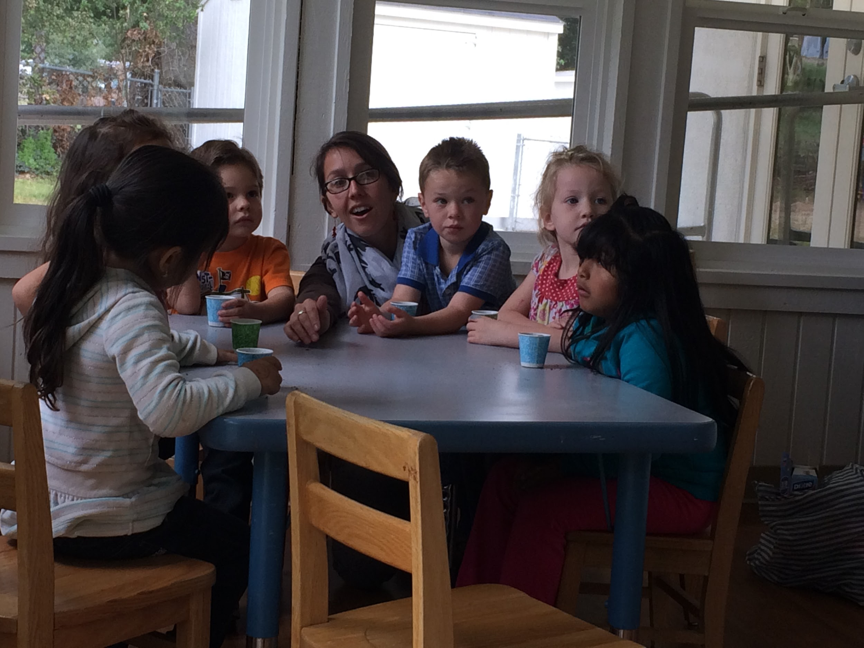
Lessons & Resources
Planning your lesson objectives
Make it interesting, fun and tasty
CACFP (Dietary Guidelines)

Slide 26
Aligning FTP Activities with Student Goals
Life Science:
Predict, observe, and document (Plants)
Ask why, try something new, is it translatable?
Math
Measure growth and change
Recipes with practical math
Literacy
Storytelling, introducing words
Providing context to the activities

Slide 27
Share a Book
Assists with transition to activity and builds interest.
Encourages children to develop theories and try dramatic play activities
Introduces new words, perspectives
Notes:
In our FTP lessons, age appropriate books draw the children into the activities and can be revisited later.

Slide 28
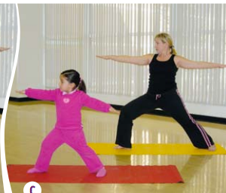
Include Physical Activity
Keep learning active, facilitates kinesthetic learning styles
links well with nutrition messages
Resources: public health, More matters Energy Balance, IMIL, games

Slide 29
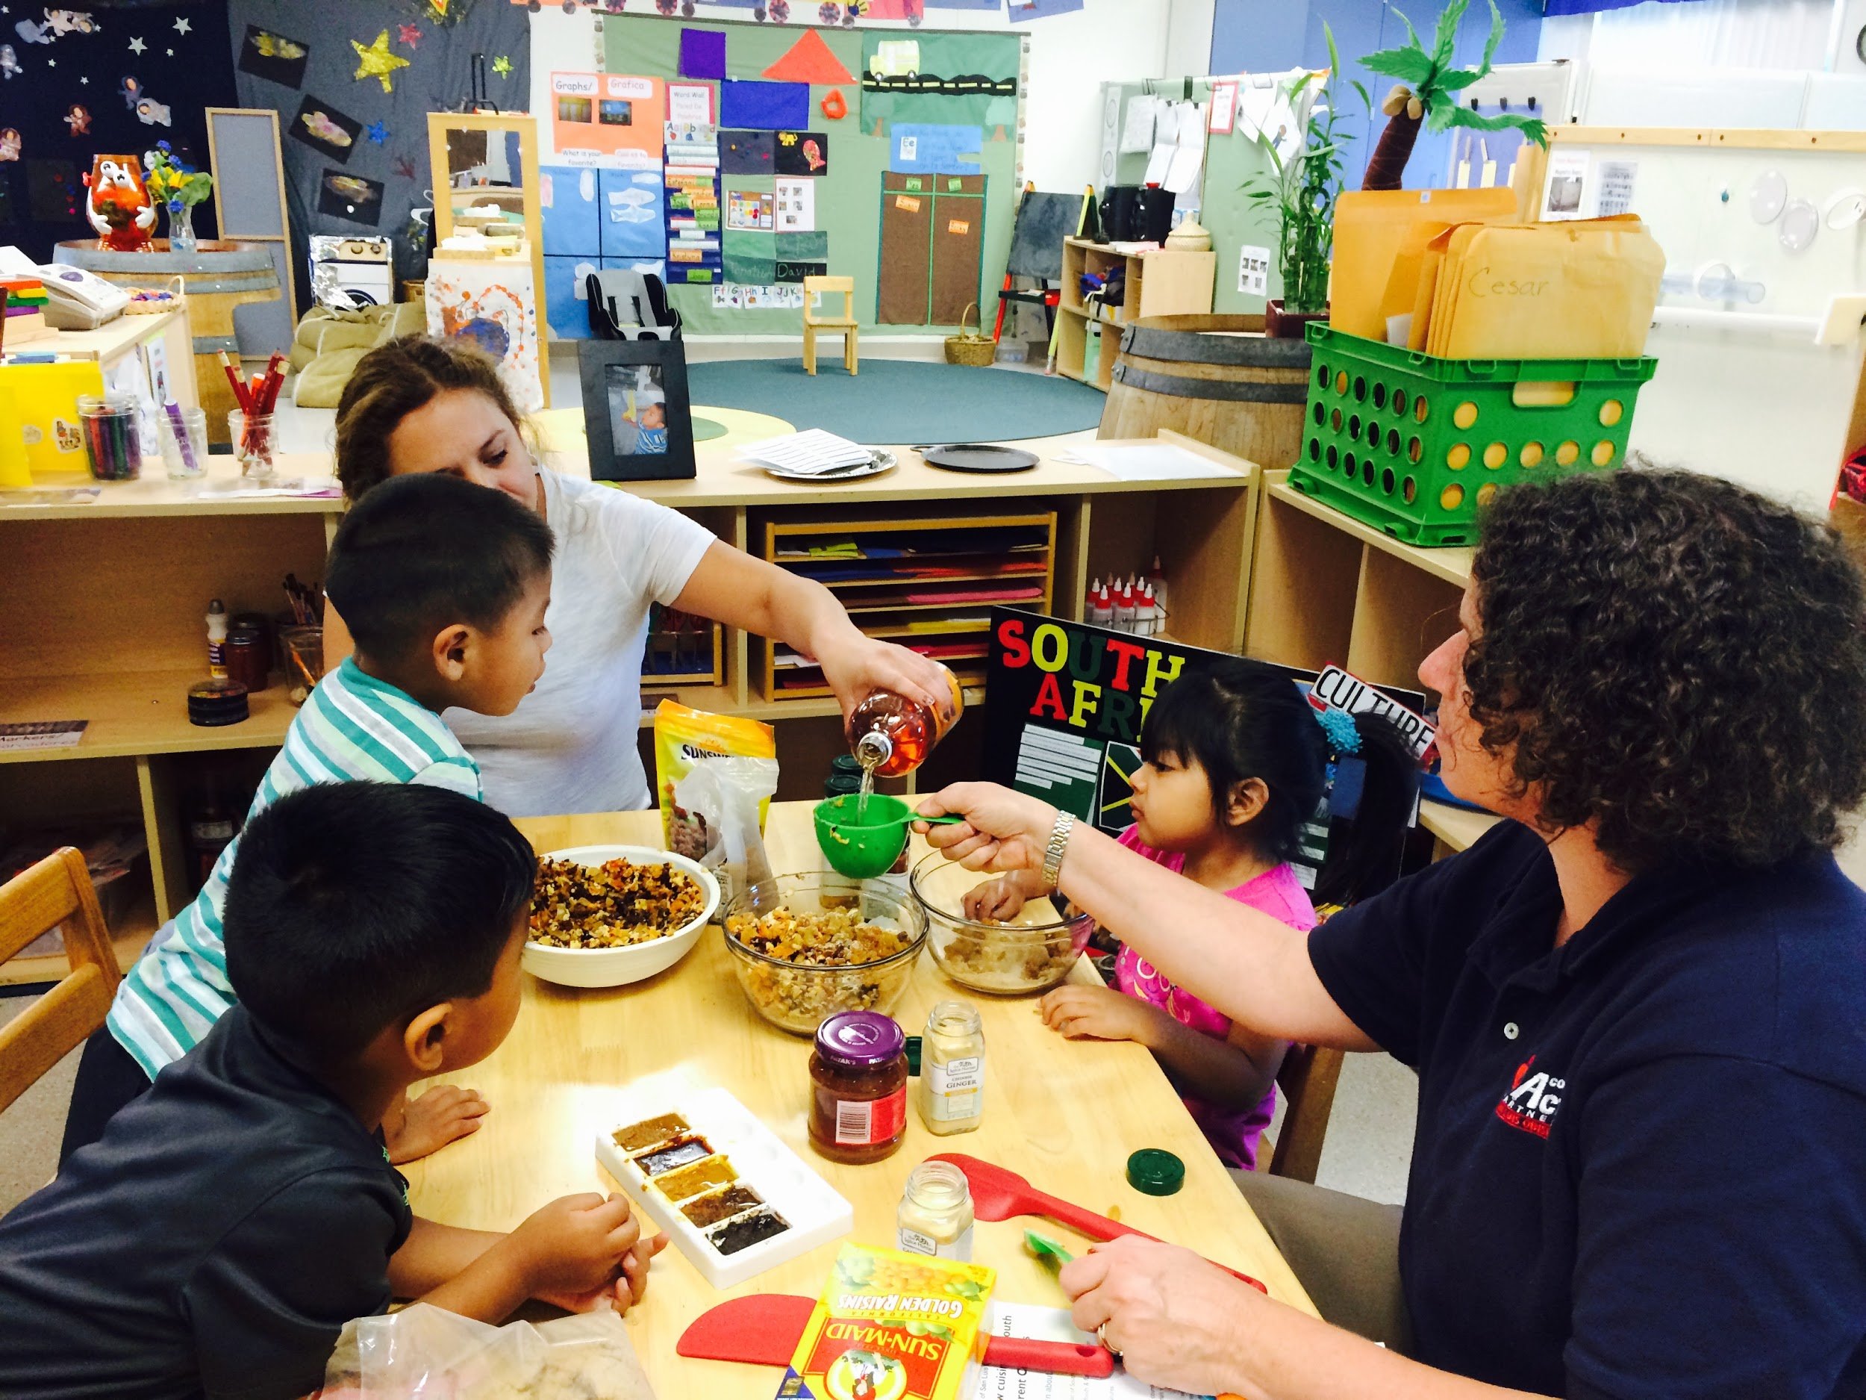
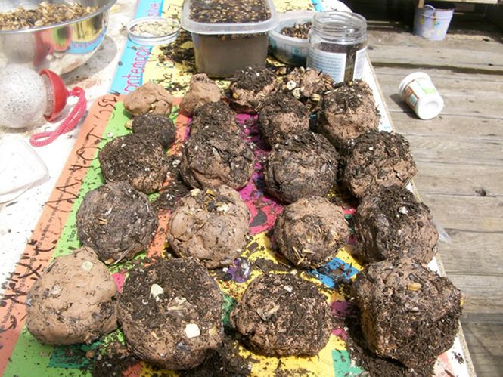
Involve the Senses
Introduce the fruit or vegetable
Cut it open and pass around to explore
Run a recipe with the children
From start to finish
Carefully examine the leaves, seeds and plants

Slide 30
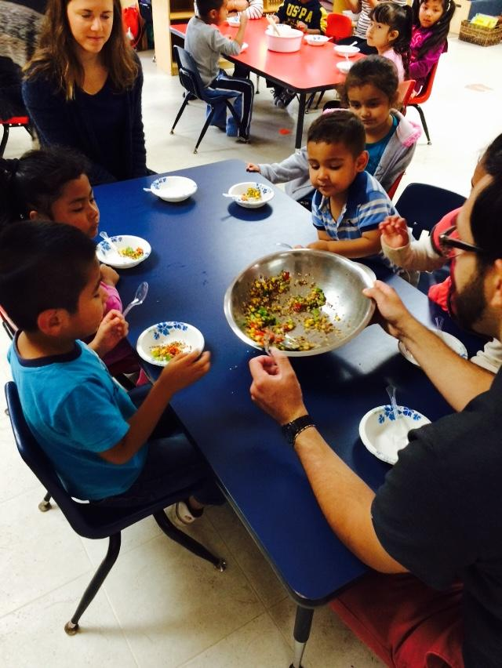
Food Experiences: Goals
Both staff and children benefit from trying new foods
Running recipes with novel ingredients reduces the fear of trying vegetables.
Create “aha” moments

Slide 31
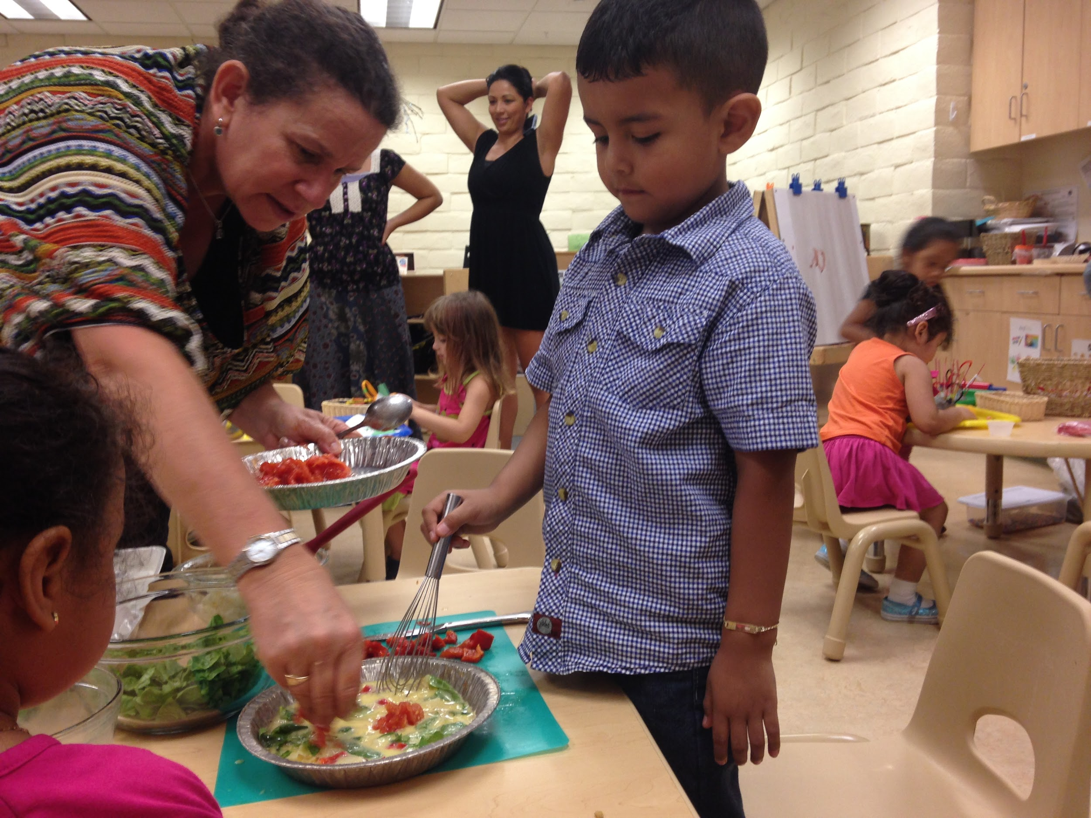
Food Experiences: Types
Science...plant pigments, physical properties, or preservation
Cultural… broaden the lens, challenge beliefs and share traditions
Skill development… fine motor, expand vocab, and improve cooperation

Slide 32
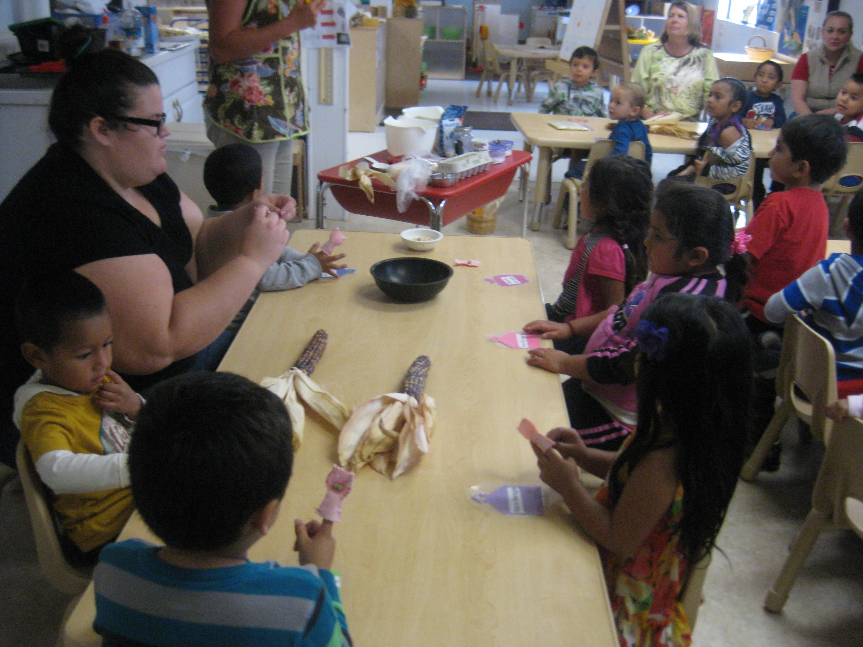
Food Experiences: Strategies
Experience traditional methods
“Feel” the part with dramatic play
Invite parents to participate in class.

Slide 33
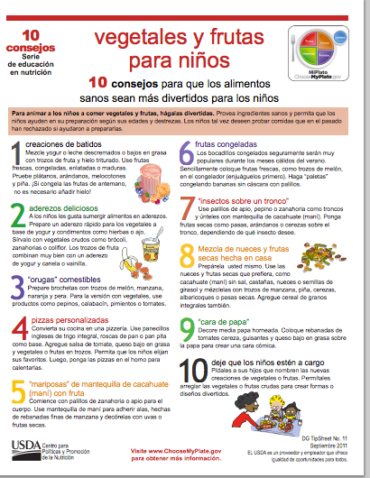
Share with parents
Invite them to participate, taste
Photo journals
Children’s artwork, reflections about the activity
Follow up nutrition education

Slide 34
Build Enthusiasm
Photo documentation
Articles
Food Demos

Slide 35
FTP Examples of Activities
Fall: Harvest - fruits of the labor, preservation, seed saving
Winter: Compost - browns, greens & insects
Spring: Planning, sowing and plant care
Summer: Growth, weeding
Notes:
Divide participants into 4 groups:
Include a recipe:

Slide 36
FTP Let’s Put it Together
Hands-On Activity
Group 1:
Group 2:
Group 3:
Group 4:
Notes:
Divide participants into 4 groups:
Ideas????

Slide 37
Conclusion
Identity your resources (material and expertise)
Plan your spaces for success
Empower and support individuals
Plan for succession

Slide 38
Thank you!
Questions?

