Slide 1
Partnering to Improve Nutrition and Physical Activity Practices in Child Care
Ann McCormack, MPH, RD, Chief
Bureau of Community Food and Nutrition Assistance Missouri Department of Health and Senior Services

Slide 2
Objectives:
Provide an overview of Missouri Eat Smart and MOve Smart Child Care programs.
Demonstrate how partnerships have maximized resources and expanded program reach.
Discuss funding sources during implementation and expansion phases.
Highlight program successes.

Slide 4
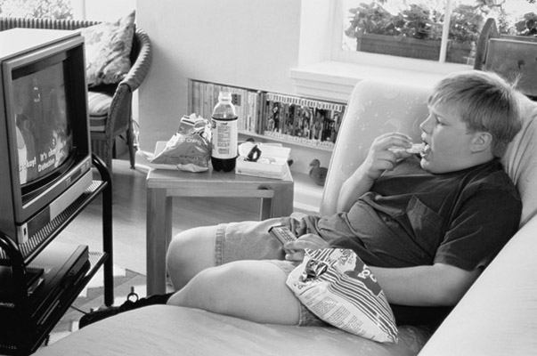
Purpose:
Prepare child care facilities for the new CACFP meal pattern
Address childhood obesity

Slide 5
Foundation for Eat Smart:
Institute of Medicine recommendations for the CACFP - “Aligning Dietary Guidance for All”
2010 Dietary Guidelines for Americans

Slide 6
How Eat Smart Works
Voluntary program
Centers apply by submitting menus and supporting documentation
Program staff conduct an on-site assessment
Programs receive recognition

Slide 7
How do we change behavior?
Policy
Environment
Behavior

Slide 8
Evidence Base
Consume fat free or low-fat milk
Increase consumption of fruits and vegetables
Choose whole grains; Limit refined grains
Consume lean meats and reduce consumption of trans fat and saturated fat.
Avoid added sugars and sugar sweetened beverages

Slide 9
Eat Smart Principles
Broad dietary recommendations to challenge child care providers to make nutrient dense foods available
Support policies that create a healthy nutrition environment
A voluntary program for any facility, large or small

Slide 10
Levels of Recognition
Advanced Level
Intermediate Level
Minimum Level
Healthfulness
Notes:
Wanted to use a stairstep approach – allow the center to make incremental changes. The Advanced level is most in line with the IOM report.

Slide 11
Benefits to Child Care
Improved health of children
Development of lifelong healthy habits
Certificate and banner
Menu templates
Parent letter
Press release
Use of the Eat Smart Logo

Slide 12
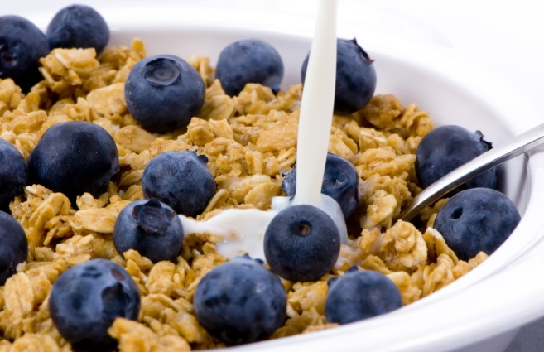
Breakfast Standards
Amount of sugar in cereals
Sweet breakfast items
Whole grain foods
Fruit and vegetables

Slide 13
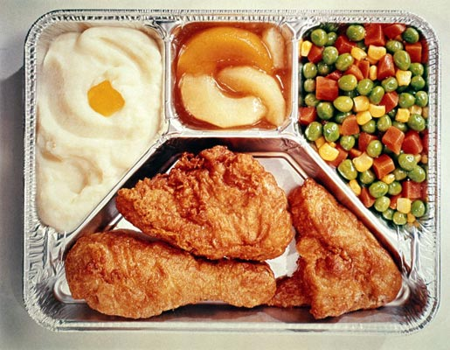
Lunch and Supper Standards
Processed breaded meats
Whole grain foods
Fruit and vegetables
Use of high fat condiments
Type of milk served

Slide 14
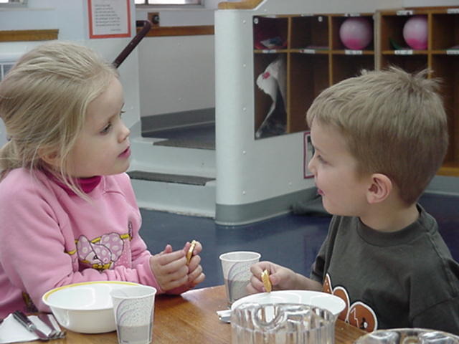
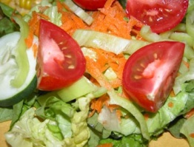
Snack Standards
Limit sweet snacks
Protein at snacks
Fruit and vegetables
Type of milk served

Slide 15
Overall Menu Standards
Vitamin A or C sources—dark green or orange fruits or vegetables
Menu variety
Juice
Artificial sweeteners
Sugar sweetened beverages

Slide 16
Nutrition Environment
Meal time environment
Family style meal service
Adult interactions with children
Meal length

Slide 17
Division of Responsibility
Adults choose the foods that will be offered, when, where and how.
Children choose what they will eat, how much, or if they will eat at all.

Slide 18
Nutrition Environment Standards
Menus posted
Foods brought into the facility
Fundraising
Hand washing
Vending machines
TV viewing
Parent involvement

Slide 19
Recognition
137 recognized child care facilities

Slide 21
MOve Smart
Physical activity standards for children 2 to 5
Based on:
American Academy
of Pediatrics
Let’s Move Child Care
I am Moving,
I am Learning (IMIL)

Slide 22
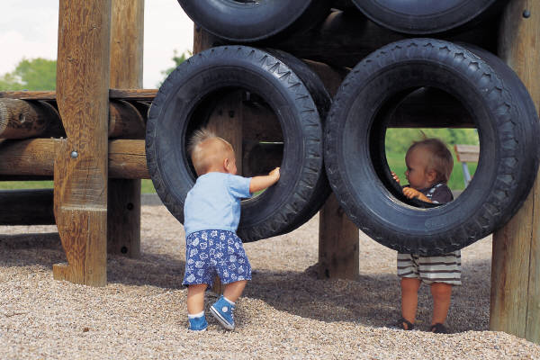
Core MOve Smart Standards
Amount of Physical Activity
90 minutes per day (30 structured)
Advanced – 120 minutes per day (30 structured)
Physical Activity not
Withheld
Equipment Available

Slide 23
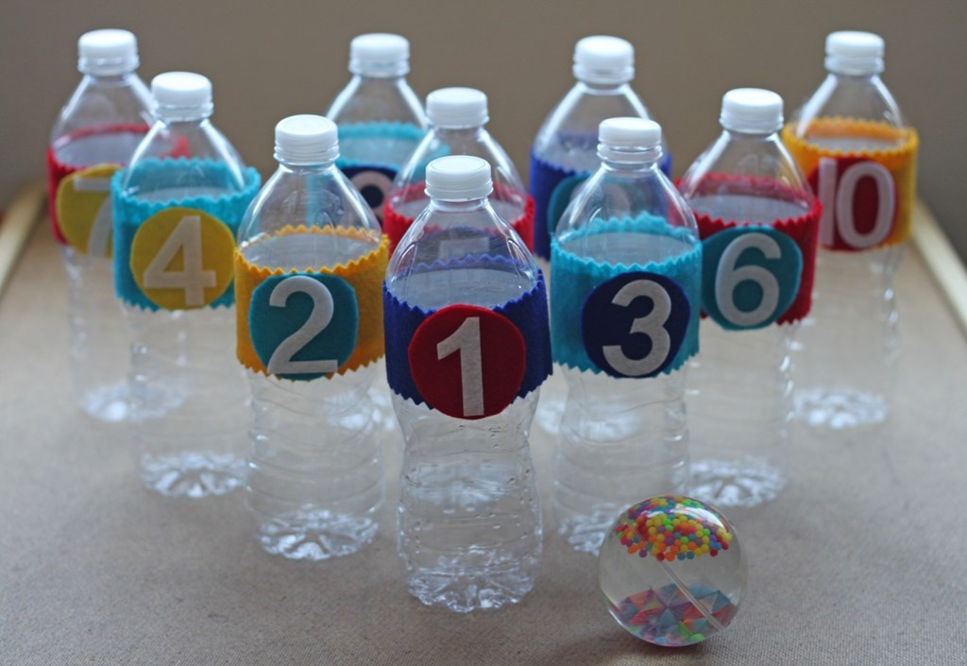
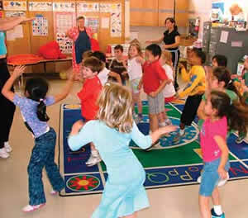
Recognition Level Standards
Indoor Physical Activity
Learning Integrated
Screen Time
Written Policy for Physical Activity

Slide 24
Recognition Level Standards
Staff Education & Training
Sedentary Time Limited
Visual Promotion of Physical Activity
Staff Participation & Role Modeling

Slide 25
Benefits to Child Care
Framed certificate
Permission to use the
MOve Smart logo
A sample press release
Parent informational brochure on MOve Smart
Recognition on the MOve Smart website and Healthy Child Care newsletter

Slide 26
Partnerships
Missouri Department of Social Services
2010 ARRA Funding – provided mini-grants to child care centers to help meet the Eat Smart Guidelines
United States Department of Agriculture
CACFP Child Care Wellness Grant
Team Nutrition Coaching Program

Slide 27
Partnerships
University of Missouri Extension Service
Eat Smart/MOve Smart Coaching Program
Eat Smart/MOve Smart Training
Centers for Disease Control and Prevention – Obesity Prevention Grant
I am Moving, I am Learning Training

Slide 28
Partnerships
Missouri Foundation for Health
Healthy Schools, Healthy Communities Grant
Local Public Health Agencies - Child Care Health Consultants
Eat Smart/MOve Smart training and consultation

Slide 29
Partnerships
Child Care Aware of Missouri - National Early Care and Education Learning Collaborative
Taking Steps to Healthy Success
Missouri Council for Activity and Nutrition (MOCAN)
Eat Smart/MOve Smart strategic goals

Slide 30
Partnerships
Missouri Accreditation of Programs for Children and Youth
Incorporate Eat Smart standards into After School Care Programs and Early Learning Center accreditation standards

Slide 31
Future Projects
Section for Child Care Regulation
Eat Smart/MOve Smart indicators on child care search public portal
Missouri Foundation for Health
Expansion to 10 – 15 additional communities in 2015
Missouri Breastfeeding Friendly Child Care
Program roll-out in fall 2014

Slide 32
Successes
Eat Smart has been highlighted at national conferences
The Missouri Council on Activity and Nutrition (MOCAN) has established Eat Smart as one of its primary goals for Child Care.
Eat Smart has been recognized by the Food Research and Action Center as a state best practice.
Eat Smart has been highlighted in CDC’s Early Care and Learning newsletter and in the “Let’s Move Child Care” newsletter.
In 2014, Eat Smart was awarded the Governor’s Award for Quality and Productivity in the category of Innovation.
Notes:
the National Child and Adult Care Food Program Professional Association (2012 and 2014), the Southern Obesity Summit (2011 and 2014), and the Society for Nutrition Education and Behavior (2013), Academy of Nutrition and Dietetics (2014) and numerous state conferences.

Slide 33
Successes
137 child care centers and 3 family child care homes have been recognized, serving 7,345 children, of which 76% are from low-income families.
Training: 736 hours of in-person Eat Smart training to 3,470 individual child care providers from 2010 through 2013.
296 individuals took Eat Smart training on-line.

Slide 34
Evaluation
Team Nutrition Coaching Program - 2011 grant period
66 centers completed the coaching program
28 have been recognized as Eat Smart
56% decreased the number of sweet items served at breakfast
59% increased the number of whole grain foods served at breakfast
53% increased the number of days they served solid fruit at breakfast instead of fruit juice
56% increased the number of whole grain foods served at lunch
56% increased the amount of fresh fruits and vegetables served at lunch
62% decreased the number of sweet snacks served
62% increased the amount of fruits and vegetables served at snack
69% increased the number of whole grain foods served at snack

Slide 35
Evaluation
CACFP Child Care Wellness Grant - Mini-grants
75 child care centers, 8 sponsors of centers and 3 sponsors of homes
Of the 38 tested variables, 26 variables showed to have statistically significant improvements (test p-value <0.05).
reduced use of high sugar foods
adults eating with children
increased use of no-sugar added fruits and vegetables at breakfast, lunch and snack
healthy celebrations
family style dining
increased use of whole grains at breakfast, lunch and snack
written policies

Slide 36
For Information
Questions?
ann.mccormack@health.mo.gov
Website:
www.health.mo.gov/eatsmart
www.health.mo.gov/movesmart

