Slide 1
Promote, Protect, Perfect CACFP

Slide 2
Promote, Protect, Perfect CACFP
Sonja Carvalho, Administrative Manager
Catholic Charities, Child & Adult Care Food Program
National CACFP Forum, Northeast
Maine Nutrition Council
Full Plates Full Potential

Slide 3
Introduction
Sponsors of Family Child Care Homes (FCCH) are declining along with Family Child Care Homes in many states
How can we ensure the integrity of the CACFP, and increase program access with all the changes taking place?

Slide 4
Most Important
Focus on Communication Skills
Resources & best practices for the successful operation of the CACFP do exist

Slide 5
Communicating with Providers
Be clear at the beginning with providers, so they know EXACTLY what is expected of them
Provide different sources – providers learn differently
Continuous contact – different ways to communicate
Know your boundaries

Slide 6
Don’t Recreate the Wheel Utilize Resources Already Available
USDA
CACFP Meal Pattern Implementation Library
Materials on other state websites
WIC
Nutrition Databases - www.nutritionix.com www.fooducate.com, etc

Slide 7
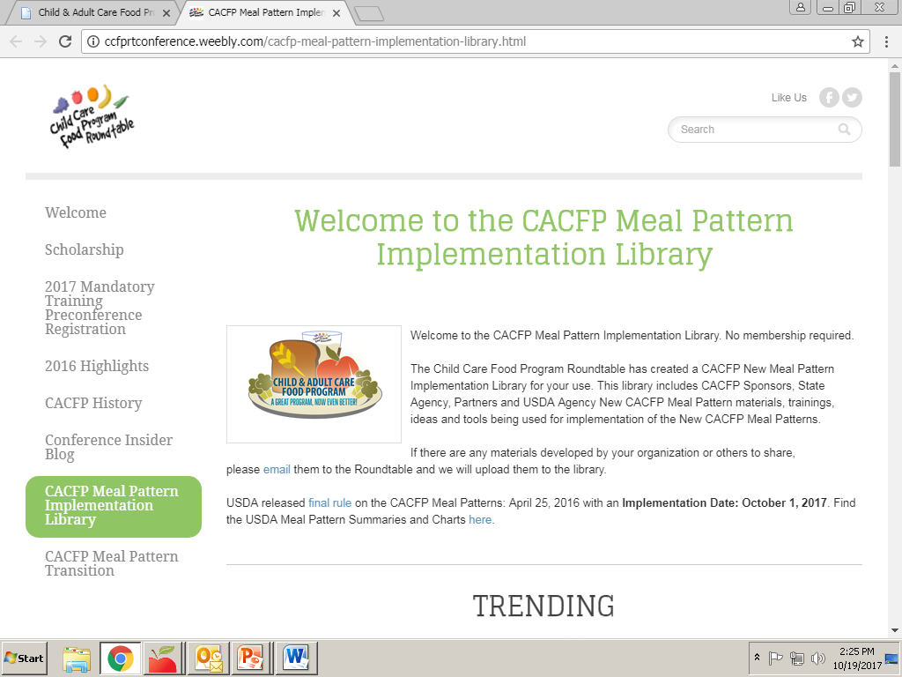

Slide 8
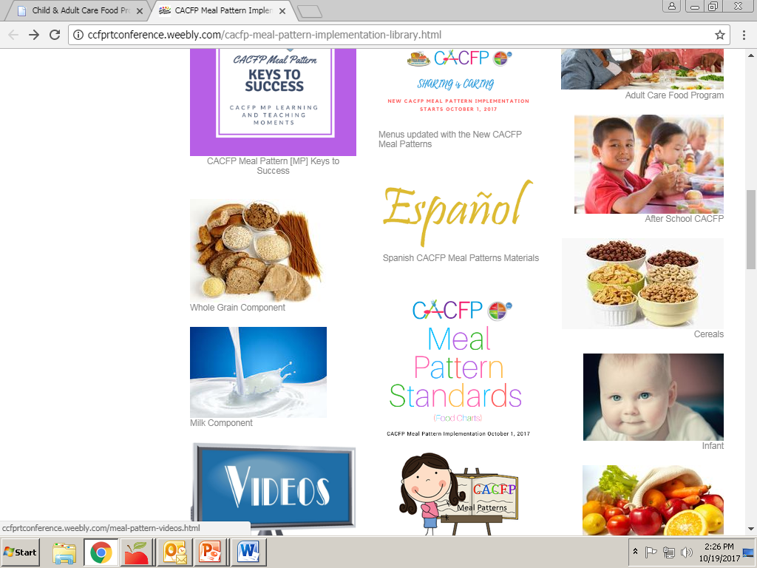

Slide 9
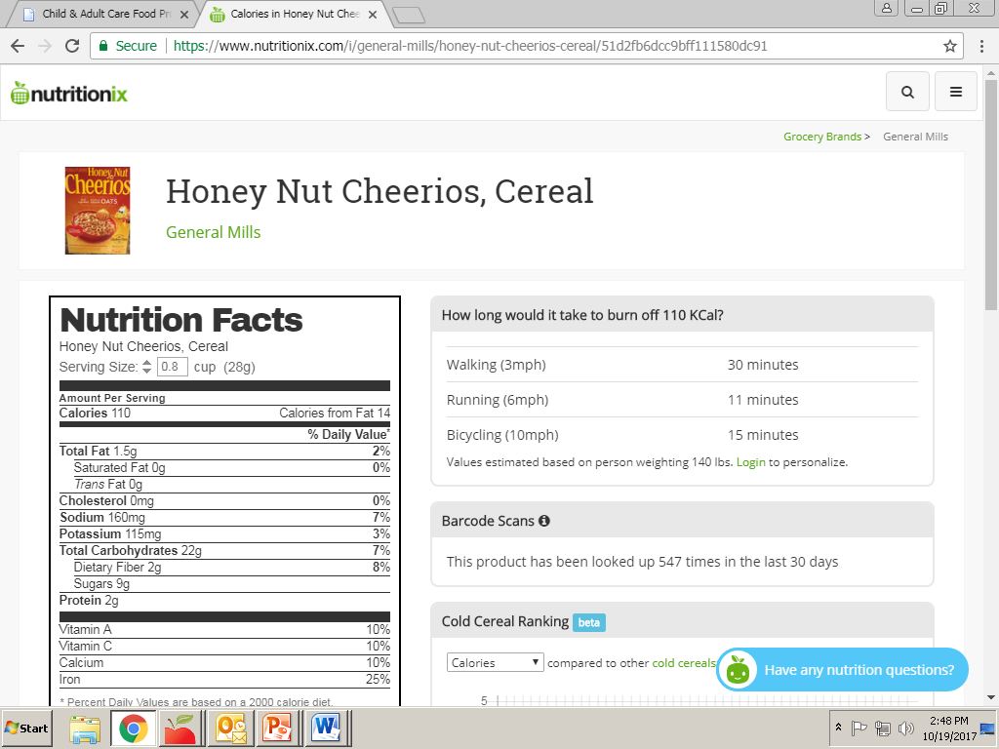

Slide 10
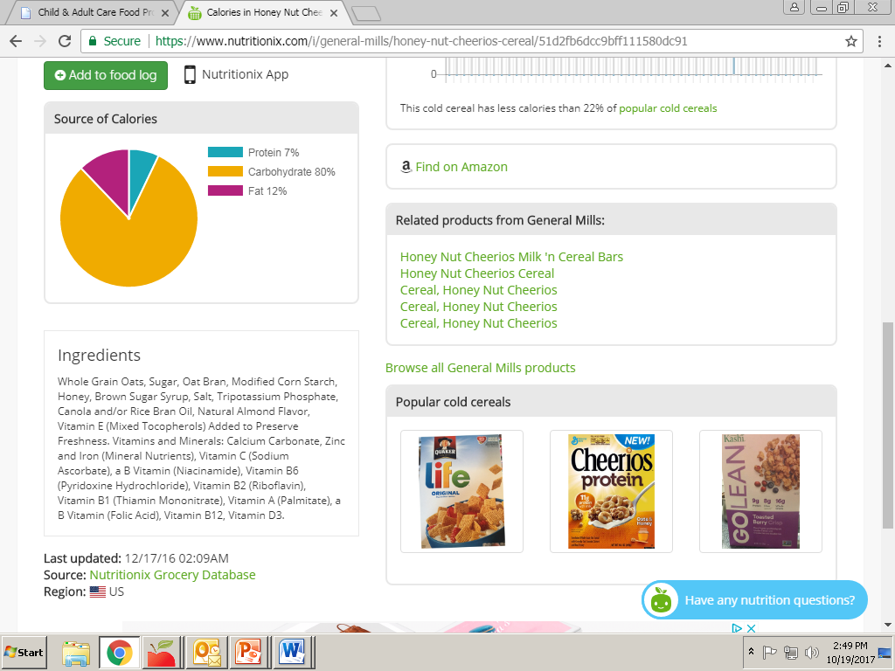

Slide 11
Communicating with Staff
Monitors are the first line of communication
Continuous training
Body language
Role play works wonderfully
Supervisory visits in the field
Office staff should be communicating the same message with providers as monitors
Cross train staff, so everyone knows the effect of their actions

Slide 12
Collaboration
We, as a CACFP community, need to pull together our resources so that we can develop better trainings for success.
CACFP

Slide 13
Ensuring CACFP Integrity (through our own actions)
Be involved in the CACFP Community
Know your regulations
Advocate for opportunities to train and be trained

Slide 14
Be Involved in the CACFP Community
Your voice is better heard in a group.
CACFP organizations have strong partnerships both at the state & national level
National CACFP Forum
National CACFP Sponsor’s Association
CCFP Roundtable (California)
Full Plates Full Potential (Maine)

Slide 15
Know Your Regulations
In world of CACFP, we all follow the same regulations:
7CFR226
796-2 Rev. 4
Learn to communicate your concerns
Work on relationships with your state agencies and other sponsors. We have the same mission – providing nutritious meals for children

Slide 16
Advocate for training opportunities to train and be trained
We are the experts
We can (and should) train
We also require proper training
Search out training resources from other states

Slide 17
Continuous Recruitment (bring on new providers as others leave)
Use every opportunity with everyone you meet to share information about the Child & Adult Care Food Program
Work with state licensing to obtain new provider lists
Post flyers
GET THE WORD OUT!

Slide 18
There are many more steps in ensuring our own integrity in the CACFP.
Many of us are already doing these steps. Now is our time to share and collaborate so that we can utilize the resources and best practices that already exist.

Slide 19
Thank You
scarvalho@ccmaine.org

