Slide 1
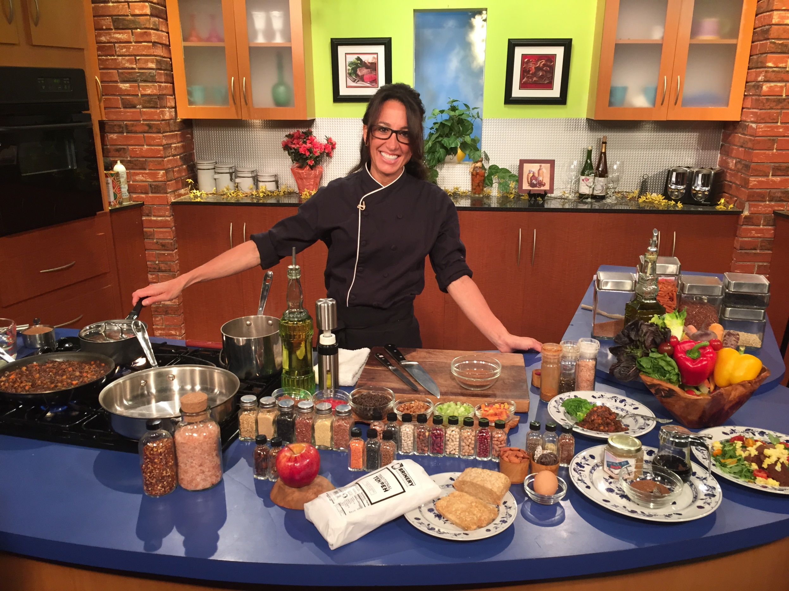
Chef Michelle Bommarito

Slide 2
Putting it to Practice
Chef Michelle Bommarito
Let’s have some fun with the
Meal Pattern Changes

Slide 3
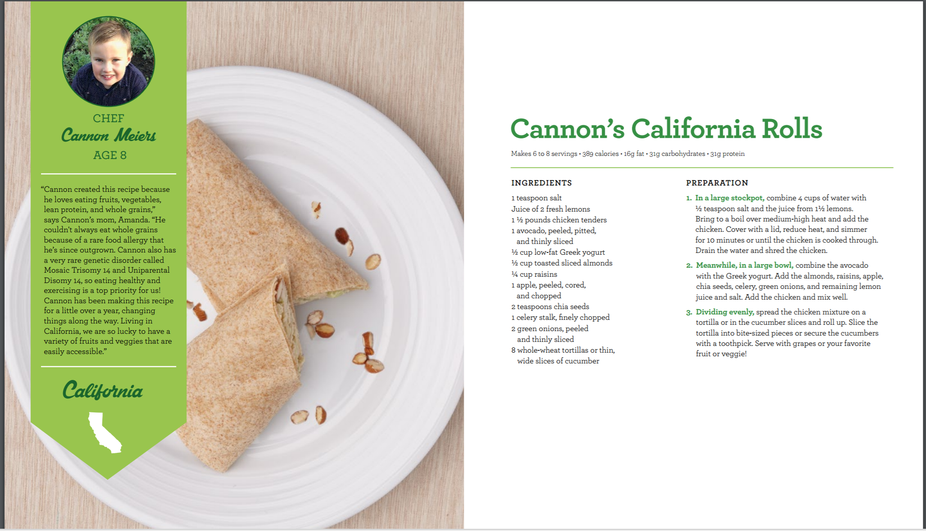
Creditable:
Ages one through two years:
Meat/meat alternate- 24 servings (1 oz.)
Breads/Grains- 32 servings if they are 2oz tortillas
Fruit/Vegetable- 18-20 servings (1/8 cup), (1/4 cup total needed)
Ages three through five years old:
Meat/meat alternate- 18 servings (1 1/2 oz.)
Breads/Grains- 32 servings if they are 2oz tortillas
Fruit/Vegetable- 9-10 servings (1/4 cup), (1/2 cup total needed)
The grains are not calculated to ounce equivalents and the vegetable serving amount can vary as a portion of the total.
For 6-12 year olds this recipes serves roughly:
Protein/meat alternate- 12 servings (2oz.)
Breads/Grains- 16 servings if they are 2oz tortillas
Fruit/Vegetable- 9-10 servings (1/4 cup) (¾ total needed)
Notes:
PREPARATION 1. In a large stockpot, combine 4 cups of water with ½ teaspoon salt and the juice from 1½ lemons. Bring to a boil over medium-high heat and add the chicken. Cover with a lid, reduce heat, and simmer for 10 minutes or until the chicken is cooked through. Drain the water and shred the chicken. 2. Meanwhile, in a large bowl, combine the avocado with the Greek yogurt. Add the almonds, raisins, apple, chia seeds, celery, green onions, and remaining lemon juice and salt. Add the chicken and mix well. 3. Dividing evenly, spread the chicken mixture on a tortilla or in the cucumber slices and roll up. Slice the tortilla into bite-sized pieces or secure the cucumbers with a toothpick. Serve with grapes or your favorite fruit or veggie! Cannon’s California Rolls
INGREDIENTS 1 teaspoon salt Juice of 2 fresh lemons 1 ½ pounds chicken tenders 1 avocado, peeled, pitted, and thinly sliced ½ cup low-fat Greek yogurt ½ cup toasted sliced almonds ¼ cup raisins 1 apple, peeled, cored, and chopped 2 teaspoons chia seeds 1 celery stalk, finely chopped 2 green onions, peeled and thinly sliced 8 whole-wheat tortillas or thin, wide slices of cucumber

Slide 4
A bit about Cannon
“Cannon created this recipe because he loves eating fruits, vegetables, lean protein, and whole grains,” says Cannon’s mom, Amanda. “He couldn't always eat whole grains because of a rare food allergy that he's since outgrown. Cannon also has a very rare genetic disorder called Mosaic Trisomy 14 and Uniparental Disomy 14, so eating healthy and exercising is a top priority for us! Cannon has been making this recipe for a little over a year, changing things along the way. Living in California, we are so lucky to have a variety of fruits and veggies that are easily accessible.”
Cannon Meiers, Age 8, is the 2016 Healthy Lunchtime Challenge
winner from Santa Rosa, California.

Slide 5
Meet up with Chef Michelle in the Exhibitor Learning Expo FIVE MINI CULINARY DEMONSTRATIONS today
◦ Steel Cut Oatmeal Waffles
◦ Lentil Tofu Stew
◦ Caramelized Pinto Bean Burrito and Yogurt Tomato Salsa
◦ Black Bean Sweet Potato Patty
◦ Sweet Vanilla Chia Seed Pudding w/fruit
Notes:
STEEL CUT OATMEAL WAFFLES
Rolled Oats: 1-1/2 cup
Steel Cut Oatmeal: 3/4 cup
Eggs: 2 eggs, beaten
Himalayan Pink Salt:
Place the rolled oats into a medium sauce pan and add in 3 cups of water. Soak overnight in the refrigerator.
Place the steel cut oats into a medium sauce pan and add in 1-1/2 cup of water. Soak overnight in the refrigerator.
The next day, bring the oats separately to a boil and lower to a simmer with the lid on. Allow to cook for approximately 2o minutes. Cool and Reserve.
In a large bowl, combine the oats and add in beaten eggs. Mix together well.
Using a waffle iron on medium heat, place 1/2 cup of mixture onto the hot iron. Press lightly and cook up firm and crispy.
Serve with fruit.
LENTIL TOFU STEW
Carrots: 4 large, peeled and small dice
Celery: 5 stalks, small dice
Tofu: 2 packages, crumbled or diced
San Marzano Tomatoes: Low sodium, 2- 28 ounce cans/ crushed
Lentils: 1 pound, cooked
Himalayan Salt: to taste
Black Pepper
Extra Light Olive Oil
Extra Virgin Olive Oil
Pure Maple Syrup Grade B: Use if a sweeter taste is desired
In a large sauce pan over medium heat, add in 1 tablespoon of Extra light olive oil.
Add in the carrots and stir until golden brown.
Then add in the celery and combine well.
Add in the crumbled pieces of tempeh and allow to get golden brown.
Add in the tomatoes and stir well.
Add in the lentils and combine. Allow to cook together for 10 minutes at a simmer.
Add in salt , pepper to taste. Drizzle in Extra Virgin Olive Oil and Pure Maple Syrup.
Serve over a bed of short grain brown rice.
CARAMELIZED PINTO BEAN BURRITO WITH YOGURT TOMATO SALSA
Pinto Beans: 2 cups
Water/vegetable broth or herbal or green tea: 6 cups
Extra light olive oil (In a misting spray bottle)
Extra virgin olive oil
Himalayan pink salt
Rinse beans in a large bowl of cold water and remove any impurities.
Soak the beans in a covered container overnight in the refrigerator. For larger beans soak for 2 nights. Additional water may be necessary. (Ratio for soaking is 3 cups of water to 1 cup of beans).
Remove from the refrigerator and drain soaking water.
Place the beans in a large stock pot. Cover beans with twice the height with cold water or any desired cooking liquid.
Bring the beans to a boil. At the boil, lower to a simmer and cover with a lid.
Allow the beans to cook until “al dente”…(depending on the size of the bean, the cooking time can range from 45 minutes to 1-1/2 hours).
Remove from heat, drain and rinse under cold water. Reserve.
METHOD FOR CARAMELIZING:
Take a saute pan and heat over medium heat. Using a mister bottle, spray in extra light olive oil.
Add in a small amount of cooked beans. With a meat pounder, wooden spoon or high heat spatula, gently press the beans in a random fashion.
Add in more beans and continue the above process. Make sure to allow some beans to remain whole for texture.
Remove from heat and drizzle with extra virgin olive oil and himalayan pink salt and any other desired seasonings…serve with a whole wheat tortilla, tomatoes lettuce and greek yogurt.
*Any bean taste delicious with this cooking method.
BLACK BEAN SWEET POTATO PATTY
Black Beans: 1-1/2 cups dry and cooked or 3 cups canned
Sweet Potato: 2 cups, cooked/approximately 2 large
Rolled Oats: 3/4 cup
Vegetable Broth or Water: 1-1/2 cup
Tomato Paste Low Sodium: 2 Tablespoons
Eggs: 2 whole
Himalayan Pink Salt:
Rinse beans in a large bowl of cold water and remove any impurities.
Soak the beans in a covered container overnight in the refrigerator. For larger beans soak for 2 nights. Additional water may be necessary. (Ratio for soaking is 3 cups of water to 1 cup of beans).
Remove from the refrigerator and drain soaking water.
Place the beans in a large stock pot. Cover beans with twice the height with cold water or any desired cooking liquid.
Bring the beans to a boil. At the boil, lower to a simmer and cover with a lid.
Allow the beans to cook until “al dente”…(depending on the size of the bean, the cooking time can range from 45 minutes to 1-1/2 hours). Remove from heat, drain and rinse under cold water. Puree half the beans. Reserve.
Scrub the skin of the sweet potatoes under cold water using an allocated kitchen brush. Oven roast the potatoes whole at 375 degrees F for approximately 45 minutes. Allow to cool and then remove the skin. Remove the flesh. Reserve.
Place the Rolled Oats in medium sauce pan and add in the vegetable broth or the water. Bring to a boil and then cover with a lid and simmer for approximately 20 minutes. Reserve.
In a small bowl, beat the 2 eggs together with a whisk. Reserve.
In a large bowl combine the beans, sweet potatoes, cooked rolled oats and tomato paste. Using a rubber spatula “fold” the ingredients together.
Add in the beaten eggs and any desired seasoning such as salt, cumin and black pepper.
Form the mixture into desired size patties and place on a sheet pan lined with parchment paper.
Bake at 375 degrees F for approximately 3o minutes.
Serve as is or with a multi grain bun and lettuce, tomato and any other desired condiments.
SWEET VANILLA CHIA SEED PUDDING
Almond Coconut Milk or Regular Milk: 2 cups
Chia Seeds: 1/2 cup / 3 ounces
Vanilla: 1 teaspoon
Cinnamon: 1 teaspoon
Pure Maple Syrup: 1 Tablespoon
In a large jar with a lid, pour in the 2 cups of the milk.
Add in the chia seeds, vanilla, cinnamon and pure maple syrup.
Place lid on jar and shake vigorously.
Refrigerate overnight with jar on the side.
Serve pudding fresh berries or any other desired fruit.
For a Rich Cocoa Chia Seed Pudding add in 2 Tablespoons of Organic Cocoa Powder or use Chocolate Almond Coconut Milk
For “sweeter” pudding add in more Pure Maple Syrup
Steel Cut Oatmeal Waffles (approximations)
For Breakfast, Lunch, Snack or Supper
Ages one through two years:
Breads/Grains- 16 servings
Ages three through five years old:
Breads/Grains- 16 servings
Ages 6-12 year olds:
Breads/Grains- 8 servings
This recipe does not indicate how many waffles it makes.
The grains are not calculated to ounce equivalents.
Lentil Tofu Stew (approximations)
For Lunch or Supper
Ages one through two years:
Meat/meat alternate- 29 servings (1/4 cup)
Fruit/Vegetable- 64 servings (1/8 cup), (1/4 cup total needed)
Ages three through five years old:
Meat/meat alternate- 19 servings (3/8 cup)
Fruit/Vegetable- 32 servings (1/4 cup), (1/2 cup total needed)
Ages 6-12 year olds:
Protein/meat alternate- 14 servings (1/2 cup)
Fruit/Vegetable- 32 servings (1/4 cup), (¾ cup total needed) OR 16 servings (1/2 cup)
The tofu in this recipe is an extra and will not count as protein until 10/1/2017. The vegetable serving amount can vary as a portion of the total.
Caramelized Pinto bean Burrito with Yogurt Tomato Salsa (approximations)
For Lunch or Supper for the beans only
Ages one through two years:
Meat/meat alternate- 21 servings (1/4 cup)
Ages three through five years old:
Meat/meat alternate- 14 servings (3/8 cup)
Ages 6-12 year olds:
Protein/meat alternate- 10 servings (1/2 cup)
Black Bean Sweet Potato Patty (approximations)
For Lunch or Supper for the patty only
Ages one through two years:
Meat/meat alternate- 16 servings
Fruit/Vegetable- 16 servings (1/8 cup), (1/4 cup total needed)
Breads/Grains- 6 servings
Ages three through five years old:
Meat/meat alternate- 10 servings
Fruit/Vegetable- 8 servings (1/4 cup), (1/2 cup total needed)
Breads/Grains- 6 servings
Ages 6-12 year olds:
Protein/meat alternate- 8 servings
Fruit/Vegetable- 8 servings (1/4 cup), (¾ cup total needed) OR 4 servings (1/2 cup)
Breads/Grains- 3 servings
The vegetable serving amount can vary as a portion of the total.
*One serving would be one creditable portion of the minimum requirement, of course some children will eat more than the minimum portion.
**The last recipe is not creditable toward the meal pattern.

Slide 6
See you in the Exhibitor Learning Expo!
Thank you
All of the recipes used Tuesday will be posted on the conference page.
michelle@michellebommarito.com

