Slide 1



2017 CCFP Roundtable Annual Conference
October 23 – 25, 2017
Squaw Creek, Lake Tahoe
Xaviera Davis, MS Linda Simmons MSHP, RD/LD
Nutritionist Nutrition Specialist
Nutrition Education and Promotion Branch Texas Department of Agriculture
Food and Nutrition Service, Child Nutrition Programs
Notes:
Hi Everyone! Thank you for taking the time to check out our session this morning. Today you will hear from myself Xaviera Davis and I am from the USDA and Linda Simmons from the Texas Department of Agriculture.

Slide 2
Skills for Success: USDA Team Nutrition
Training Materials for the CACFP
Xaviera Davis, MS
Nutritionist
Nutrition Education and Promotion Branch
Food and Nutrition Service, Child Nutrition Programs
Notes:
Hi Everyone! My name is Xaviera Davis and I am a Nutritionist with the Nutrition Education and Promotion Branch at the USDA’s Food and Nutrition Service, in Child Nutrition Programs.
This morning I am here to talk about the resources that we have developed to empower child care providers with the knowledge and skills needed to successfully implement the updated CACFP Meal Pattern Requirements which went into effect earlier this month, October 1st.

Slide 3










An initiative of the
USDA’s Food and Nutrition Service to support the Federal Child Nutrition Programs.
Provides nutrition education and training materials to State agencies, sponsoring organizations, child care centers and family day care homes participating in CACFP.
https://teamnutrition.usda.gov
@TeamNutrition
Notes:
As many of you know, the USDA’s Team Nutrition initiative is here to help you create and support a culture of healthy eating and physical activity habits within your programs.
Team Nutrition supports the Child and Adult Care Food Program through
training and technical assistance for those preparing and serving meals
nutrition education resources for children and their caregivers, and
by helping child care providers create environments that support nutritious food choices and physical activity.
Working together with our State agencies, CACFP sponsoring organizations, and child care centers and family day care homes, and parents and the community we can improve children's lifelong eating and physical activity habits and support learning both inside and outside of child care, day care, and afterschool settings.
I know many of you are already familiar with the vast collection of materials in Team Nutrition’s collection. The focus of today’s session is on a few of the CACFP Meal Pattern Training Tools we released earlier this year.

Slide 4
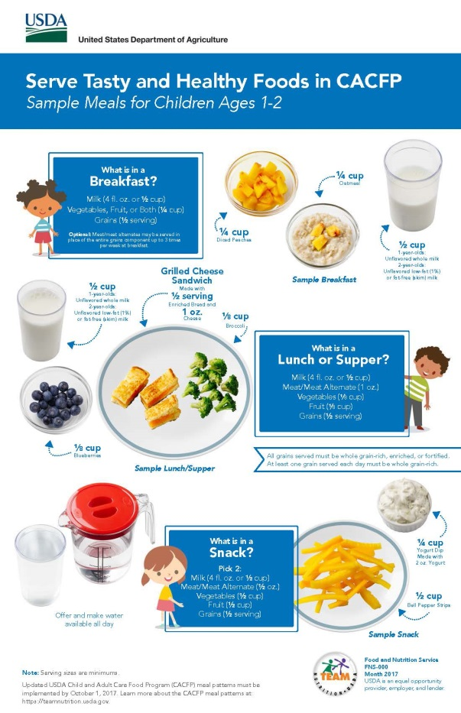
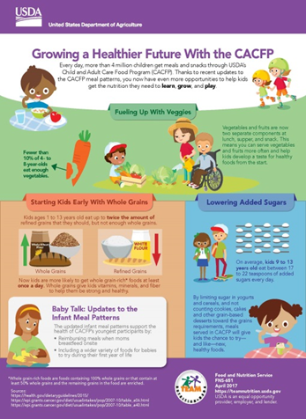
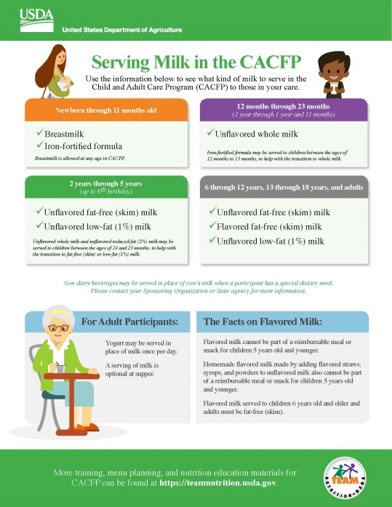
CACFP Meal Pattern Training Tools
Infographic
Poster Set
Training Worksheets
Available in English and Spanish
https://www.fns.usda.gov/tn/cacfp-meal-pattern-training-tools
Notes:
These tools consist of an infographic that highlights some of the updates to the meal pattern. A poster set that provides sample meals and a series of training worksheets on a number of topics, to date we have released 3 and more are under development.
All materials were developed with the input of peer reviewers from State agencies, sponsoring organizations, and other stakeholders with decades of experience in CACFP. We also held feedback groups with providers in Texas and Virginia to make sure that our materials resonated with our target audience, and were appealing and engaging, user-friendly, and useful.
The bulk of this session is going to focus on the worksheets but before that we will review some of key features of the infographic and posters.

Slide 5


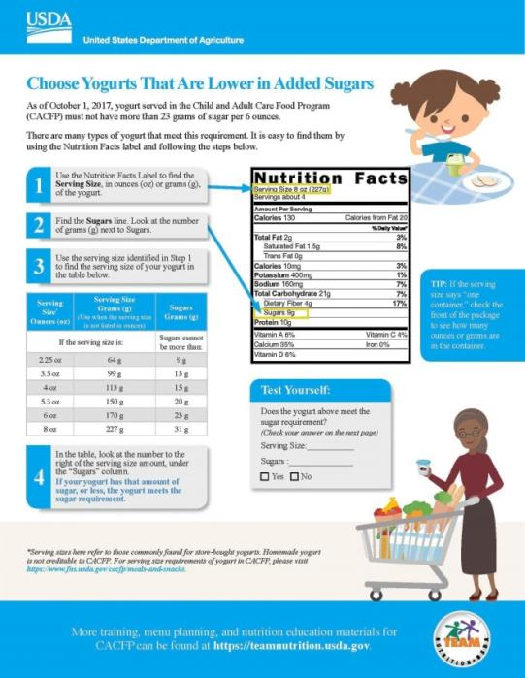
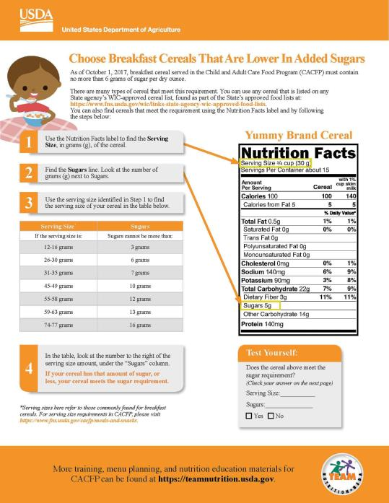
CACFP Meal Pattern Training Tools
Growing a Healthier Future with the CACFP Infographic
Notes:
The infographic was specifically designed for the CACFP, and it is titled “Growing a Healthier Future With the CACFP.”
This infographic is meant generate awareness about how changes to the CACFP meal patterns help support children’s learning, growth, and health.
As you can see, it takes a look at what children are eating now, and how the meal pattern updates can help kids get even more of the foods and nutrients that they need to grow and be healthy long after childhood is over!

Slide 6
Fueling Up With Veggies
Notes:
The infographic has 4 key sections.
The top of the infographic gives an overview of CACFP and the updates to the meal pattern. It also talks about the importance of Fueling Up with Vegetables. To the left of the image we share information about the percentage of children ages 4 to 8 that eat enough vegetables, and on the right we talk about how the updated meal pattern can provide children more opportunities to try and consume vegetables during he day. The goal is that increased exposure to vegetables will make eating them a healthy habit.

Slide 7
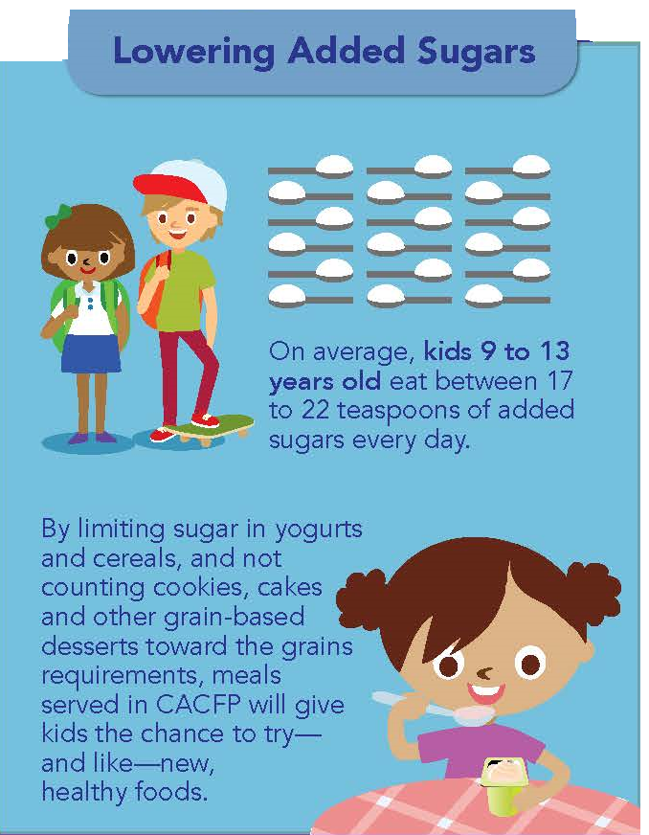
Lowering Added Sugars
Notes:
The 2nd part of infographic also looks at how much added sugars children are eating; in this example we use 9 to 13 year olds, and again we talk about how updates in the CACFP meal pattern can help lower the amount of added sugars in children’s diets

Slide 8
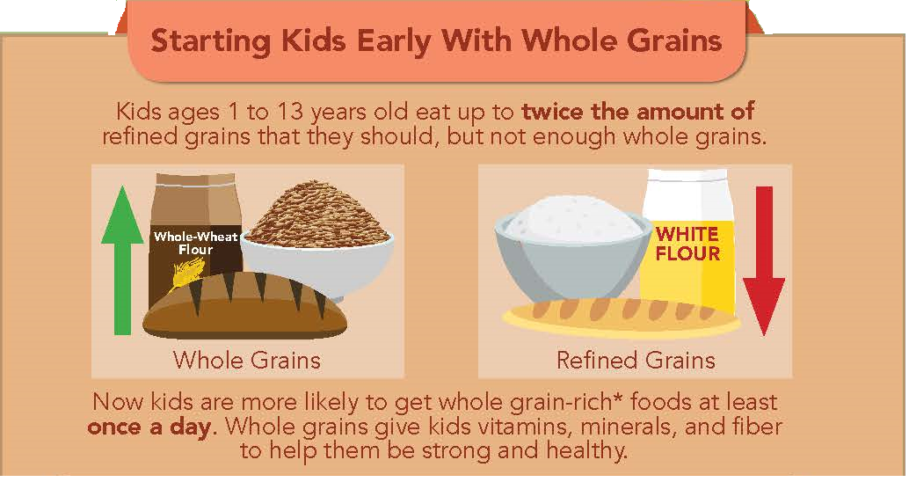
Starting Kids Early With Whole Grains
Notes:
The 3rd part of the infographic looks at the amount of whole grains and refined grains children are eating, and how the meal pattern can help make sure children get the whole grains they need.

Slide 9
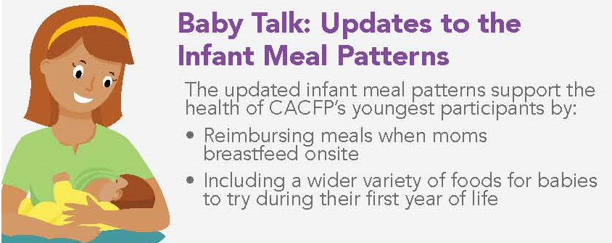
Updated Infant Meal Patterns
Notes:
Finally, the infographic highlights the benefits of the meal pattern updates for our youngest participants: infants, including the reimbursement centers receive when moms breastfeed onsite and the greater variety of foods that will be allowed in the updated meal pattern.

Slide 10
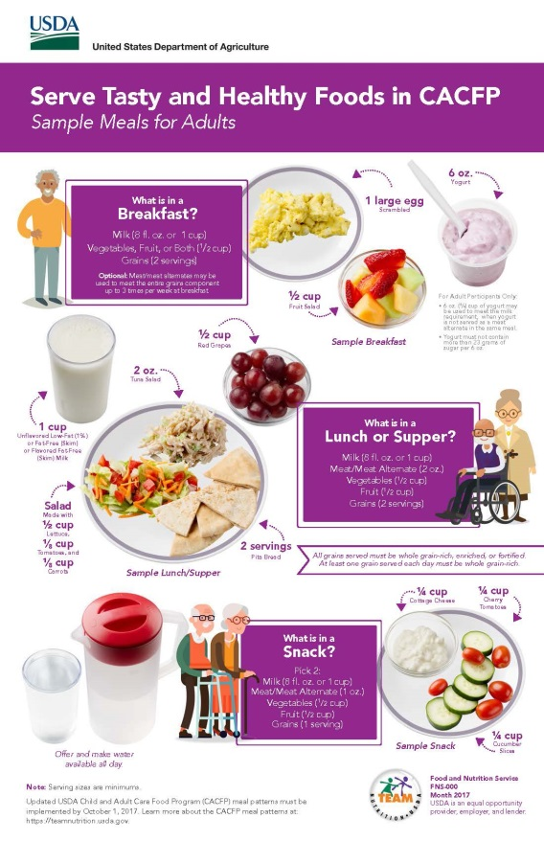
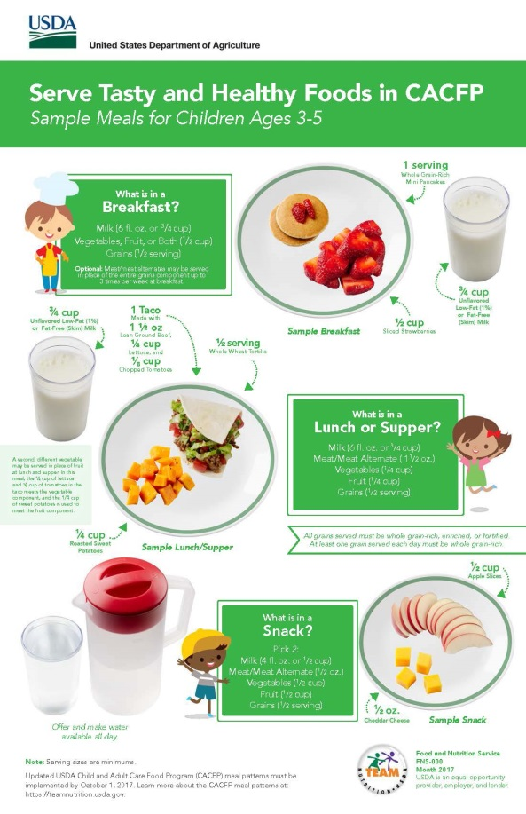
CACFP Meal Pattern Training Tools
Serve Tasty and Healthy Meals in the CACFP posters:
  Sample Meals for Children Ages 1-2
  Sample Meals for Children Ages 3-5
  Sample Meals for Children Ages 6-12 and 13-18
  Sample Meals for Adults
Notes:
We have also released a set of posters that visually depicts the meal patterns for the different age groups ( 1-2, 3-5, 6-12 and 13-18 as well as adults). The images for the posters represent actual CACFP serving sizes

Slide 11
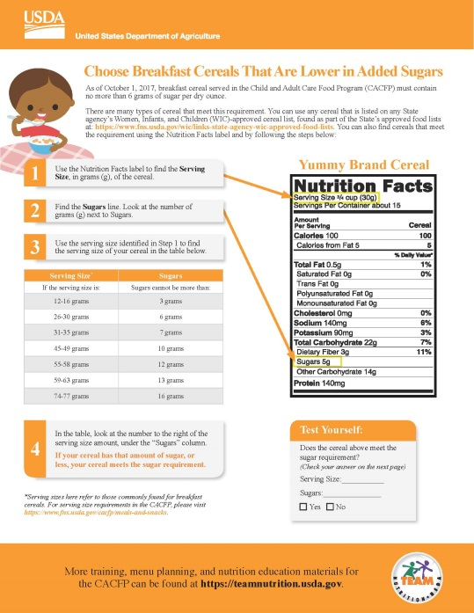

CACFP Meal Pattern Training Tools
New!
Training Worksheets:
  Methods for Healthy Cooking
  How to Serve Meat and Meat Alternates Instead of Grains at Breakfast
  Identify Foods That Are Whole Grain-Rich
  Grain-Based Desserts in the CACFP
  Serve Tasty Whole Grain-Rich Foods While Staying on a Budget
  Offer Versus Serve In the CACFP
Notes:
We are also working on releasing a series of worksheets.
--Methods for Healthy Cooking
Choose Yogurts That Are Lower in Added Sugars
--Choose Breakfast Cereals That Are Lower in Added Sugars
--Serving Milk in the CACFP
--How to Serve Meat and Meat Alternates Instead of Grains at Breakfast
--Identify Foods That Are Whole Grain-Rich
--Grain-Based Desserts in the CACFP
--Serve Tasty Whole Grain-Rich Foods While Staying on a Budget
--Offer Versus Serve in the CACFP

Slide 12
CACFP Meal Pattern Training Tools
New!!!
Training Worksheets:
  Choose Yogurts That Are Lower in Added Sugars
  Choose Breakfast Cereals That Are Lower In Added Sugars
  Serving Milk in the CACFP
Notes:
Great! So now we will turn to take a deeper look into three training worksheets that you see on the screen:
---Choose Yogurts That Are Lower in Added Sugars
--Choose Breakfast Cereals That Are Lower in Added Sugars
--Serving Milk in the CACFP
Should have received the worksheets, if you did not please raise you hand and someone will get them to you.

Slide 13
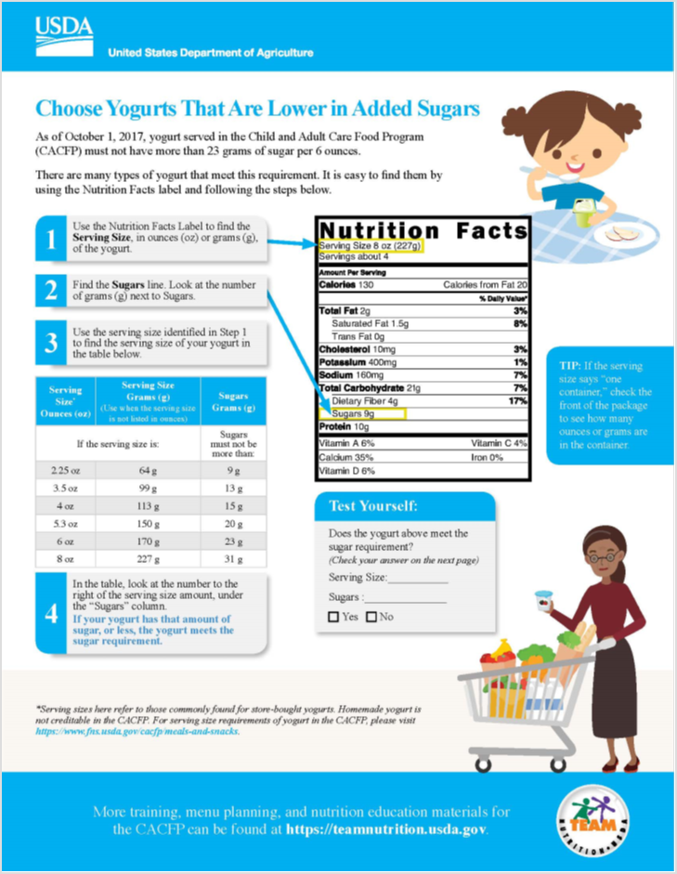

Choose Yogurts That Are Lower in Added Sugars
Notes:
The worksheet is one page, front and back.
The front:
has a brief sentence with the implementation date and the rule regarding the amount of sugars in yogurt, as well as a brief overview of how to use this worksheet
It also walks you through the steps of how to find yogurts that meet the sugar limit using the Nutrition Facts Panel

Slide 14
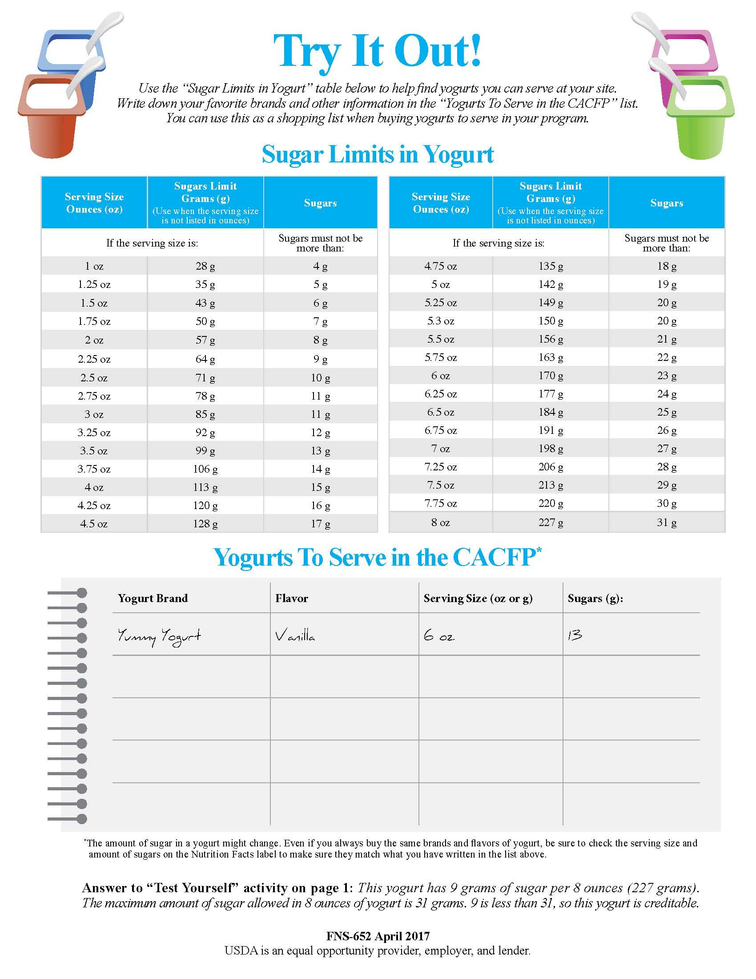
Notes:
On the back of the sheet you’ll also see that there is more extensive chart of the yogurt by weight. The front had what we liked to call the “greatest hits’, or more commonly found amounts of yogurt on a nutrition facts label, but we know manufacturers may come up with new products that come in different serving sizes. So, this way you are covered no matter the yogurt you choose!

Slide 15

Notes:
The back of the worksheet also has a list that people can use to write down their favorite brand and flavor of yogurt that are creditable, so they can use it as a shopping list.
Because we know that yogurt formulations can change from time to time, we also include a note reminding users to check the nutrition facts label on the yogurt every time to make sure their yogurt meets the sugar limit.
Does anyone have any questions about this activity so far? Great! Let’s do a few more examples.

Slide 16
Choose Yogurts That Are Lower in Added Sugars
Notes:
Now lets review the 4 easy steps that will help you identify a yogurt that meets the sugar limit of ( 23 grams per 6 ounces of yogurt).
Step 1: points to the Nutrition Facts label and asks you to find the Serving Size of the yogurt, either in oz or grams,
Step 2: locate the amount of sugars in the product
As you see here, the serving size is listed in ounces and in grams. Many yogurts will list both, but some containers will only list ounces, while others only list grams.
Sometimes the label may also say “one container”, and then you would have to look at the weight of the container, usually on the front of the yogurt, to find the weight.
Luckily, for sugars, they are only listed in grams!
So once you have identified your serving size and your sugars, you can move on to step 3.

Slide 17
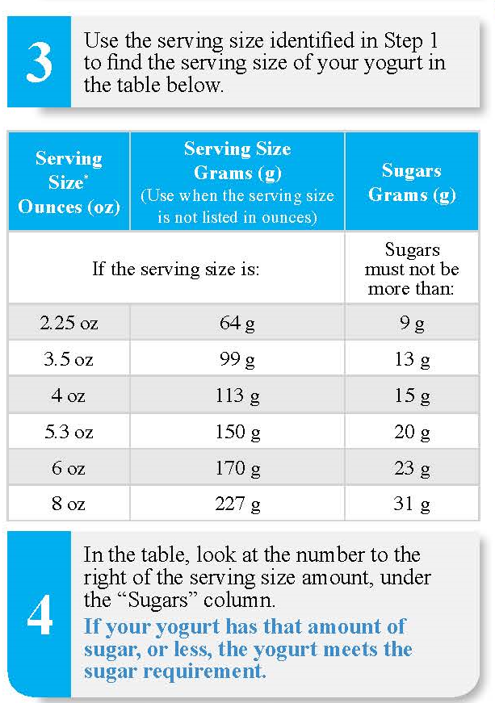
Choose Yogurts That Are Lower in Added Sugars
Notes:
Step 3: asks you to find your serving size in the chart below. Again, we give the option of using ounces or grams.
.

Slide 18
Choose Yogurts That Are Lower in Added Sugars
Notes:
Step 4 asks you to look at amount of sugar listed next to the serving size in the chart. This is the maximum amount of sugar that a yogurt can contain, based on its serving size.
If the amount of sugar in your yogurt is equal to, or less than that number, then the yogurt is creditable.

Slide 19
Choose Yogurts That Are Lower in Added Sugars
Notes:
So, for example, if you have 4 oz of yogurt, the maximum amount of sugar you can have would be 15 grams.

Slide 20
Choose Yogurts That Are Lower in Added Sugars
Notes:
Great! So we can also practice this with the Nutrition Facts Label of the yogurt on this page. I’ll give you a minute now to go through the steps on your own and fill out the Test Yourself box on the front. Look up at me when you are done.
Ok, it looks like most people are done. Let’s go through the answer together. What is the serving size of this yogurt?

Slide 21
Choose Yogurts That Are Lower in Added Sugars
8 oz/ 227 grams
Notes:
Yep! 8 oz, or 227 grams.
And how many grams of sugars does it have?

Slide 22
Choose Yogurts That Are Lower in Added Sugars
8 oz/ 227 grams
9 grams
Notes:
9 grams! So, does this yogurt meet the sugar requirement?

Slide 23
Choose Yogurts That Are Lower in Added Sugars
8 oz/ 227 grams
9 grams
Notes:
Yes! Yes it does! As you can see on the chart, the maximum amount of sugar allowed in 8 oz of yogurt is 31 grams. Because this yogurt only has 9 grams of sugar, it is below the limit of 31 grams of sugar, and therefore meets the sugar requirement for yogurt in the CACFP

Slide 24
Notes:
This answer is also on the back of the worksheet, on the bottom so people can check their work on their own.

Slide 25
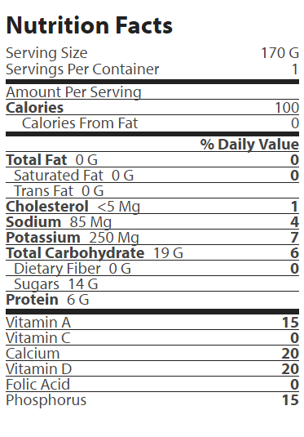
Try It Out!
Which yogurts can you add to your list?
A Brand Strawberry Yogurt
B Brand
Blueberry Yogurt
Notes:
Here you see the nutrition facts label for two different yogurts. Take a look at the Nutrition Facts label and use the chart on the worksheet to decide which yogurt or yogurts meets the sugar limit. You can write it down on your “Yogurts to Serve in CACFP” list.
NEXT SLIDE

Slide 26
Try It Out!
Which yogurts can you add to your list?
A Brand Strawberry Yogurt
B Brand
Blueberry Yogurt
Notes:
So go ahead and do that now, and look at up at me when you are done.
Ok! Let’s take a look at our answers. Can we add yogurt A?

Slide 27
Try It Out!
Which yogurts can you add to your list?
A Brand Strawberry Yogurt
Notes:
Yogurt A

Slide 28
o
A Brand Strawberry 170 g 14
Notes:
Yep, A brand yogurt meets the sugar limit, so we can add it to our List. What about B brand yogurt

Slide 29
Try It Out!
Which yogurts can you add to your list?
B Brand
Blueberry Yogurt
Notes:
Yogurt B

Slide 30
Try It Out!
Which yogurts can you add to your list?
B Brand
Blueberry Yogurt
Notes:
Yogurt B

Slide 31
o
A Brand Strawberry 170 g 14
B Brand Blueberry 5.3 oz/ 150g 15
Notes:
Yep! B brand yogurt made the list too.

Slide 32

Choose Breakfast Cereals That Are Lower in Added Sugars
Notes:
The top of the page has a brief sentence with the implementation date and the rule. This worksheet also points out that any cereal on any State’s WIC cereal list, as part of the overall WIC-approved foods list, will meet the sugar requirement in CACFP. So if you know your cereal is on a State’s WIC list, you will not have to do any further calculations. If your cereal is not on any State’s list, you can also use this worksheet to see if your breakfast cereal meets the sugar limit.
Please remember that once you determine if a cereal meets the CACFP sugar limit, you must do some further investigation. To be creditable in the CACFP a cereal must meet the sugar limit and be made with enriched, fortified or whole grains.

Slide 33

Choose Breakfast Cereals That Are Lower in Added Sugars
Notes:
The cereal worksheet is very similar to the yogurt worksheet, in that it’s one page front and back. The first page focuses on the steps of how to find yogurts that meet the sugar limit using the Nutrition Facts Panel

Slide 34
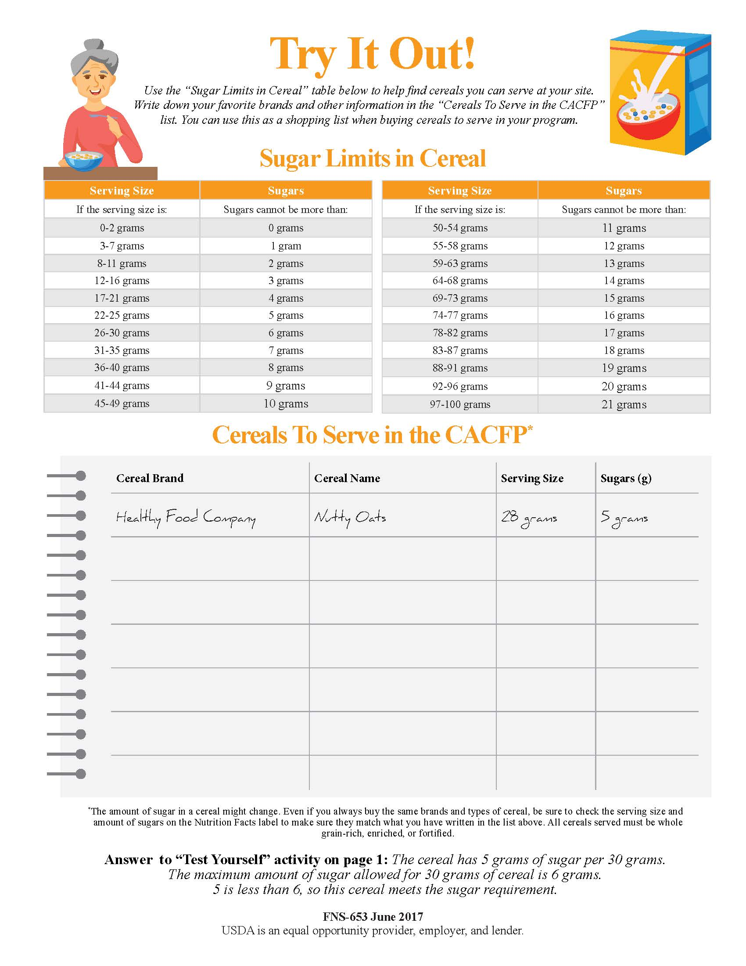
Notes:
On the back of the sheet you’ll also see that there is more extensive chart of cereal serving sizes, listed by weight. The front had what we liked to call the “greatest hits’, or more commonly found amounts of cereal on a nutrition facts label, but we know manufacturers may come up with new products that come in different serving sizes. So, this way you are covered no matter the cereal you choose!

Slide 35
Notes:
The back of the worksheet also has a list that people can use to write down their favorite brand and flavor of cereal that are creditable, so they can use it as a shopping list.
Because we know that cereal formulations can change from time to time, we also include a note reminding users to check the nutrition facts label on the cereal every time to make sure their cereal meets the sugar limit.

Slide 36
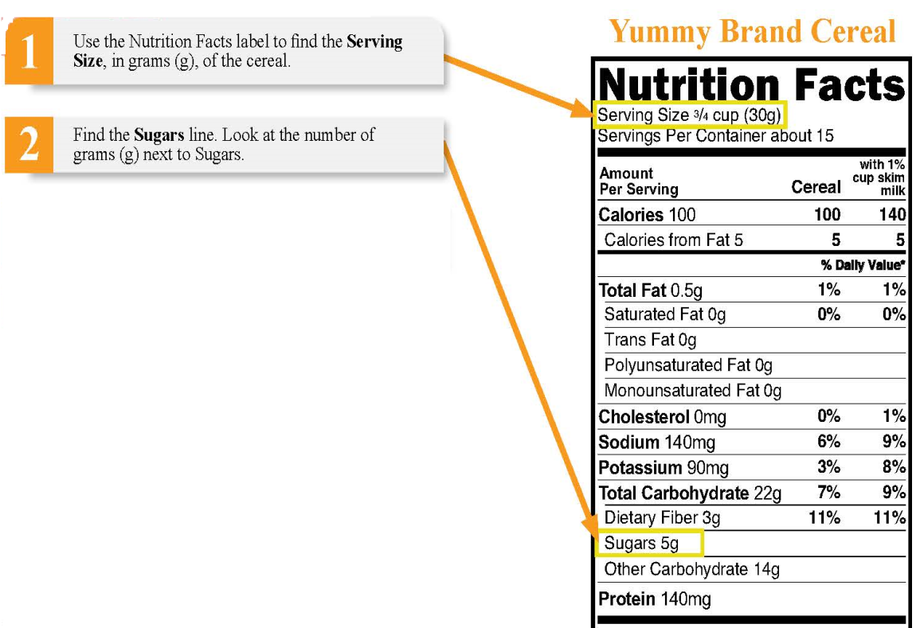
Choose Breakfast Cereals That Are Lower in Added Sugars
Notes:
Again you have your four steps, with the first steps of finding the Serving Size, in grams, of the cereal. Remember that for yogurt, you looked at ounces and grams, but here you are just looking at grams. Many times cereals will also list servings in cups—here you have ¾ cup of cereal—but you only have to pay attention to grams here.
Once you have your Serving size, you can then look at the amount of sugars in one serving of the cereal.

Slide 37
Choose Breakfast Cereals That Are Lower in Added Sugars
Notes:
In Step 3, you take the serving size of the cereal, and look at which row it belongs to under “Serving Size”. Here serving sizes are listed as a range, so find the range that’s appropriate for your serving size. For example, if my serving size for cereal was 27 grams, which row would it belong in? (the 26-30 grams range).

Slide 38
Choose Breakfast Cereals That Are Lower in Added Sugars
Notes:
Perfect! 27 is between 26 and 30 grams, so you would look at the 26-30 grams row on this chart.

Slide 39
Choose Breakfast Cereals That Are Lower in Added Sugars
Notes:
Step 4 asks you to look at maximum amount of sugar listed next to the serving size in the chart. If the amount of sugar in your cereal is less than or equal to that number, then the cereal is creditable.

Slide 40
Choose Breakfast Cereals That Are Lower in Added Sugars
Notes:
So, for our 27 gram serving of cereal, what’s the most amount of sugar it can have? 6 grams!
Great! What if we had a 31 gram serving of cereal?

Slide 41
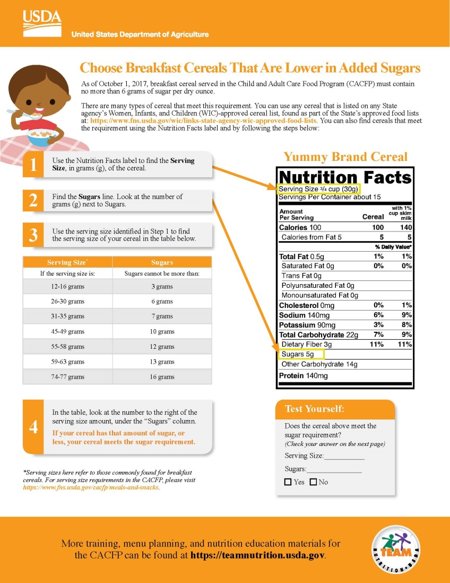
Choose Breakfast Cereals That Are Lower in Added Sugars
Notes:
And again, you can test your knowledge with example given on the front. I’ll give you a minute now to try it on your own. Again take a look at me when you are done!
Ok, it looks like most people are done. Let’s go through the answer together…..
What’s the serving size here? 30 grams

Slide 42
Choose Breakfast Cereals That Are Lower in Added Sugars
30 grams
Notes:
Perfect! 30 grams. How much sugar is in one serving of this cereal? You’re right, 5 grams!

Slide 43
Choose Breakfast Cereals That Are Lower in Added Sugars
30 grams
5 grams
Notes:
Perfect! So, looking at the chart on your worksheet---is this cereal creditable?!

Slide 44
Choose Breakfast Cereals That Are Lower in Added Sugars
30 grams
5 grams
Notes:
It sure is!
As you can see on the chart, the maximum amount of sugar allowed in 30g of cereal is 6 grams. Because this cereal only has 5 grams of sugar per serving, it is below the limit of 6 grams of sugar, and therefore meets the sugar requirement for cereal in the CACFP

Slide 45
Notes:
Just like the yogurt worksheet, the answer is also on the back of this worksheet, on the bottom so people can check their work on their own.

Slide 46
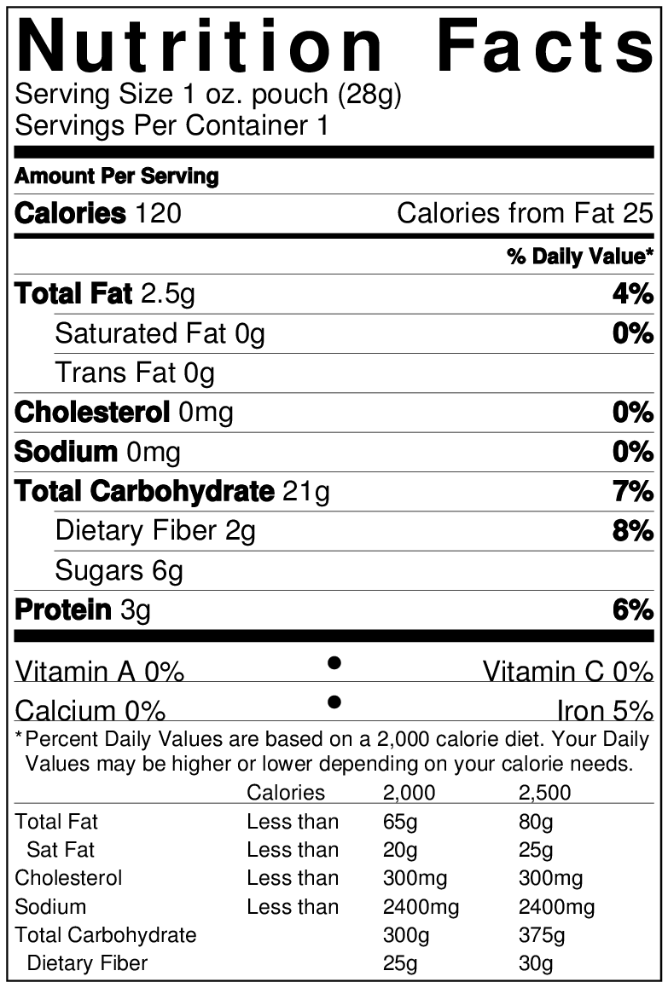
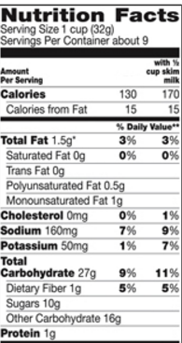

Try It Out!
Which cereals can you add to your list?
C Brand
Great Granola
Cereal
D Brand
Funny Flakes
Cereal
Notes:
Now I’ll give you guys a few minutes to practice. Here you see the nutrition facts label for two different cereals. Take a look at the Nutrition Facts label and use the chart on the worksheet to decide which cereal or cereals meets the sugar limit. You can write it down on your “Cereals to Serve in the CACFP” list. –NEXT SLIDE

Slide 47
Try It Out!
Which cereals can you add to your list?
C Brand
Great Granola
Cereal
Notes:
Yep! We can add C brand granola cereal to the list.
C Brand Great Granola cereal---6 grams of sugars per 1 oz serving. I want to take a minute here to point out that the label 28 grams as being equal to one ounce. An ounce is actually equal to 28.35 grams, but because weights are rounded down to the nearest whole number when the number after the decimal point is less than .5, this label lists the weight as 28 grams.

Slide 48
o
C Brand Great Granola 28 g 6g
Notes:
Great! So we have added C Brand Great Granola Cereals to our list.

Slide 49
Try It Out!
D Brand
Funny Flakes
Cereal
Notes:
How about D brand Funny Flakes cereal?

Slide 50
Try It Out!
Which cereals can you add to your list?
D Brand
Funny Flakes
Cereal
Notes:
How about D brand Funny Flakes cereal?
D Brand Funny Flakes cereal has 10 grams of sugar per 32 grams. The most sugar allowed for 32 grams (which falls between 31 to 35 grams) is 7 grams. So this cereal has too much sugar per serving to be reimbursable in CACFP.
.

Slide 51
Serving Milk in the CACFP
Notes:
Finally, our third worksheet that was released today is the Serving Milk in the CACFP Worksheet. As the name implies, here we go through the types of milks allowed for each age in the CACFP.

Slide 52
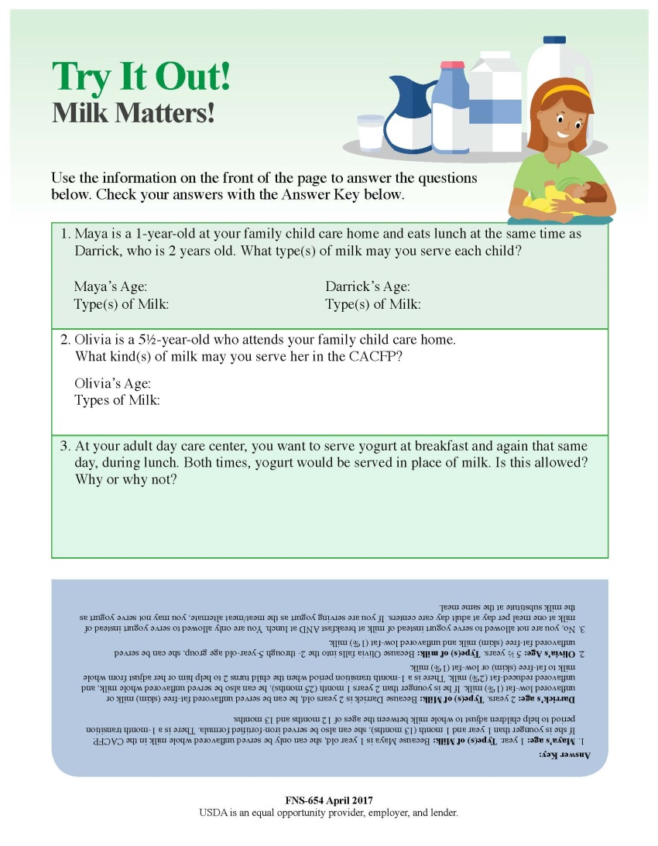
Serving Milk in the CACFP
Notes:
The back includes some activities to help with understanding and comprehension.

Slide 53
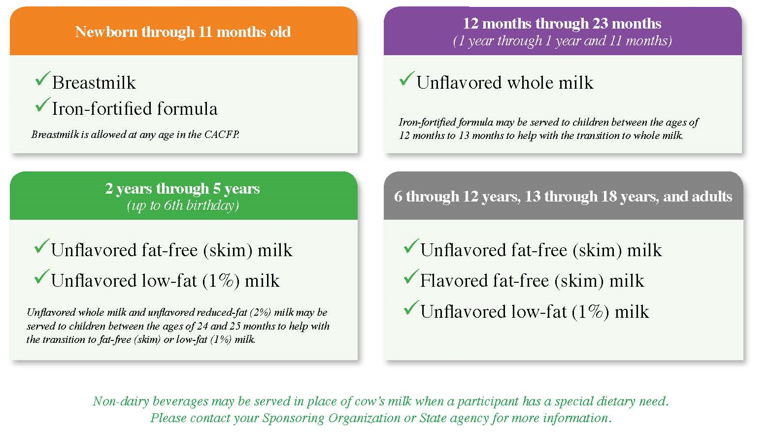
Serving Milk in the CACFP
Notes:
Here we go through the types of milks allowed for each age in the CACFP. This also notes that breastmilk is allowed at any age in the CACFP, the transition period from that allows iron-fortified formulas for one-year olds, and the transition period that allows reduced fat (2%) milk for 2-year-olds. Because there are many situations and scenarios where non-dairy beverages may need to be served, there is a note for the provider to work with their Sponsor or State agency as needed.

Slide 54
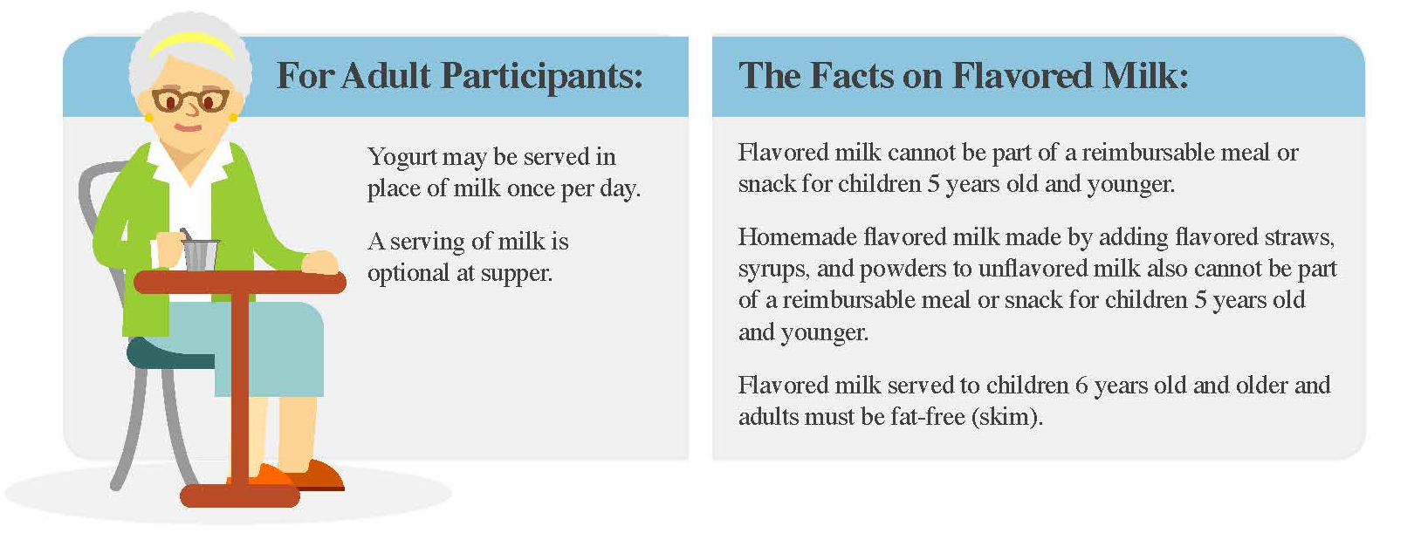
Serving Milk in the CACFP
Notes:
We also highlight the flexibilities for milk for Adult participants only, namely how yogurt may be served in place of milk once per day, and how a serving of milk is optional at supper.
Finally, we add some clarification regarding flavored milk in the CACFP, namely that it cannot be part of a reimbursable meal or snack for children 5 years old and younger, whether it is store bought or homemade with flavored straws, powders, or syrups. Flavored milk served to children 6 years and older, and adults, must be fat-free (skim).

Slide 55
Serving Milk in the CACFP
Notes:
Just like the other worksheets, the back has a “Try It Out!” section which takes you through different scenarios about what kind of milk can be served to a participant in a given situation. Let’s take a minute now to do questions 1 and 3. I”ll give you a few minutes; please look at me when you are done.
What was your answer for Question 1? How old is Maya? What kind of Milk can she be served?

Slide 56
Serving Milk in the CACFP
1
Unflavored Whole Milk
Notes:
Great! What about Darrick? How old is he? What kind of milk can he be served?

Slide 57
Serving Milk in the CACFP
1
2
Unflavored Whole Milk
Unflavored skim (fat-free) milk; Unflavored low-fat (1%) milk.
Notes:
Perfect! Because Darrick is 2, he can have unflavored skim (fat-free) milk and unflavored low-fat (1%) milk.
TIME PERMITTING—PROBE FOR TRANSITION PERIOD.
What if Maya just turned one 2 days ago. Are there other kinds of milk could she be served for a reimbursable meal or snack?—Breastmilk, iron-fortified formula.
What if Darrick just turned 2 las week. What other kinds of milk could he be served for a reimbursable meal or snack? 2% (reduced fat) mil,.
Ok, what about the adult day care---can you serve yogurt at breakfast and lunch in place of milk in the same day? Why or why not?

Slide 58
Serving Milk in the CACFP
1
2
Unflavored Whole Milk
Unflavored skim (fat-free) milk; Unflavored low-fat (1%) milk.
No, you may only serve milk INSTEAD of yogurt once per day, to adult participants only.
Notes:
Perfect! Because Darrick is 2, he can have unflavored skim (fat-free) milk and unflavored low-fat (1%) milk.
TIME PERMITTING—PROBE FOR TRANSITION PERIOD.
Ok, what about the adult day care---can you serve yogurt at breakfast and lunch in place of milk in the same day? Why or why not?

Slide 59
Serving Milk in the CACFP
Notes:
There is a more extensive answer key at the bottom of the page, upside down, where you can check your answers as well.
What questions do you have for me about this worksheet, or about milk in general?

Slide 60
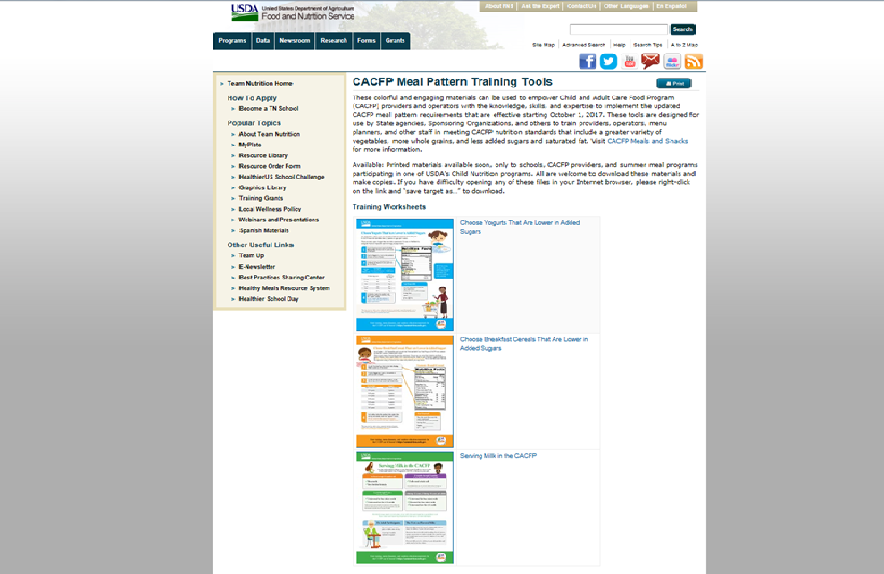
Notes:
Great! Well, just to wrap up, if you’d like to try this again at home, our worksheets are now available on the Team Nutrition Website at the link you see at bottom of this slide. The infographic is also on the bottom of this page.

Slide 61



Follow Us on
@TeamNutrition
Notes:
You can also go to the Team Nutrition website, which has a simpler web address, and you’ll see that our materials are highlighted as two of the spotlights on the bottom.

Slide 62
Follow Us on
@TeamNutrition
Notes:
To explore more of Team Nutrition’s materials, you can click on “Resource Library” on the left tool bar to see all of our resources that are available online.

Slide 63
Notes:
From the Resource Library, you can sort by audience to find resources for child care.

Slide 64
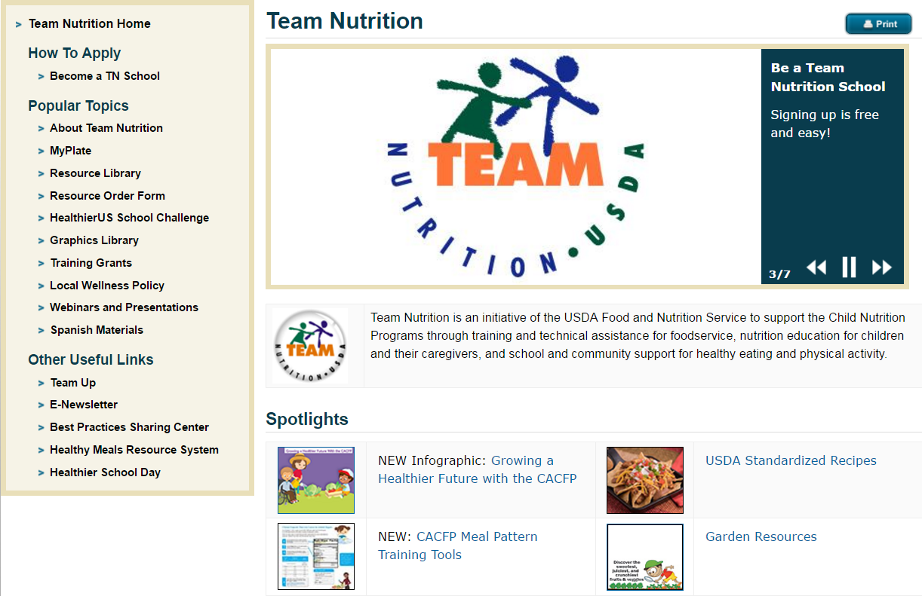
How To Order Print Copies
FREE!
Resource Order Form at teamnutrition.usda.gov.
  FREE for those participating in a Child Nutrition program
  Sponsoring Organizations and State agencies can also order in bulk.
  TeamNutrition@fns.usda.gov
Notes:
From the homepage, you can also access the Resource Order Form to order print copies of Team Nutrition Materials. Print copies are FREE for those participating in the USDA Child Nutrition Programs, including shipping! It’s like Amazon, but better b/c you don’t even need your credit card!
Sponsors and State agencies can also order in bulk—just email TeamNutrition@fns.usda.gov for more details.

Slide 65
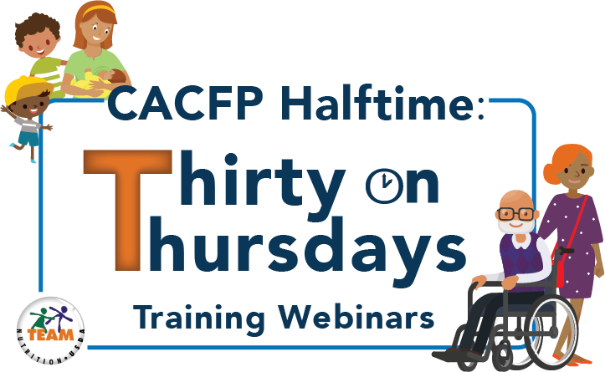
Notes:
Thank you for joining us to help kick-off our CACFP webinar series that we are calling “CACFP Halftime: Thirty on Thursdays”. These webinars will be held on the third Thursday of every month in both English and in Spanish. The English webinar will be held from 2-2:30pm Eastern time and the Spanish webinar will be held after the English webinars from 3:00-3:30 Eastern time.
These webinars will be recorded and made available at a later date on the Team Nutrition website.

Slide 66

Thank you!
https://teamnutrition.usda.gov
TeamNutrition@fns.usda.gov
@TeamNutrition
Follow us on

Slide 67
Linda Simmons
Texas Department of Agriculture (TDA)CACFP Resources

