Slide 1
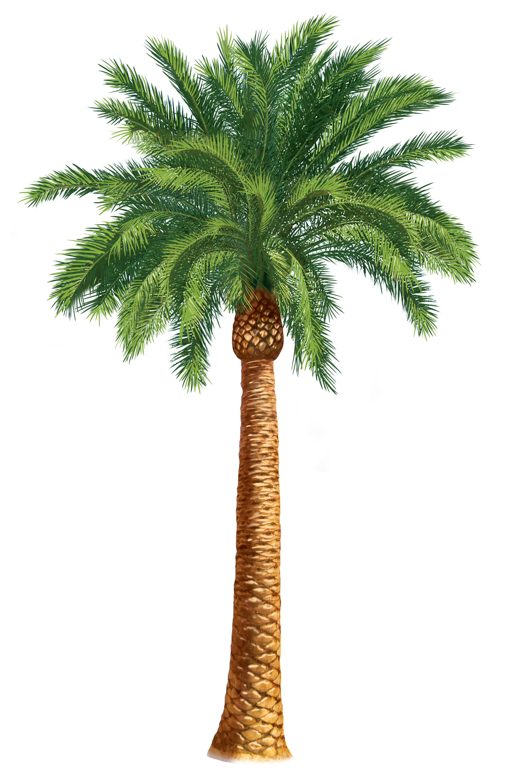
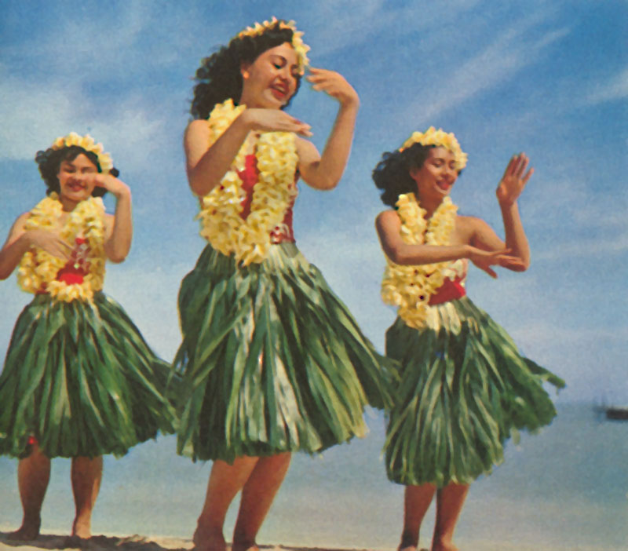
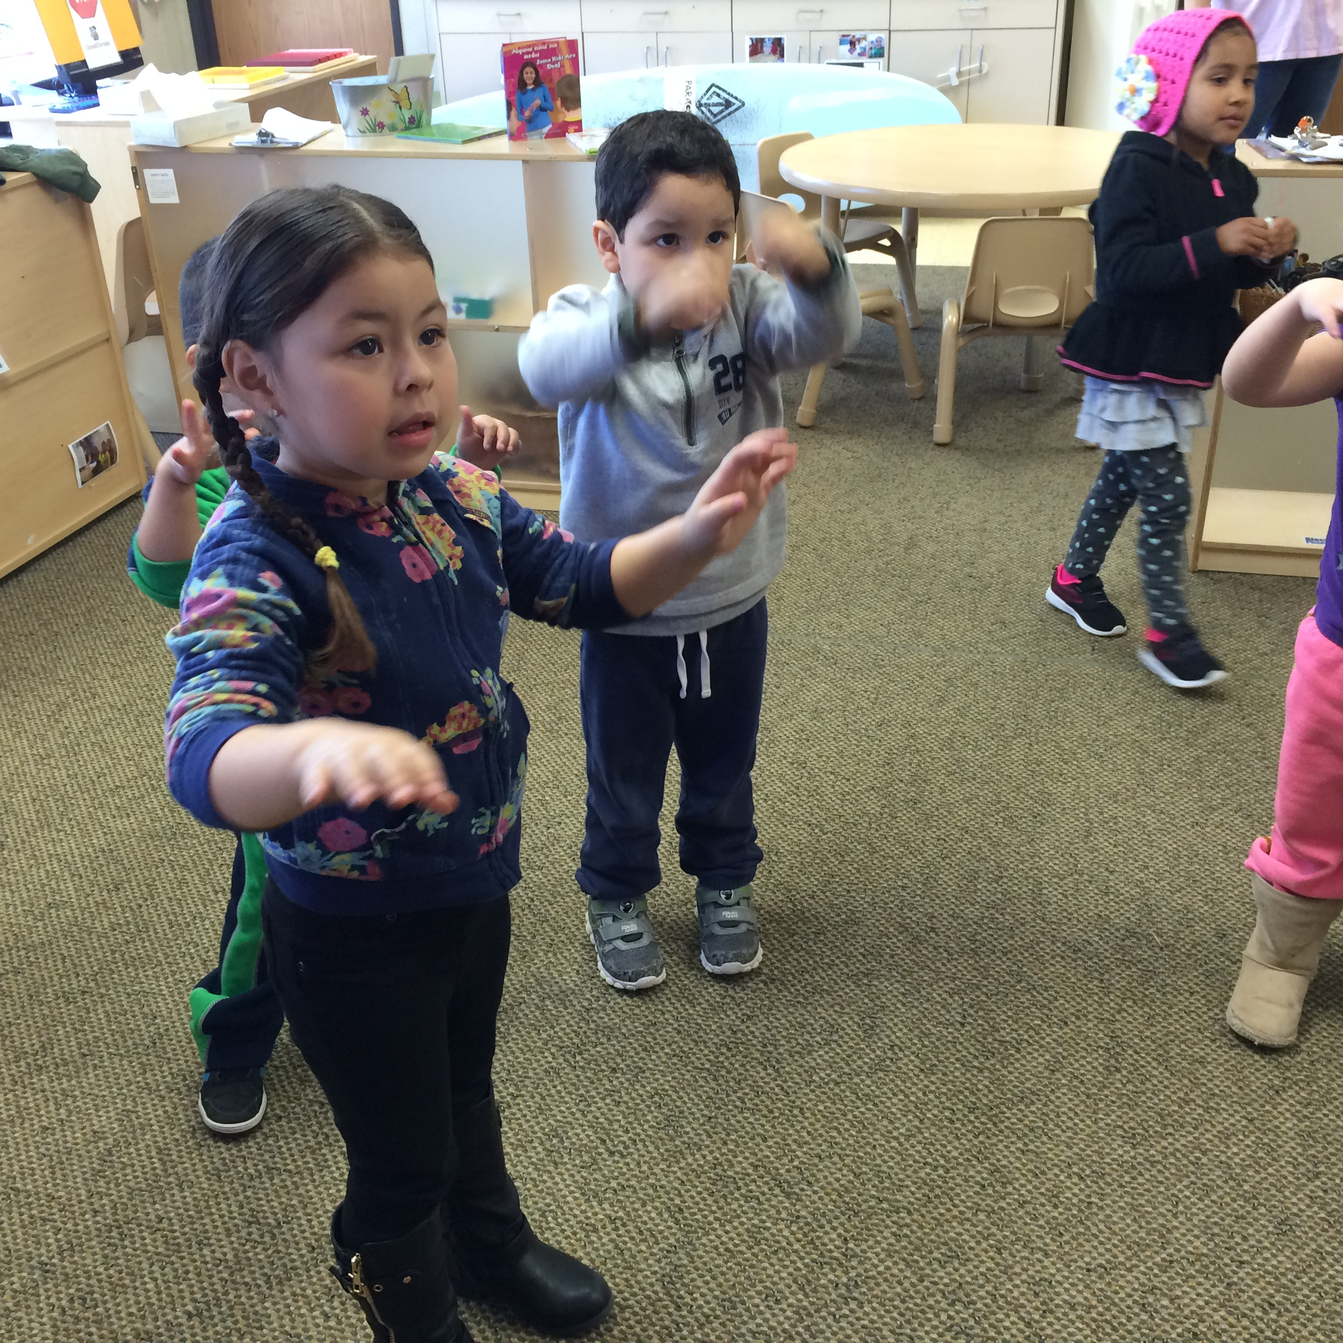
Inspiring Movement
in the CACFP office and childcare setting
Presented by Brooke ten Bosch and Julie Lefko

Slide 2
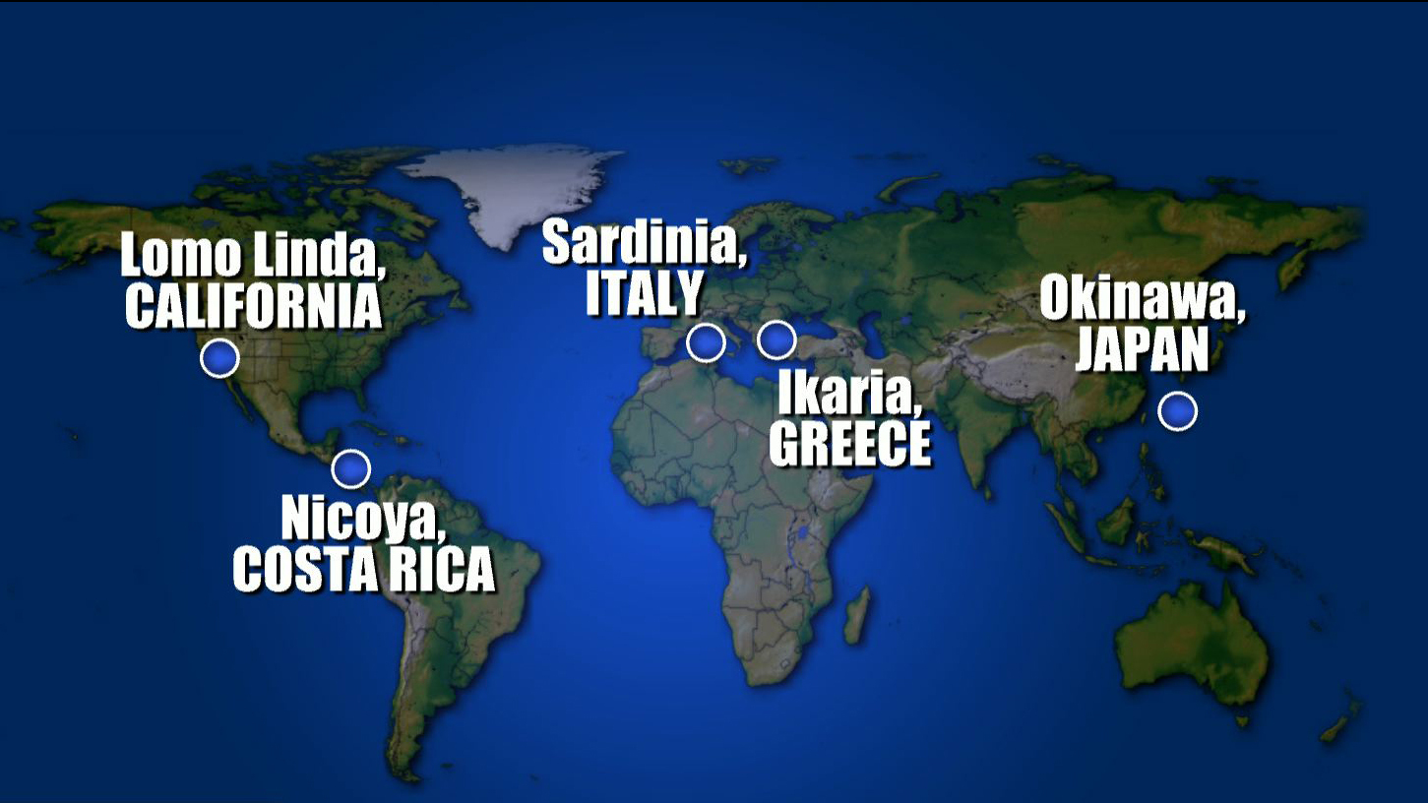

Slide 3
1. Move Naturally
Americans burn fewer than 100 calories a day engaged in “exercise”. We can get more physical activity naturally if we live in walkable communities, de-convenience our homes by getting rid of power tools and grow gardens. Walking is the best activity for longevity.
2. Know your Purpose
People who know why they wake up in the morning live up to seven years longer than those who don’t. Know your values, passions and talents–and how to share them on a regular basis.
3. Down Shift
Chronic inflammation caused by stress is related to every major, age-related disease. To reverse inflammation, find time each day to meditate, nap, pray or enjoy a happy hour.
4. 80% Rule
Cut 20% of your calories with evidence based practices: eat a big breakfast, eat with your family, remove the TV from your dining area and say pre-meal expressions of appreciation.
5. Plant Slant
Eat mostly a plant-based diet heavy on beans, nuts and green plants. Eat meat in small portions (the size of a deck of cards) fewer than twice weekly.
6. Wine at 5
Two glasses of wine daily will add years to your life, especially when consumed during a plant-based meal.
7. Family First
Living in a thriving family is worth a half a dozen extra years of life expectancy. Invest time in your kids, nurture a monogamous relationship and keep your aging parents nearby.
8. Belong
Recommit, reconnect or explore a new faith-based community. It doesn’t matter if you’re Christian, Jewish, Muslim or Buddhist. People who show up to their faith community four times a month live an extra 4-14 years.
9. Right Tribe
Your friends have a long-term and measure impact on your health and longevity. Taking stock in who your friends are and expanding your social circle to include healthy-minded, supportive people might be the most powerful thing you can do to add years to your life.
Blue Zone Characteristics
Notes:
Interest examples: sports, culture, games, the outdoors, promise of fun, gardening, chores, health, dancing, yoga, zumba, themes
Needs examples: hypertension, diabetes, obesity, stress, mental health, drink more water
Allows for more intentional and participant-specific program planning

Slide 4
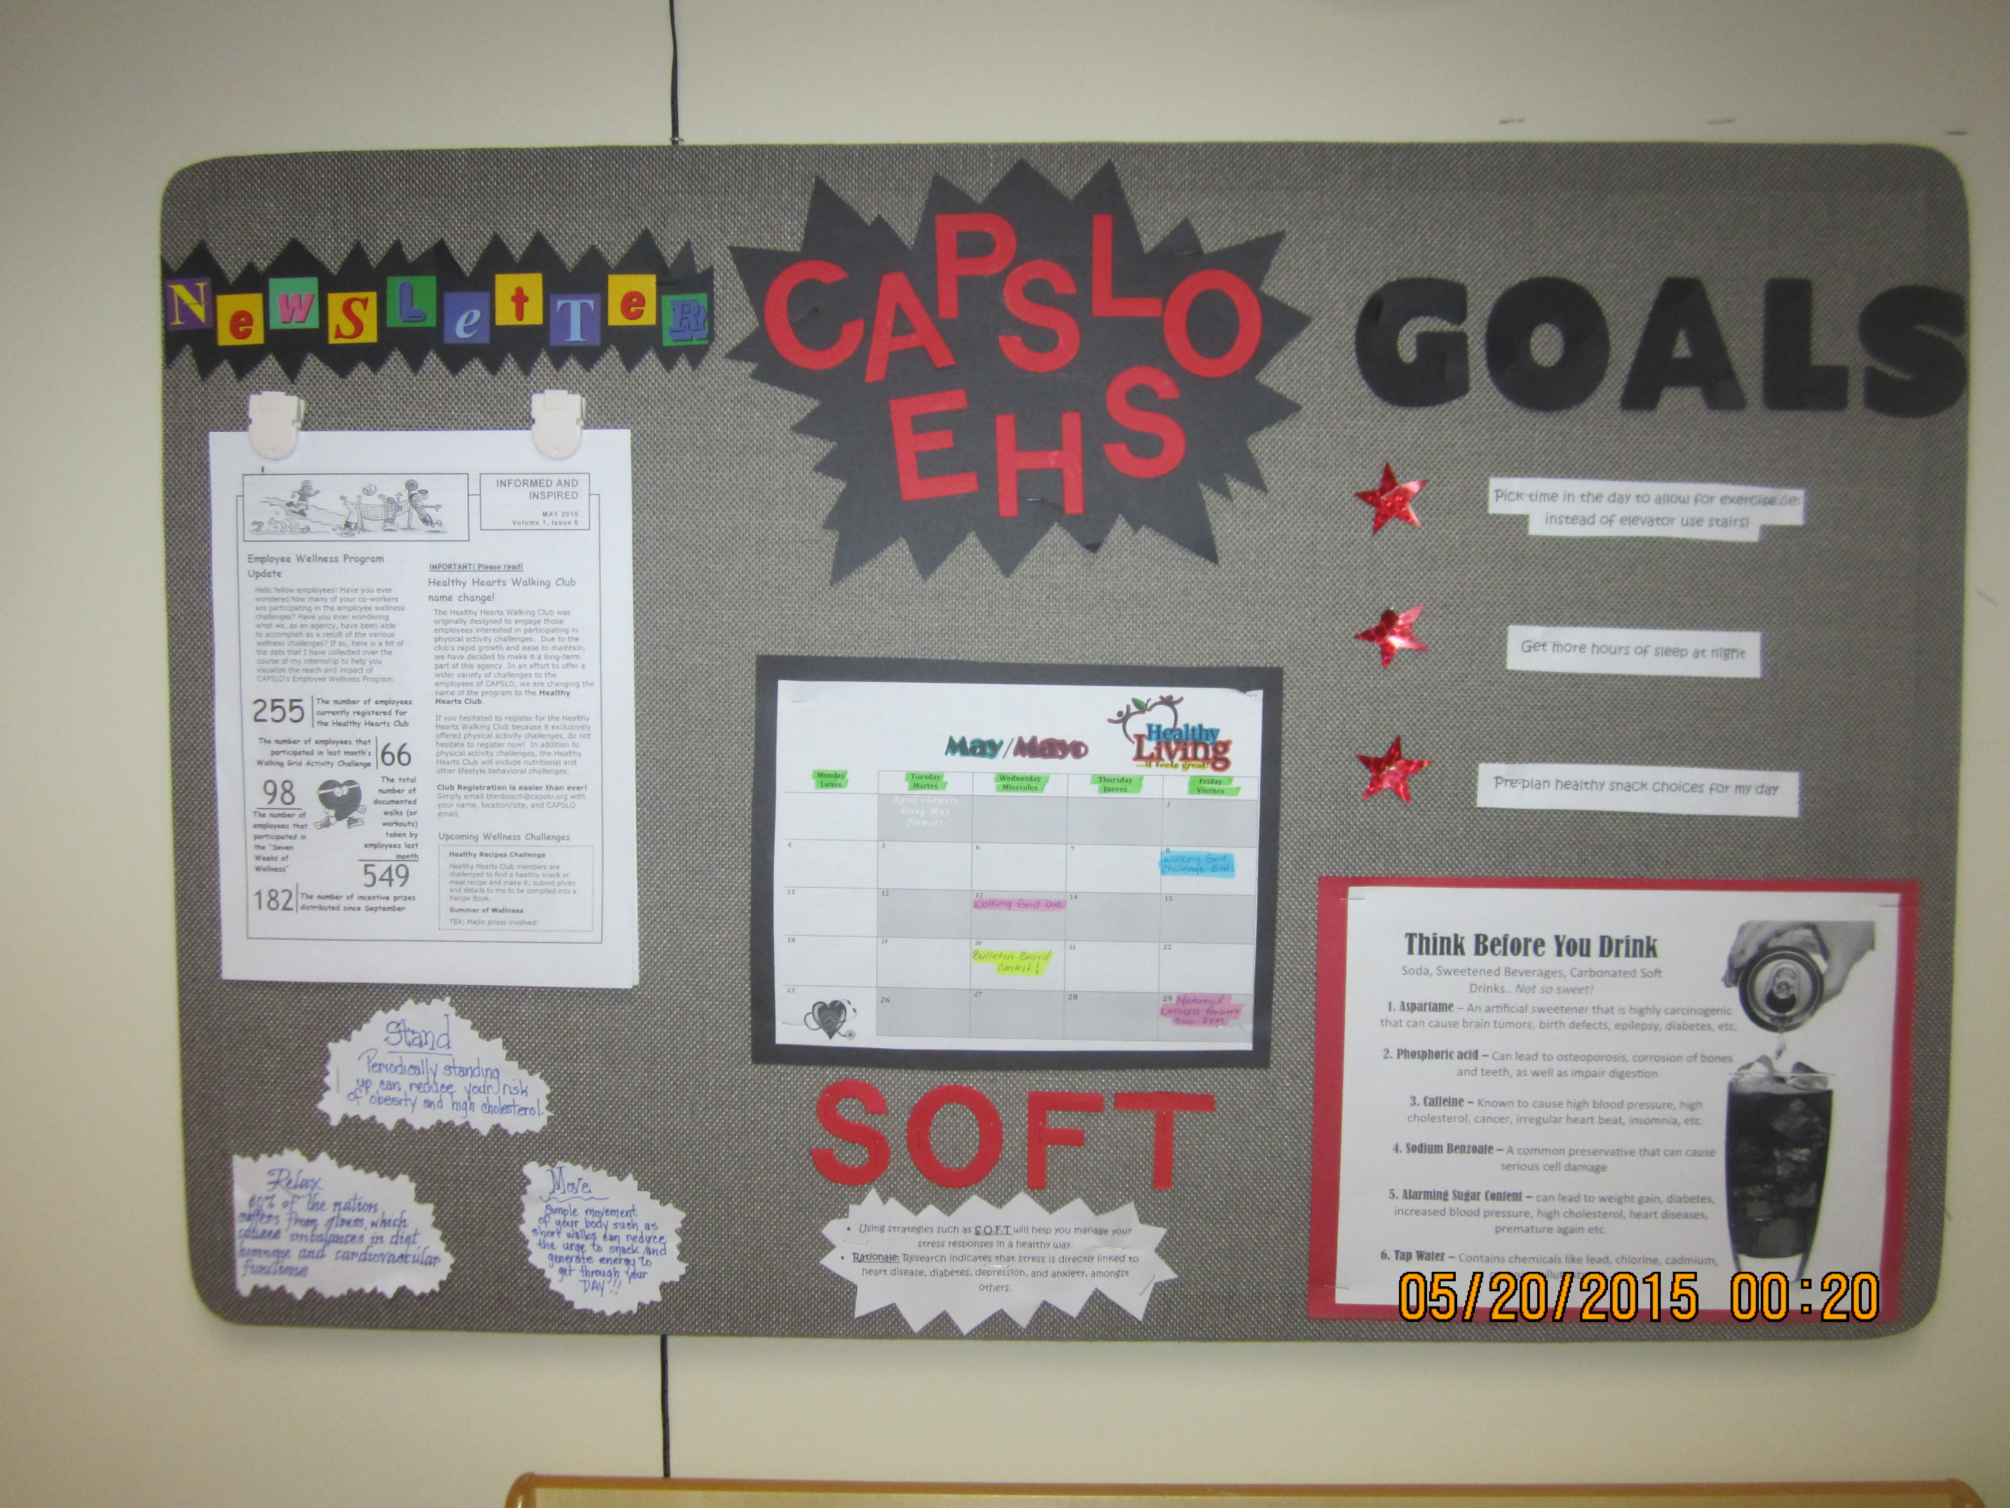
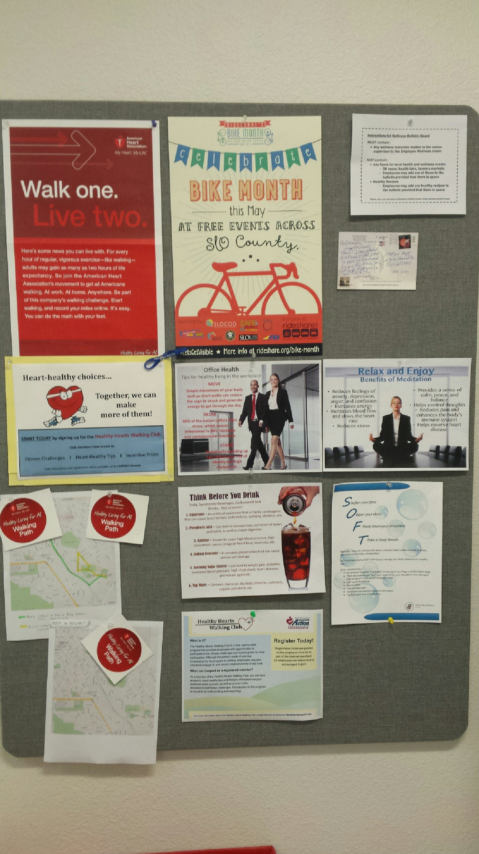
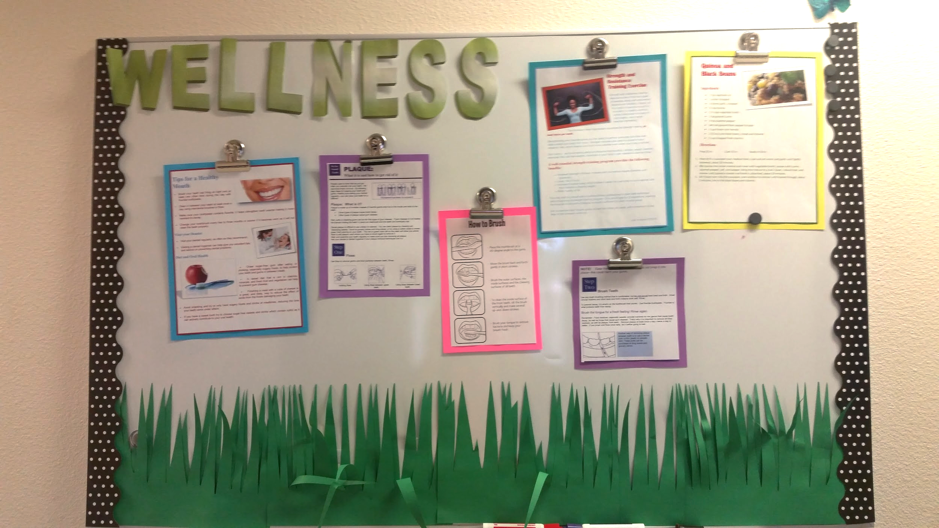

Slide 5
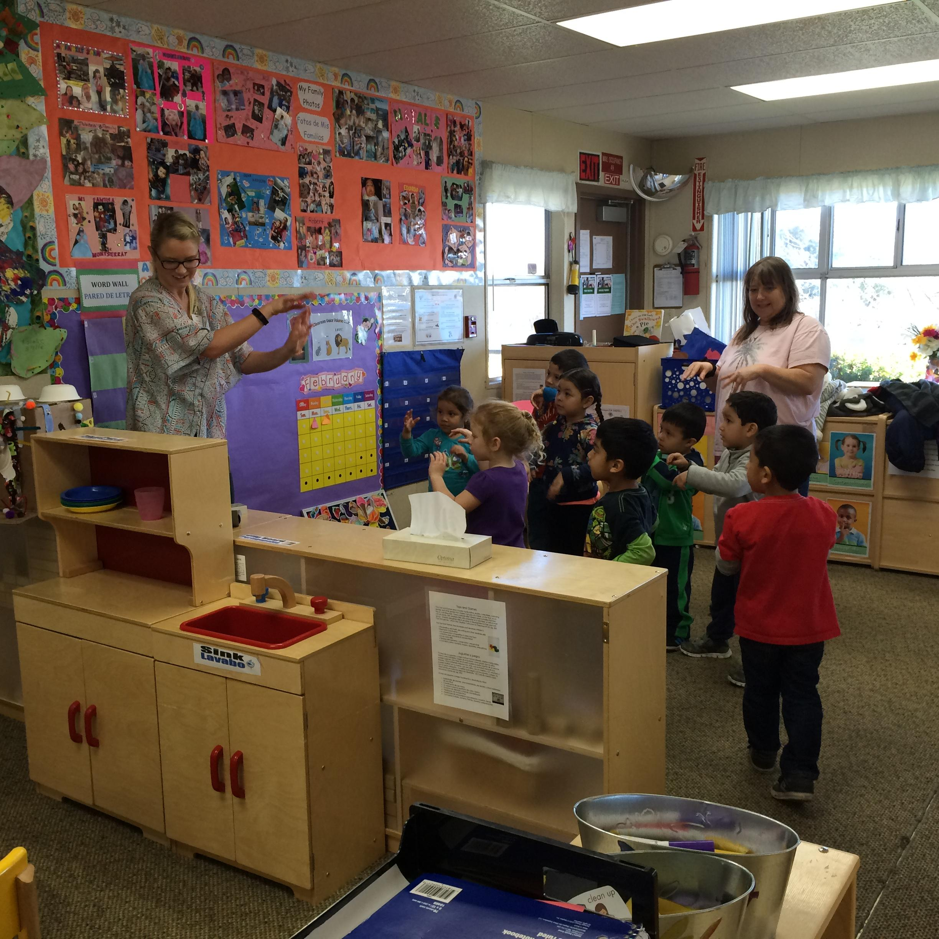
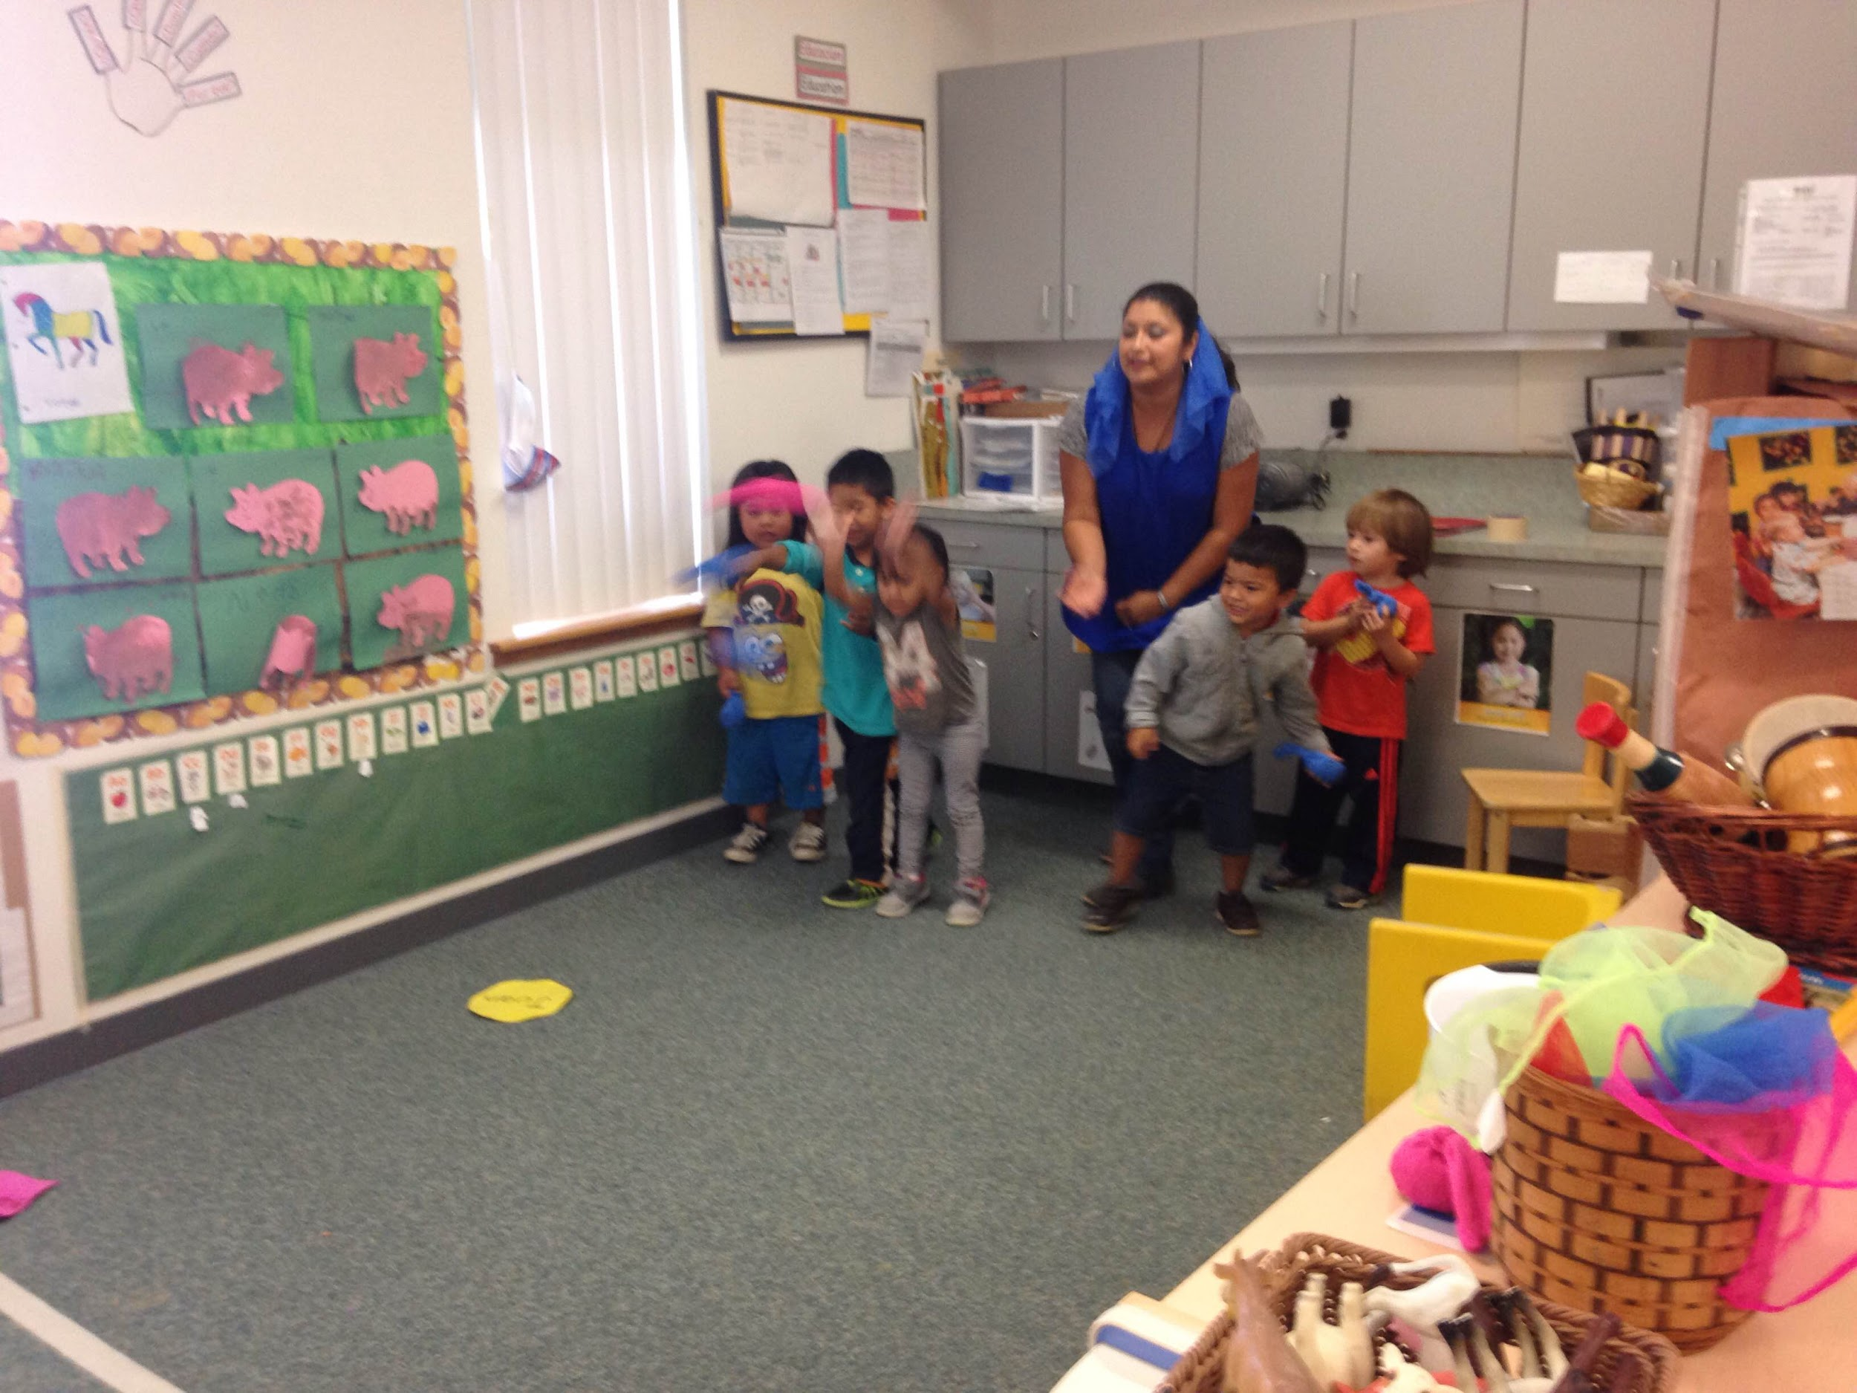
What does physical activity look like with preschoolers?
Notes:
Want to focus on quality rather than just quantity to help grow gross and fine motor skills
Preschoolers are capable of doing structured activities
Teachers should feel like they are getting some physical activity as well when doing physical activity with preschoolers

Slide 6
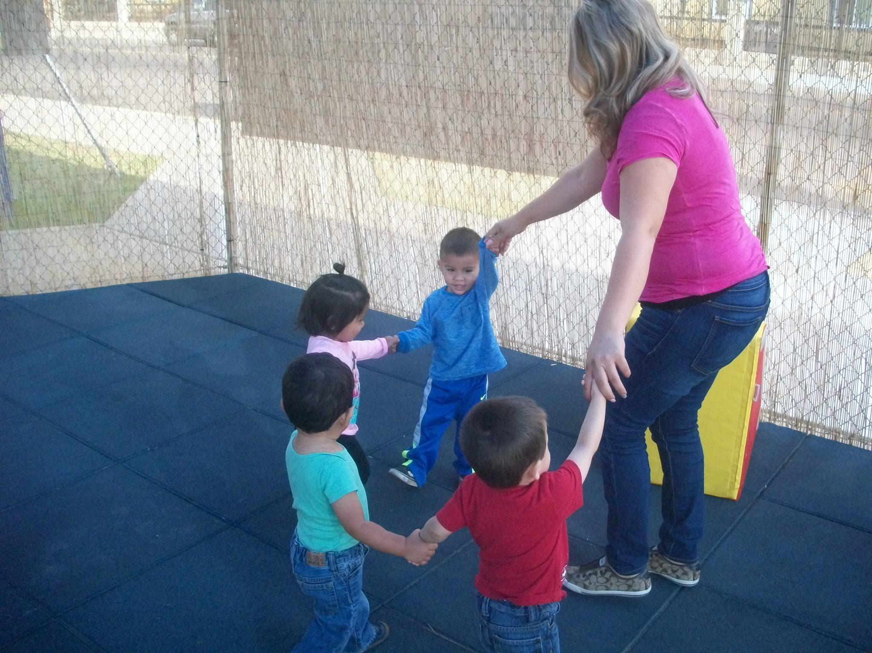
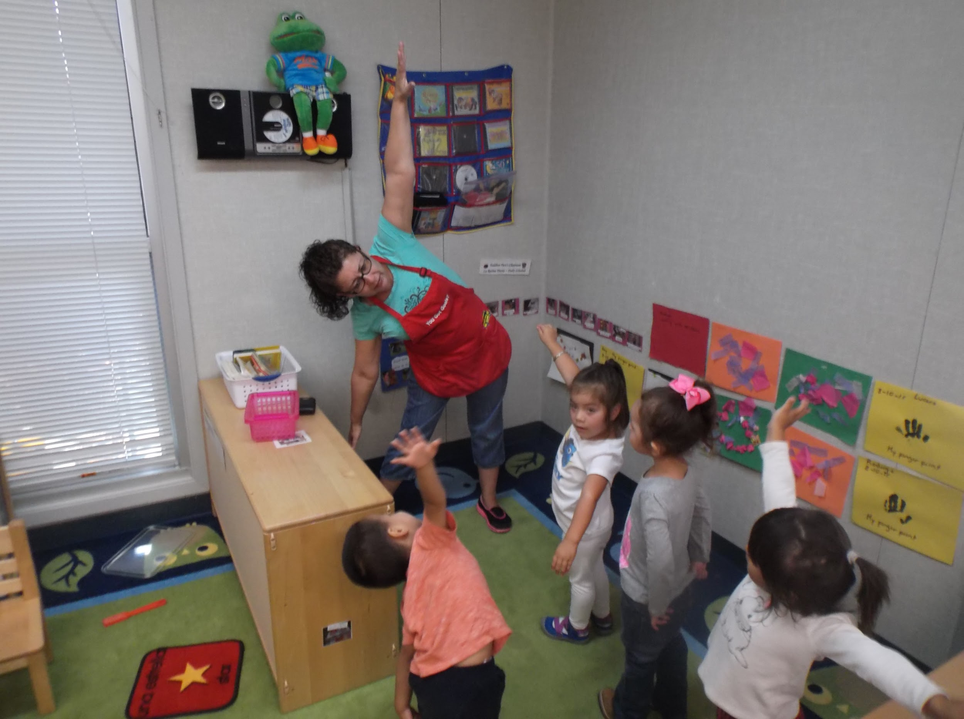
What does physical activity look like with toddlers?
*Pictures from CAP Madera- Migrant Delegate
Notes:
Use wic handout and get pictures from High St.

Slide 7
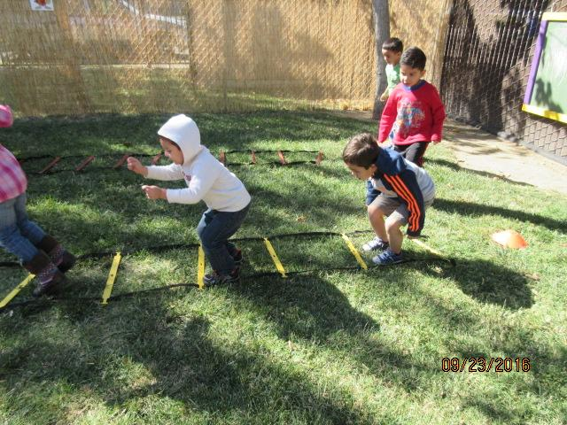
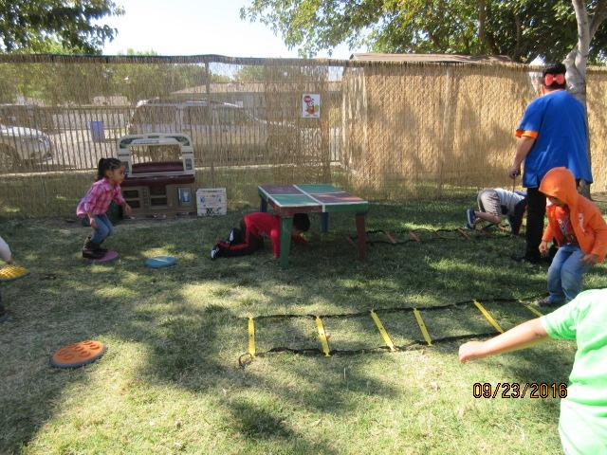
DIY!
Having fun, engaging physical activity does not need to be expensive. You can create great games and activities from simple materials such as:
Yarn
Sponges
Washclothes
Streamers
*Pictures from CAP Madera- Migrant Delegate

Slide 8
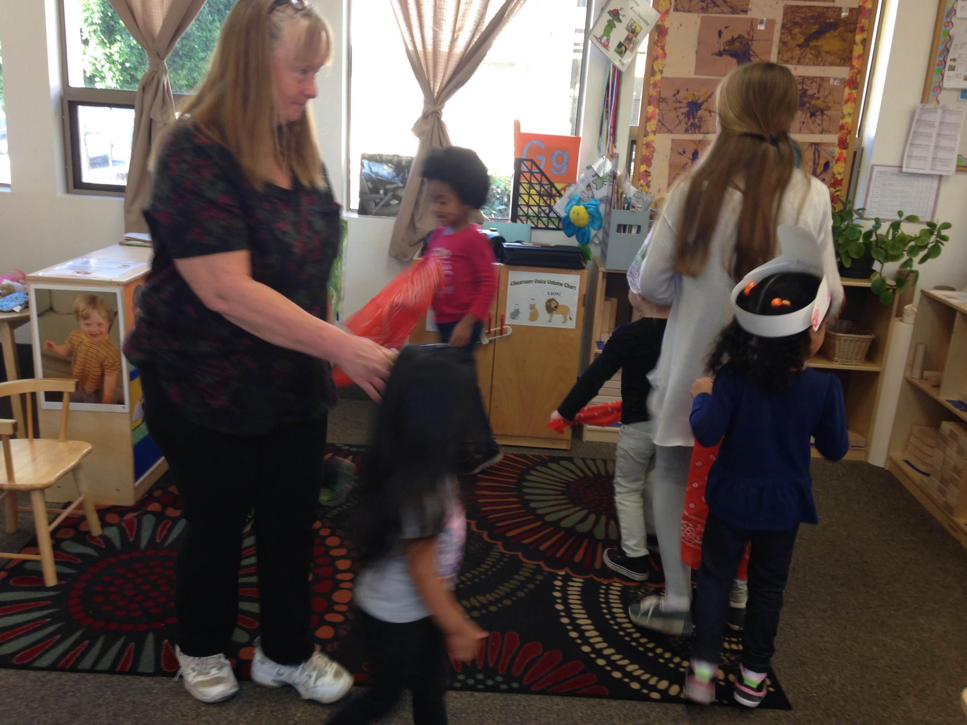
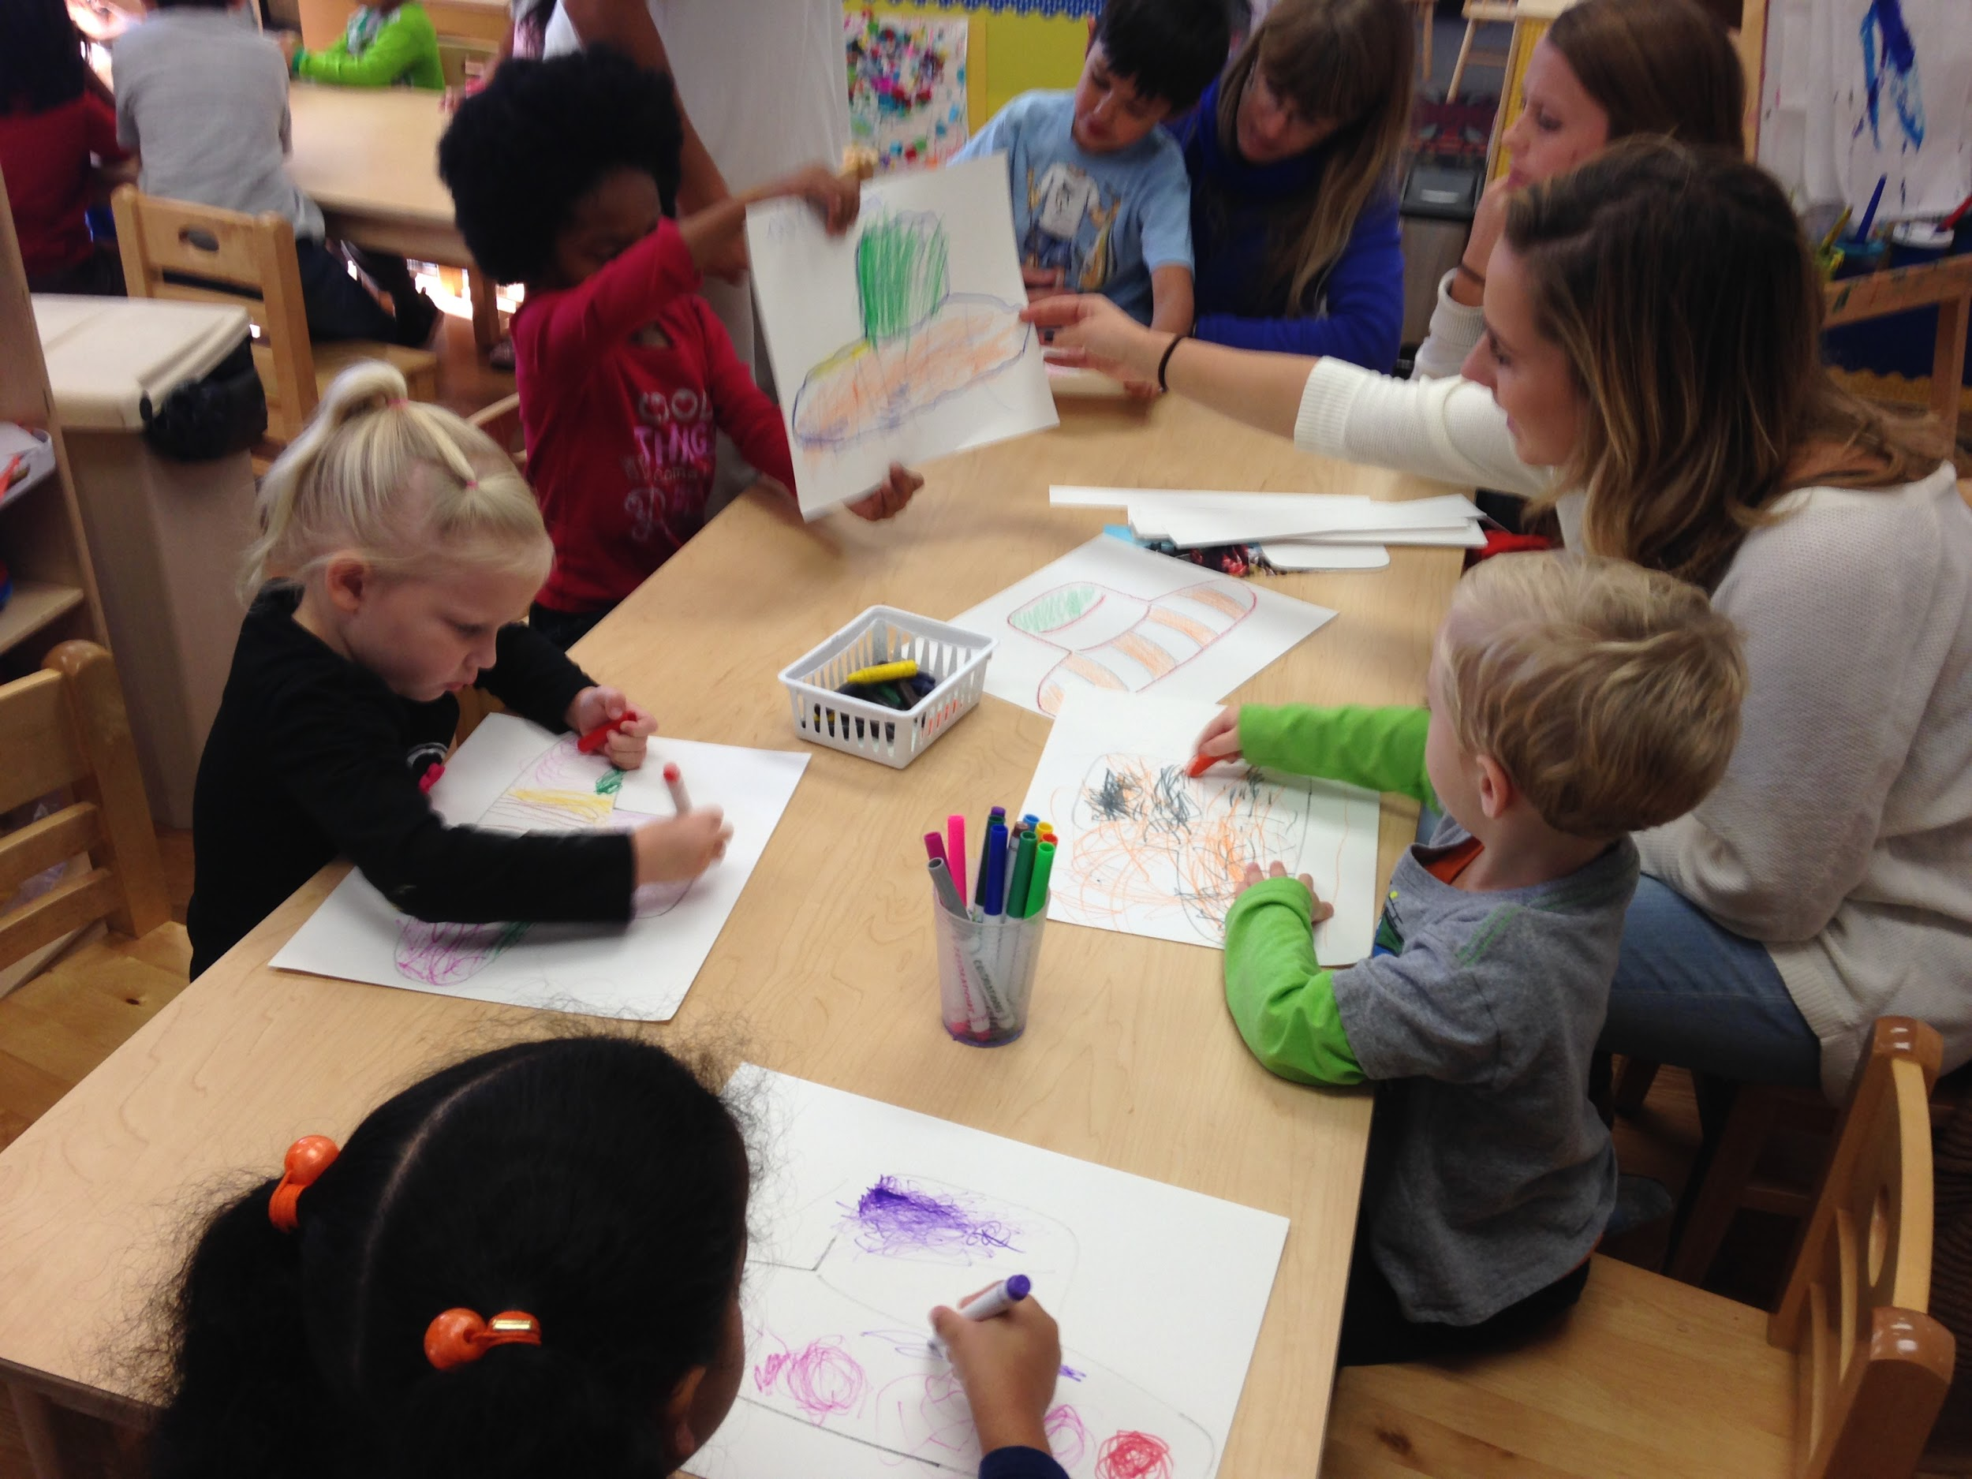
Art and food activities can stem into PA
Notes:
Children can make their own individualized cultural hat or other customary garment and then do a dance or sport activity in their new customary article of clothing. They can also create a customary trinket as well.
Exampes: Making gaucho hats and then doing a cowboy dance, making south african color feeling symbols flags and then doing a customary dance, making chinese new year masks and then doing the chinese new year dragon dance
*** When working with different cultures especially with cultural clothing and customs please be culturally appropriate and not streotypical. Please respect the culture. If the cultural activity describes something from the past that was releveant to the culture, but is not how the people dance today, please mention the past component (i.e. ancient Egyptian dances)

Slide 9
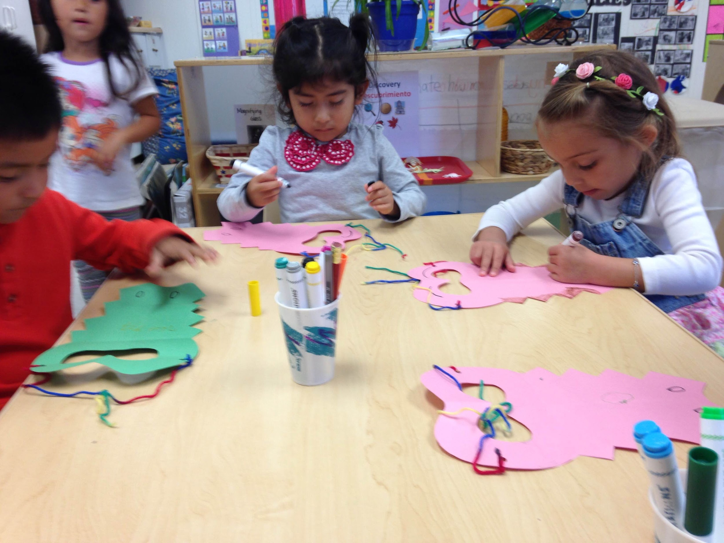
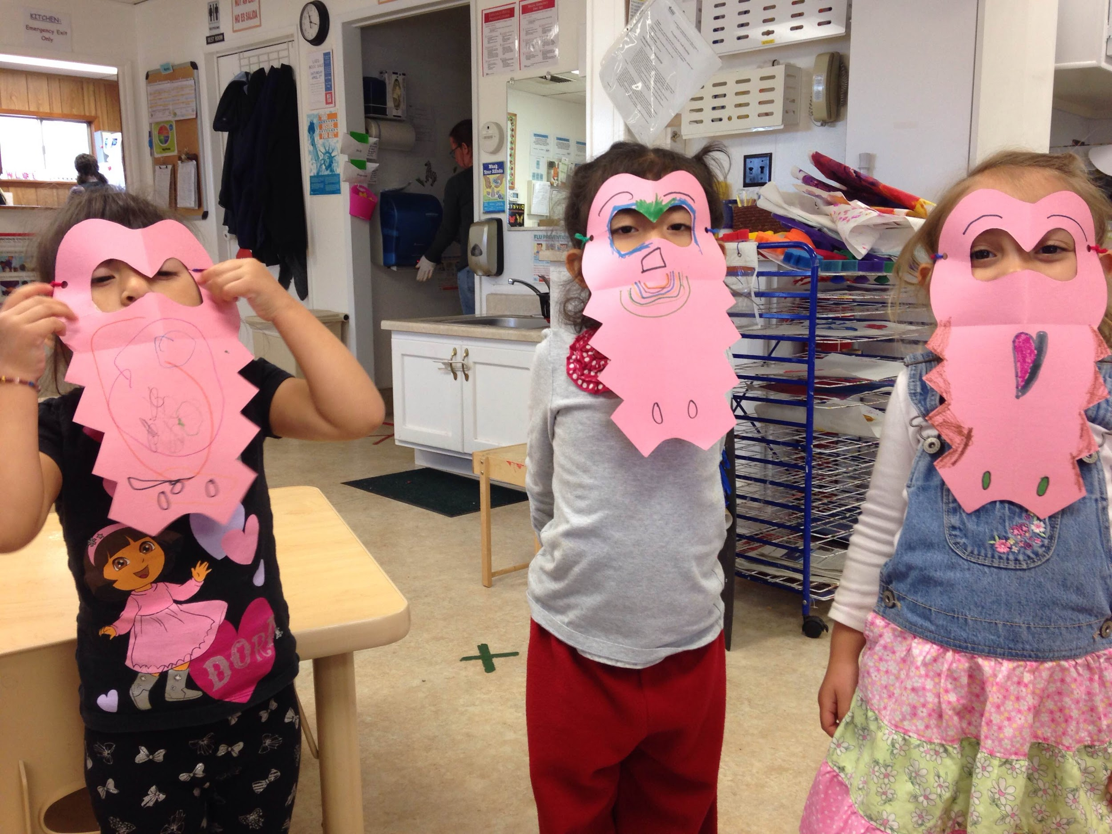
Notes:
Activities can help children learn about different things in their environment such as different types of animals. They can then pretend to be these animals when doing physical activity.
Pictures are from a Cajun food activity, children made veggie gumbo, learned about crocodiles, a well known animal in the Bayou, made alligator masks and then did a crocodile dance!

Slide 10
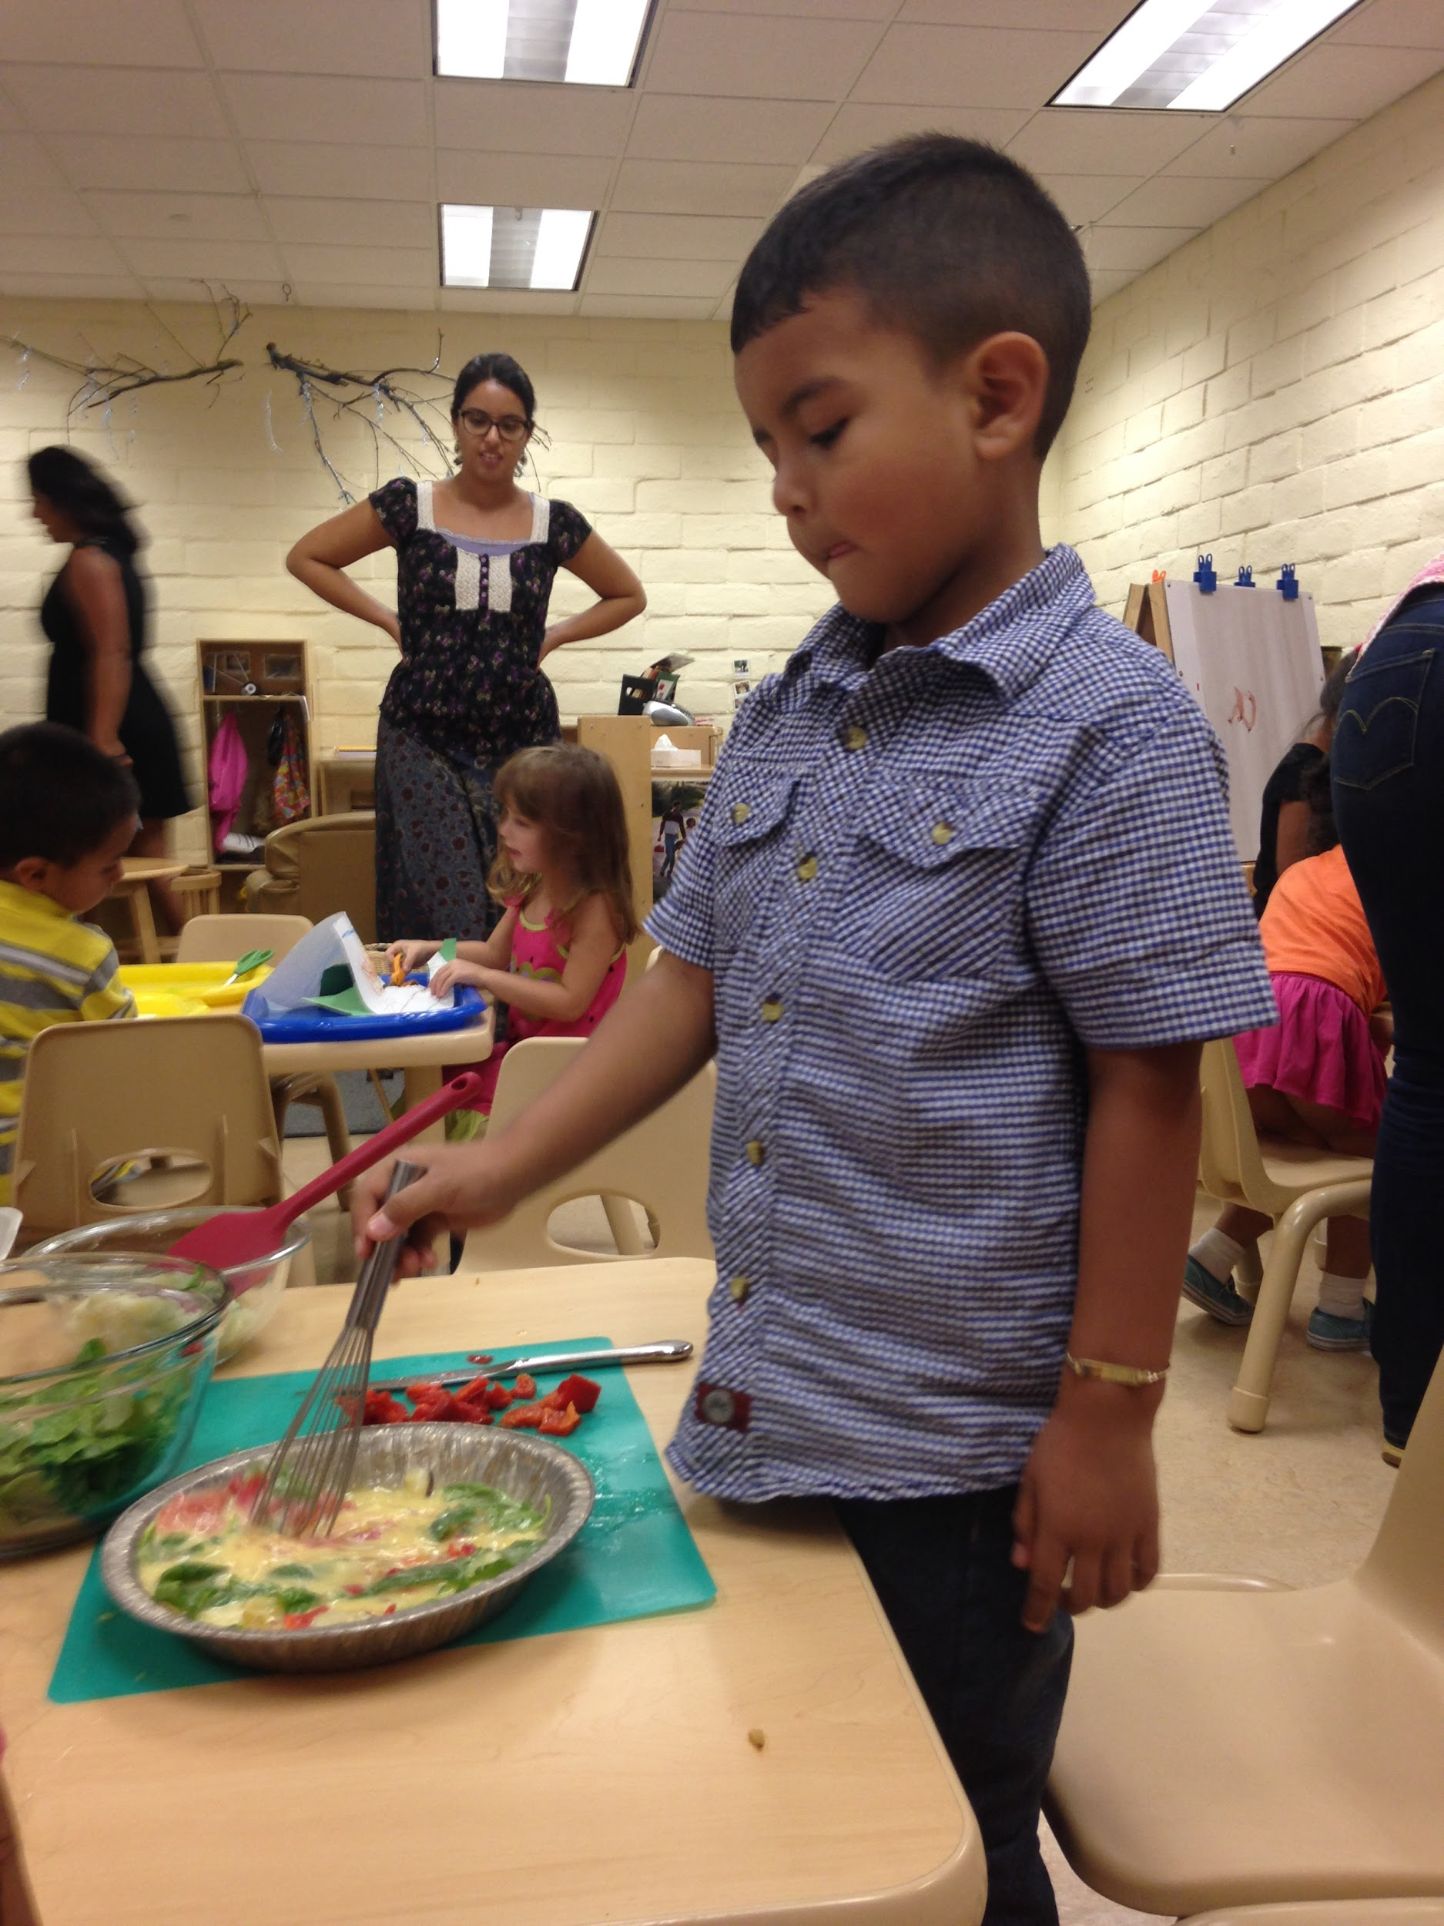
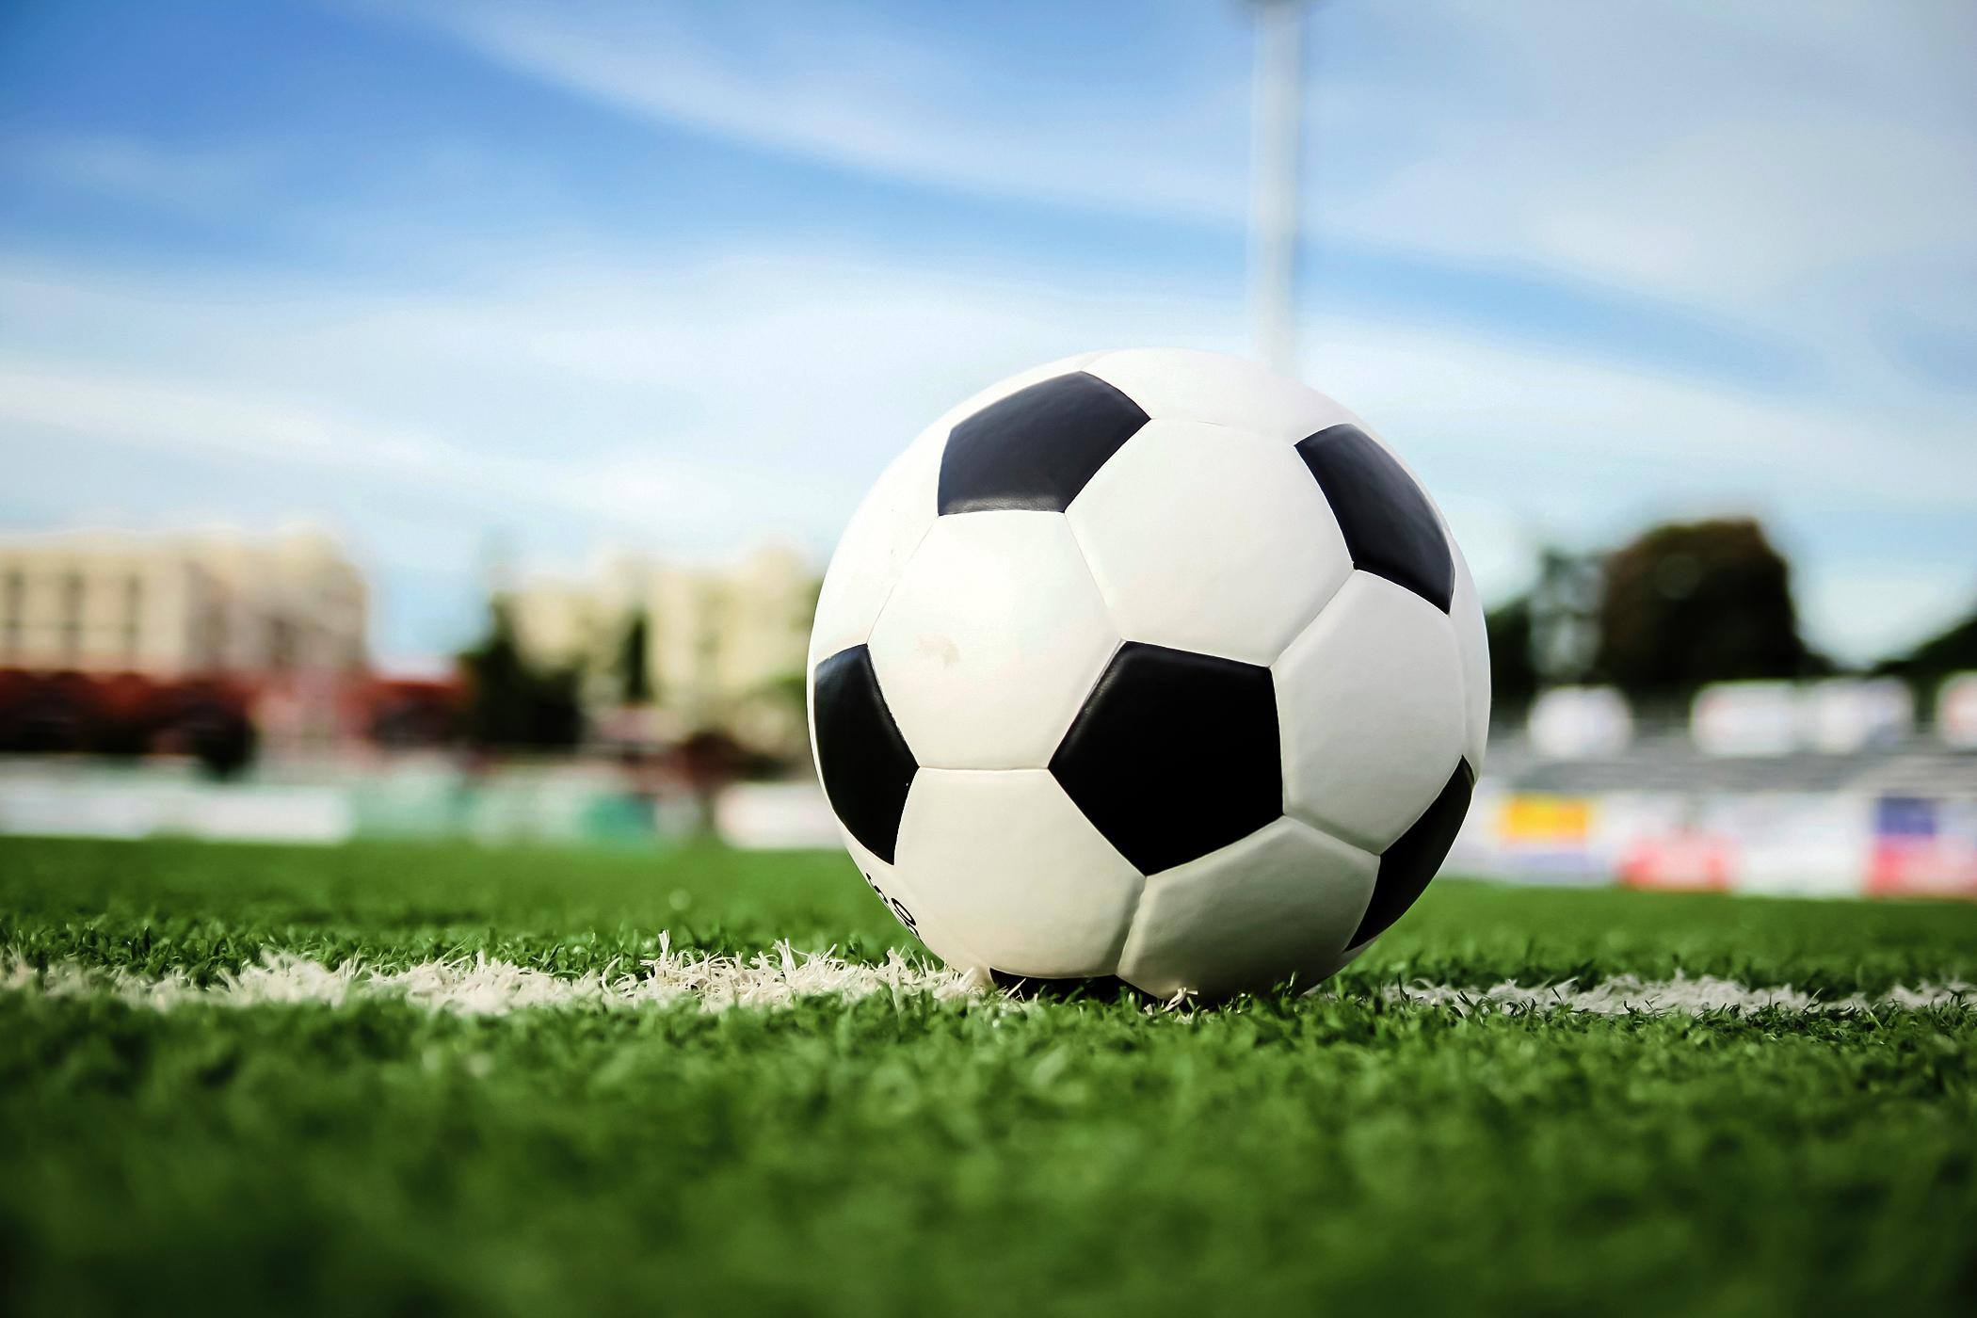
Notes:
This activity was about Spain and the children did a soccer drill warm up before cooking up some tortilla espanolas!

Slide 11
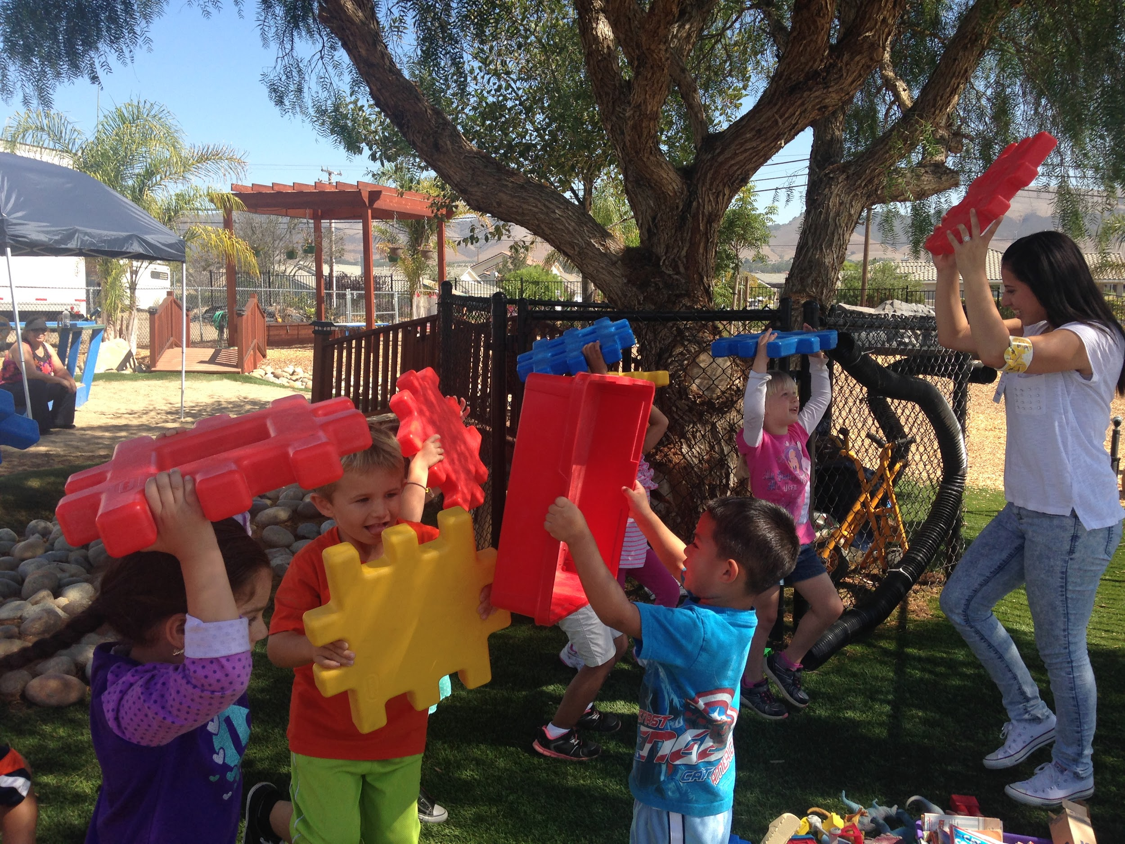
Preschoolers do not need overly simplistic games and activities, they can do so much more!
Notes:
Aerobic PA: any of various sustained exercises, as jogging, rowing, swimming, or cycling, that stimulate and strengthen the heart and lungs, thereby improving the body's utilization of oxygen.
Anaerobic PA: any short-duration exercise that is powered primarily by metabolic pathways that do not use oxygen. Such pathways produce lactic acid, resulting in metabolic acidosis. Examples of anaerobic exercise include sprinting and heavy weightlifting
Preschooler’s can start to learn the difference between different types of physical activity and what parts of their body certain physical activity benefits. This helps children learn why PA is beneficial, helps them understand how their bidy works, and gives them quality physical activity. A well structured PA activity will incorporate a little of both aerobic and anaerobic physical activity
Please keep safety in mind! More complex activities such as balancing need to only be the basics since this may be new. Rememember that young children do not weigh much! Children this age are typically between 30-50 lbs., this needs to be kept in mind when they are lifting objects!

Slide 12
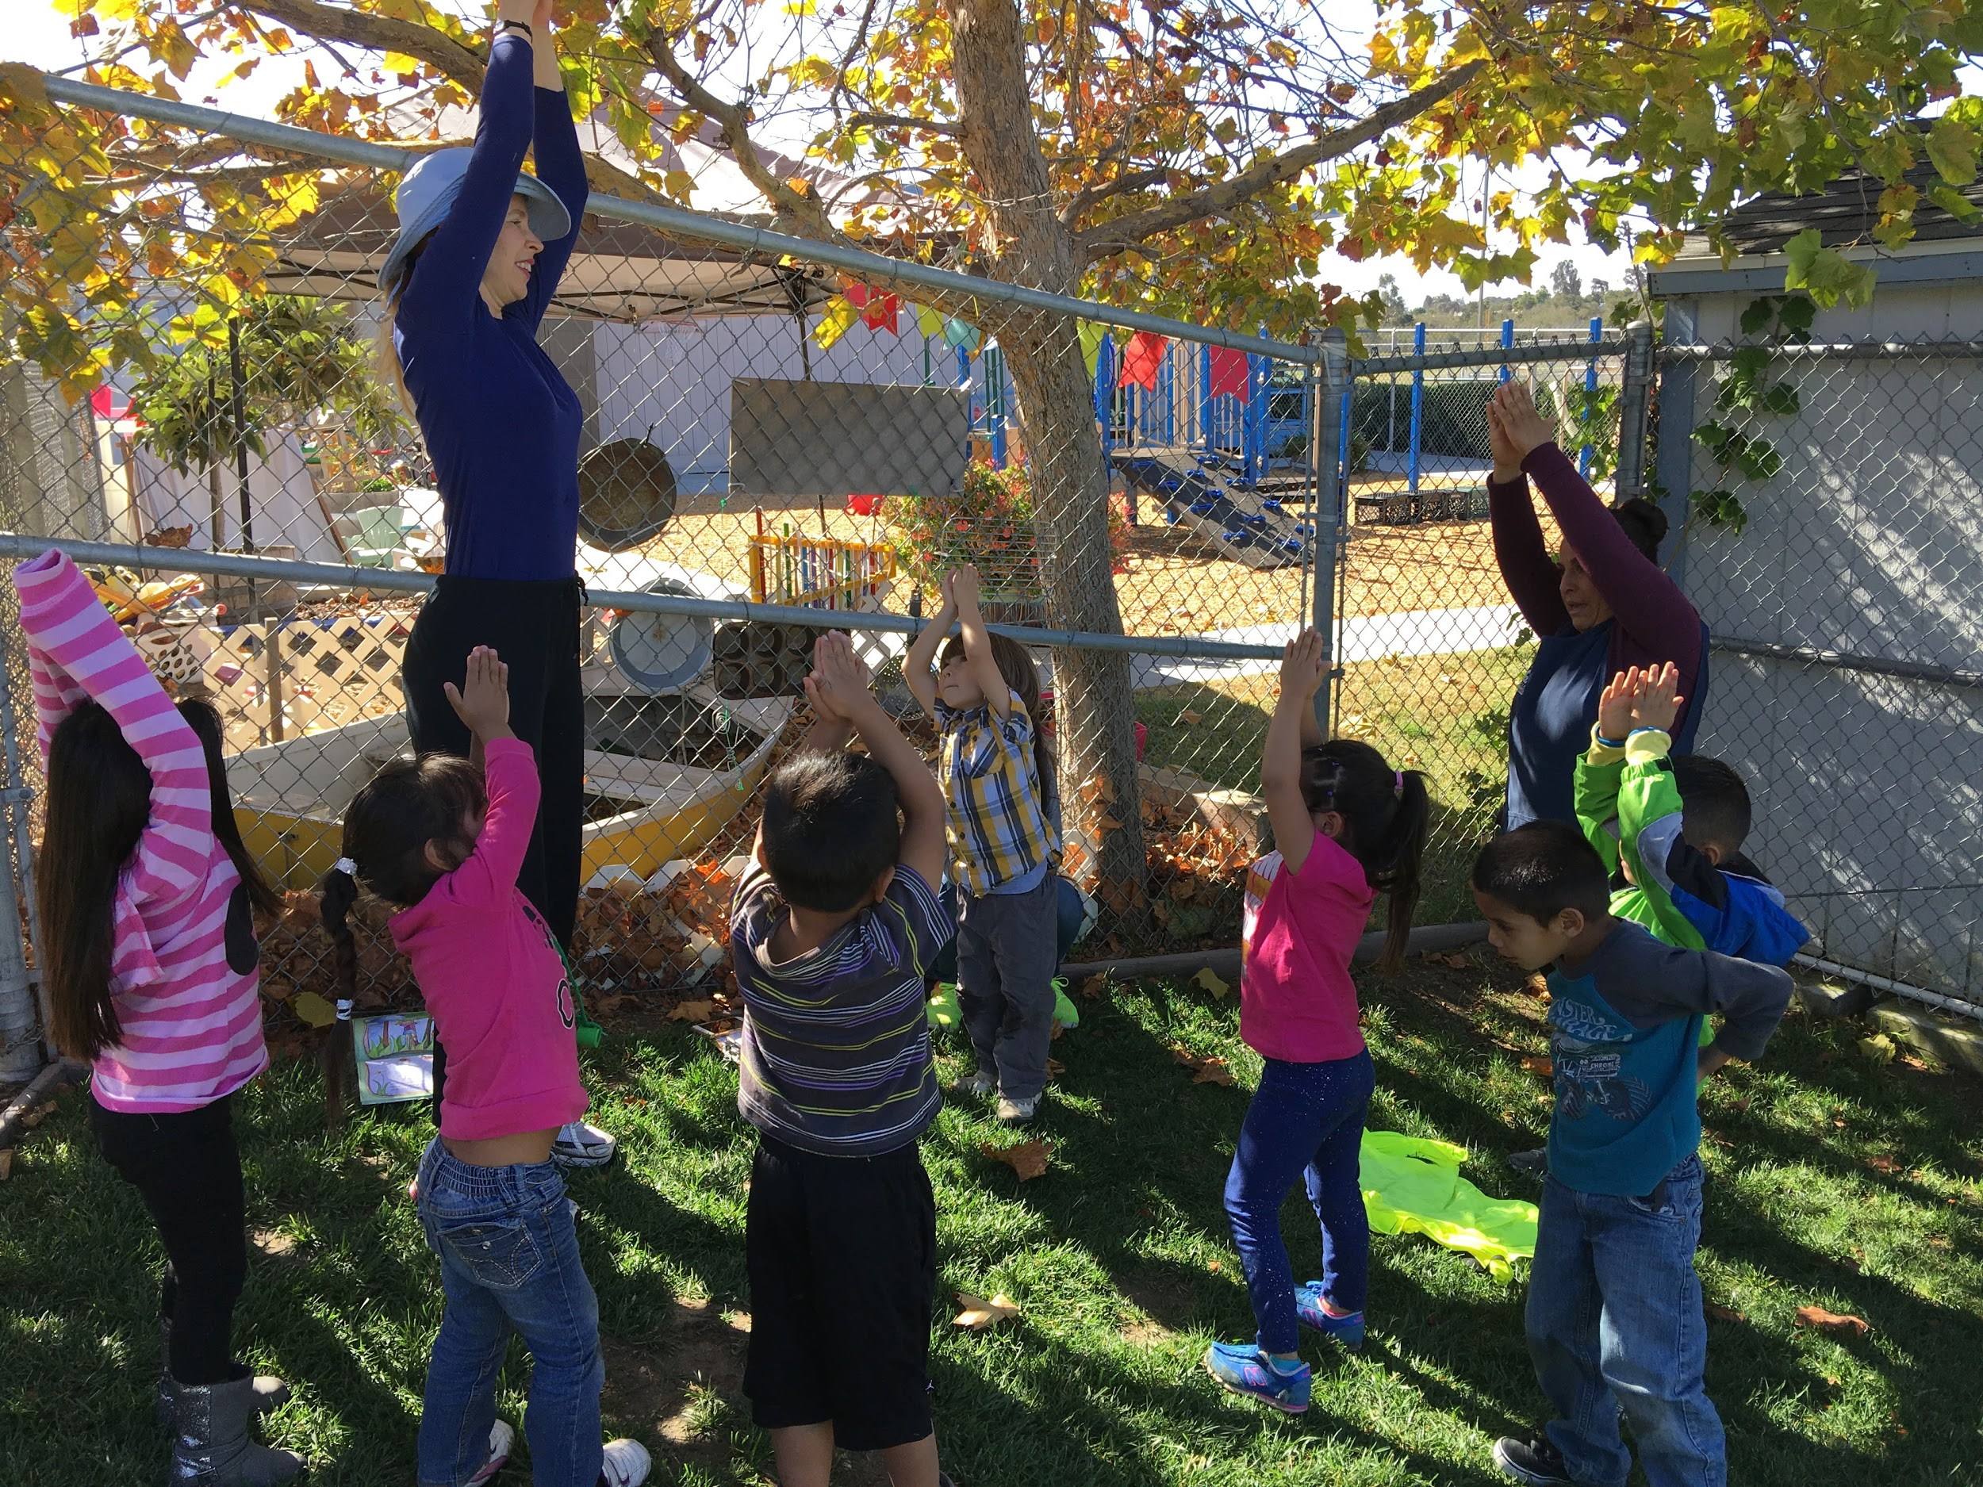
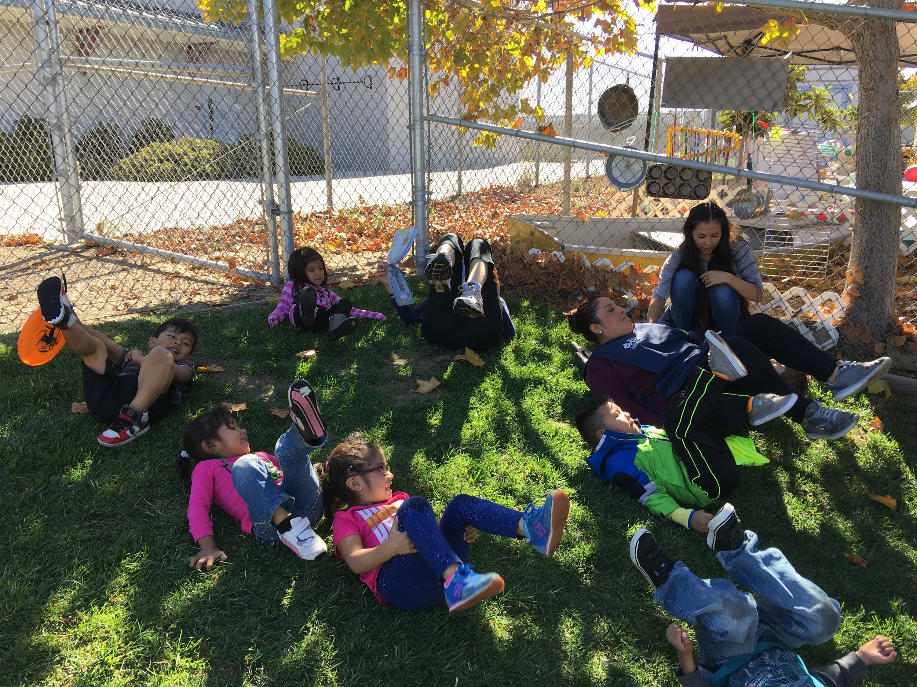
Wellness is not only for adults, it’s for children too!
Notes:
Get picture from Cielito nutrition activity
Nowadays everyone is talking about holistic wellness. This is not only for adults, children can work on their holistic wellness as well. Holistic wellness strives for one to be healthy in multiple aspects of their being (physical, social, emotional, intellectual, spiritual, and environmental) This means that mental health, health, nutrition, and education are all incorporated.
Yoga is a great step towards holistic wellness, it is great physical activity and it is relaxing for the body and mind.
Children can do yoga as well! There are some great children’s yoga resources as well!

Slide 13
There are many children’s yoga materials to choose from!
Notes:
The two materials shown are materials are program has used with our participants

Slide 14
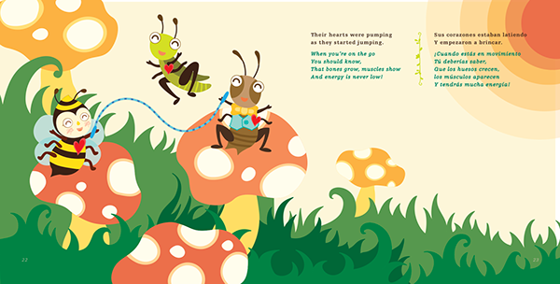
You can also buy books where there’s physical activity while the story is being read!
Notes:
Get image from the tiger book
There are speciality books that specifically have points in the story where teachers can be interactive with the children and incorporate the physical activity that’s being done by the characters in the book. These specialty books are not absolutely necessary to do this. Teachers can look through books the center already has and can incorporate interactive physical activity for children into those books.
Example: in the story the girl leaped over the massive puddle (everyone in the classroom leaps), then the girl is in an airplane and flies in circles (everyone pretends they are an airplane and flies in circles)

Slide 15
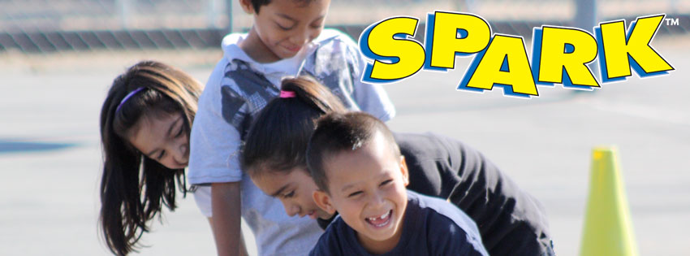
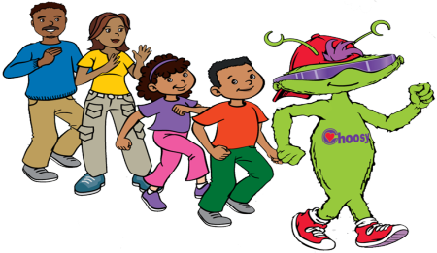
There are many different options of physical activity enhancement programs agencies can choose from!
Notes:
IMIL: (I am Moving, I am learning) has a large focus on moderate to vigorous PA. Concentrates on having the children tell their muscles what to do and using repetition in order to attain more motor skills for more complex physical activity. An enhancement not a curriculum. Incorporates Choosy music- upbeat children’s music about health, nutrition, wellness, and physical activity.
Spark- has a lot of visuals for children to see for their physical activity. More of a curriculum that comes with tested activities. Visual aid cards that are great for children with disabilities or are English as a second language. Cards come in English and Spanish besides having the visual
Shine- CACFP’s program. Has great resource video’s to show teachers on the best ways to engage and implement physical activity into the daily routine. Shows an ok scenario and a better scenrio and explains why the better scenario is more beneficial for the children.

Slide 16
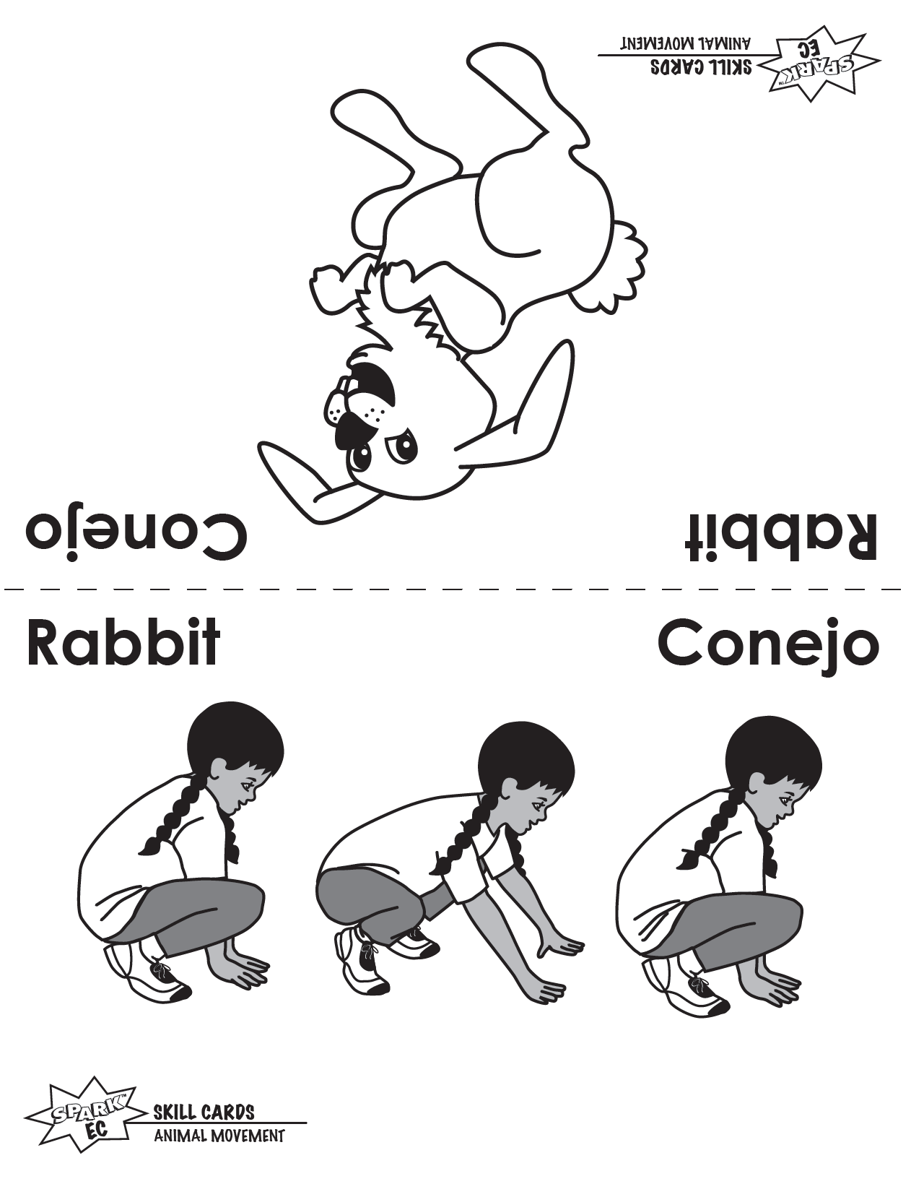
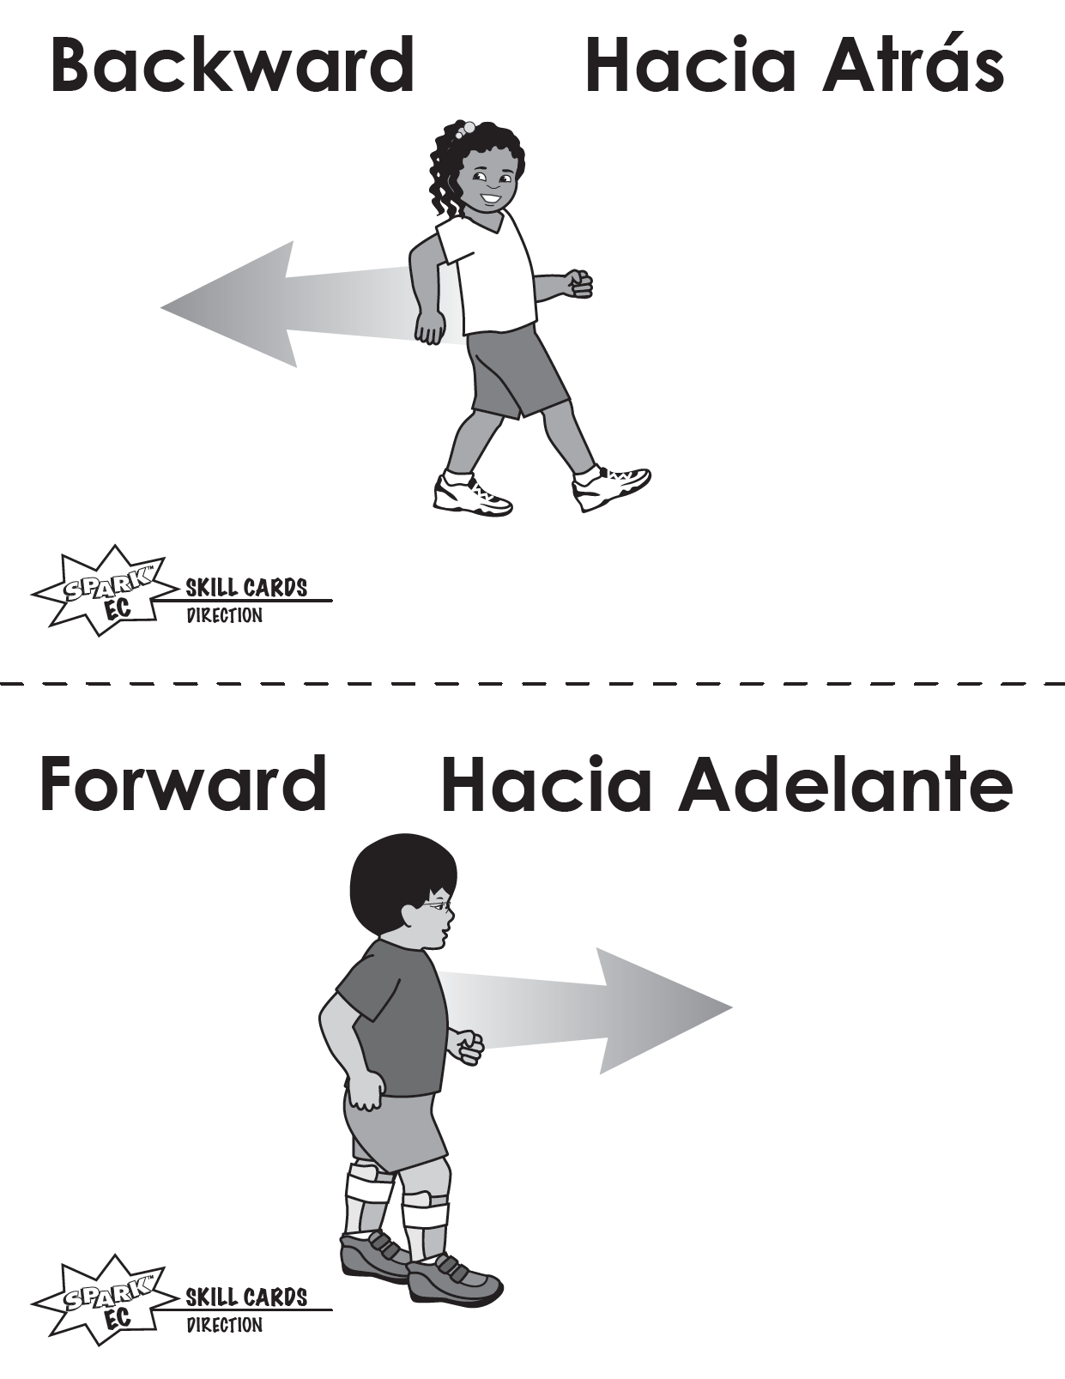

Slide 17
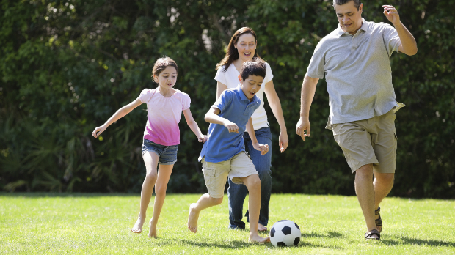
Encouraging physical activity at home
Physical activity is a great way for families to bond and spend time together. Families can:
Go to the park together
Go to a dance class
Go on a hike
Ride bicycles
Go ice skating

Slide 18
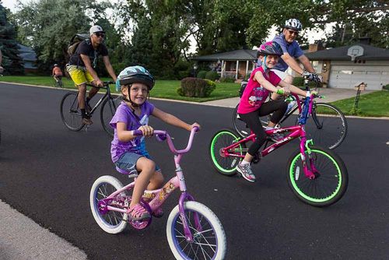
Physical activity can also be easily done in everyday activities such as:
Chores
Transitions
Outings
Notes:
Parents can make everyday tasks into a game. Laundry can be made into a basketball game, there can be a clean up dance party. The family can decide to walk or bike to dinner rather than taking a car.

