Slide 1
How to Prepare Creditable Meals in the
Child and Adult Care Food Program (CACFP)
New Tools and Resources
Ann Hall, MRE
Nutritionist
Xaviera Davis, MS
Nutritionist
Nutrition Education, Training, and Technical Assistance Division
Child Nutrition Programs, Food and Nutrition Service

Slide 2
Overview
The Basics of Preparing Creditable Meals in the CACFP
CACFP Meal Pattern
USDA Standardized Recipes
Using the USDA’s Food Buying Guide for Child Nutrition Programs (FBG) Interactive Web-Based Tool
Hands on Activity using the Recipe Analysis Workbook (RAW)

Slide 3
The Basics
Creditable Meals Provide
Each of the required meal components
In the required amount for the age of the child or adult
For the meal served

Slide 4
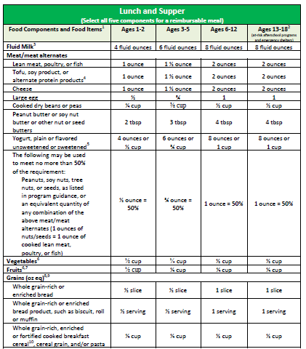
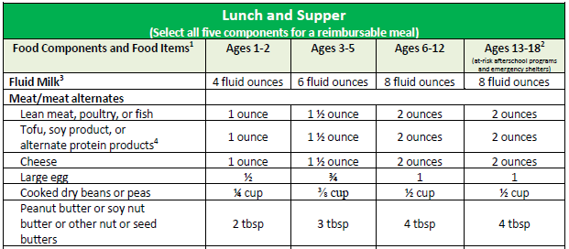
Verify Your Menu using CACFP Meal Pattern

Slide 5
New Child Care Recipes
https://www.fns.usda.gov/tn/team-nutrition

Slide 6
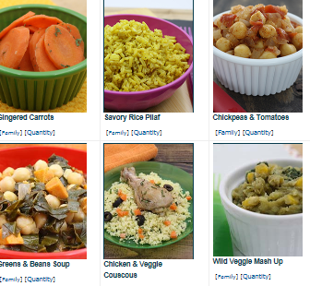
New Child Care Recipes

Slide 7
Day Care Home Recipe
6 Servings
CACFP Crediting Information

Slide 8
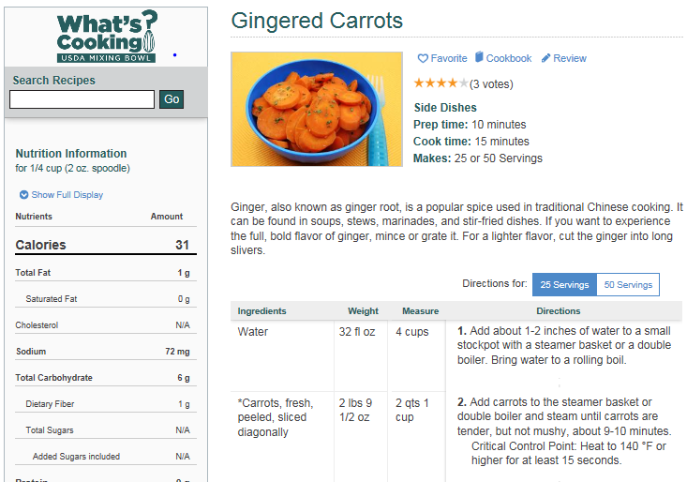
Insert
Picture
Here
Child Care Center Recipe
25 or 50 servings

Slide 9
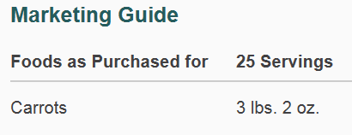
Insert
Picture
Here
Child Care Center Recipe (cont.)
Crediting Information and Marketing Guide
CACFP Crediting Information
Marketing Guide

Slide 10
Cookbooks for Homes and Child Care Centers

Slide 11
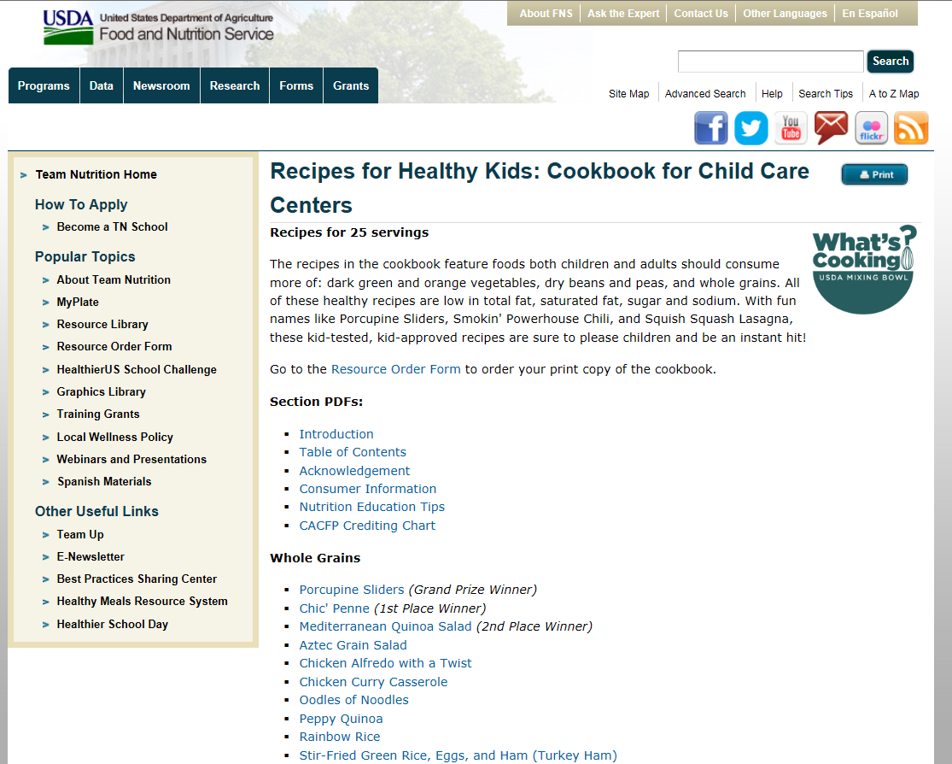
Find Recipes in the Resource Library

Slide 12
http://www.fns.usda.gov/tn/resource-library
www.teamnutrition.usda.gov

Slide 13
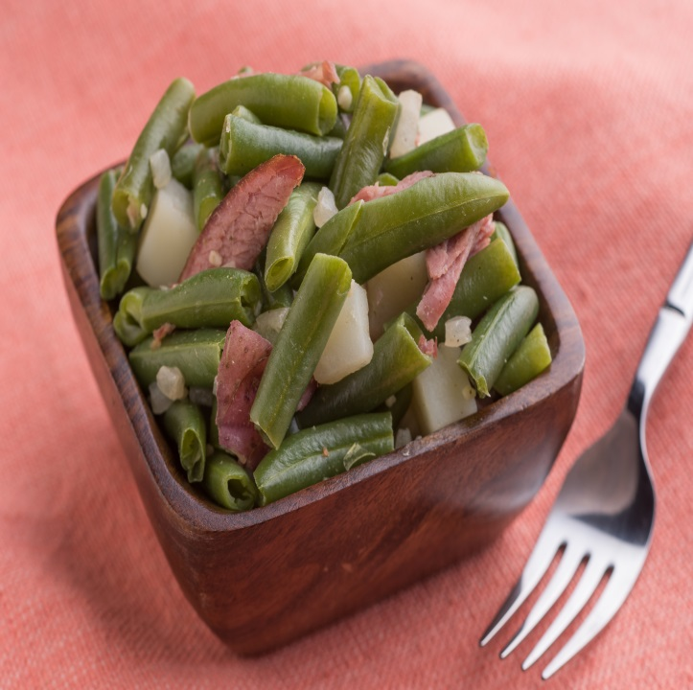
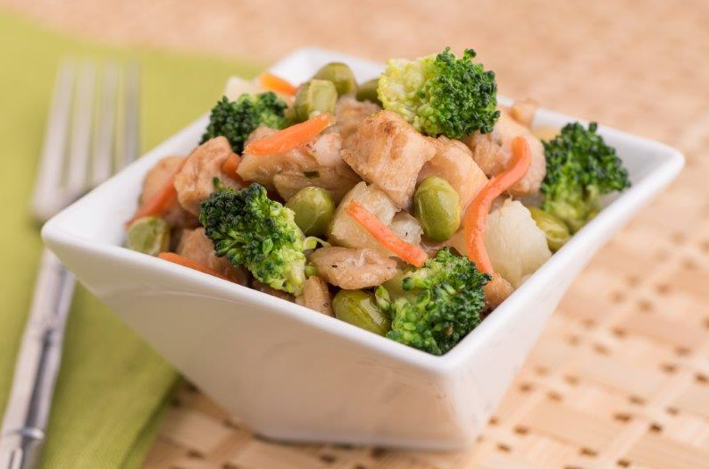
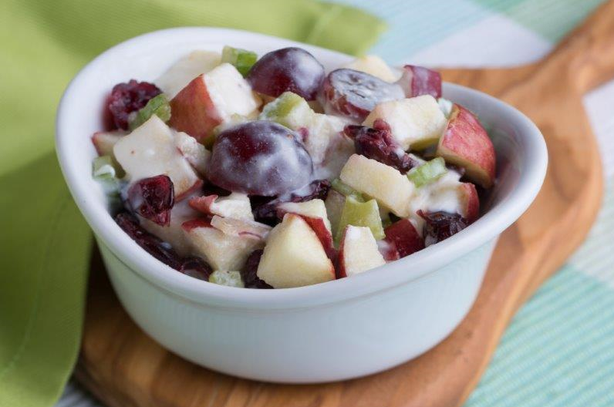
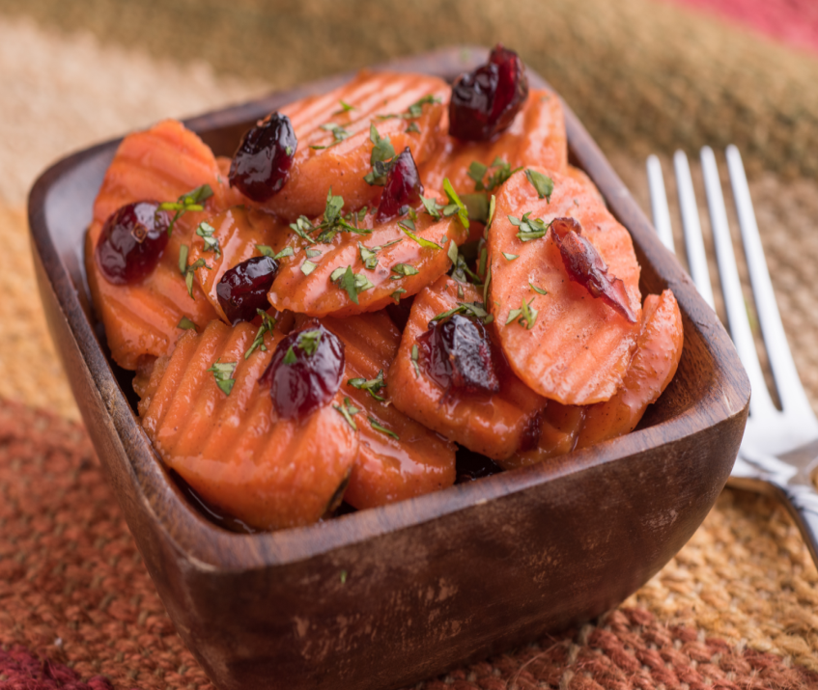
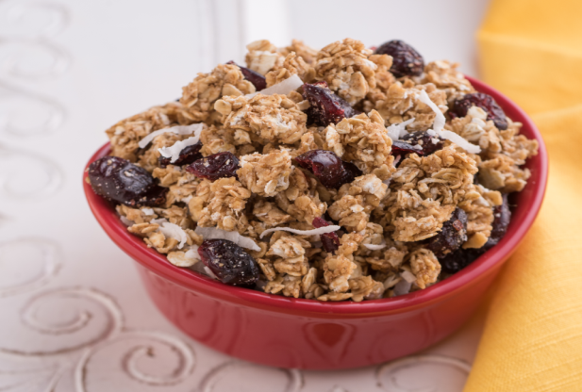
USDA
Standardized
Recipes
https://www.fns.usda.gov/usda-standardized-recipe

Slide 14
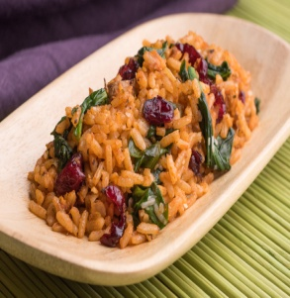
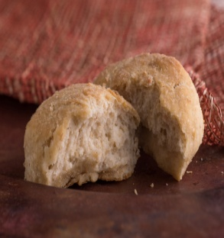
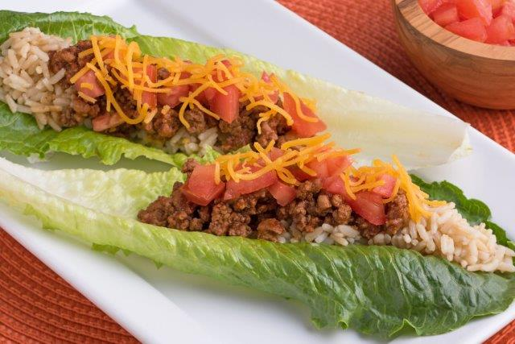
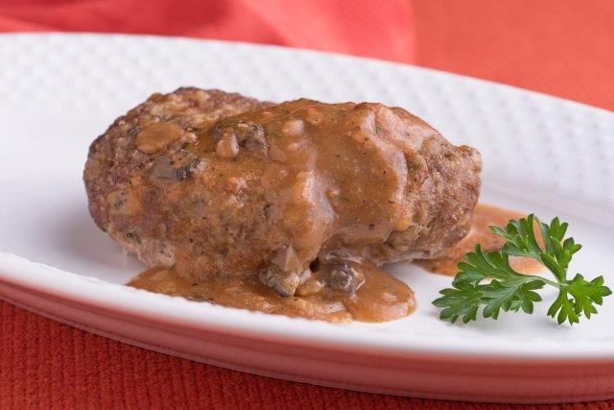
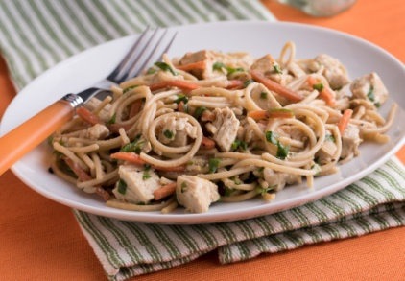
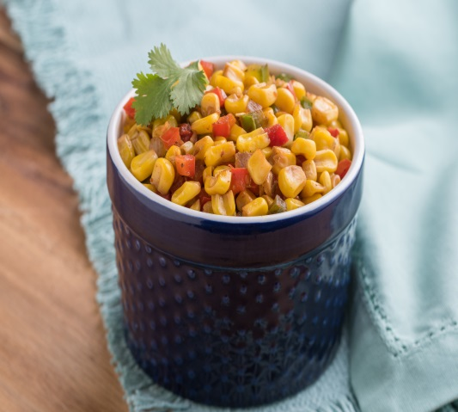
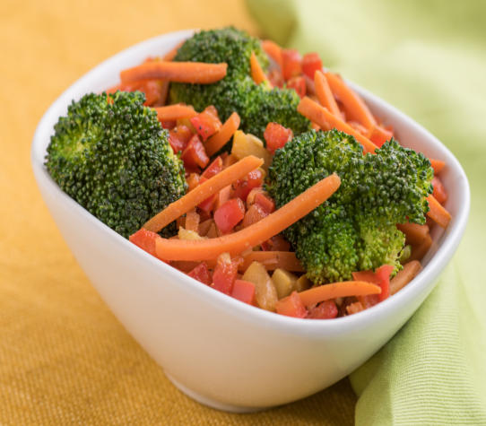
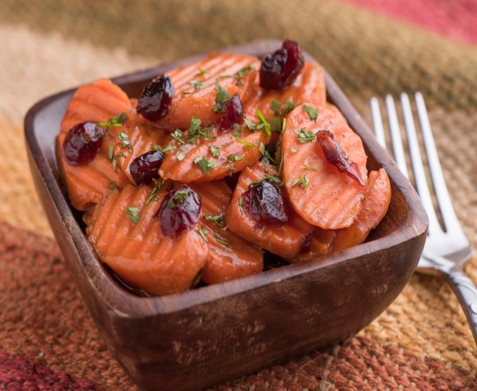
Whole Grains
Rice Pilaf
Baking Powder Biscuits
Granola
Main Dishes
Taco Salad
Salisbury steak
Chicken Noodles
Vegetables
Mexicali corn
Chinese Vegetables
Orange Glazed Carrots

Slide 15
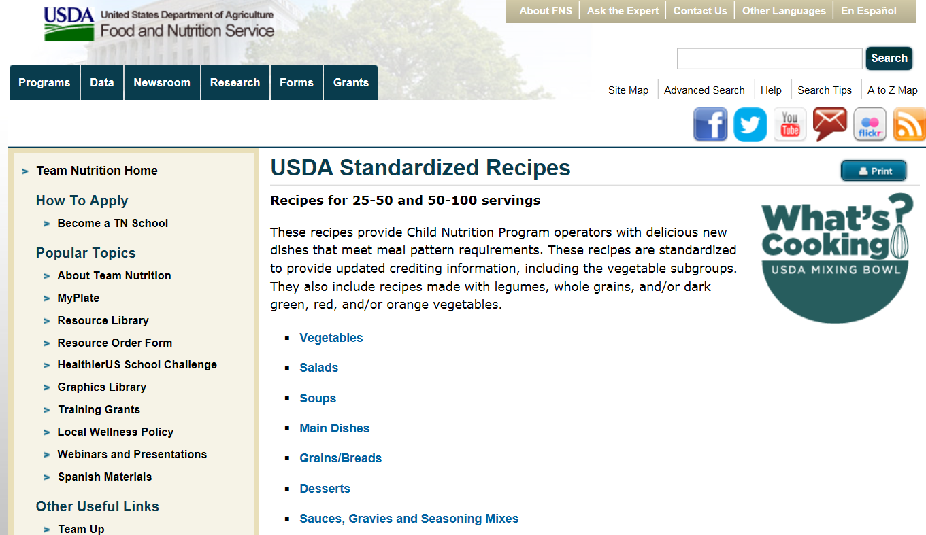
https://www.fns.usda.gov/usda-standardized-recipe
Find Recipes in the Resource Library

Slide 16
What’s Cooking? USDA Mixing Bowl
https://www.whatscooking.fns.usda.gov
Notes:
And all of the recipes mentioned today may also be accessed through the What’s Cooking? USDA Mixing Bowl Website.
This website includes recipes from several Food and Nutrition Service Programs, including SNAP, Food Distribution, Center for Nutrition Policy and Promotion (CNPP), and of course, Child Nutrition programs. They also released videos showing how to make some of the R4HK recipes, like the Chic Penne Pasta you see here.
In What’s Cooking, you can find recipes available in both English and Spanish, and recipes can be sorted by how many servings they yield. Recipes come in household size (about six servings per recipe) and Large Quantity Recipes for schools (50 to 100 servings per recipe) and child care centers (25 to 50 servings per recipe).
To access what’s Cooking USDA Mixing Bowl go to https://whatscooking.fns.usda.gov/
To search for household recipes:
Once you are on the home page, in the banner under the USDA Mixing Bowl symbol choose Household Recipes, enter the recipe name in the search bar to search on a specific recipe or choose Child Nutrition (CNP) to see what household size recipes CNP has to offer.
To search for large quantity recipes (recipes that provide 25 servings or more):
Once you are on the home page, in the banner under the USDA Mixing Bowl symbol choose quantity recipes, enter the recipe name in the search bar to search on a specific recipe or choose Child Nutrition (CNP) to see what large quantity recipes CNP has to offer. CNP provides quantity recipes in sizes of 25-50 servings for the Child and Adult Care Program and in 50-100 serving sizes for schools participating in the National School Lunch Program (NSLP).
To search for recipes in Spanish:
Once you are on the home page, in the banner under the USDA Mixing Bowl symbol choose Recetas en Español, enter the recipe name in the search bar to search on a specific recipe or choose Child Nutrition (CNP) to what recipes CNP has available in Spanish.

Slide 17
Food Buying Guide for Child Nutrition Programs
Notes:
The Food Buying Guide for Child Nutrition Programs (FBG) is the essential tool for food yield information for all Child Nutrition Programs, helping you: 1) purchase the correct amounts of foods and 2) determine the meal pattern contribution.

Slide 18
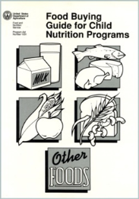
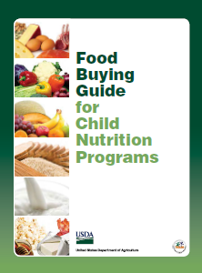
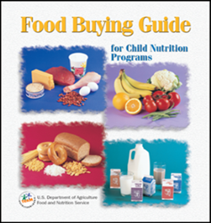
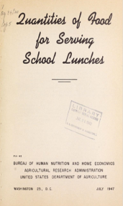
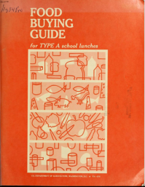
What is the Food Buying Guide (FBG)?
Authoritative source of food yield information for all Child Nutrition
Programs (CNP)
Provides information for:
Purchasing the required
quantities of foods
Determining contribution
toward the meal pattern requirements
Coming Soon
Downloadable FBG

Slide 19
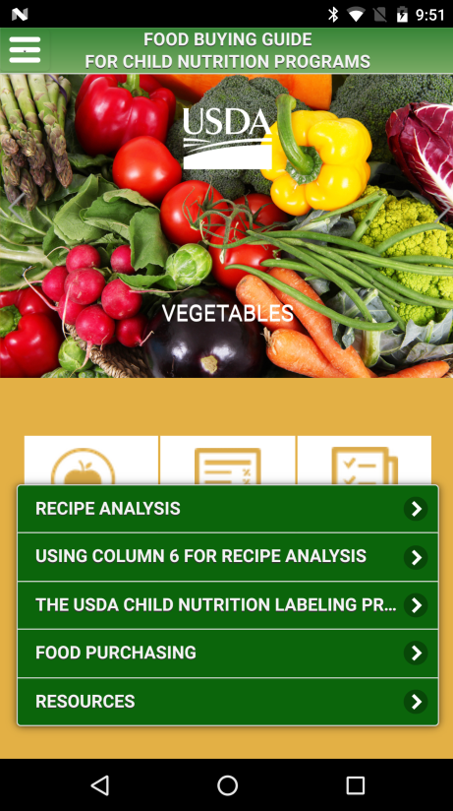
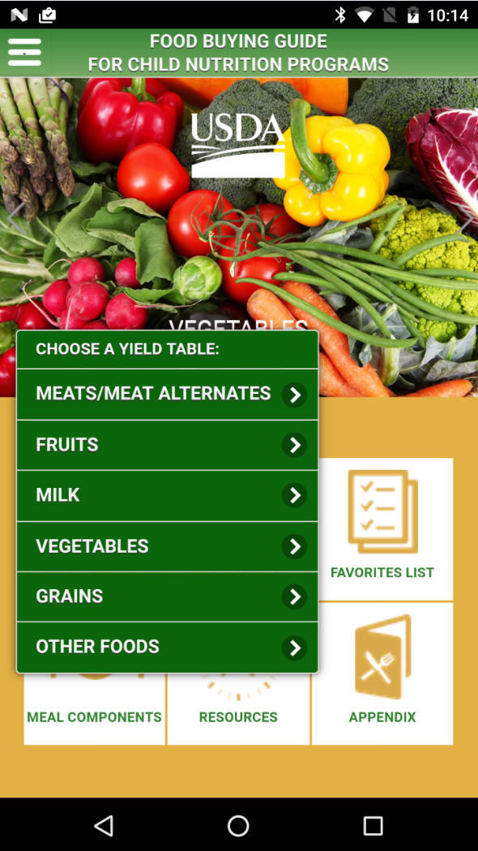
Coming Soon

Slide 20
How to use the
Food Buying Guide
Interactive Web-Based Tool
https://foodbuyingguide.fns.usda.gov/

Slide 21
https://www.fns.usda.gov/tn/team-nutrition
Click here to log on
Log in directly: https://foodbuyingguide.fns.usda.gov/

Slide 22
https://www.fns.usda.gov/tn/team-nutrition
Find Link at FBG Home Page on Team Nutrition Resource Library
Log in directly: https://foodbuyingguide.fns.usda.gov/
Notes:
You may log into the RAW by going to the Food Buying Guide for Child Nutrition Programs on the Team Nutrition website (website address is at the top of the slide) or you may log in directly to the web-based tool (website address is at the bottom of the slide).

Slide 23
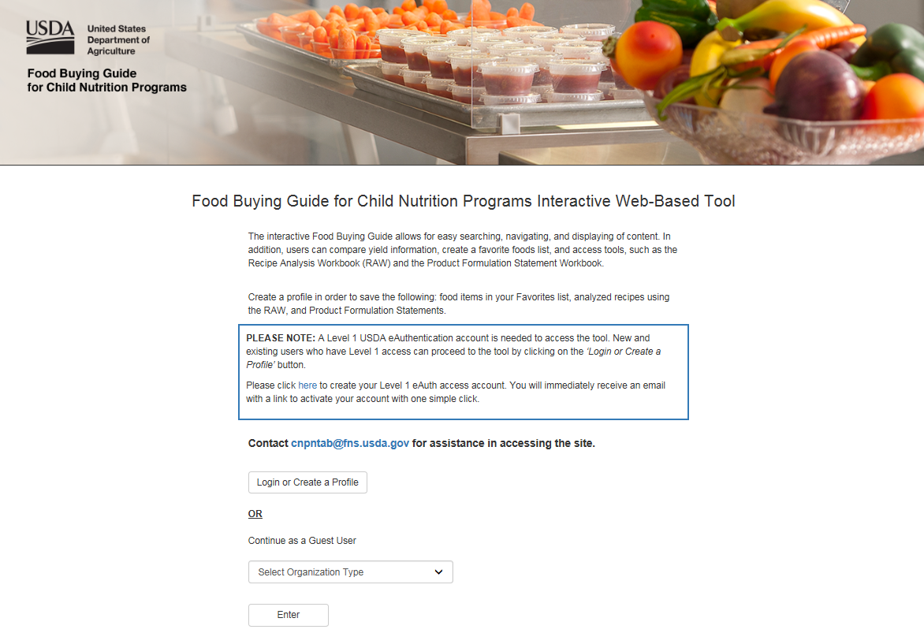
Create a Level 1 eAuth access account
OR Login or Create a Profile
Notes:
During this part of the training, I will introduce you to USDA’s Food Buying Guide for Child Nutrition Programs Interactive Web-based Tool, also referred to as the FBG; explain how you, as a registered user of the system, can get started using it; walk you through navigating the FBG website via Home Page Buttons and the Top Navigation Menu; and provide you information on resources and contacts for getting help when you need it.
The FBG has three main user groups: Guest, Registered, and Administrator. This training is specifically intended for Registered Users. Each user can affiliate themselves with one Organization Type, such as the FNS National Office, FNS Regional Office, Vendors, state agencies, schools, child care programs, and other organizations.
Registered Users can access key components of the Food Buying Guide. These users are able to easily search and navigate food yields, compare food yields, analyze recipes, and create a Favorites List for future reference. I will discuss these functionalities in more detail later in this training.

Slide 24
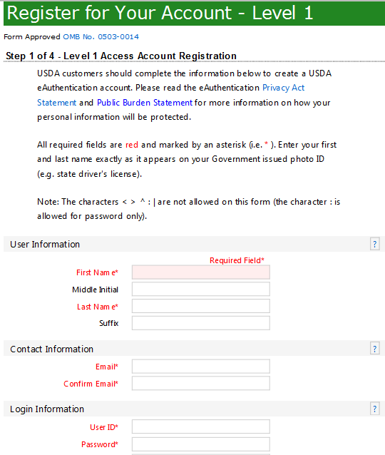
Fill in Required Information

Slide 25
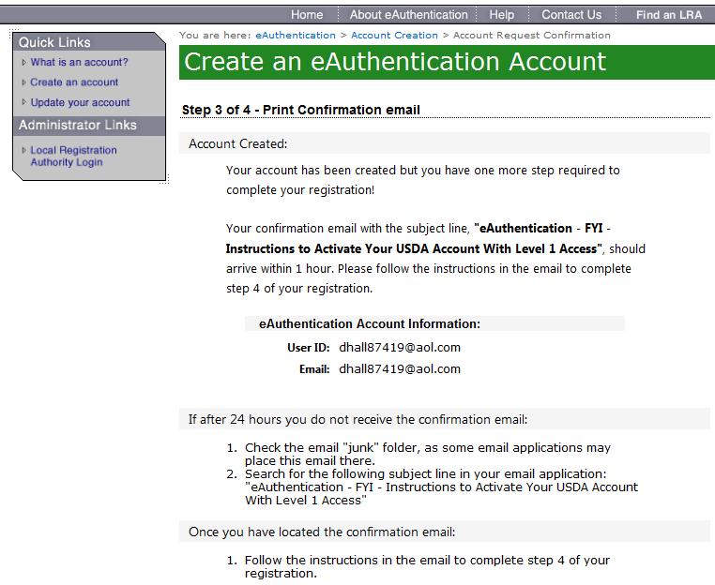

Slide 26
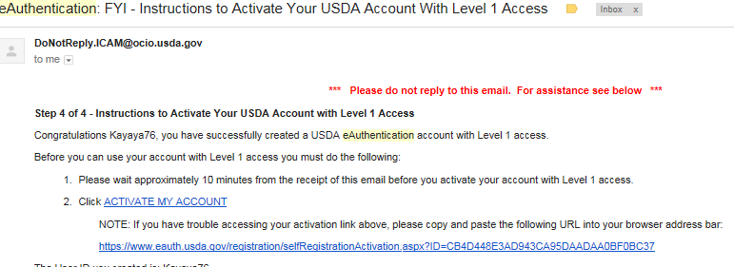
Email with Instructions to Activate Your Account

Slide 27
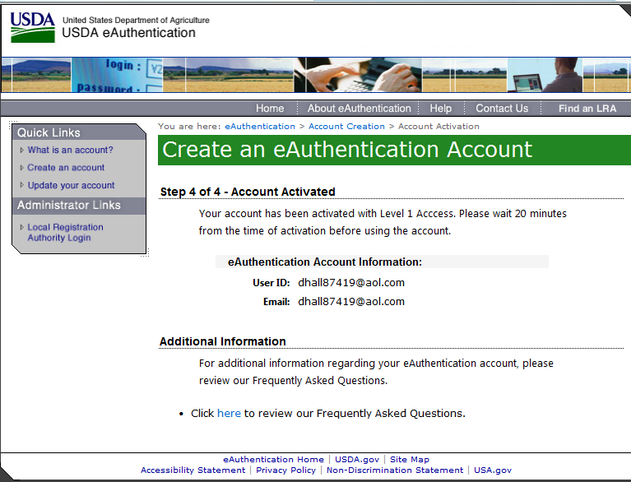

Slide 28
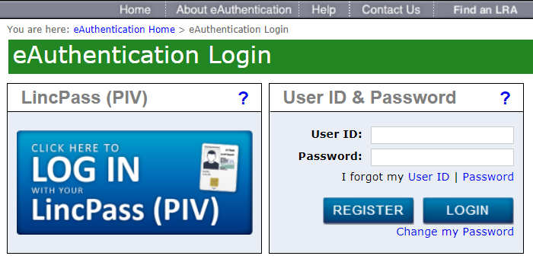
https://foodbuyingguide.fns.usda.gov/
Login Screen
Notes:
Log in.
The LincPass (PIV) is an option for USDA employees to log in using their ID card called a LincPass

Slide 29
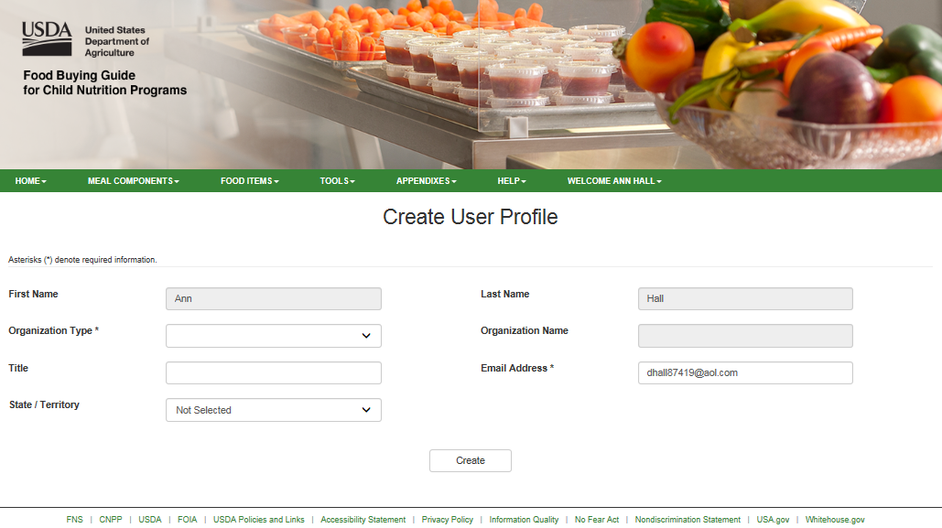
Login Screen

Slide 30
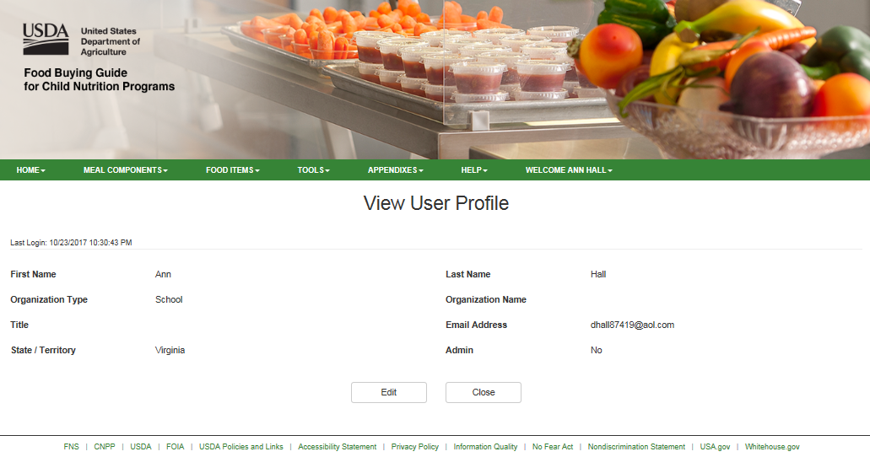

Slide 31
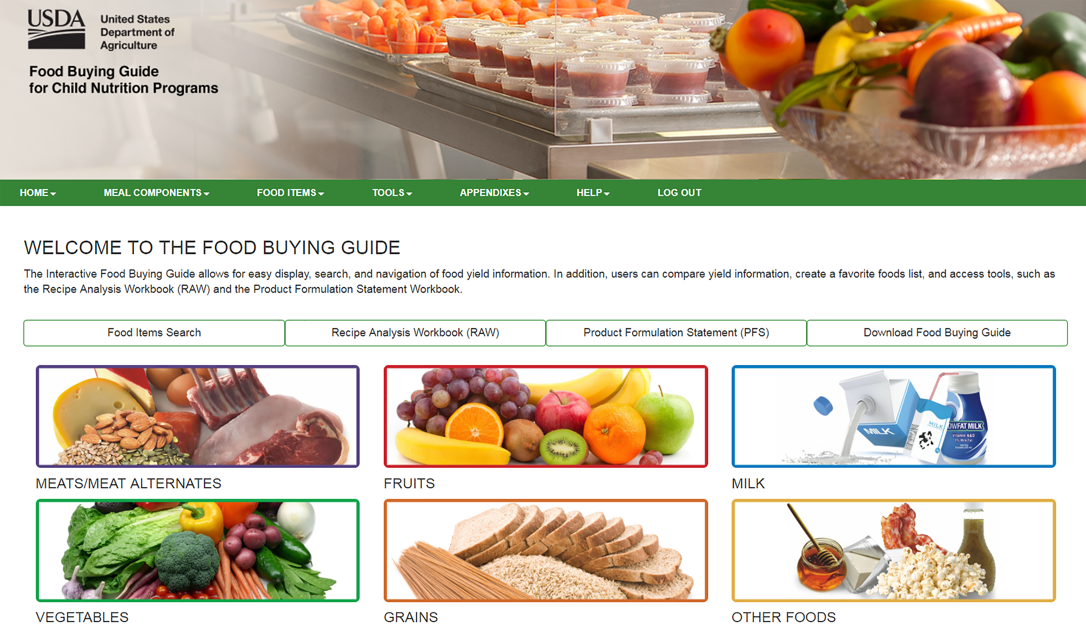
FBG Home Page

Slide 32
Live Demonstration of the
Food Buying Guide
Interactive Web-Based Tool
https://foodbuyingguide.fns.usda.gov/

Slide 33
Product Formulation Statement
(PFS)
For use by Vendors

Slide 34
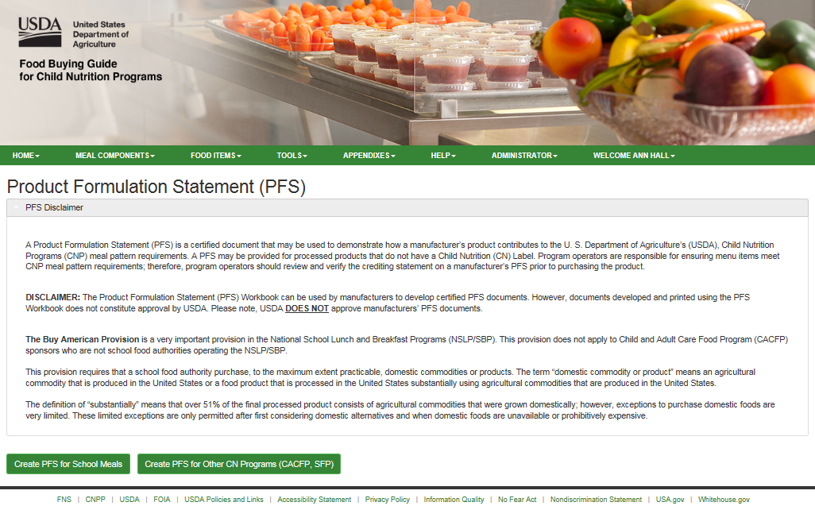

Slide 35
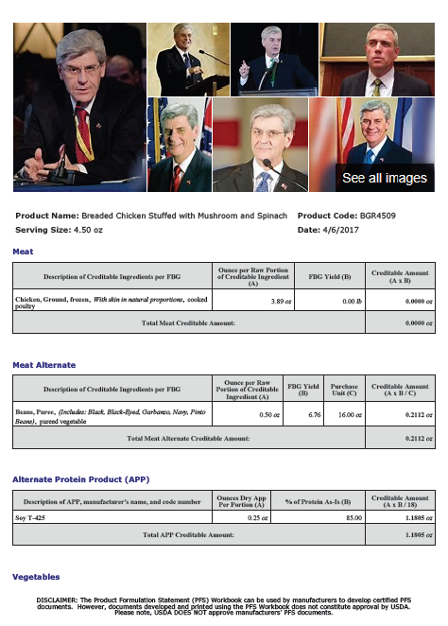
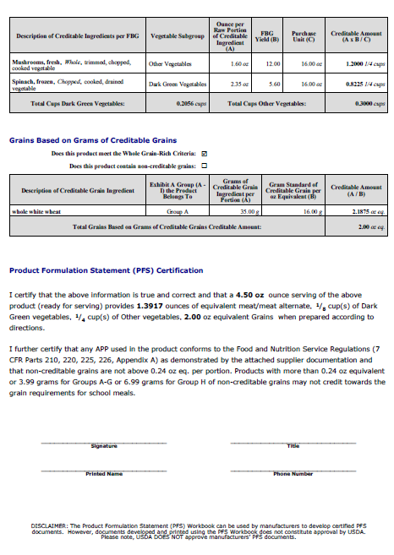
Test Kitchen
1 Test Hwy
Sterling , VA 20164

Slide 36
Group Activity to Enter a Recipe into the
Recipe Analysis Workbook (RAW)
And
Create a Creditable Meal
https://foodbuyingguide.fns.usda.gov/

Slide 37
Directions for Activity
Those with devices logged into the FBG site, go to one of the Stations along the wall
Others please join them--- divide the groups up evenly
Using the Baked Batatas and Apples and the CACFP Lunch Meal Pattern:
*Use the RAW to determine the meal pattern contribution
*Add food items to create a lunch menu for 3-5 yr olds

Slide 38
Access RAW from Home Page

Slide 39
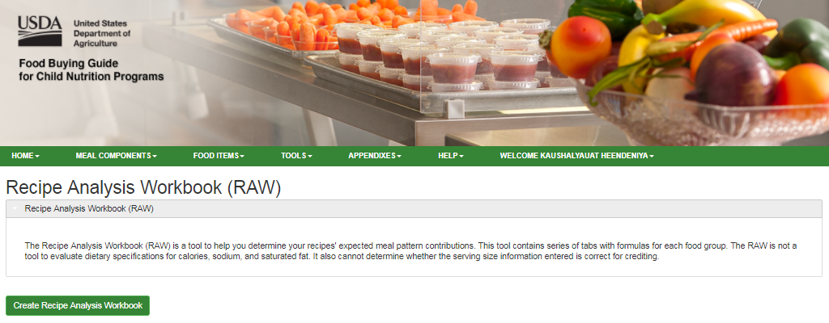
Create a new Recipe Analysis Workbook

Slide 40
Results for Group Exercise:
Baked Batatas and Apples

Slide 41
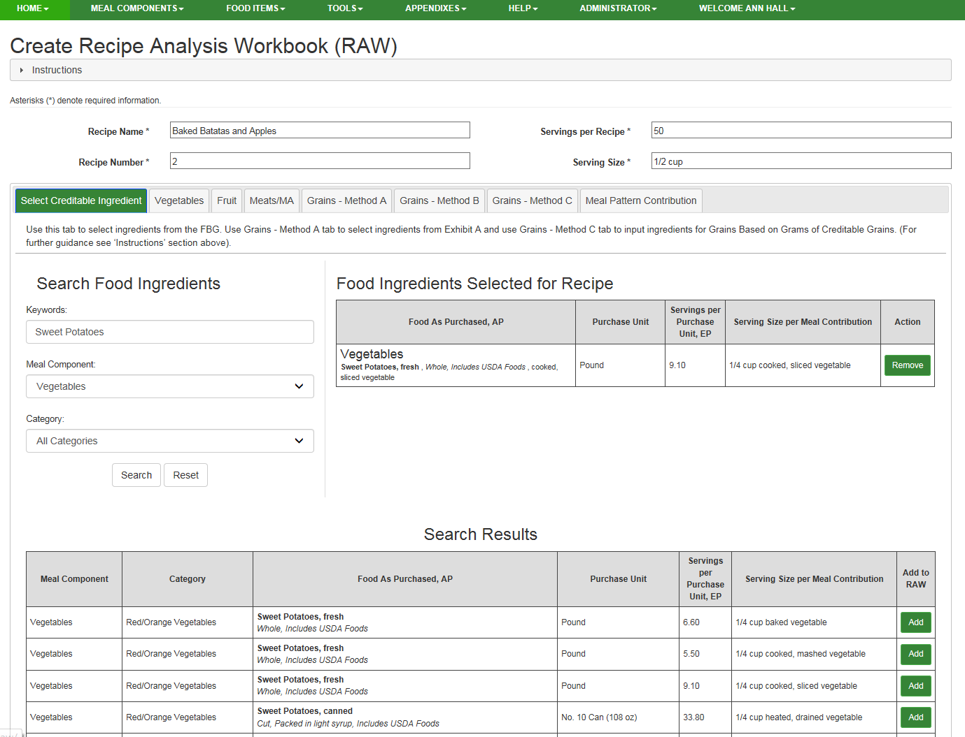

Slide 42
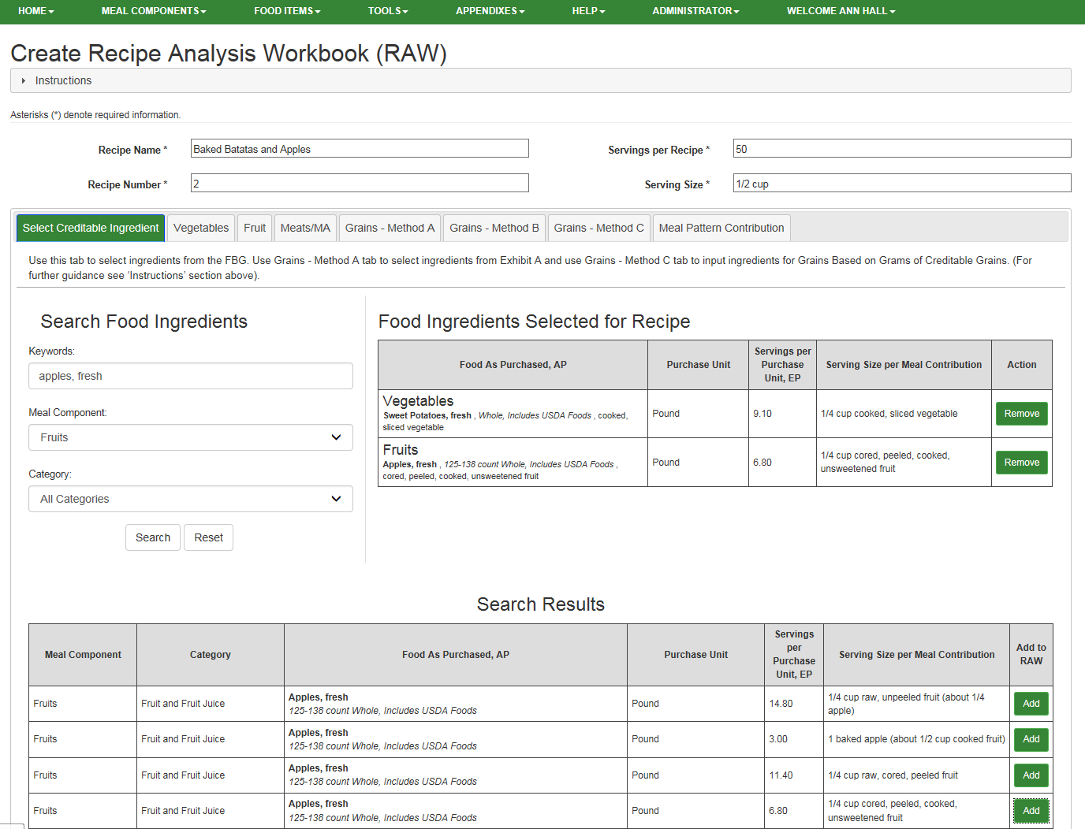

Slide 43
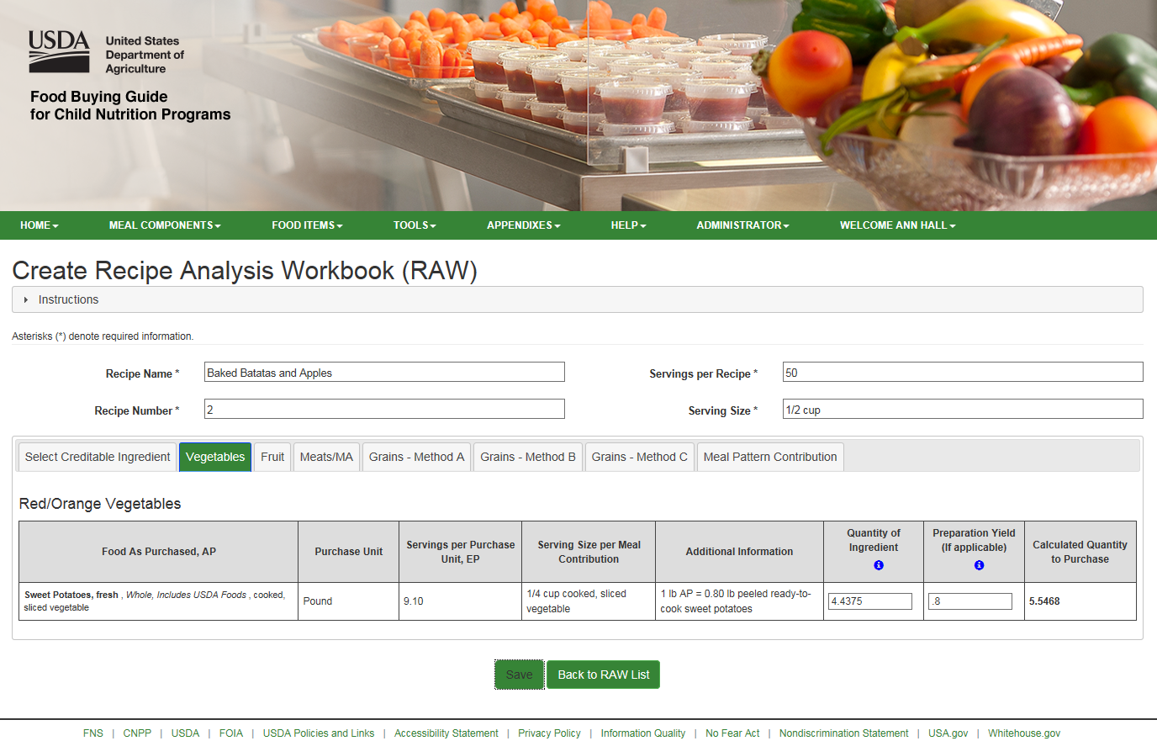

Slide 44
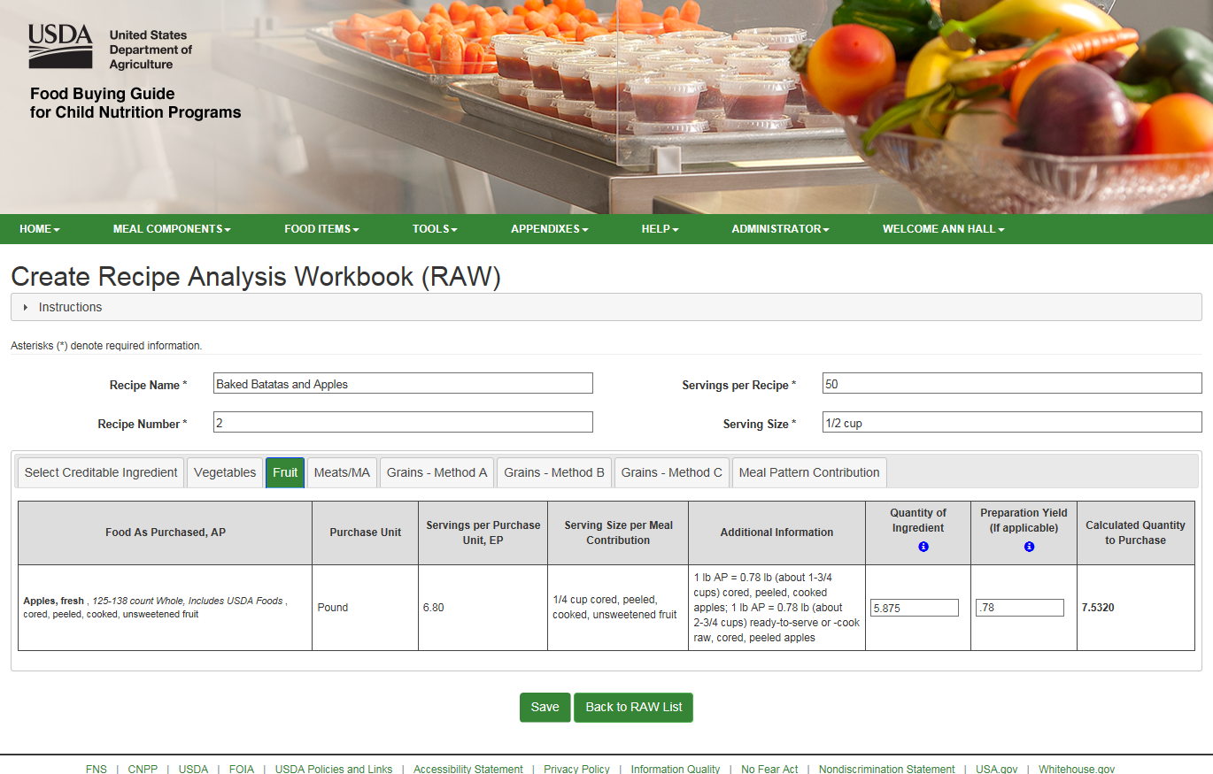

Slide 45
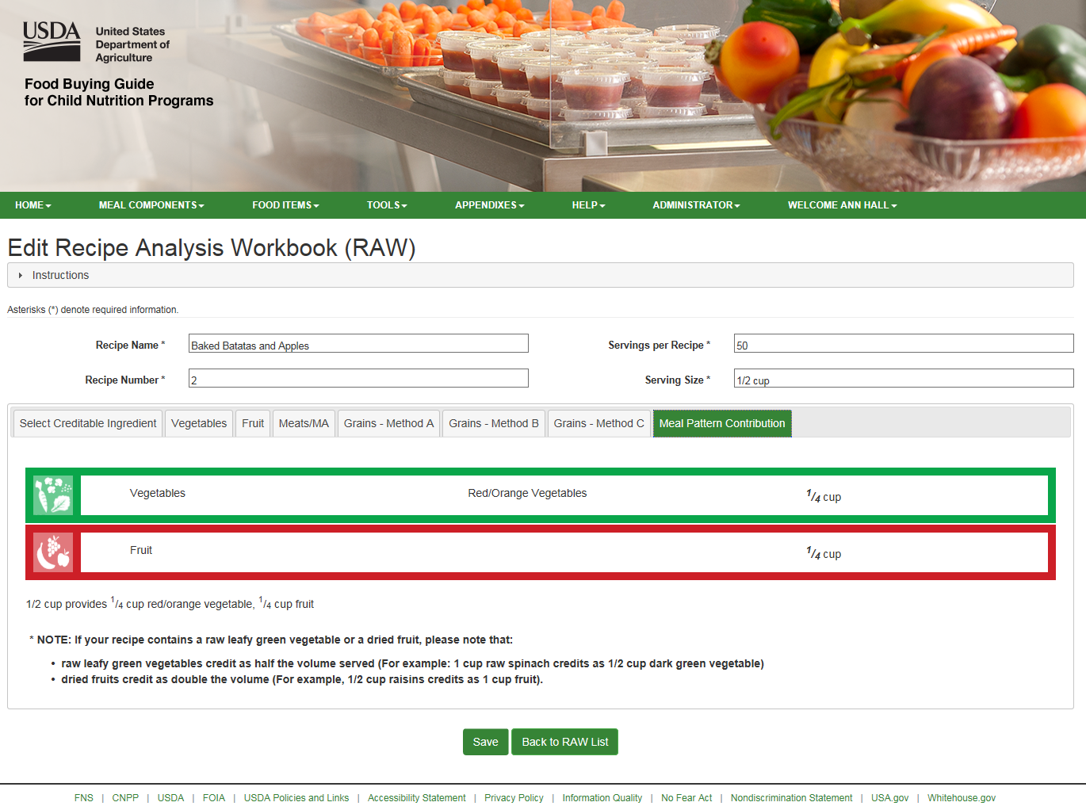

Slide 46
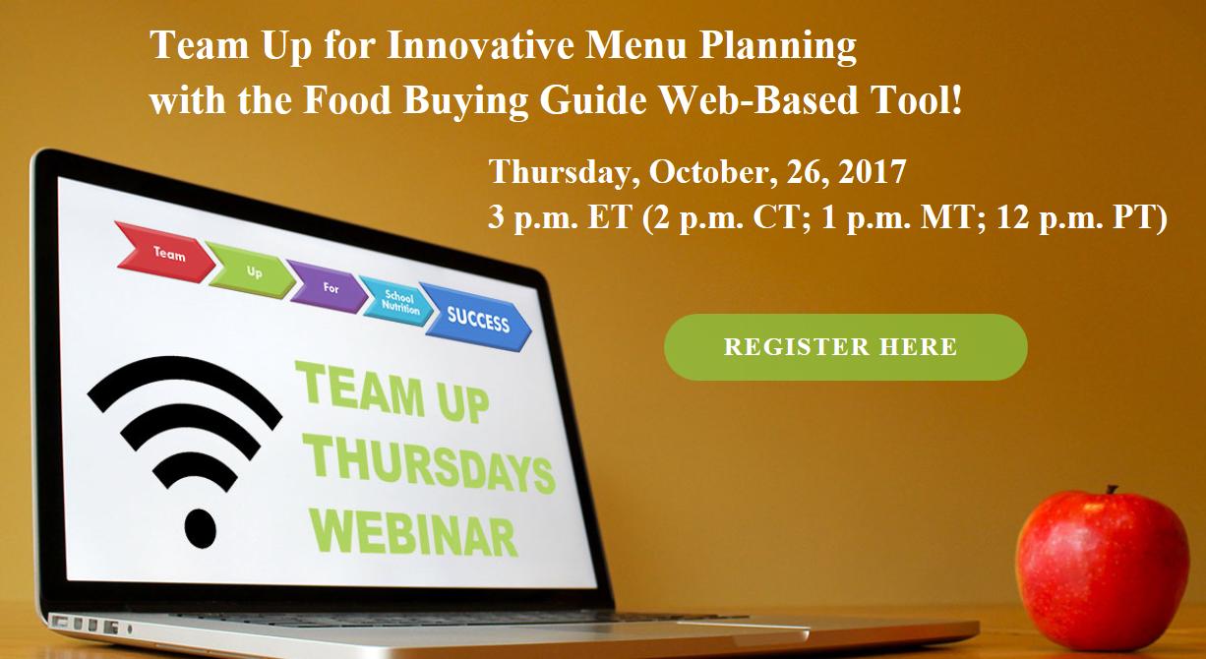
www.theicn.org/teamup

Slide 47
Follow Us on
@TeamNutrition

Slide 48
Nutrition and Technical
Assistance Branch
Mailbox
cnpntab@fns.usda.gov

Slide 49
Questions?
cnpntab@fns.usda.gov

