Slide 1
WELCOME
CACFP…
Nutrition
at It’s Peak
To the 26th Annual Child Care Food Program Roundtable Conference

Slide 2
CCFP Roundtable Conference #RT2017

Slide 3
THANK YOu For your support and partnership, we couldn’t do it without you!

Slide 4
Volunteers
Thank You
Thank You
Thank You

Slide 5
Reasons you came
CACFP
energized
motivated
Ideas
Meal Patterns
Learn
Questions
Transition
Regulations
Advocacy
Network
Implementation
leadership
They made me…
Answers

Slide 6
Implementation has begun

Slide 7
you are! making a great program even better

Slide 8
on the Meal Pattern Rollout

Slide 9
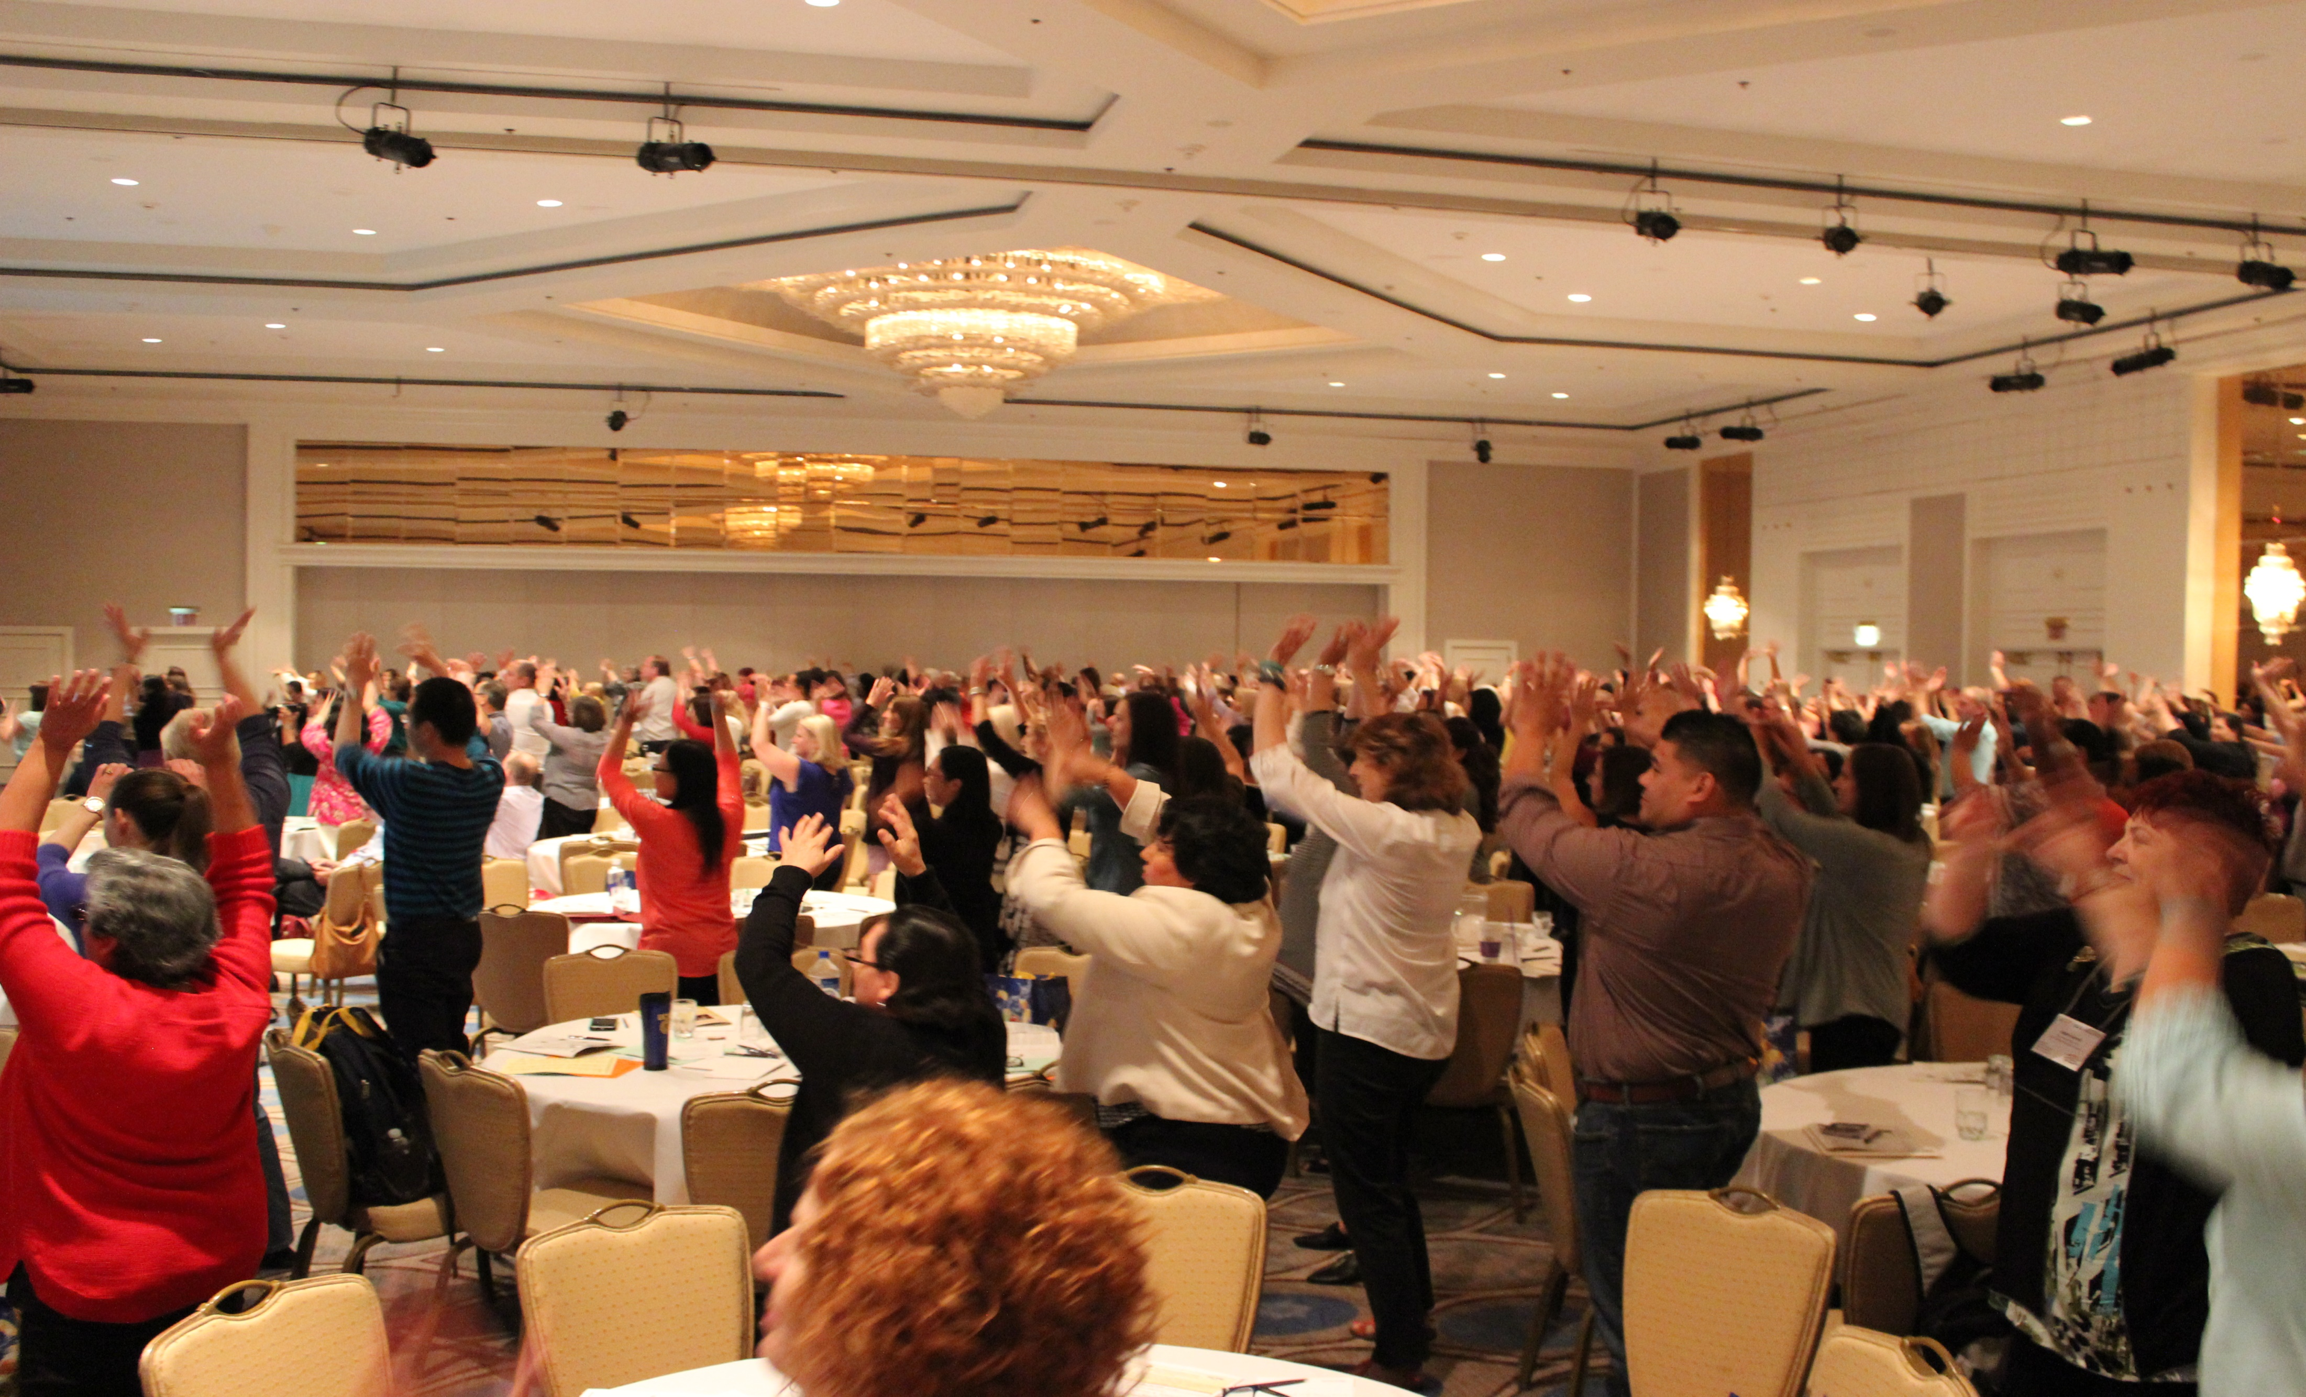
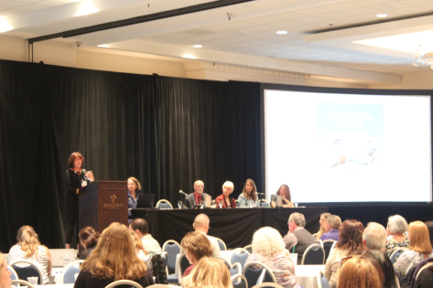
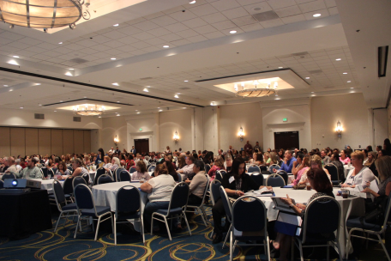
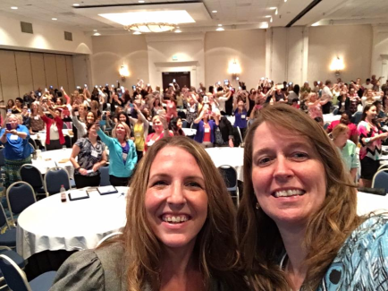
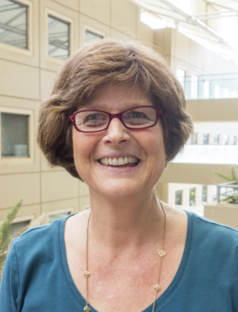
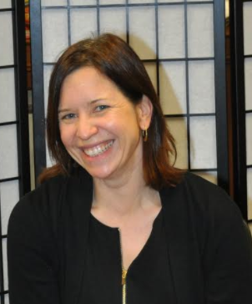
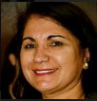
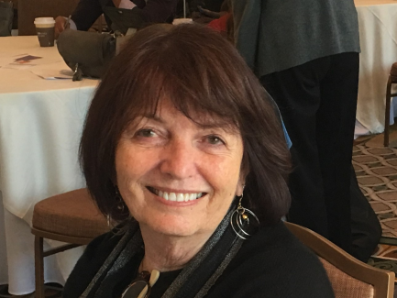
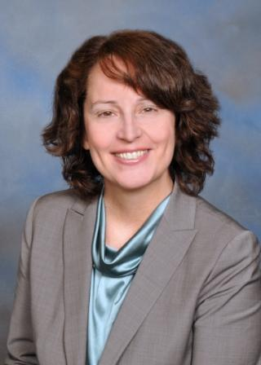
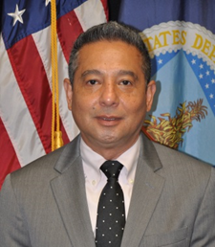
General sessions
Monday. Tuesday. Wednesday.

Slide 10
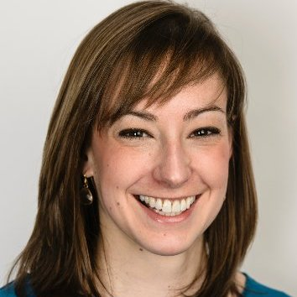
Q & A with USDA
Monday and Tuesday

Slide 11
Visit our Exhibitors Tuesday
California Child Development Administrators Association
California Department of Education
Nutrition Services Division
California Department of Public Health WIC Division
Department of Public Health (CDPH) Nutrition Education and Obesity Prevention (NEOP)
Institute of Child Nutrition (ICN)
CAL PRO NET, Fresno City College
Minute Menu Systems, LLC
Nice and Bella Jewelry
Simply Scarves
Tupperware Brands
U.S. Food and Drug Administration

Slide 12
wOrkshop Tracks
Implementing CACFP Policy Change Best Practice
Provider/Parent Better Education
Feeding/Food Preparation
Better Program and IT Management
Thank you! Presenters

Slide 13
Tuesday New CACFP Meal Pattern implementation library

Slide 14
Buy your raffle ticket
Winners announced Tuesday at Lunch
Be there to Win!
Support your Child Care Food Program Roundtable

Slide 15
Yoga mornings with Doris
Tuesday and Wednesday mornings
7:00am – 7:45am in the Sun Plaza Deck

Slide 16
Zumba with Kyuna
Tuesday and Wednesday
7:00-7:45am Tinkers Knob

Slide 18
Child care Food Program Roundtable Website Has a New look

Slide 19
Join us at the roundtable
We saved a seat for you at the Roundtable, Become a Member today!
Member
Now is the time to take your seat at the Roundtable and Support your Child Care Food Program Roundtable

Slide 20
Use The Evaluation Tool Throughout the conference @ surveymonkey.com/r/H38FJV3
Complete
online
Submit
Online when complete
Complete throughout the entire conference!

Slide 21
Anaheim Majestic Garden Hotel Anaheim, CA
SAVE the Date for a bit of CACFP Magic
Join us at the Roundtable
October 15 -17, 2018

